Slide 1





Optimal real-time control of water distribution systems undergoing cyber-physical attacks
Andres Murillo, Davide Salaorni, Riccardo Taormina, and Stefano Galelli

Slide 2

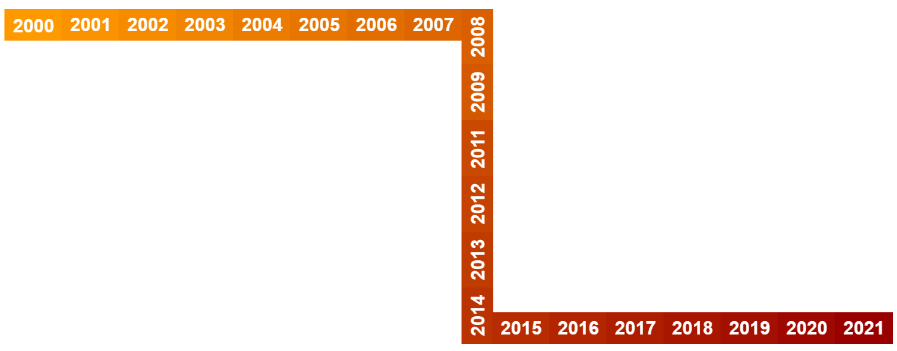
Water systems are under attack
Hassanzadeh, A., Rasekh, A., Galelli, S., Aghashahi, M., Taormina, R., Ostfeld, A., & Banks, M. K. (2020). A review of cybersecurity incidents in the water sector. Journal of Environmental Engineering, 146(5), 03120003.

Slide 3
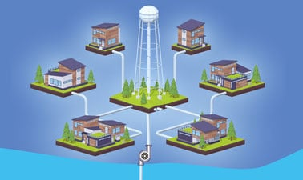
Learning to ProtecT Water Distribution Systems
Cyber layer
Anomaly Detection
Physical Layer
Intelligent Agent
Notes:
Poca letterattura su modelli complessi come digital twim

Slide 4

Learning to ProtecT Water Distribution Systems
Cyber layer
Anomaly Detection
Physical Layer
Intelligent Agent

Slide 5
Digital HydrAulic SIMulator (DHALSIM) a digital twin for cyber-security of WDS
Murillo A., Taormina R., Tippenhauer N., Galelli S., 2020, Co-Simulating Physical Processes and Network Data for High-Fidelity Cyber-Security Experiments, ACSAC – ICSS 2020

Slide 6


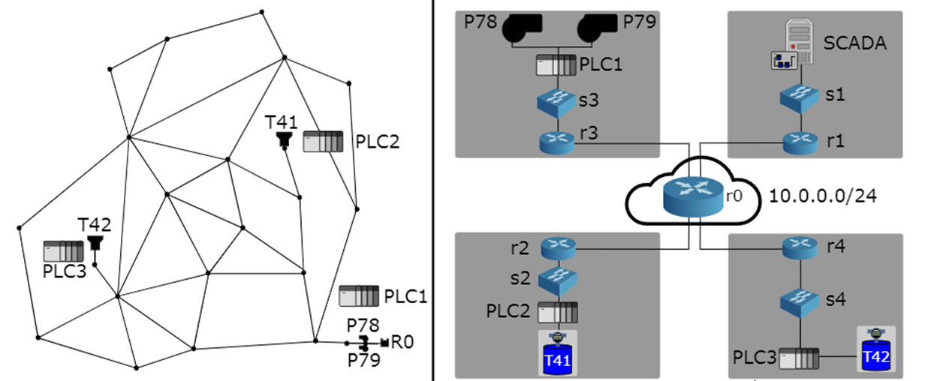
Optimal Real-Time Control Under Attack
2
3
Anytown WDS
Hacker intercepts and manipulates Tank readings Man-in-the-middle attack
Intrusion detection systems flags the attack
Intelligent agent operates the actuators (e.g., pumps) to minimize consequences
1

Slide 7
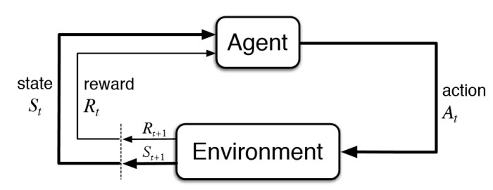
Reinforcement Learning (RL)
RL trains an agent to solve a particular task by interacting with an environment. The agent has only one purpose: maximize its total reward.
The agent observes the state of the environment, and tries to move to a better state by performing actions. Actions lead to rewards which could be positive or negative.
image credits: kdnuggets.com
Notes:
Reinforcement Learning (RL) trains an agent which interacts with an environment. The agent arrives at different scenarios known as states by performing actions. Actions lead to rewards which could be positive and negative.
The agent has only one purpose here – to maximize its total reward across an episode. This episode is anything and everything that happens between the first state and the last or terminal state within the environment. We reinforce the agent to learn to perform the best actions by experience. This is the strategy or policy.

Slide 8
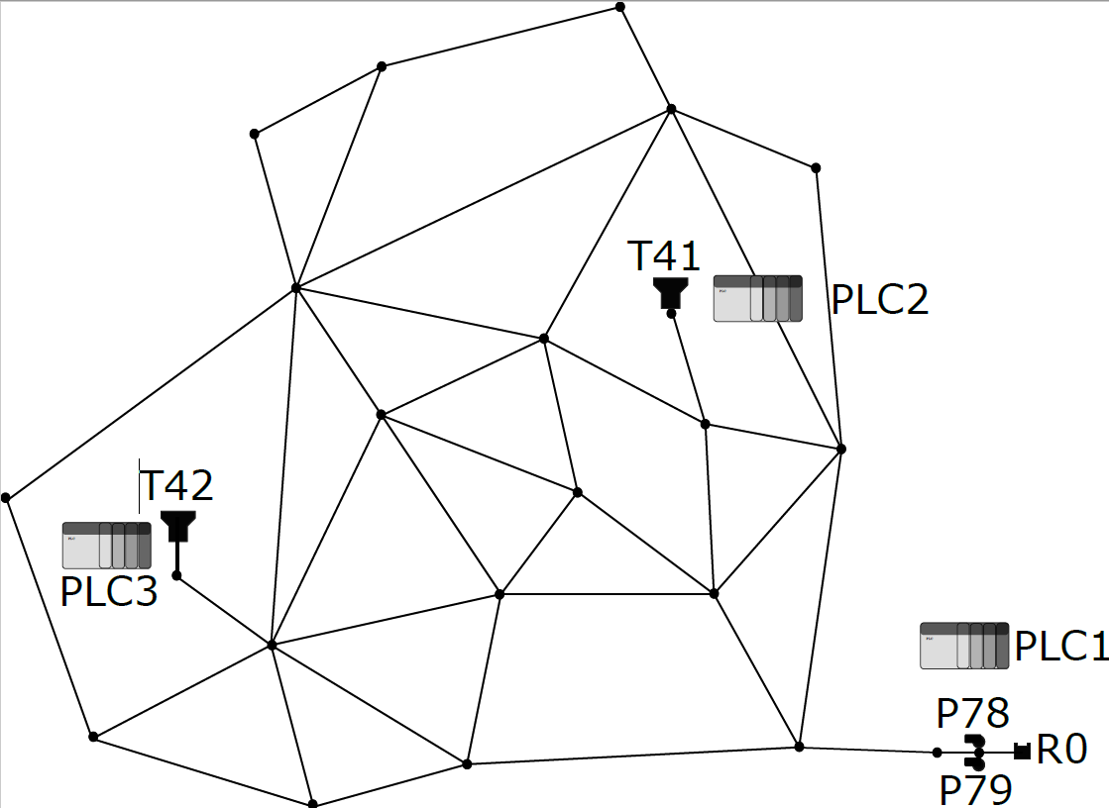
RL agent: States and Actions
Observation Space:
Level of tanks
Pressure of junction after pumps
Moving average of demand patterns
Day of the week
Time of the day
Attack detection flag
Readings from
PLC2 and PLC3
Action Space:
[0] : both pumps turned off
[1] : only pump P78 active
[2] : only pump P79 active
[3] : both pumps turned on
Applied by PLC1

Slide 9

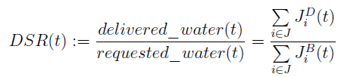

RL agent: Reward
maximize demand satisfaction
limit pump status updates
overflow of tanks

Slide 10
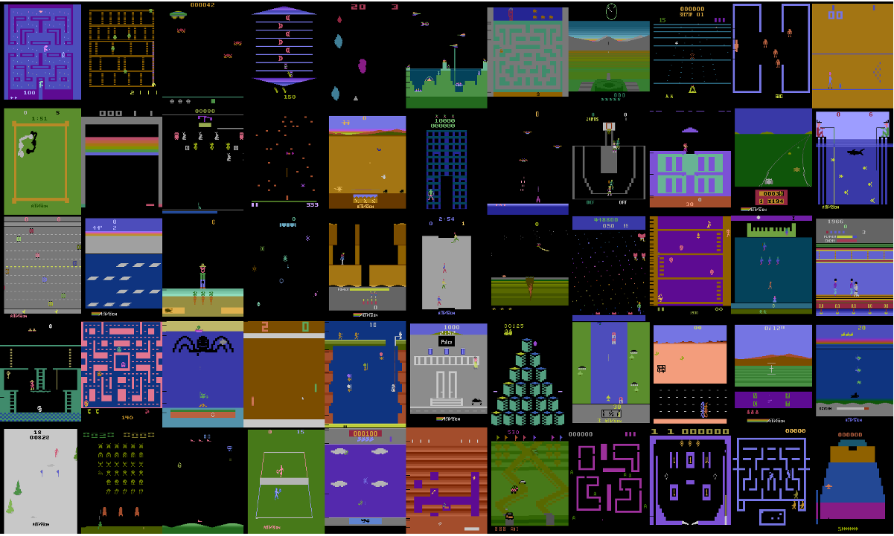
Deep Q-Learning
Finite MDP
Discrete action space
Continuous observation space
Deep Learning model as function approximator
Experience Replay Buffer to limit correlation of samples
Target network to improve stability
Volodymyr Mnih, Koray Kavukcuoglu, David Silver, Alex Graves, Ioannis Antonoglou, Daan Wierstra, and Martin Riedmiller. “Playing Atari with Deep Reinforcement Learning.” In: NIPS Deep Learning Workshop 2013.

Slide 11

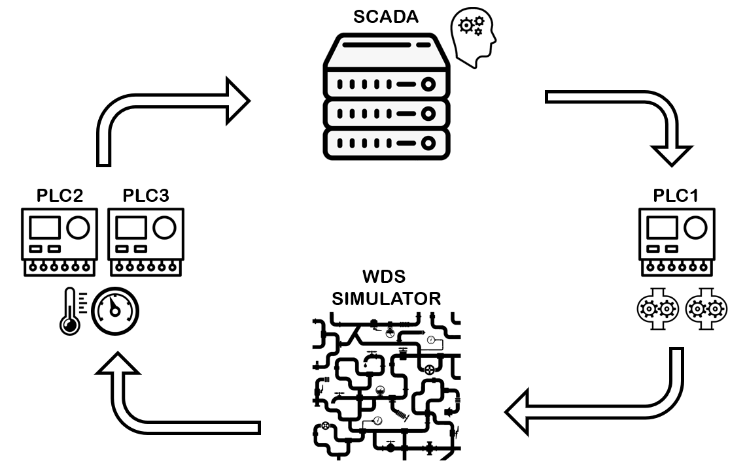

EXPERIMENTs
Episode duration: 1 week
#training episodes: 5 to 50
Hydraulic step: 5 or 10mins
Varying demand patterns for each week
Multiple man-in-the-middle-attacks
Assumptions
Perfect intrusion detection
Training dataset contains similar attacks

Slide 12
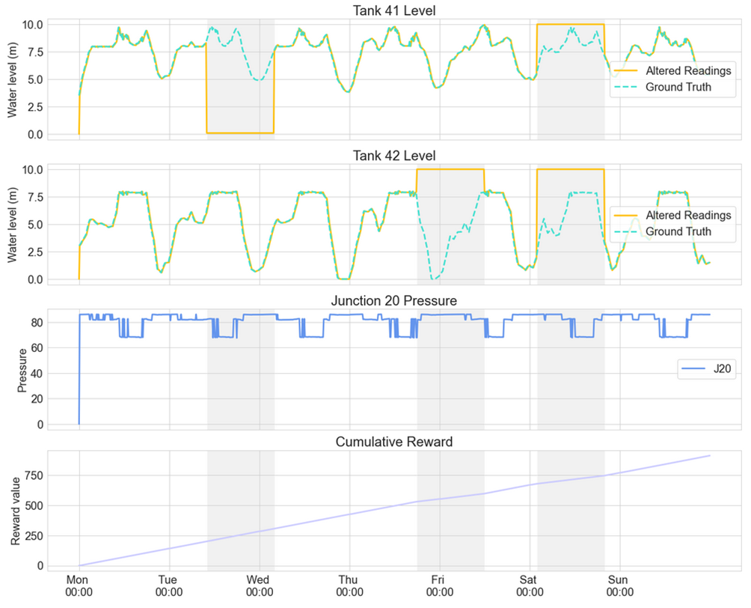
Results
#1
#3
#2
Pumps already on for ATTACK #1
Correct response to all other attacks: pumps are not shut down!
Cumulative reward increasing
Pumps are on most of the time: this is unrealistic!
#4

Slide 13
Future Work
More realistic experiments
Reward functions should better reflect real-world operations (e.g., pump energy consumption, pressure at critical point)
RL agent only trains on normal operating conditions (e.g., no attacks)
Larger water networks with more complex states and actions
DHALSIM implementation
Denial-of-service attacks preventing RL agent to operate some actuators
Improve speed of cyber-layer emulation to reduce training times
Connecting a real intrusion detection system in the loop

