Slide 1
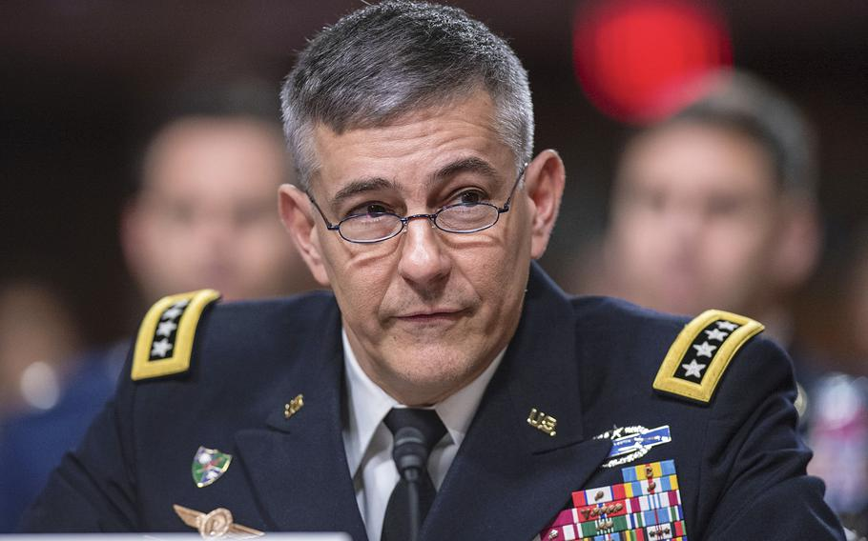
General Stephen J. Townsend, U.S. Army, became the 5th commander of United States Africa Command in July 2019. Headquartered in Stuttgart, Germany, U.S. AFRICOM is one of six joint service geographic combatant commands and is responsible for all U.S. military operations and activities to protect and advance U.S. national interests in Africa. General Townsend’s previous assignment was commanding U.S. Army Training and Doctrine Command where he oversaw all recruitment, training and education for America’s Army. From Griffin, Georgia, General Townsend was commissioned as an Army infantry officer upon graduation from North Georgia College in 1982. He has led and commanded troops at every echelon from rifle platoon to infantry division and Army corps as well as two combined/joint task forces. General Townsend's operational experience includes Operation Urgent Fury, Grenada; Operation Just Cause, Panama; Operation Uphold Democracy, Haiti; Operation Enduring Freedom, Afghanistan; and Operation Iraqi Freedom, Iraq. In 2016-17, he led the multi-national effort to defeat ISIS in Iraq and Syria during Operation Inherent Resolve. His career includes service with four Army divisions, the 82d Airborne, 7th Light Infantry, 101st Air Assault and the 10th Mountain; the 75th Ranger Regiment; the separate 3d Stryker Brigade, 2d Infantry Division; as well as command of the XVIIIth Airborne Corps. His past joint duty assignments include U.S. Indo-Pacific Command, U.S. Central Command, the Joint Staff, Regional Command-East in Afghanistan and Combined/Joint Task Force-Operation Inherent Resolve in Iraq and Syria. General Townsend holds two master’s degrees and military qualifications and awards appropriate to his service as a career infantry officer. General Townsend is married to Melissa, also from Georgia. They have two married sons, one an Army Captain, the other an Army veteran and university student. The Townsends happily spoil two grand-children and two large and unruly dogs.

Slide 2

A native of Albany, N.Y., Command Sergeant Major Wood entered the United States Army on July 27, 1981, and received his Basic and Advanced Individual Training at Fort Benning, Ga. From 1981 to 1985, he served as a Team Leader and Squad Leader with the 2nd, 4th and 5th Battalions, 16th Infantry, First Infantry Division, Goeppingen, Germany, and Fort Riley, Kan. He was then assigned as a Squad Leader and Platoon Sergeant with the 4th Battalion, 22nd Infantry, 25th Infantry Division (LT), Schofield Barracks, Hawaii, from 1986 to 1990.
From 1990 to 1993, Command Sergeant Major Wood served as a Platoon Sergeant and Senior Ranger Instructor with the 4th Ranger Training Battalion at Fort Benning, Ga. He was a Platoon Sergeant and First Sergeant in the 3rd Battalion, 504th Parachute Infantry Regiment, 82nd Airborne Division at Fort Bragg, N.C., from 1994 to 1997. He then returned to Hawaii as a First Sergeant with the 2nd Battalion, 5th Infantry, 25th Infantry Division (LT) at Schofield Barracks from 1997 to 1999. He served as Battalion Command Sergeant Major of 4th Battalion, 31st Infantry, 10th Mountain Division at Fort Drum, N.Y. from 2000-2002, serving in Operation Anaconda in Afghanistan in the spring of 2002. His next assignment was as Brigade Command Sergeant Major with the 4th Brigade, 78th Division (TS), Fort Bragg, N.C., from 2002 to 2004.
He served from 2004 to 2005 as Command Sergeant Major of United States Army South, FT. Sam Houston, Texas, and from 2006 to 2007 as Command Senior Enlisted Leader for Combined Forces Command-Afghanistan in Kabul, Afghanistan. He assumed the command senior enlisted leader position March 26, 2007.

Slide 3


