Slide 1
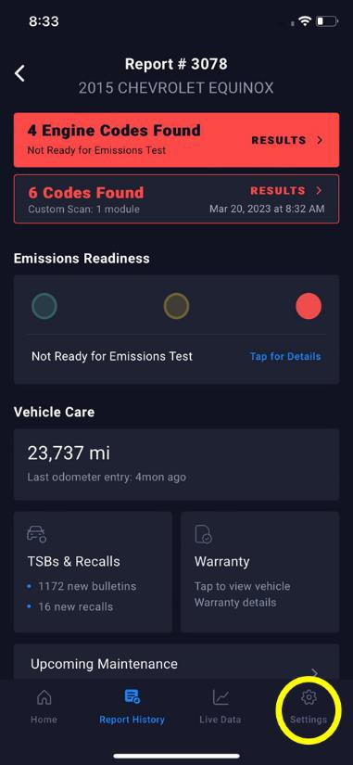
Title
RepairSolutions2: How to report an issue
Tool #
1000
Creator
David G.
Created/Update Date
T/N #
23-1000-002
Description: How to report an issue with the Repair Solutions 2 application.
1. Open the RS2 App:
When you open the app, you'll see the 'Home' screen by default.

Slide 2
2. Access Settings:
Tap on the "Settings" icon located at the lower right corner of the screen.

Slide 3
3. Navigate to Data Logging:
Scroll down within the settings until you find 'Data Logging' under the Advanced tab.
Tap on 'Data Logging.' This will take you to the Data Logging Mode.

Slide 4
4. Enter Data Logging Mode:
Click 'Continue,' and you'll be directed to the 'Report an Issue' screen.

Slide 5
5. Describe Your Issue:
You'll find a text box where you can describe your issue. You need to write a minimum of 50 characters and can write up to 1,000 characters.

Slide 6
6. Record Your Screen:
When you select 'Start Data Capture,' a banner will appear at the bottom of your screen. This indicates that the app is recording your screen.
Now, you can proceed to replicate the issue within the RS2 app.

Slide 7
7. End Data Capture:
After you've successfully replicated the issue, tap 'Done' on the right side of the banner.

Slide 8
8. Share Data:
Following 'Done,' click on 'Share Data' to send your issue report to our customer service team.
9. Confirmation Email:
You'll receive an automatic confirmation email at your account's registered email address. This email confirms that we've received your issue report.
10. Await Resolution:
Our dedicated customer service team will review the issue you reported. You can expect to hear back from us soon with solutions or further assistance.

