Slide 1
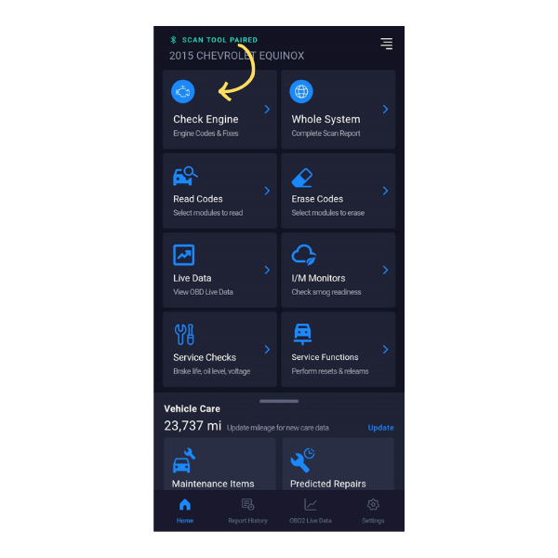
Title
How to run a Report for your Check Engine Light
Tool #
1000
Creator
David G.
Created/Update Date
T/N #
23-1000-003
Description: This guide aims to help you understand how to generate a report for your Check Engine Light using the Innova 1000.This guide aims to help you understand how to generate a report for your Check Engine Light using the Innova 1000.
Step 1: Select Check Engine
After successfully pairing the Innova 1000 with the RS2 (RepairSolutions2) app, navigate to the Check Engine option.
This option is typically available within the app's menu.

Slide 2
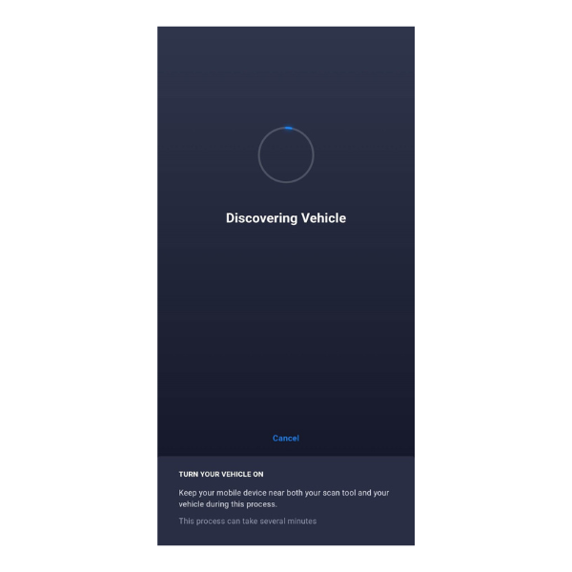
Step 2: Wait for Data Reading
Once you've selected the Check Engine option, the RS2 app will begin reading data from your vehicle.
This data reading process includes retrieving information such as the odometer reading from your vehicle.

Slide 3
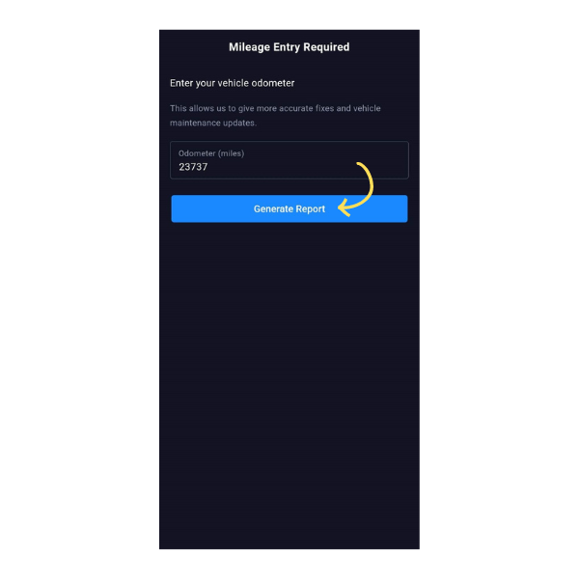
Step 3: Generate Report
After the RS2 app has successfully retrieved data from your vehicle, it will display the odometer reading.
At this point, you'll have the option to select "Generate Report.“
Choose this option to initiate the report generation process for your Check Engine Light issue.

Slide 4
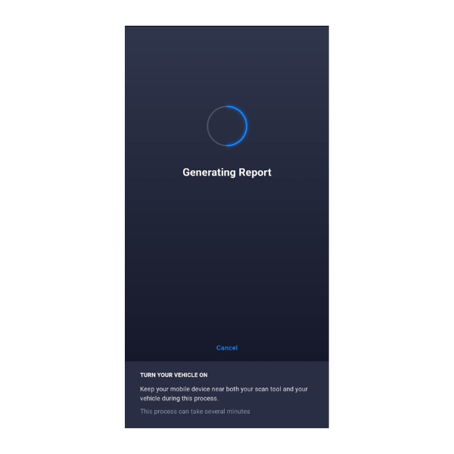
Note: During the report generation, ensure your vehicle is turned to the ON position. Also, ensure your smart device (e.g., smartphone or tablet) is in close proximity to your Innova 1000 dongle. This proximity ensures reliable communication between the dongle and the app.

Slide 5
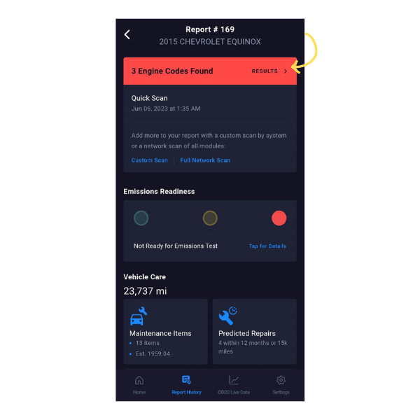
Step 4: View the Check Engine Light Report
Upon completing the Check Engine scan, a comprehensive report is already created. This report contains all the Diagnostic Trouble Codes (DTCs) associated with the issues triggering your Check Engine Light.
Locate and select the "Results" option within the app's interface, often indicated by a red banner or a designated area.
By following these steps, you can successfully generate and view a report for your Check Engine Light using the Innova 1000 and the RS2 app. This report provides valuable information about the specific issues identified by the diagnostic scan, helping you make informed decisions about necessary repairs or maintenance. If you encounter any challenges or have further questions, feel free to contact us for assistance. Your vehicle's health is our priority!

