Slide 1
Title
Erasing Diagnostic Trouble Codes (DTCs) with Innova 5110
Tool #
5110
Creator
David G.
Created/Update Date
T/N #
23-5110-001
Description: How to erase diagnostic trouble codes with 5110.
Facing DTCs on your vehicle and need to clear them using the Innova 5110? Here's a step-by-step guide to help you through the process.
Important Note:
When you use the ERASE function to clear DTCs, Freeze Frame data, and Manufacturer Specific Enhanced Data are also erased.
- If you plan to take your vehicle to a service center, avoid erasing the codes as they contain valuable information for troubleshooting.

Slide 2
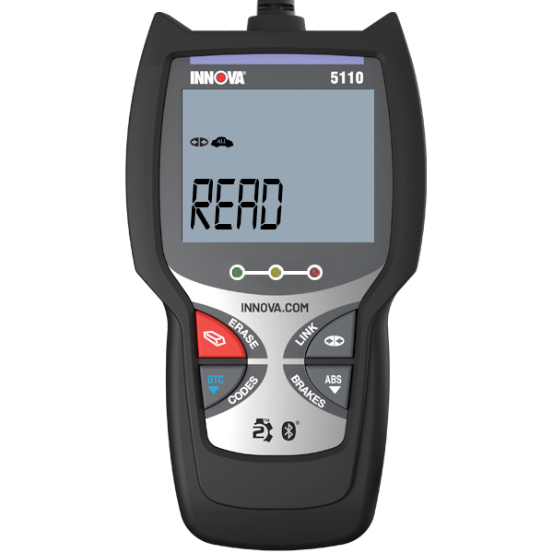
Step 1: Preparing for Erasing DTCs
Begin by performing the code retrieval procedures while connected to your vehicle.
2. Depending on the type of codes you need to erase, follow the respective steps below:
For erasing OBD2 DTCs: Wait until the codes are displayed on the code reader’s LCD and proceed to step 2.
For erasing ABS DTCs: Press the ABS button to retrieve ABS codes, and then proceed to step 3.

Slide 3
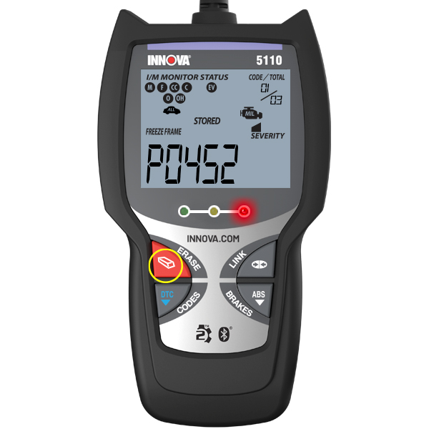
Step 2: Erasing OBD2 DTCs
1. To erase OBD2 DTCs, press and release the ERASE button on the Code Reader.

Slide 4
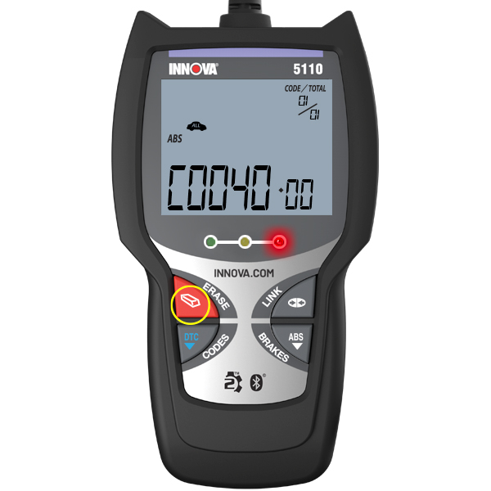
Step 3: Erasing ABS DTCs
If you're dealing with ABS codes, press the ABS button to read the ABS codes.
2. To view multiple ABS codes, keep pressing the ABS button.
3. After viewing the ABS codes, press the ERASE button.

Slide 5
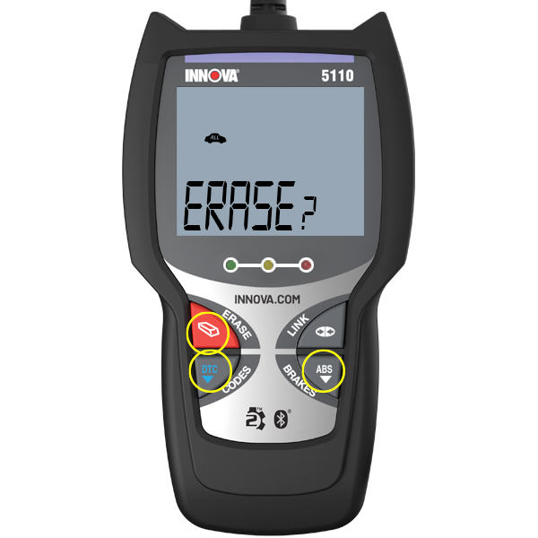
Step 4: Confirmation to Erase DTCs
The LCD display will show "ERASE?" as a confirmation.
2. Press the ERASE button again to proceed with the erasing process.
3. If you change your mind and decide not to erase the codes, press the DTC or ABS button to return to the code retrieval function.

Slide 6
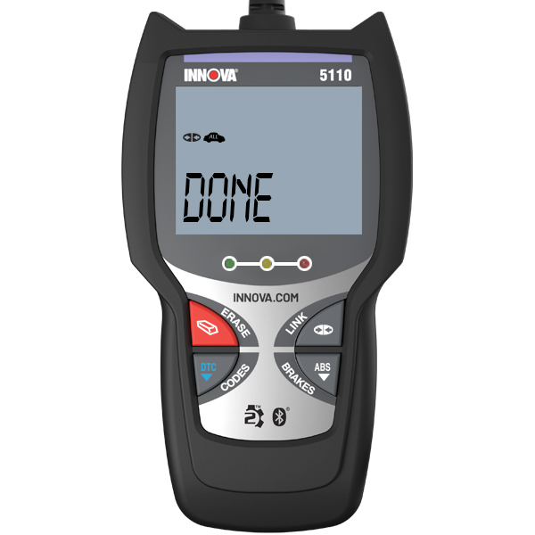
Erasing Process:
If you proceed to erase the DTCs, the LCD display will indicate "ERASE" during the erasing process.
As all retrievable information gets cleared from the computer’s memory, the code reader will re-link to the vehicle’s computer.
- Once the process is complete, the LCD display will show the message "Done."
By following these steps, you can successfully erase DTCs using the Innova 5110. Remember to be cautious when deciding to erase codes, especially if you plan to seek professional help for your vehicle's issues. If you have any questions or face difficulties, don't hesitate to contact us for assistance. We're here to help you keep your vehicle running smoothly.

