Slide 1
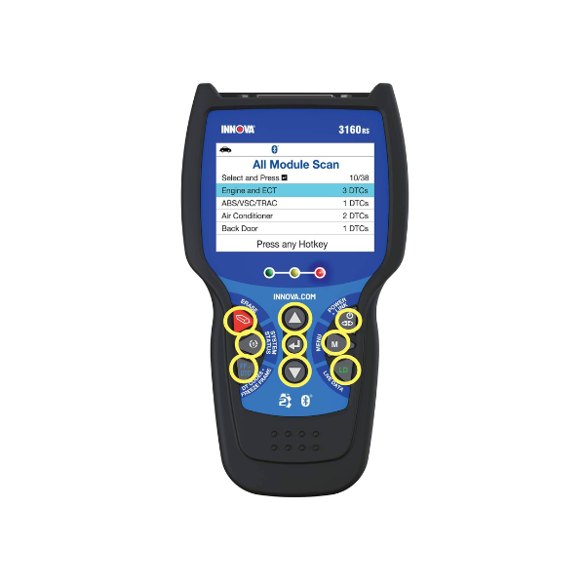
Title
What is a Hot Key?
Tool #
5210
Creator
David G.
Created/Update Date
T/N #
23-5210-001
Description: Understanding what is a Hot Key.
Purpose:
This description aims to clarify the functionalities of Hot Keys in Innova's handheld OBD2 devices.
What is a Hot Key?
A Hot Key refers to a specific button or key on your Innova handheld OBD2 device that provides quick access to certain features or functions. These keys are designed to streamline your device's operation, allowing you to navigate through different options swiftly.

Slide 2
Using Hot Keys:
When your device displays the instruction "Press any Hot Key," it's prompting you to press any button on your device to proceed. This action enables you to continue using the device or access specific features.
To find out which button corresponds to specific features, refer to the button descriptions on your device. Each button may have a designated function, such as accessing the menu, returning to the home screen, or selecting a certain mode.
- By pressing a Hot Key, you're essentially selecting a pre-defined action without needing to navigate through menus, making your device interaction more efficient.
In summary, Hot Keys on Innova's handheld OBD2 devices are buttons that provide convenient shortcuts to various device functions. When prompted to press a Hot Key, simply press any button on your device to continue using it or access specific features. Familiarize yourself with the button descriptions to make the most of your device's capabilities. If you have any questions or need further assistance, feel free to consult the device manual or contact our support team.

