Slide 1
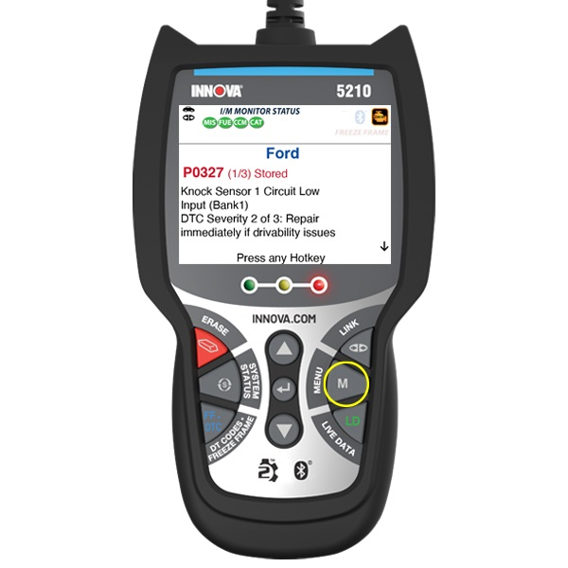
Title
Performing a Battery & Alternator Test
Tool #
5210
Creator
David G.
Created/Update Date
T/N #
23-5210-002
Description: This guide provides step-by-step instructions on how to perform a Battery & Alternator Test using the Innova 5210 diagnostic tool.
guide aims to help you understand how to generate a report for your Check Engine Light using the Innova 1000.
Battery & Alternator Test: The Innova 5210 can assess your vehicle's battery and alternator system to ensure they are functioning within acceptable parameters. You have the option to perform a battery check or an alternator system check.
Step 1: Access the MENU
While your Innova 5210 is linked to your vehicle, locate and press the MENU button on the tool.

Slide 2
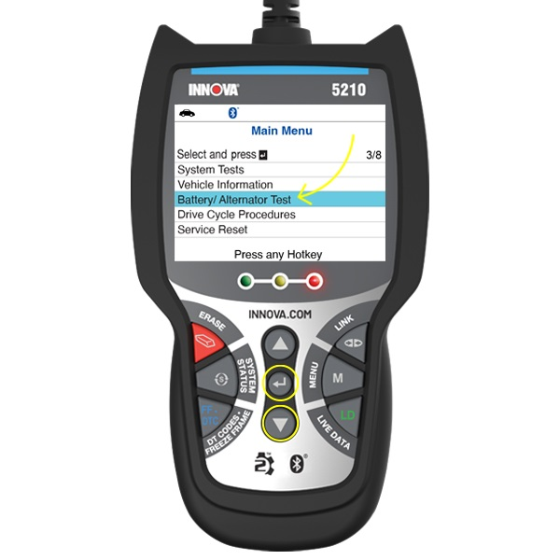
Step 2: Navigate to Battery/Alternator Test
Once in the MENU, navigate through the options using the DOWN ▼ button until you find "Battery/Alternator Test.“
Highlight "Battery/Alternator Test" and press the ENTER ↵ button to select it.

Slide 3
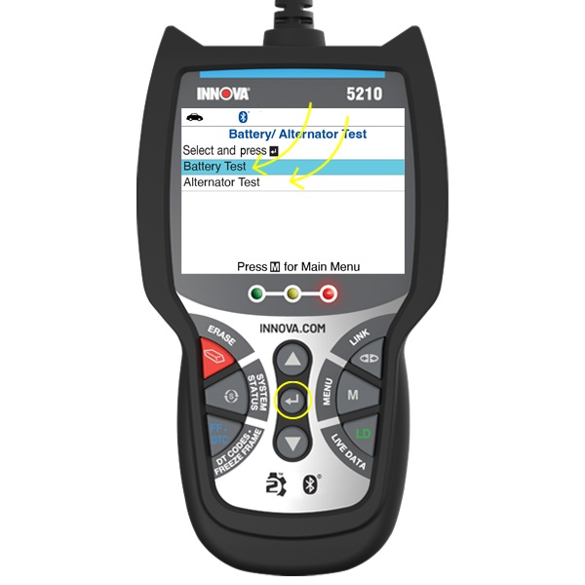
Step 3: Choose Battery or Alternator Test
The Battery/Alternator Test menu will now appear on the screen.
From this menu, select whether you want to perform a "Battery Test" or an "Alternator Test.“
Highlight your choice and press the ENTER ↵ button to confirm.
Note: The chosen test will now be performed, and the Innova 5210 will retrieve relevant information.

Slide 4
Completing the Test:
After viewing the retrieved information, press the MENU button to return to the Main Menu.
The test results will provide insight into the health of your vehicle's battery or alternator system, helping you gauge if they are operating optimally.
By following these steps, you can effectively perform a Battery & Alternator Test using the Innova 5210 diagnostic tool. If you have any questions about the test results or need further assistance, don't hesitate to consult your tool's manual or reach out to our support team. Ensuring your vehicle's key components are in good condition is essential for maintaining its performance.

