Slide 1
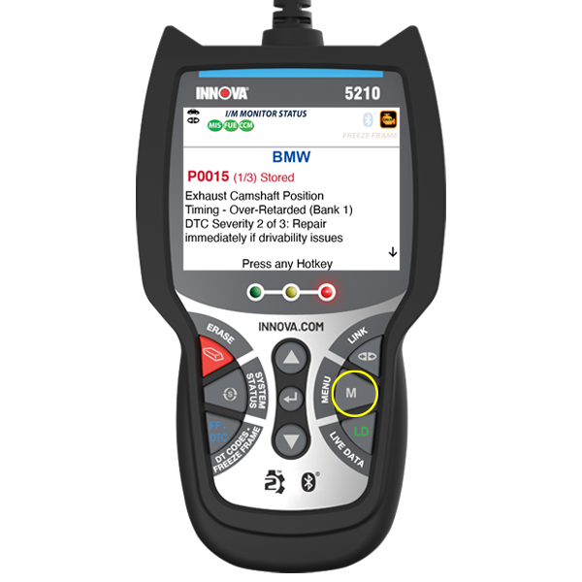
Title
Viewing LED Definitions using Innova 5210
Tool #
5210
Creator
David G.
Created/Update Date
T/N #
23-5210-003
Description: This guide aims to assist you in navigating the Innova 5210 interface to view LED light definitions.
Viewing LED Definitions:
The LED Definitions feature in the Innova 5210 provides explanations for the green, yellow, and red System Status LEDs. These LEDs on the Scan Tool visually indicate the I/M Readiness status of the vehicle being tested.
Step 1: Access the MENU
Locate and press the MENU button on the Innova 5210 to enter the MENU.

Slide 2
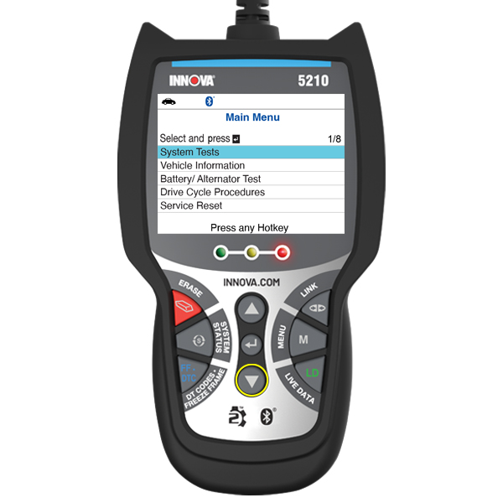
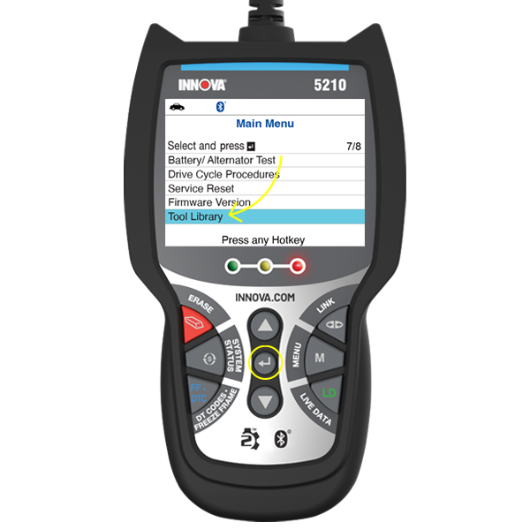
Step 2: Navigate to Tool Library
In the MENU, use the DOWN ▼ button to scroll through options until you find "Tool Library.“
Highlight "Tool Library" and press the ENTER ↵ button to select it.

Slide 3
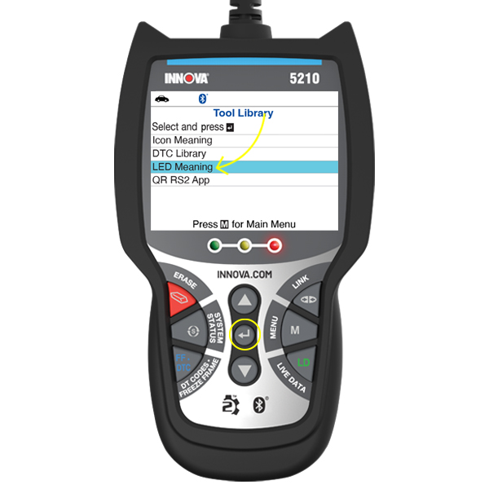
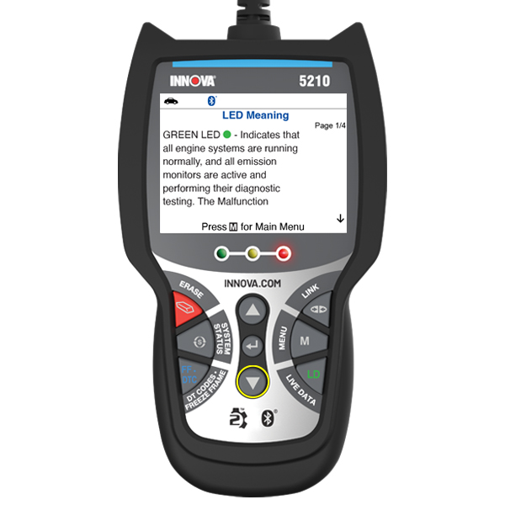
Step 3: Select LED Meaning
The Tool Library menu will appear.
From this menu, select "LED Meaning.“
Highlight "LED Meaning" and press the ENTER ↵ button to confirm.
Viewing LED Definitions:
The LED Definitions screen will now be displayed.
Use the DOWN ▼ button to scroll through the screen to view the explanations for the various LED meanings.
The LED meanings correspond to the different colors of System Status LEDs on the Scan Tool, providing you with insights into the I/M Readiness status of the vehicle under test.

