Slide 1

My sunshine
Nasa Challenge
Creapption Group

Slide 2
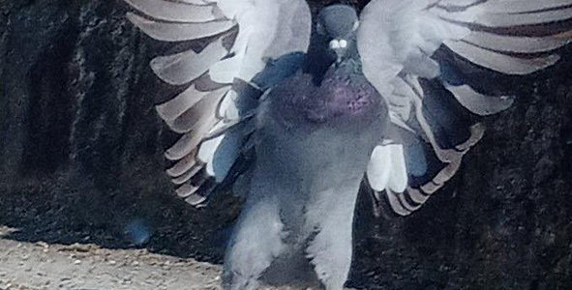
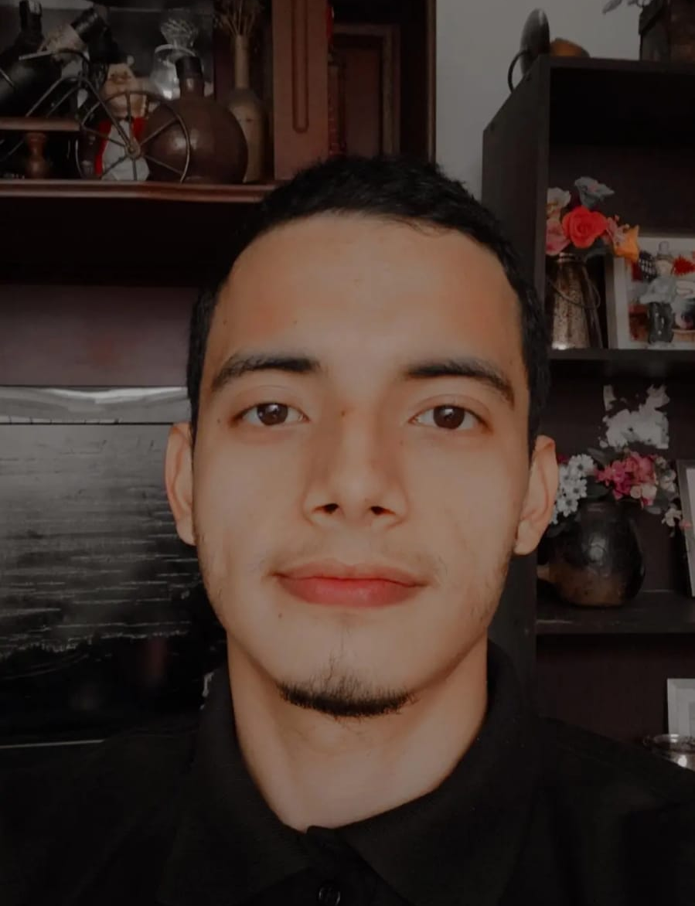
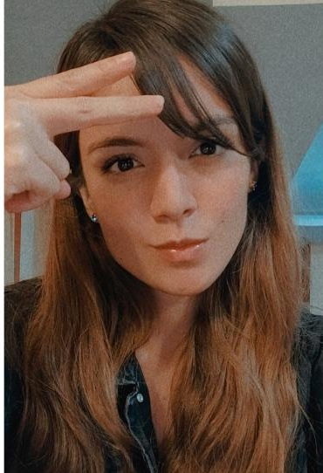
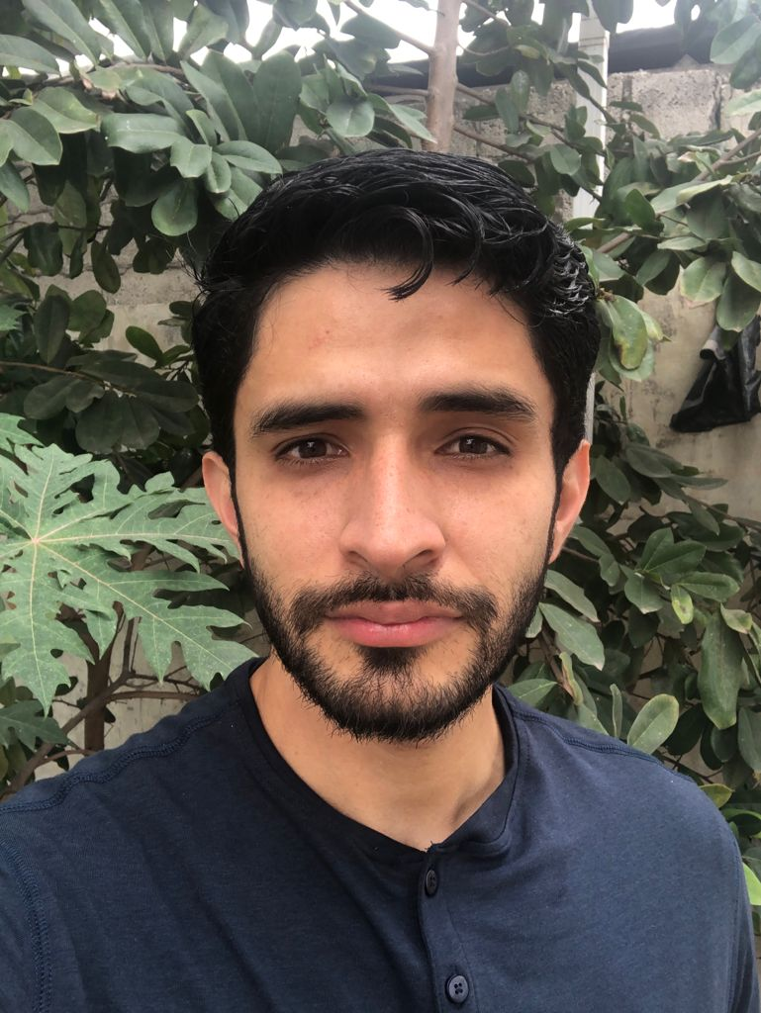
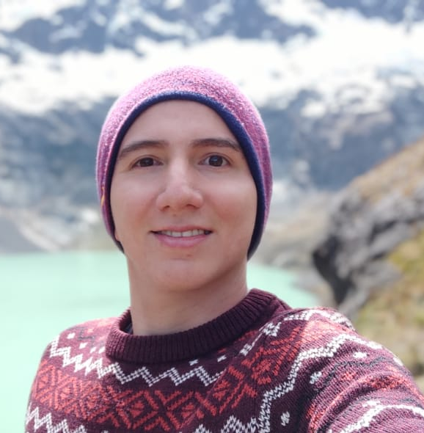
Team Creapption
Andre Aguirre
Thamara Torres
Brayan Loayza
Erick Maldonado

Slide 3
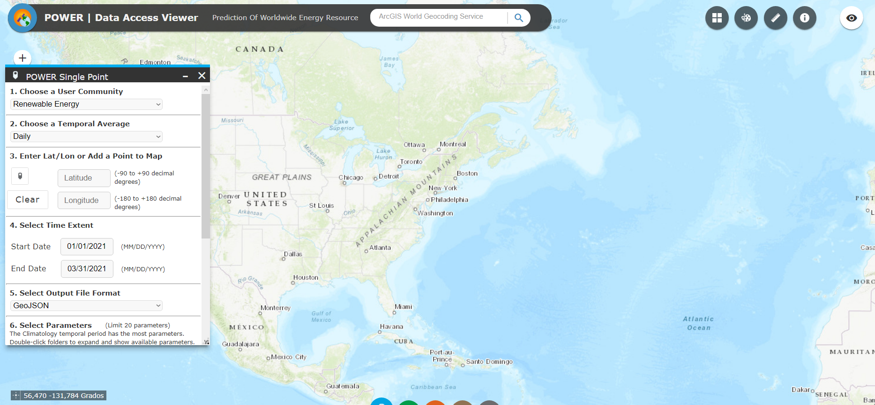
Nasa Information
Problem:
Data presented by this web site is not user friendly.

Slide 4

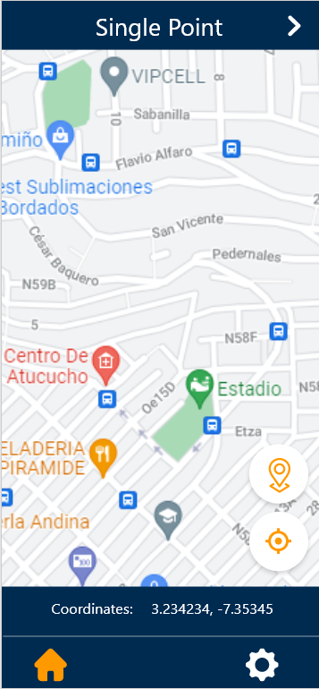
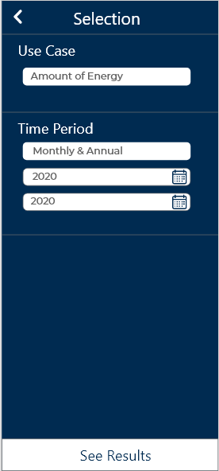
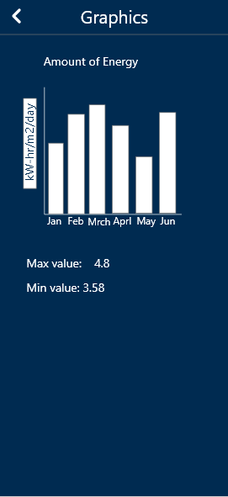
Solution: My sunshine app
Present an user friendly UI interface
Give simple information to users
Show the resulting data as graphics in charts or bars

