Slide 1
Replace Existing Configuration Manager Application for Diona Solutions
David Fagan – 20095398
URL Landing Page - http://bit.ly/3n5V693

Slide 2
Introduction
Web Application.
Configure Diona's solutions.
Aims
More extensible
Easier to manage
Improve the visual display to appear more modern

Slide 3
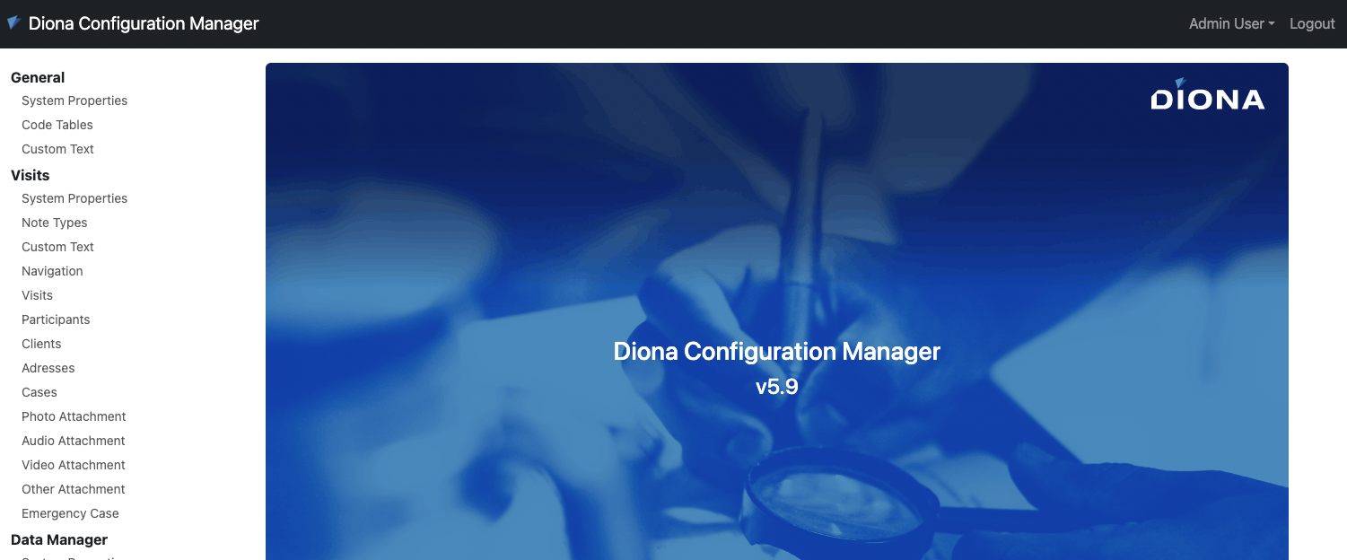
Demo

Slide 4
Technology
NodeJS
MongoDB
JavaScript
ExpressJS
Pug
Bootstrap 5
Balsamiq
Jira/Trello

Slide 5
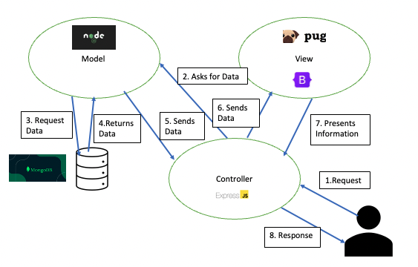
MVC

Slide 6
Methodology
Agile Scrum
Sprints – Smaller & more manageable sections
Daily scrum meetings
How to track and plan the project?
JIRA
Trello

Slide 7
Design
User requirements
Screen Designs
Walkthrough
UML Class Diagram
Personas
User Stories

Slide 8
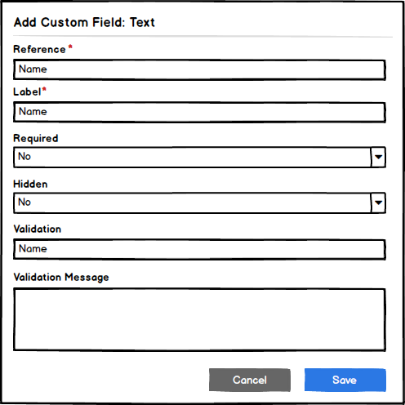
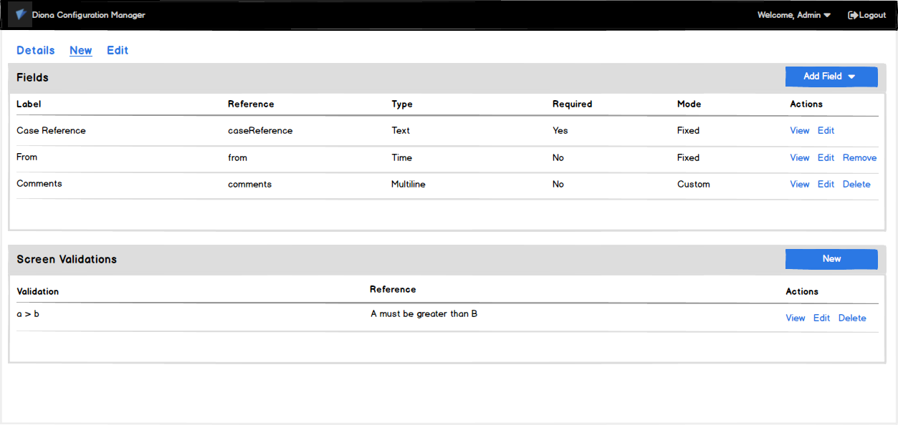
Screen Designs

Slide 9
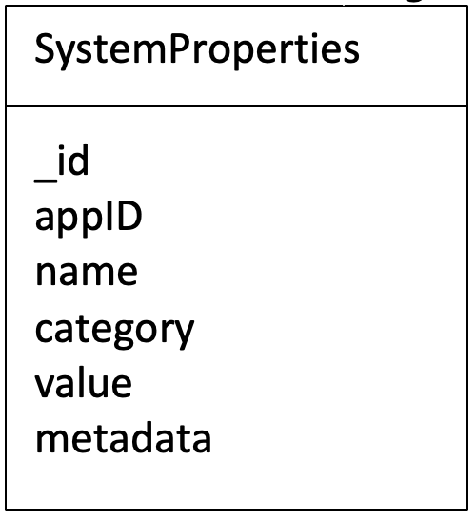
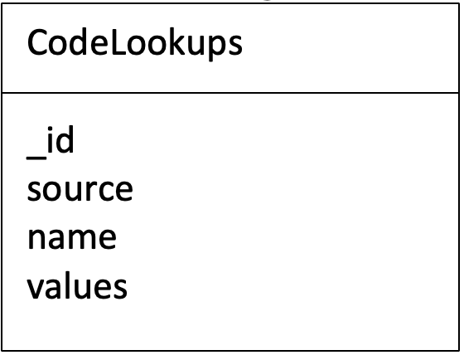
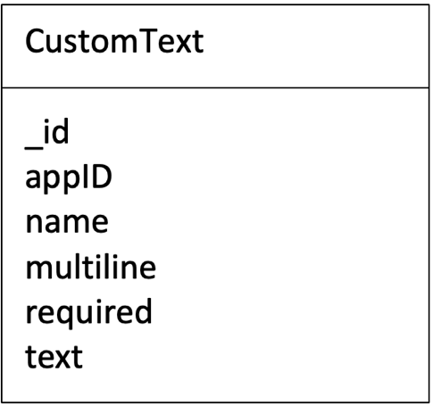
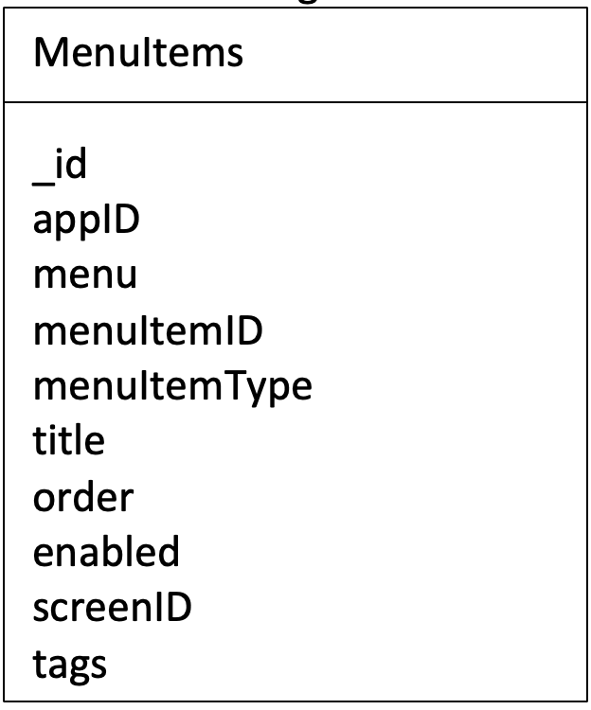
UML Class Diagrams

Slide 10
Implementation
System Properties
Code Tables
Custom Text
Navigation
Configuration Screens
Read Only
Editable

Slide 11
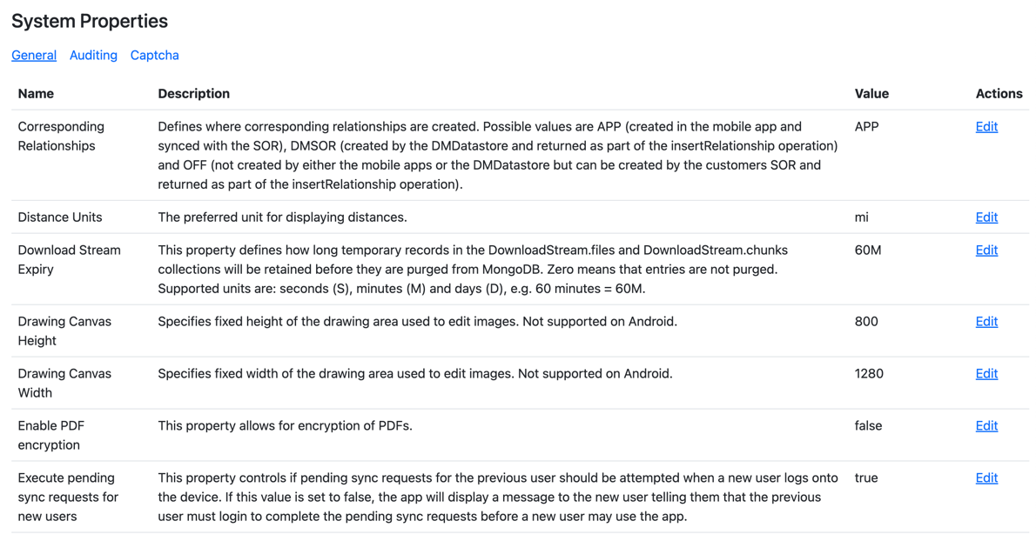
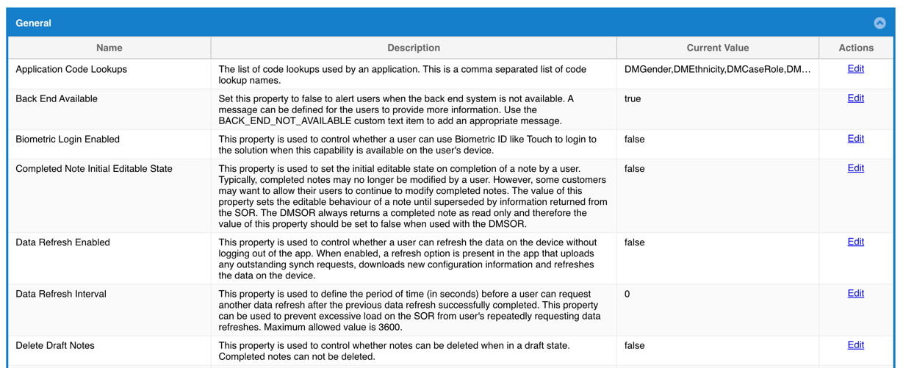
System Properties List Screen

Slide 12
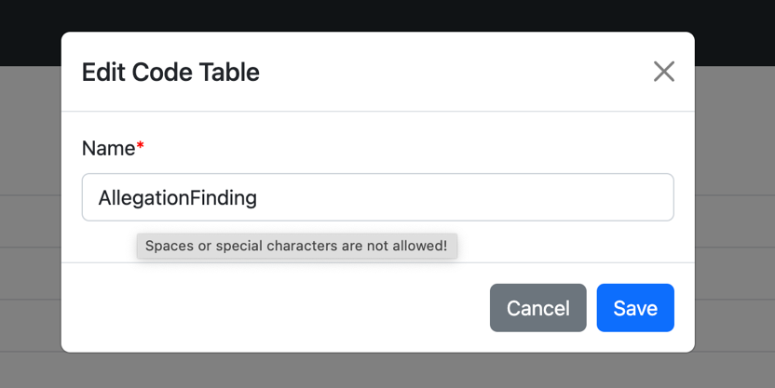
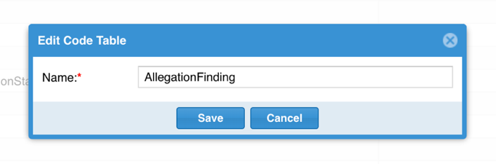
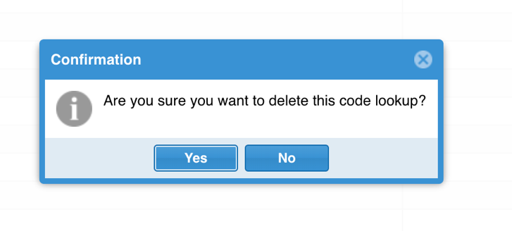
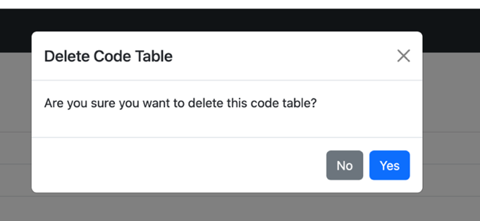
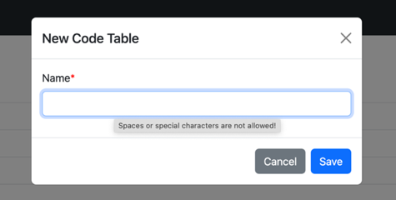
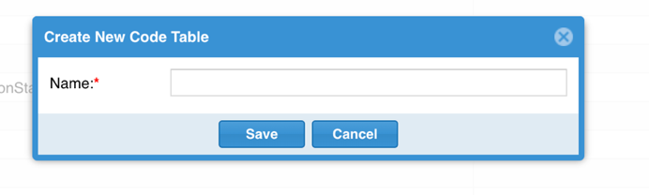
Code Table Dialogs

Slide 13
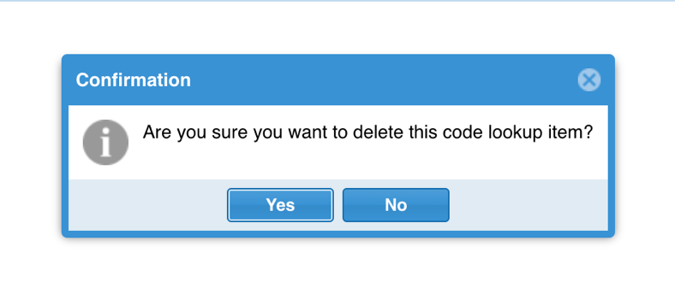
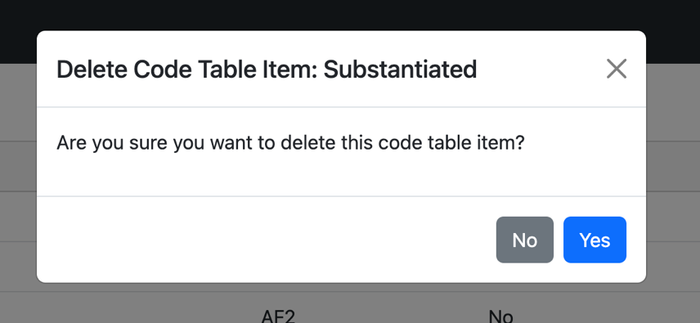
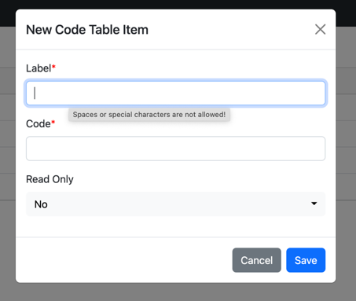
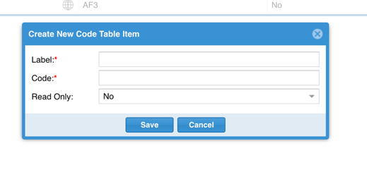
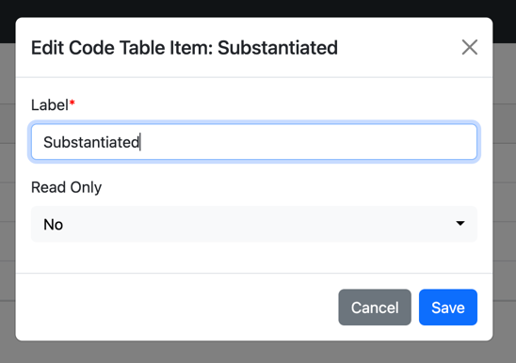
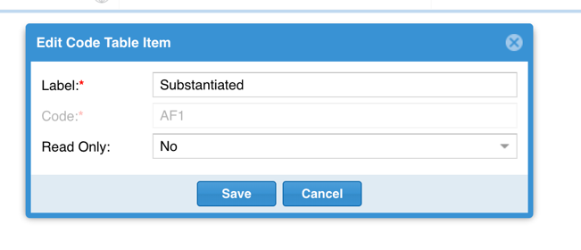
Code Table Items Dialogs

Slide 14
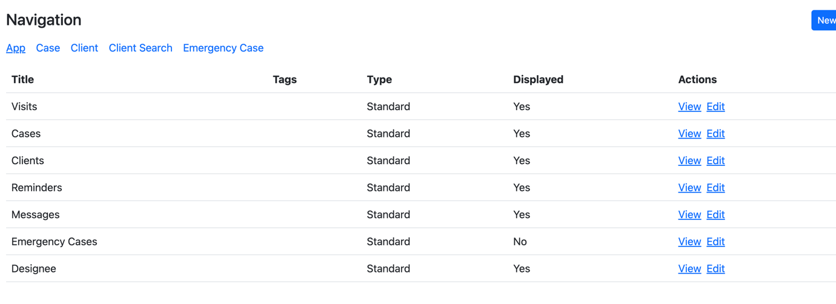
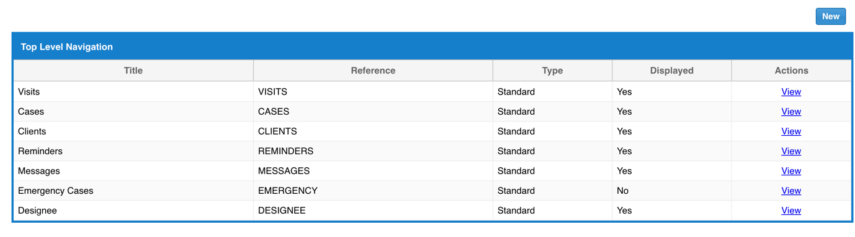
Navigation

Slide 15
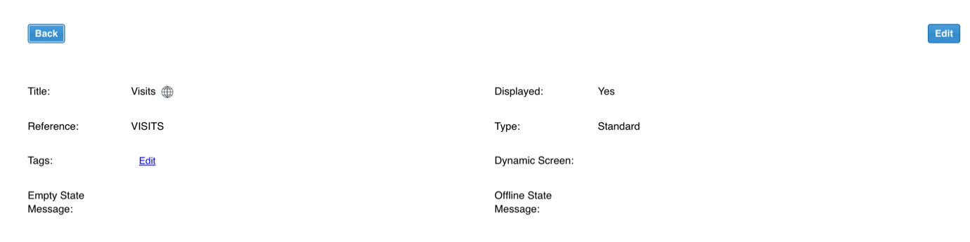
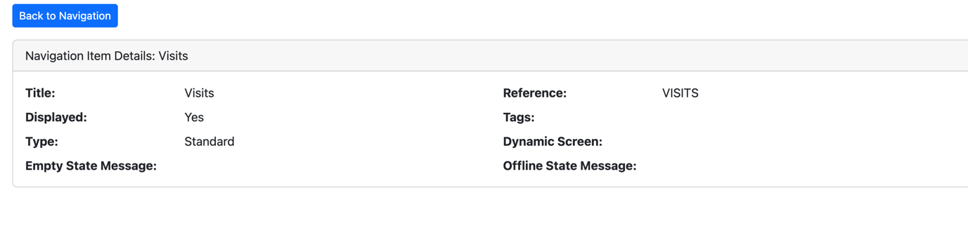
Navigation View Screen

Slide 16
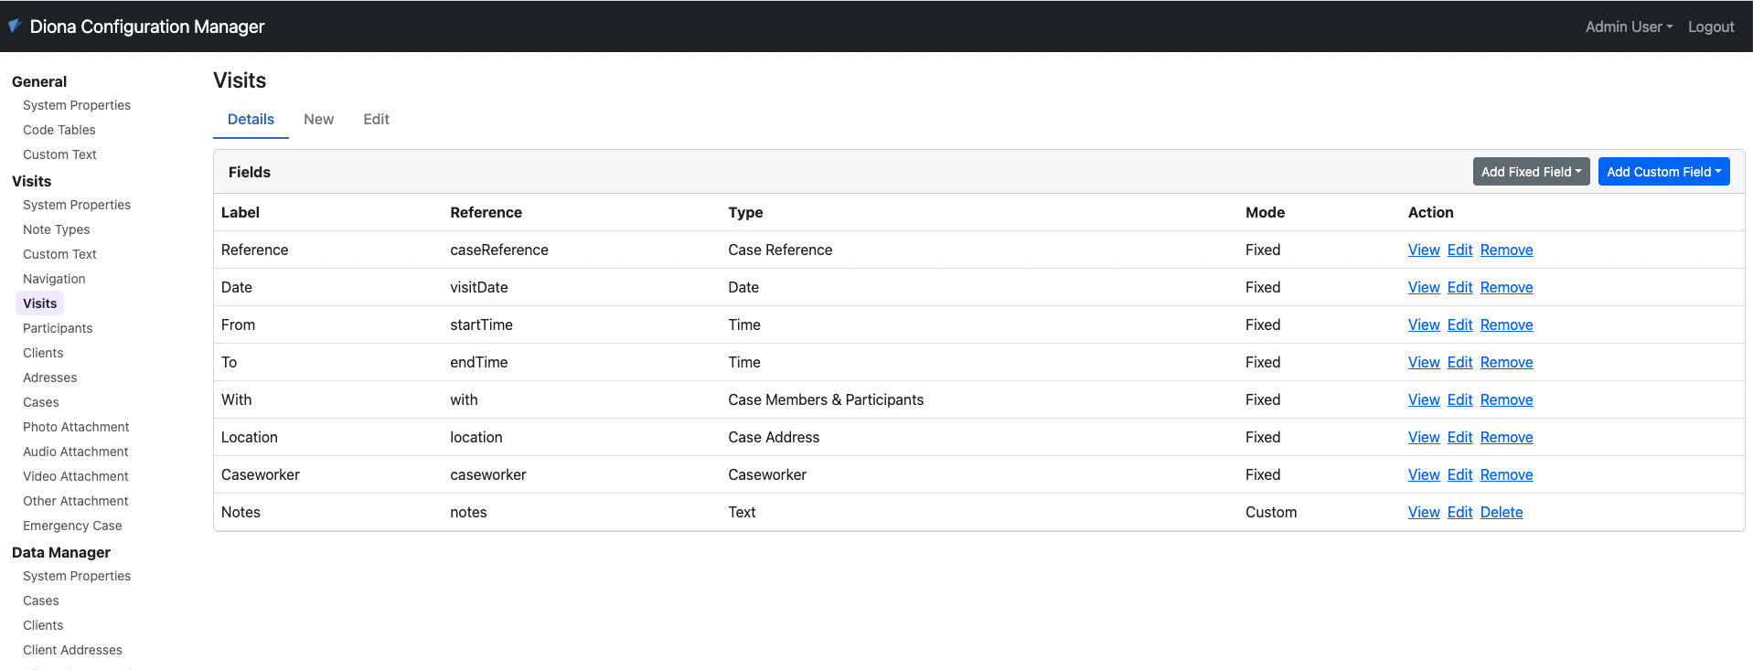
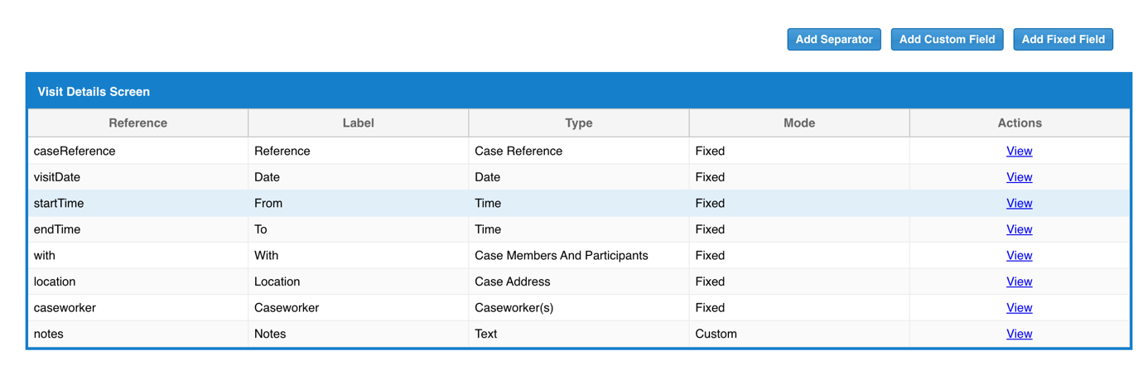
View Screen Configuration List

Slide 17
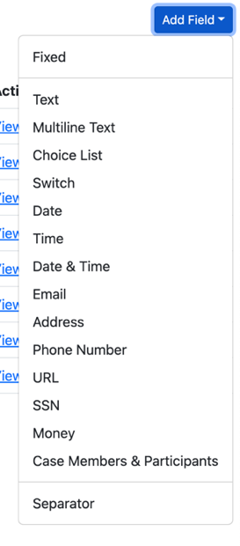
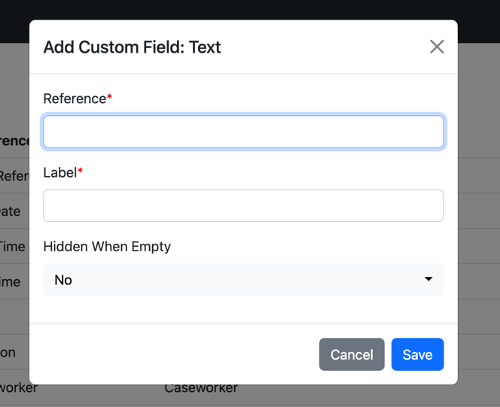
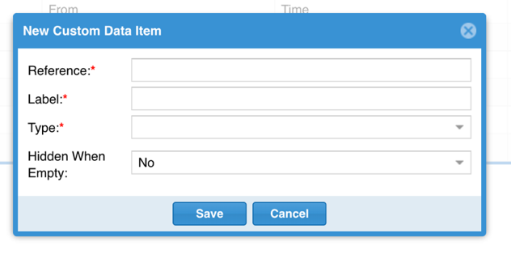
View Screen Configuration: Dialogs & Dropdown

Slide 18
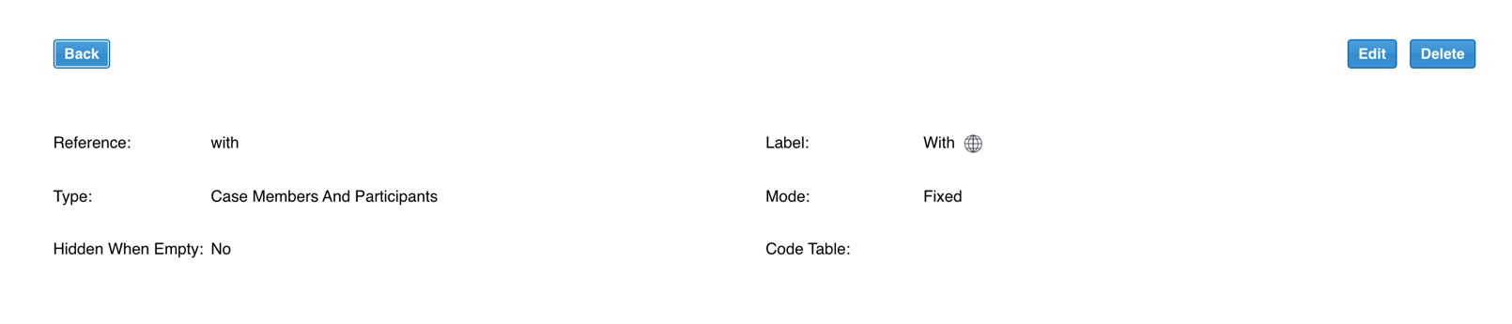
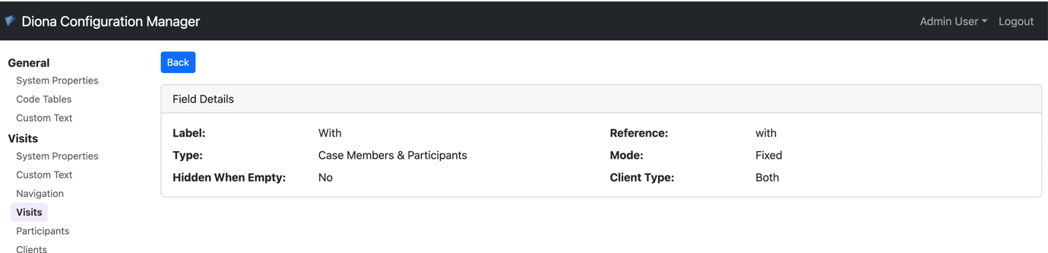
View Field Details Screen

Slide 19
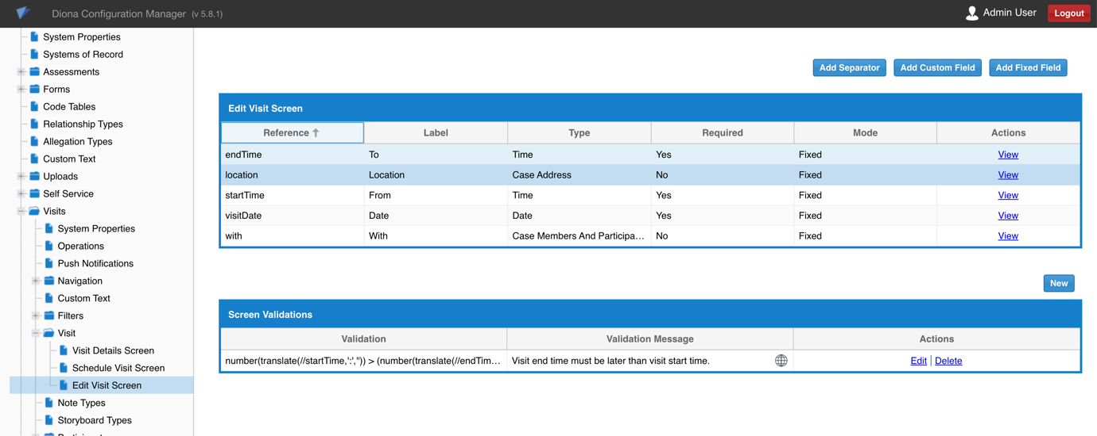
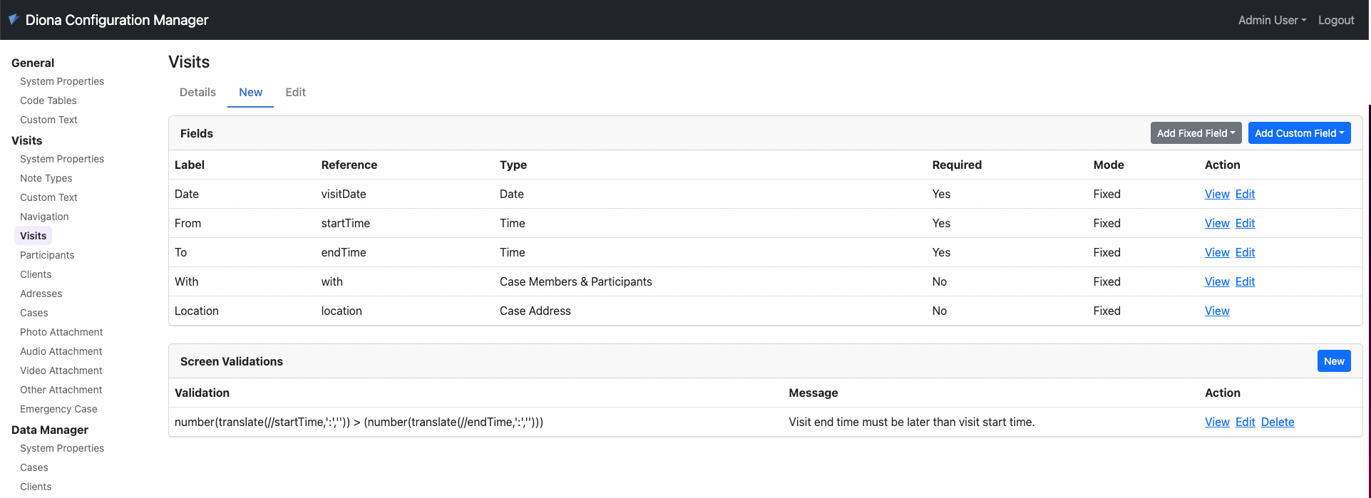
Editable Screen Configuration: List

Slide 20
What I Learned
Agile Scrum Methodology
JavaScript
ExpressJS
Pug
MongoDB
Bootstrap

Slide 21
Problems Encountered & Solutions
Many problems faced during project
Solved:
Reading documentation
Google
Workplace supervisor
Validation of a form

Slide 22
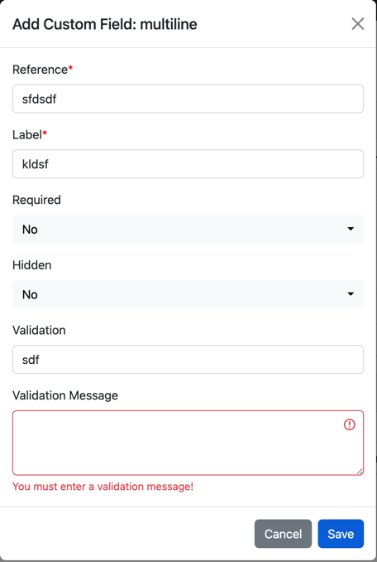
Problems Encountered & Solutions

Slide 23
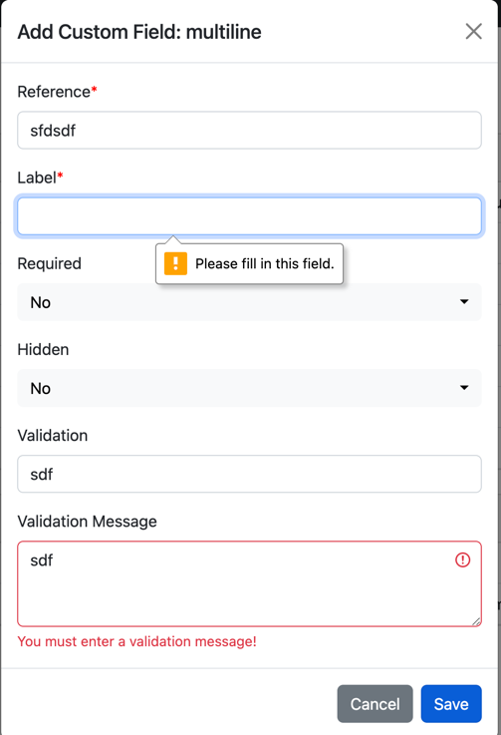
Problems Encountered & Solutions

Slide 24
Future Development
≈ 70% Complete
Sections:
Relationship Types
Allegation Types
Operations
Push Notifications
Filters
Note Types
Storyboards
Manual Testing
Automated Testing

Slide 25
Thank You For Listening Any Questions?

