Slide 1
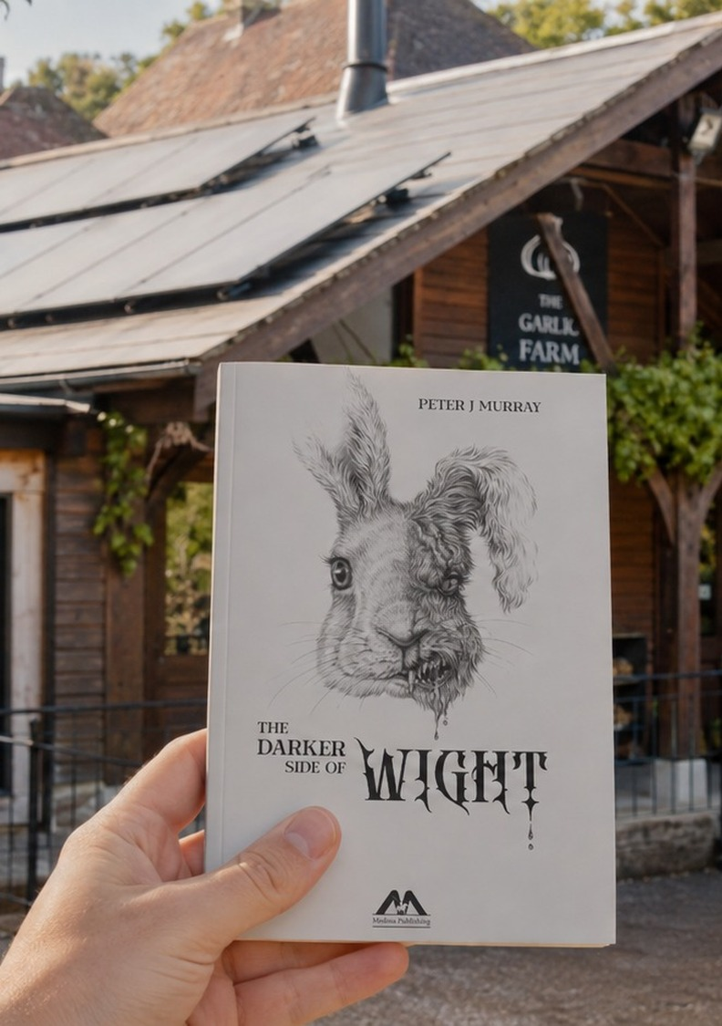
THE DARKER SIDE OF WIGHT × THE GARLIC FARM
Shrouded in Garlic
A story-led visitor experience for The Garlic Farm
A proposal from Medina Publishing, Island author Peter J Murray and IsleConnect: a new reason for families to visit, and a test of a new kind of local marketing.
Presented by Simon Harrop, Medina Publishing
September 2026
01
Notes:
Thank you for your time. I'm Simon Harrop from Medina Publishing. I'm presenting today on behalf of our small partnership: Pete Murray, the author of The Darker Side of Wight; Medina, his publisher; and David Grannum of IsleConnect, who designs and produces the experience.
The short version: we'd like to create a story-led experience for The Garlic Farm that gives families a fresh reason to visit, steers them towards your shop and restaurant, and leaves you with a library of media you can keep using. Everything today is built around what the farm gets first.

Slide 2

THE DARKER SIDE OF WIGHT × THE GARLIC FARM
The idea in one line
“Step into the story at the place that inspired it.”
Visitors scan a card at the farm and follow a short, family-friendly story by Island author Peter J Murray through three spots on the farm. Each stop mixes a real farm fact with a moment of fiction, and the story ends where you choose: a tasting, the shop or the restaurant.
10–15
3
0
minutes, entirely optional
stops on routes you already have
apps to download
02
Notes:
If you remember one line, it's this one: step into the story at the place that inspired it. It's fiction, and we're clear about that, but it's set in a real place you can walk through.
In practice, a family sees a small card, scans it with their phone and a short story opens in the browser. There's no app to download and no account. They walk to three spots on the farm. At each one they learn something real about garlic and the farm, hear a minute of the story, and look for a clue.
At the end, the story hands them to whatever you want them to do next: taste something, visit the shop, book a table or pick up the book. It takes ten to fifteen minutes and it's entirely optional, so it never gets in the way of an ordinary visit.

Slide 3
THE DARKER SIDE OF WIGHT × THE GARLIC FARM
What’s in it for The Garlic Farm
A new reason to visit, built entirely around what the farm already does well.
01
02
03
A fresh reason to visit
Longer, richer visits
Sales steered where you choose
A story families can only finish at the farm, launched with a film made for your own channels.
Three short stops draw attention to the land, the growing year and the craft behind your products.
Every visit ends with a next step you pick: a tasting, a product, a table or the shop.
04
05
06
Content you keep using
Nothing new to build
Evidence, not promises
A hero film, short edits, stills and captions for social media, your website and on-site screens.
No app, no new attraction and no sign-up needed to take part. Just small cards on existing routes.
You see scans, completions and clicks towards shop, menu and book, then decide what happens next.
03
Notes:
This is the heart of it, so I'll take a moment here.
First, it gives families a new, seasonal reason to choose the farm: a story they can only complete by being here.
Second, it makes the visit richer. The stops point people at the things you're proud of: the land, the growing year, how the products are made.
Third, it steers spending. You decide what each visit ends with, so on a busy restaurant day it might point to the shop, and on a quiet one to a table.
Fourth, you're left with media you can keep using: film, short clips, photographs and ready-written captions.
Fifth, there's nothing to build. No app, no new attraction, and nobody needs an account or to give personal details to take part. Just small cards on routes that already exist.
And finally, it's measured. You'll see how many people took part and what they did next, and you decide whether to continue.

Slide 4
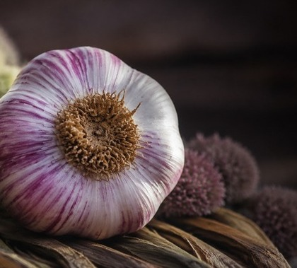
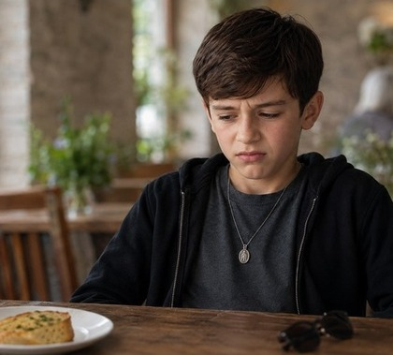
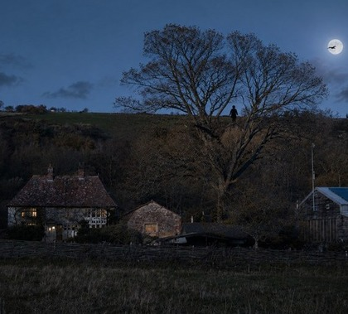
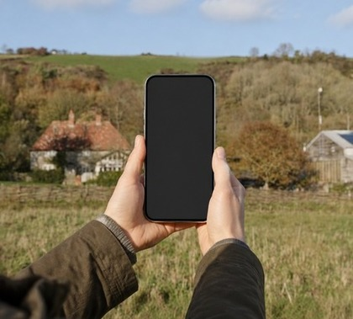
THE DARKER SIDE OF WIGHT × THE GARLIC FARM
The story behind it
Peter J Murray’s The Darker Side of Wight brings a darker edge to real Island places. Shrouded in Garlic takes that world to the farm through Matty, a young visitor who finds that garlic, light and reflection are clues to something unexplained.
Atmospheric rather than frightening. Pete and the farm agree the tone for a family audience.
00:13
00:18
00:39
00:42
The garlic turns
Meet Matty
A shape crosses the moon
Scan at the real place
Frames from the existing 48-second concept film, which becomes the starting point for the finished film.
04
Notes:
Pete's book takes real Island places and gives them a darker, storytelling edge. Shrouded in Garlic brings that world to the farm through Matty, a boy whose visit turns up clues about garlic, light and reflection.
These frames come from a 48-second concept film David has already produced. It shows the shape of the finished film: it starts with the real farm, turns into Matty's story, and ends with an invitation to come and scan the story for yourself.
The tone is atmospheric rather than scary. Pete and the farm would agree exactly how dark it gets for a family audience.

Slide 5
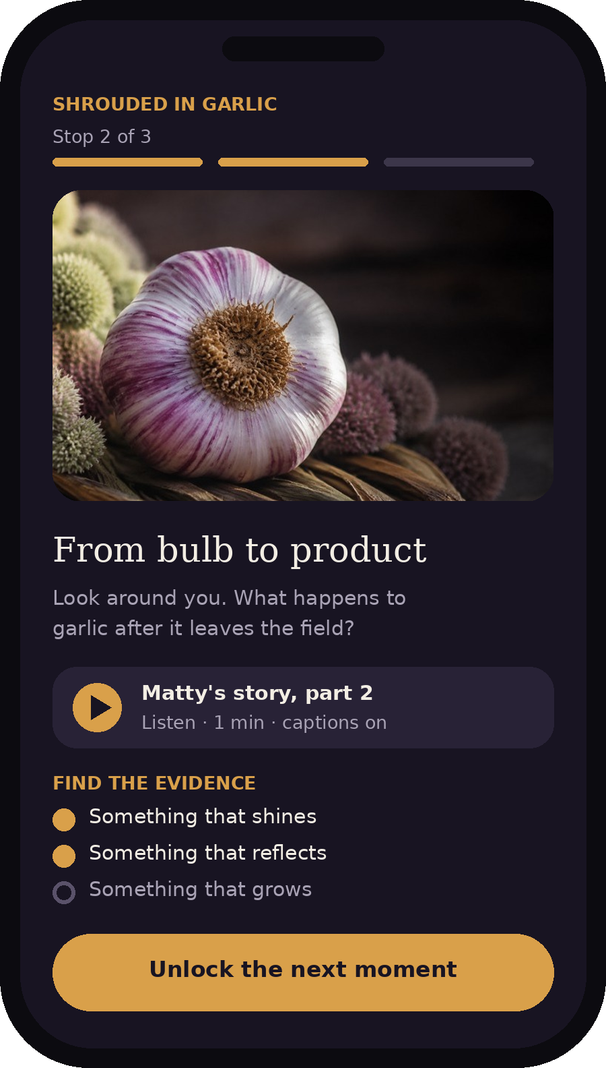
THE DARKER SIDE OF WIGHT × THE GARLIC FARM
How it works for a visitor
1
Notice
A card at the entrance, shop or café, or a post on your channels, introduces the story.
2
Scan
The story opens in the phone’s browser. Nothing to download and no account to create.
3
Explore
Three short stops, each with a real farm fact, a one-minute story moment and a clue to find.
4
Act
The final stop offers one next step you choose: taste, browse, dine or buy the book.
5
Return
An optional newsletter sign-up through the farm’s existing consent process, the next event or the next story.
10–15 minutes, entirely optional, and it fits around normal visitor movement.
Illustrative stop page
05
Notes:
Here's the visitor's view, step by step.
They notice a small card or see a post. They scan it and the story opens straight away in their phone's browser.
On the right is an illustration of what a stop looks like on the phone: a photo, a line or two of real farm information, a one-minute piece of Matty's story with captions, and a short list of things to find. Finding them unlocks the next part of the story.
The final stop hands over to the farm: a tasting, a product, the menu or the book. Then there's a gentle reason to come back, such as signing up to your newsletter through your existing consent process, the next event or the next story.
The wording on the screen is illustrative. The farm supplies and approves all the real facts.

Slide 6
THE DARKER SIDE OF WIGHT × THE GARLIC FARM
Three stops on the farm
A first outline. The site walk decides the exact spots so the route works with normal visitor flow.
 | 01 The land | 02 From bulb to product | 03 Taste and discovery
The real farm | Growing, varieties and the seasons | Harvesting, drying or preparation | A product, tasting or menu item you choose
The story | Matty’s story begins | A clue that fiction has entered the farm | The mystery resolves, or leaves a question
The visitor | Looks around and finds the first clue | Listens, looks closely, finds the next clue | Chooses how the visit ends
You choose the locations, facts, products and final call to action.
06
Notes:
This is how the three stops might work. Each column is one stop. Reading down: what's real on the farm at that spot, what happens in the story, and what the visitor does.
The first stop is about the land and the growing year, and it's where the story begins. The second is about what happens to garlic after harvest, and it's where the fiction starts to creep in. The third is about taste, and it's where the story ends and hands over to a product, a tasting or the menu.
The important line is at the bottom: you choose the spots, the facts and the products. We'd settle the actual route on a walk round the farm with you.

Slide 7
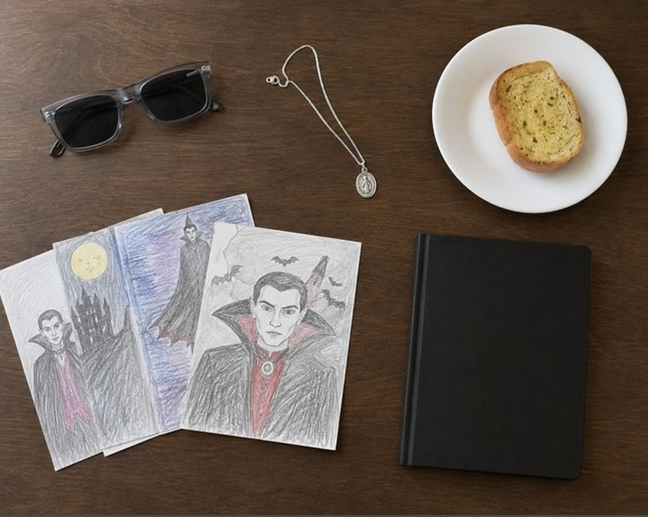
THE DARKER SIDE OF WIGHT × THE GARLIC FARM
A challenge the whole family can share
Find the evidence
Spot three details connected to garlic, light or reflection.
Unlock the next moment
Each find opens a short piece of story, sound or film.
Choose how the visit ends
Taste something, browse the shop, read more or carry on walking.
All five senses have a place: look for clues, listen to the story, smell and handle the garlic where appropriate, and finish with an optional tasting.
Story props from the concept: the clues Matty follows.
07
Notes:
Children lead the hunt. At each stop they look for something connected to garlic, light or reflection, which are the clues in Matty's story. Finding them unlocks the next part.
It's designed so adults can enjoy the farm at their own pace while children stay engaged. It also brings in the senses naturally: sight and sound through the story, smell and touch with the garlic where that's practical, and taste at the end.
No account or personal details are needed to take part.

Slide 8
THE DARKER SIDE OF WIGHT × THE GARLIC FARM
One production, useful to everyone
Each asset is made once, approved once and used by every partner. That keeps the cost down and the reach up.
Asset | For The Garlic Farm | For Pete and Medina Publishing
Hero film, 48–60 seconds | Website, social media and on-site screens | Book promotion, author events and school visits
Short vertical edits | Reels and Stories for seasonal pushes | Reader and bookseller posts
Silent screen loop | Shop, café or entrance screens | Launch and event screens
Still images | Posts, listings and newsletters | Press, book listings and displays
Mobile story pages | The on-farm experience itself | A live showcase for the book
Caption and copy bank | Ready-to-post wording | Coordinated partner posts
IsleConnect receives the agreed delivery fee. Permission to publish an approved case study supports the introductory pricing.
08
Notes:
This is why the partnership works commercially. Everything is made once and used many times, by everyone.
The farm uses the film and clips on its website, social media and screens. Pete and Medina use the same approved material to promote the book at events and in schools. So one production budget gets two sets of promotion, and each partner's audience sees the others.
IsleConnect is paid the agreed delivery fee. On top of that, with your approval, David would like to publish a case study showing this approach working at one of the Island's best-known attractions. That permission is what makes the introductory pricing possible.

Slide 9
THE DARKER SIDE OF WIGHT × THE GARLIC FARM
How the word gets out
A distribution plan agreed at kick-off, with a named owner for every channel. Partner sharing is arranged, not assumed.
Channel | Who does what | Basis
The Garlic Farm’s own channels | IsleConnect prepares posts and captions; the farm chooses what to publish | Agreed at kick-off
Pete and Medina Publishing | Share with readers, booksellers, schools and event audiences | Agreed at kick-off
Local community and interest groups | IsleConnect identifies relevant family, food, walking and folklore groups and asks first | Only where each group’s rules allow
Tourism and partner organisations | IsleConnect approaches; each organisation decides whether to share | Arranged, not assumed
Local press and listings | IsleConnect drafts; the partners approve before anything is sent | Optional
Reach and sales can’t be guaranteed. Each channel is tracked, so effort goes where it works.
09
Notes:
Distribution is agreed up front, with a clear owner for each channel, rather than assumed.
David prepares the posts and captions; the farm decides what goes on its own channels. Pete and Medina share with their readers, booksellers and school audiences. David will also approach relevant local community and interest groups, such as family, food, walking and folklore groups, but only where each group's rules allow it and after asking first. Tourism organisations and the local press are approached, not taken for granted.
We can't guarantee reach or sales, but every channel is tracked, so we'll see which ones actually bring people to the farm.

Slide 10
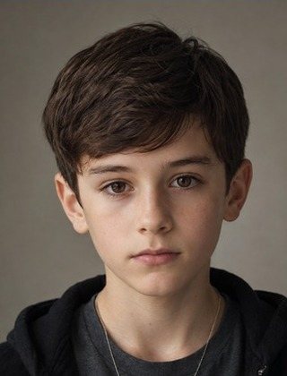
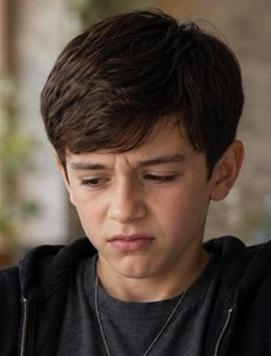
THE DARKER SIDE OF WIGHT × THE GARLIC FARM
Testing a new kind of local marketing
Real place
The farm, its land, products and people give the story its truth.
AI-assisted story world
AI image and video tools create a consistent character, scenes and night-time atmosphere that would otherwise need actors, a crew and night shoots.
Real people
Character master
Café scene
Pete, the farm’s own team and visitors add the voices and reactions that build trust.
Generated separately, shown at the same scale: the same face, hair, hoodie and pendant. That consistency is what lets one character carry a whole campaign.
People lead throughout: every script, image and film is written, checked and approved by the partners before anything is published.
The story world attracts attention. The farm, the author and visitors provide the trust.
10
Notes:
This is also a test of something new, and we'd like the farm to be the first to try it.
It combines three layers. The real place: your farm and products. An AI-assisted story world: David uses AI image and video tools to create Matty and the story scenes. Traditionally that would mean casting, a film crew and night shoots, which would put this out of reach for a single venue. And real people: Pete, your team and your visitors, who give it authenticity.
The two images on the right were generated separately: the character master and a scene in the café. Shown at the same scale, it's clearly the same boy, with the same face, hair, hoodie and pendant. That consistency is what makes it feel like a proper production.
People stay in charge. Nothing is published without the farm, Pete and Medina approving it.

Slide 11
THE DARKER SIDE OF WIGHT × THE GARLIC FARM
Low risk, and measured from day one
Built-in safeguards
What the pilot measures
Clearly presented as fiction, alongside real farm facts
No app, account or personal details needed to use the trail
Any optional newsletter sign-up uses the farm’s existing consent process
Visit counts use anonymous analytics, with settings checked before launch
Nothing published without farm, author and publisher approval
Matty is a fictional, generated character; no real child is filmed
Fits around normal operations, for a defined trial period
QR scans and story starts
Progress through each stop, and completions
Clicks towards the shop, menu, booking and book
An optional redemption code for a clear sales signal
Short visitor feedback and staff observations
Reach and sales can’t be guaranteed. The pilot measures what actually happens, so the next decision rests on evidence.
11
Notes:
On risk: the experience is clearly presented as a story. Nobody needs an account or to give personal details to use the trail; if someone chooses to join your newsletter, that goes through your existing consent process. Visit counts come from anonymous analytics, and David checks those settings before launch. Nothing goes public without your approval. Matty is an invented character created with AI tools, so no real child is filmed. It runs for a defined trial period and fits around normal operations.
On results: we'll measure how many people start the story, how far they get, and how many go on to the shop, menu, booking or book. An optional code, for example a tasting offer, gives a clearer sales signal. We'll add short visitor feedback and what your staff notice.
We won't promise numbers we can't control. What we promise is to measure honestly, so you can decide on evidence.

Slide 12
THE DARKER SIDE OF WIGHT × THE GARLIC FARM
The investment
Start small, prove it, then decide. Indicative until the site walk fixes the scope.
 | Story Test | Venue Campaign | Island Anchor
Purpose | Recommended start: prove one short visitor journey | Launch and refine a family campaign | The first venue in a wider Island story
On the farm | 3 stops | 3 stops plus family challenge | Up to 6 touchpoints and a partner route
Film and campaign | Hero film and 3 posts | Hero film, short edits, 8-week sequence | Expanded asset bank, silent screen edit, 12-week sequence
Real-people content | Not included | One agreed filming session | Book launch or venue filming session
Included period | 4-week live trial | 8-week campaign | 12-week campaign
Reporting | End-of-trial summary | Monthly review and final report | Monthly refinement and partner report
Production fee | £1,450 | £3,250 | £5,950
After the included period | Extension quoted if wanted | Optional support, £450 per month | Optional support, £750 per month
Each production fee covers everything listed, including the included period. Monthly support is optional and starts only after that period ends. Introductory pricing reflects reuse of the existing concept film and permission to publish an approved case study. Printing, paid media, screen placement and third-party licence fees are excluded.
12
Notes:
There are three levels, and we'd recommend starting with the Story Test.
For £1,450 it proves one complete visitor journey: three stops, the hero film and three launch posts, a four-week live trial and an end-of-trial summary. If it works, the Venue Campaign builds it into a full family campaign: a filming session and an eight-week campaign with monthly reviews, all within the £3,250. Island Anchor is the bigger step, with a twelve-week campaign included in the £5,950.
To be clear on the monthly figures: each production fee already covers the whole included period. The monthly support is optional and only starts afterwards, if you want the campaign to keep running.
These are introductory prices. IsleConnect is paid the agreed fee; the prices are lower than a normal production because we're reusing the existing concept film and because IsleConnect would like to publish an approved case study. The final figure is fixed after the site walk.

Slide 13
THE DARKER SIDE OF WIGHT × THE GARLIC FARM
From go-ahead to launch
Around six weeks from go-ahead to launch, depending on approvals.
STAGE 1
STAGE 2
STAGE 3
Build and approve
Launch
Measure and decide
Site walk and agreed goal
Route and story adaptation
Film and mobile story pages
Facts, brand and rights approval
QR cards on the chosen stops
Short staff briefing, prepared for you
Launch posts on the agreed channels
Real-people filming, where included
Results against an agreed baseline
What to keep, change or extend
Seasonal reuse of approved content
Recommendation for the next story
Launch window. A go-ahead at the 24 September meeting points to a full launch in early November, ready for darker evenings and Christmas gifting. An earlier half-term teaser using the existing concept film is possible if partners approve it in time.
13
Notes:
Delivery is in three stages. First we build and get everything approved: the site walk, the route, the story adaptation, the film and the mobile pages. Second, we launch: cards go up, your staff get a short briefing that we prepare, and posts go out on the channels we agreed at kick-off. Third, we measure and decide together what to keep, change or extend.
From a go-ahead, launch is around six weeks, depending on how quickly approvals come back. If we agreed today, that means a full launch in early November. That makes darker evenings and the run-up to Christmas a natural window, which suits a slightly spooky story and gifting from the shop. If everyone approves quickly, we could run a shorter teaser at half-term using the concept film, ahead of the full launch.

Slide 14
THE DARKER SIDE OF WIGHT × THE GARLIC FARM
Who does what
What we’d ask of the farm
The Garlic Farm
Visitor priorities, route, facts, products and brand approval
A site walk and one named contact
Your choice of stops, facts and products
A short staff briefing (we prepare it)
Space for small QR cards on existing routes
Approval before anything is published
Sharing selected posts on your channels
Peter J Murray
Story, character and adaptation approval
Medina Publishing · Simon Harrop
Partnership, publishing permissions and book sales
IsleConnect · David Grannum
Experience design, production, campaign, measurement and reporting
14
Notes:
We've tried to keep the load on the farm light. We'd need a site walk and one named contact, your choice of stops, facts and products, and a short staff briefing, which David prepares. Then space for a few small cards, your approval before anything goes public, and sharing some posts on your channels.
Pete looks after the story and the character. Medina, through me, handles the partnership, publishing permissions and book sales. David and IsleConnect do the design, production, campaign and reporting.

Slide 15
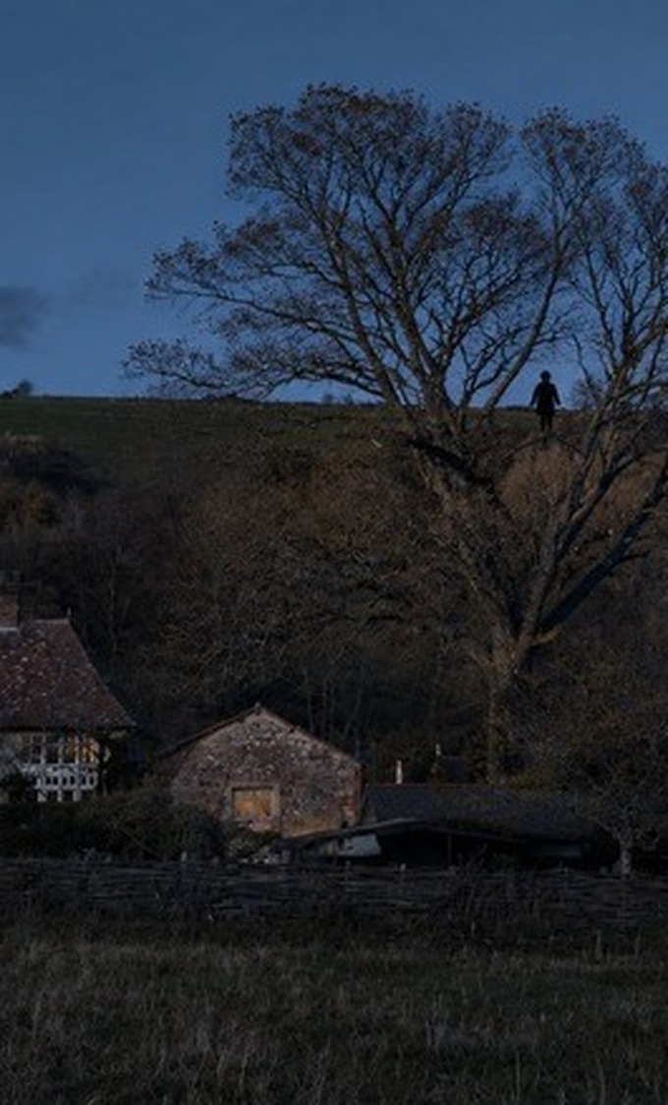
THE DARKER SIDE OF WIGHT × THE GARLIC FARM
The next step: a walk round the farm
A short site walk answers four questions, and then IsleConnect issues one fixed-scope proposal and price.
Audience
Priority
Which visitors should the first experience serve?
Which action matters most: shop, restaurant, book or return visit?
Route
Timing
Which three spots work without disrupting operations?
When should it launch, and at which level?
David Grannum, IsleConnect
david@isleconnect.co.uk · 07496 902449 · www.isleconnect.co.uk
Simon Harrop, Medina Publishing
15
Notes:
The next step is simple and commits you to nothing: a walk round the farm with David, Pete and me.
On that walk we'd answer four questions. Who is this for? What matters most commercially: the shop, the restaurant or return visits? Which three spots work without getting in anyone's way? And when should it launch, and at which level?
After that, David will send one fixed-scope proposal and price for you to consider. Could we put a date in the diary for the walk?

