Slide 1
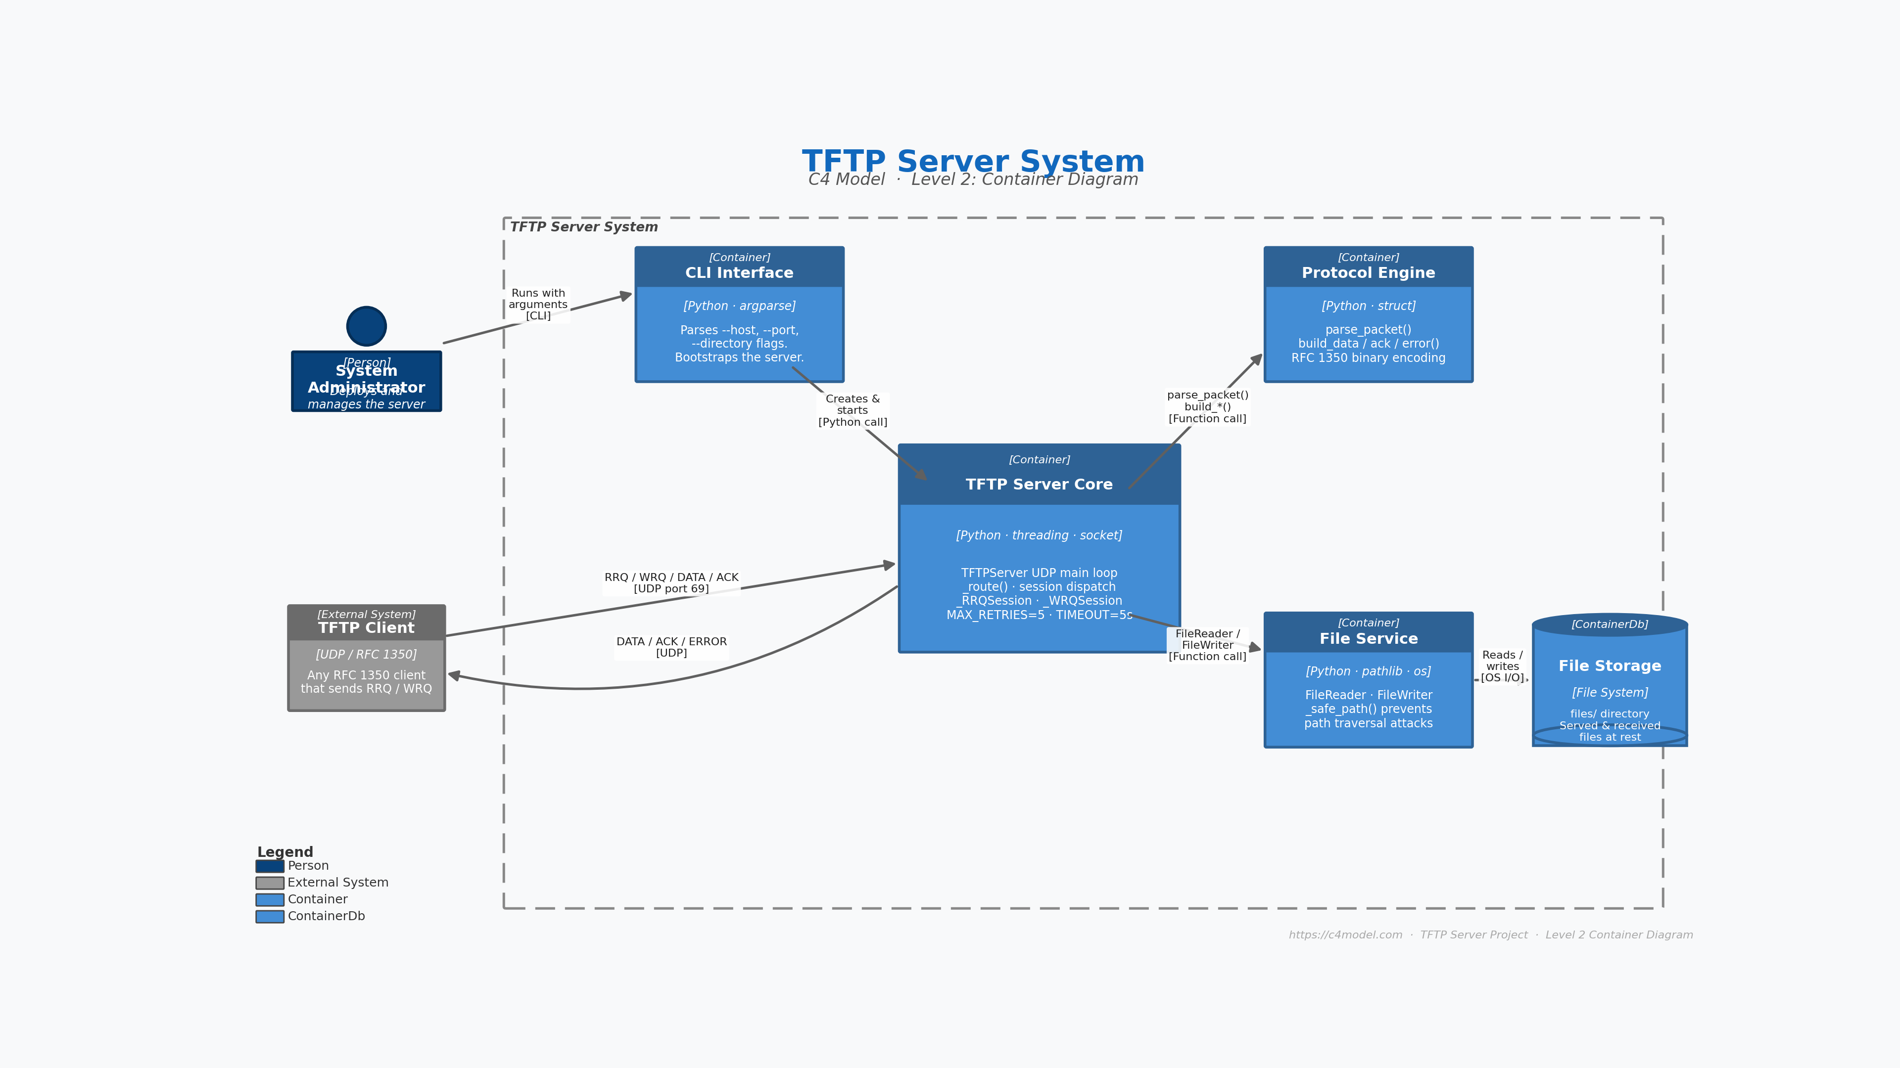

Slide 2
[Person]
System Administrator
Description
The human actor who deploys, configures, and operates the TFTP Server. Interacts exclusively through the CLI Interface.
Technology
Terminal / SSH
Code File
server.py (entry point, main())
Key Details
• Provides --host, --port, --directory flags at startup • Monitors server log output on stdout • Stops the server via KeyboardInterrupt (Ctrl+C)
C4 Model · Level 2 Container Diagram · TFTP Server | c4model.com

Slide 3
[External System]
TFTP Client
Description
Any external application that implements the TFTP protocol (RFC 1350). Initiates file transfers by sending RRQ (read) or WRQ (write) datagrams to the server's UDP port.
Technology
UDP / RFC 1350
Code File
External – not part of this codebase
Key Details
• Examples: tftp(1) CLI, curl --tftp-*, network boot loaders (PXE) • Connects to UDP port 69 by default (configurable) • Session TID (Transfer ID) is a random ephemeral port per transfer
C4 Model · Level 2 Container Diagram · TFTP Server | c4model.com

Slide 4
[Container · Python / argparse]
CLI Interface
Description
Parses command-line arguments, validates the root directory, initialises the Python logger and instantiates TFTPServer. Acts as the application entry point and lifecycle manager.
Technology
Python 3 · argparse · logging
Code File
server.py · src/cli.py
Key Details
• parse_args() → Namespace(host, port, directory) • validate_directory() raises ArgumentTypeError on invalid path • main() wires logging, args and TFTPServer.start() • Catches KeyboardInterrupt for graceful shutdown
C4 Model · Level 2 Container Diagram · TFTP Server | c4model.com

Slide 5
[Container · Python / threading]
TFTP Server Core
Description
The central container of the system. Runs a UDP socket loop, routes incoming datagrams to existing sessions or spawns new ones, and manages concurrent transfers via a thread-per-session model.
Technology
Python 3 · socket · threading · queue
Code File
src/tftp_server.py
Key Details
• TFTPServer.start() — binds UDP socket, receives datagrams in a loop • _route(data, addr) — dispatches packets: new session or queued message • _RRQSession.run() — handles file downloads (send DATA, wait ACK) • _WRQSession.run() — handles file uploads (receive DATA, send ACK) • MAX_RETRIES=5, SESSION_TIMEOUT=5 s per block • Thread-safe session registry: dict[addr → Queue] + threading.Lock
C4 Model · Level 2 Container Diagram · TFTP Server | c4model.com

Slide 6
[Container · Python / struct]
Protocol Engine
Description
Encodes and decodes all TFTP binary packets according to RFC 1350. Stateless pure-function module; contains all opcode constants and error code definitions.
Technology
Python 3 · struct (binary packing)
Code File
src/protocol.py
Key Details
• Opcodes: OP_RRQ=1, OP_WRQ=2, OP_DATA=3, OP_ACK=4, OP_ERROR=5 • parse_packet(data) → dict dispatches to _parse_request/data/ack/error • build_rrq/wrq/data/ack/error() return bytes ready to sendto() • BLOCK_SIZE = 512 bytes; is_last_block() checks len < 512 • Supported modes: netascii · octet · mail • Custom TFTPError exception carries RFC error codes
C4 Model · Level 2 Container Diagram · TFTP Server | c4model.com

Slide 7
[Container · Python / pathlib]
File Service
Description
Provides safe, validated file I/O for the server. FileReader streams a file in 512-byte blocks for RRQ transfers. FileWriter atomically persists received blocks for WRQ transfers. _safe_path() prevents path-traversal attacks.
Technology
Python 3 · pathlib · os
Code File
src/file_service.py
Key Details
• FileReader.next_block() → (block_num, bytes≤512); supports context mgr • FileWriter.write_block(payload); abort() deletes partial file on error • _safe_path() resolves symlinks and rejects paths outside root_dir • Raises TFTPError(ERR_ACCESS_VIOLATION) on traversal attempt • Raises TFTPError(ERR_FILE_NOT_FOUND / ERR_FILE_EXISTS) as appropriate • Raises TFTPError(ERR_DISK_FULL) when OSError occurs during write
C4 Model · Level 2 Container Diagram · TFTP Server | c4model.com

Slide 8
[ContainerDb · File System]
File Storage
Description
The persistent data store. A directory on the local file system designated at startup via --directory. Files within this directory can be downloaded (RRQ) or uploaded (WRQ) by TFTP clients.
Technology
File System (ext4 / any POSIX FS)
Code File
files/ (default directory; configurable)
Key Details
• Read by FileReader during RRQ (download) sessions • Written by FileWriter during WRQ (upload) sessions • No file may be overwritten — FileWriter enforces no-clobber policy • Symlinks are resolved before path validation (no escaping root) • Permissions checked at open-time (read/write access)
C4 Model · Level 2 Container Diagram · TFTP Server | c4model.com

Slide 9
[Container → Container | C4 Level 2]
Relationships · Arrows
From
To
Label
Technology
System Administrator
CLI Interface
Runs with arguments
CLI / shell
CLI Interface
TFTP Server Core
Creates & starts server
Python function call
TFTP Client
TFTP Server Core
RRQ / WRQ / DATA / ACK
UDP port 69 (RFC 1350)
TFTP Server Core
TFTP Client
DATA / ACK / ERROR
UDP
TFTP Server Core
Protocol Engine
parse_packet() / build_*()
Python function call
TFTP Server Core
File Service
FileReader / FileWriter
Python function call
File Service
File Storage
Reads / writes files
OS I/O (pathlib)
C4 Model · Level 2 Container Diagram · TFTP Server | c4model.com

