Slide 1
Intro to Data Science | Long assignment 2023/2024 - Churn problem
Davi Santos (UP202310061)
Ana Isabel

Slide 2
Business understanding
Customer churn is a critical event for service providers, influencing business decisions and prompting actions for customer retention. To gain valuable insights into churn events, leveraging machine learning models becomes essential. These models can predict whether a customer is likely to churn, enabling proactive measures for customer retention. The results of these models can inform targeted campaigns, among other strategic initiatives.
Business Problem: This report addresses the prediction of customer churn in a telecommunications service. The churn target variable is binary, with "yes" indicating customers who have abandoned the service and "no" for those who have not.
Machine Learning Problem: Predicting churn is a classification problem, determining whether a user is likely to abandon the service or not. This poses a challenge due to the imbalanced distribution of classes, with the minority of customers tending to churn. To address this, we will explore various approaches and models to identify the most effective solution in this scenario.

Slide 3
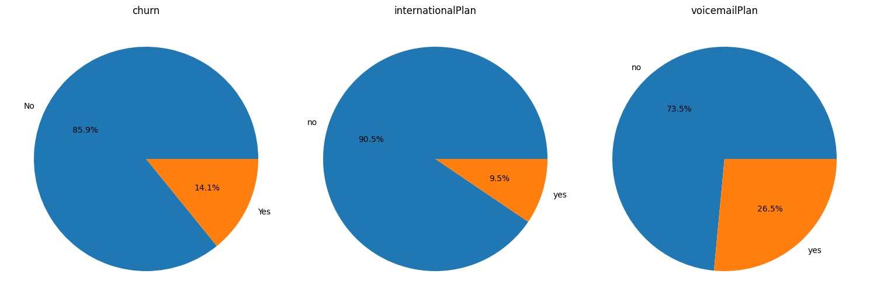
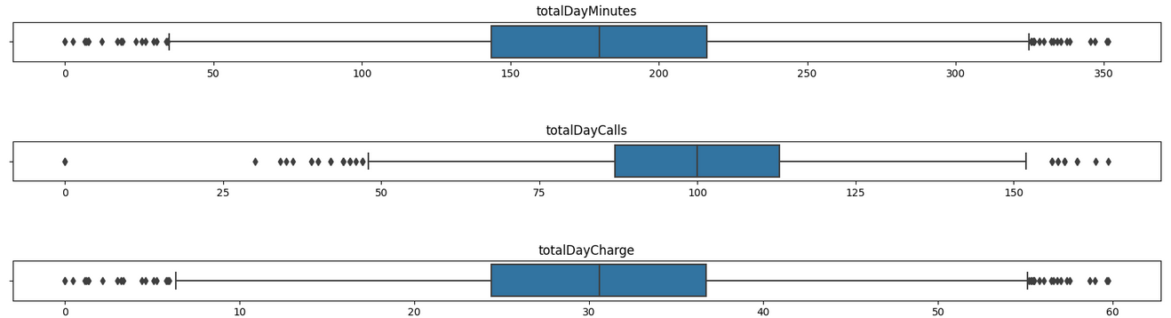
Data Understanding
The dataset contains 5000 entries and 18 variables, one of them is “churn” the target variable which is binary.
The target variable (churn) and the other categorical variables have imbalanced binary classes.
The other features are numerical
There are no unrealistic outliers

Slide 4
Data preparation
Data cleaning:
- We cleaned the decimal houses of the features to avoid values with up to 10 decimal houses, to avoid noise.
- In order to do the correlation analysis, we needed to encode the categorical data into integers, so yes = 1 and no = 0
Data transforming:
- The NA values are very few. We analysed the distribution of the number of NAs on churn = yes and we concluded that it was ~ 16%. We decided that it was low enough to drop them.
- We compared the distribution before and after we dropped the NAs and we concluded that it stayed mostly the same, so we could move on to the next steps
- To drop unnecessary features (if they exist), we need to do the correlation analysis. We saw that some were very correlated and between each pair of features, we sticked to the one that correlates more with churn.

Slide 5
Modeling
Considering we have an classification problem with imbalanced dataset, some classification models can perform better in this case. We will test the listed models and evaluate their performance:
k-Nearest Neighbors (kNN): Uses the distance measure between the points considering k neighbors. It requires data normalization, so can be adopted for our problem.
Naive Bayes: Class-conditional independence (analyse features correlation), assumes Gaussian distribution for continuous features. Can be not a good approach for our problem, need further evaluation.
Decision Trees (DT): Very good for data with low resolution, high granularity. (High information gain in the events), hyperparameters have high significance. This models can have good performance in the imbalanced datasets depending on the entropy of the features/labels.
Tree ensembles: Ensembles can boost the performance of the Decision Trees since it replicates and evaluate DT models iteratively giving weights to the best models along the iterations.
Support Vector Classifier (SVC): Use the SVM to create and evaluate functions that can separate the data into classes.
Neural Network Classifier (Multi-layer Perceptron Classifier): Use multi-layer weighted neural network to find the best weighted nodes for data classification. Requires normalization and has high computational cost. Have many hyperparameters that can be tuned, but as previously mentioned it is costly.

Slide 6
Cross-Validation and SMOTE
The usage of SMOTE can tune the classification models performance in imbalance dataset situations. We could validate it after some examples with and without SMOTE in the train fold of Cross-Validation.
Important points to consider about SMOTE and Cross-Validation in imbalanced dataset:
The Cross-Validation can be done using StratifiedKFold, to ensure the maintenance of class distribution (imbalanced) in the validation fold;
The SMOTE must be done only in the train fold of Cross Validation;
Hold-out:
80% Train / 20% Test - higher amount to use Cross-Validation as first model filtering approach.
SMOTE the Train dataset only after the Cross-Validation phase.

Slide 7
Cross-Validation and SMOTE
Improvement in the capacity of catch the True Positive cases (Churn cases) represented by the recall metric. Trade off is reduction of precision.
model | train_smote | CV_train_smote | CV_mean_accuracy | CV_mean_recall | CV_mean_precision | CV_mean_f1
kNN | False | False | 90,88% | 53,85% | 74,33% | 62,04%
kNN | False | True | 84,93% | 77,54% | 47,80% | 59,04%
kNN20 | False | False | 90,94% | 42,20% | 87,55% | 56,07%
kNN20 | False | True | 86,15% | 82,85% | 50,64% | 62,69%
kNN68 | False | False | 89,48% | 26,95% | 94,16% | 41,34%
kNN68 | False | True | 86,36% | 86,26% | 51,11% | 64,01%

Slide 8
Model selection
Considering the importance of the Recall and F1 scores to our business goals, we can already define few models to proceed with the full train and evaluation:
KNeighborsClassifier(n_neighbors=68);
RandomForestClassifier(max_depth=5, ccp_alpha=0.0015,random_state=3);
DecisionTreeClassifier(random_state=3,ccp_alpha=0.0015);
MLPClassifier().
model | train_smote | CV_train_smote | CV_mean_accuracy | CV_mean_recall | CV_mean_precision | CV_mean_f1 | test_accuracy | test_recall | test_precision | test_f1
kNN68 | True | True | 86,06% | 85,17% | 50,45% | 63,27% | 87,89% | 85,59% | 54,30% | 66,45%
RandomForest | True | True | 85,85% | 83,05% | 50,05% | 62,35% | 88,60% | 84,75% | 56,18% | 67,57%
DecisionTree | True | True | 86,89% | 81,58% | 52,81% | 63,85% | 88,95% | 80,51% | 57,58% | 67,14%
MLPClassifier | True | True | 85,32% | 85,17% | 48,93% | 62,06% | 86,46% | 83,90% | 51,03% | 63,46%

Slide 9
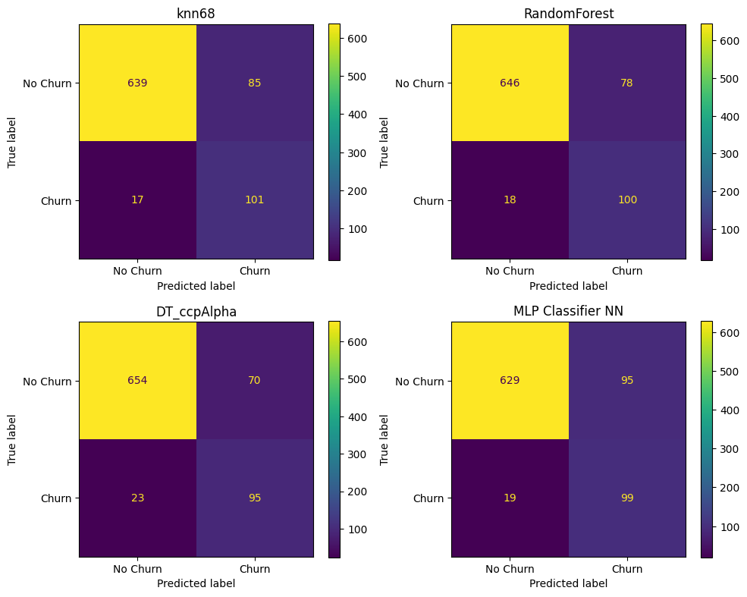
Evaluation and Main Conclusions
Models Evaluation:
The Random Forest using specific parameters (ccp_alpha=0.0015, max_depth=5, n_estimators=200) exposed slightly better performance when compared with the other selected models, evaluating by F1 and accuracy.
However, the DT, the kNN and the MLPClassifer also shown very good performances.

Slide 10
Evaluation and Main Conclusions
Mis-classification Problem:
The class False Positive (No churn predicted as Churn) is the one which results in more mis-classifications. It can be caused by the imbalanced dataset problem. The models can be good to predict the Churn cases, but they are not precise in the sense that we have high amount of False Positives.
Machine Learning and Business problems resolution:
The RandomForest had the best performance overall.
Depending on the business problem, the mis-classifications of specific classes can be critical or not, in our case would be needed a business evaluation to define what is the priority:
offer more customer retention campaigns with lower precision and hit more clients;
offer less campaigns with more precision, considering miss more risky clients in the campaigns.
That would involve the decision considering campaigns cost vs. impact of churn clients in the loss of revenue.

Slide 11
Evaluation and Main Conclusions
In summary
In summary, with this project we could find a models with good performance in the classification problem considering imbalanced dataset and also understand the some constraints of this kind of problem:
The understanding of business goal/machine learning goal is important to define the evaluation metrics we will use;
The analysis of NAs, class distribution, outliers, feature redundancy are important in the data preprocessing for this kind of problems;
The holdout definition considering the strategy of model selection and the amount of models tested;
The importance of Stratification in the holdout split and also in the Cross-Validation for effective model evaluation in the imbalanced scenario;
The correct understanding of effects of oversampling in the Cross-Validation step (it need to be performed only in the train fold).
The model evaluation considering the business goal/machine learning problem.
SMOTE improved the Recall and F1 for all the models. Any of these models could be choose to resolve our Machine Learning problem:
the Random Forest exposed the best F-score (67,57%), the best accuracy (88,60%) and good recall (84,75%);
the kNN68 was the model with more balanced high scores. It had good F-score (66,45%), good accuracy (87,89%) and the best recall (85,59%).
Still way for improvement:
These models still being able to be optimized. There are several possibilities to try to enhance the models performance, such as try the data imputation strategies, outlier handling, hyperparameter tuning (by using a GridSearch for example), etc.

