Slide 1
Substrate 区块链应用开发
孙凯超
kaichao@parity.io
获取帮助: https://substrate.io
交易费用和权重

Slide 2
内容
交易费用的存在原因
设计思路
组成部分
FRAME 模块导读

Slide 3

存在原因 - Web 2.0
服务提供方利用用户的个人信息、产生的数据、注意力等来变现：
广告推送；
用户数据分析指导商家决策；
直接共享、贩卖用户隐私等。
** 用户数据的所有者是服务提供方
Notes:
HW:
Substrate provides you with everything you need
to run a blockchain out of the box.
A database layer, networking layer, consensus engine, transaction queue, and libraries of runtime modules
But if you need to, you can choose to customize
Each of these components for your specific needs

Slide 4

存在原因 - Web 3.0
用户通过私钥掌握数据，敏感数据可以通过加密防止被窃取。
Notes:
HW:
Let’s dive more into Substrate
Substrate is an
open source
Modular
and extensible
FRAMEWORK for building blockchains…

Slide 5
存在原因 - Web 3.0
天下没有免费的午餐，享受自由也要支付服务费用，用来：
激励参与方更加有效的协作；
调节资源的利用率
团队
节点
用户
Notes:
HW:
Substrate provides you with everything you need
to run a blockchain out of the box.
A database layer, networking layer, consensus engine, transaction queue, and libraries of runtime modules
But if you need to, you can choose to customize
Each of these components for your specific needs

Slide 6
如何设计交易费用
典型的资源限制：
不同地区带宽差异巨大
有限的区块大小
有限的区块生成时间
昂贵的链上存储空间
如何分配交易费用
Notes:
HW:
Substrate provides you with everything you need
to run a blockchain out of the box.
A database layer, networking layer, consensus engine, transaction queue, and libraries of runtime modules
But if you need to, you can choose to customize
Each of these components for your specific needs

Slide 7
如何设计交易费用
典型的资源限制：
不同地区带宽差异巨大
有限的区块大小
有限的区块生成时间
昂贵的链上存储空间
如何分配交易费用
可用的设计思路：
计算每笔交易占用的字节数来收取费用
计算或者性能测试得出不同交易所消耗的时间
一次性付费和租赁两种模式
通过链上治理进行分配
Notes:
HW:
Substrate provides you with everything you need
to run a blockchain out of the box.
A database layer, networking layer, consensus engine, transaction queue, and libraries of runtime modules
But if you need to, you can choose to customize
Each of these components for your specific needs

Slide 8
Substrate 交易费用组成
总费用 = 基本费用 + 字节费用 + 权重费用 * 动态调节费率 + 小费
Notes:
HW:
Substrate provides you with everything you need
to run a blockchain out of the box.
A database layer, networking layer, consensus engine, transaction queue, and libraries of runtime modules
But if you need to, you can choose to customize
Each of these components for your specific needs

Slide 9
Substrate 交易费用组成
总费用 = 基本费用 + 字节费用 + 权重费用 * 动态调节费率 + 小费
参数：
ExtrinsicBaseWeight
125 * WEIGHT_PER_MICROS
MaximumBlockWeight
2 * WEIGHT_PER_SECOND
WeightToFee
Notes:
HW:
Substrate provides you with everything you need
to run a blockchain out of the box.
A database layer, networking layer, consensus engine, transaction queue, and libraries of runtime modules
But if you need to, you can choose to customize
Each of these components for your specific needs

Slide 10
字节费用
总费用 = 基本费用 + 字节费用 + 权重费用 * 动态调节费率 + 小费
参数和特点：
字节数是SCALE编码后的长度
最大区块长度MaximumBlockLength
每字节的费用TransactionByteFee
配置在可升级的runtime代码
字节费用 = 每字节费用 * 字节数
Notes:
HW:
Substrate provides you with everything you need
to run a blockchain out of the box.
A database layer, networking layer, consensus engine, transaction queue, and libraries of runtime modules
But if you need to, you can choose to customize
Each of these components for your specific needs

Slide 11
字节费用
总费用 = 基本费用 + 字节费用 + 权重费用 * 动态调节费率 + 小费
参数和特点：
字节数是SCALE编码后的长度
最大区块长度MaximumBlockLength
每字节的费用TransactionByteFee
配置在可升级的runtime代码
字节费用 = 每字节费用 * 字节数
** Kusama网络：5MB，0.0001ksm
Notes:
HW:
Substrate provides you with everything you need
to run a blockchain out of the box.
A database layer, networking layer, consensus engine, transaction queue, and libraries of runtime modules
But if you need to, you can choose to customize
Each of these components for your specific needs

Slide 12
权重费用
总费用 = 基本费用 + 字节费用 + 权重费用 * 动态调节费率 + 小费
权重被用来定义交易产生的计算复杂度：
区块的总权重 MaximumBlockWeight
两种不同级别的交易类型
Normal
Operational
可用区块比 AvailableBlockRatio
三种设置权重的方式：固定，自定义，FunctionOf
** Kusama网络：区块的总权重 2,000,000,000,000；可用区块比：75%
Notes:
HW:
Substrate provides you with everything you need
to run a blockchain out of the box.
A database layer, networking layer, consensus engine, transaction queue, and libraries of runtime modules
But if you need to, you can choose to customize
Each of these components for your specific needs

Slide 13
固定权重
// 固定权重的Normal交易
#[weight = 10_000]
fn accumulate_dummy(origin, increase_by: T::Balance) -> DispatchResult {
// --snip--
}
// 固定权重的Operational交易
#[weight = (2_000_000, Operational)]
fn accumulate_dummy(origin, increase_by: T::Balance) -> DispatchResult {
// --snip--
}
Notes:
HW:
Substrate provides you with everything you need
to run a blockchain out of the box.
A database layer, networking layer, consensus engine, transaction queue, and libraries of runtime modules
But if you need to, you can choose to customize
Each of these components for your specific needs

Slide 14
自定义权重
自定义权重计算方法，自定义的结构体，并实现接口：
WeighData，计算权重
ClassifyDispatch，判断交易级别
PaysFee，设置是否付费标志位
Notes:
HW:
Substrate provides you with everything you need
to run a blockchain out of the box.
A database layer, networking layer, consensus engine, transaction queue, and libraries of runtime modules
But if you need to, you can choose to customize
Each of these components for your specific needs

Slide 15
自定义权重
// The struct with a multiplier
struct WeightForSetDummy<T: pallet_balances::Trait>(BalanceOf<T>);
/// A type alias for the balance type.
type BalanceOf<T> = <T as pallet_balances::Trait>::Balance;
impl<T: pallet_balances::Trait> WeighData<(&BalanceOf<T>,)> for WeightForSetDummy<T>
{
fn weigh_data(&self, target: (&BalanceOf<T>,)) -> Weight {
let multiplier = self.0;
(*target.0 * multiplier).saturated_into::<Weight>()
}
}
Notes:
HW:
Substrate provides you with everything you need
to run a blockchain out of the box.
A database layer, networking layer, consensus engine, transaction queue, and libraries of runtime modules
But if you need to, you can choose to customize
Each of these components for your specific needs

Slide 16
自定义权重
impl<T: pallet_balances::Trait> ClassifyDispatch<(&BalanceOf<T>,)> for WeightForSetDummy<T> {
fn classify_dispatch(&self, target: (&BalanceOf<T>,)) -> DispatchClass {
if *target.0 > <BalanceOf<T>>::from(1000u32) {
DispatchClass::Operational
} else {
DispatchClass::Normal
}
}
}
impl<T: pallet_balances::Trait> PaysFee<(&BalanceOf<T>,)> for WeightForSetDummy<T> {
fn pays_fee(&self, _target: (&BalanceOf<T>,)) -> Pays {
Pays::Yes
}
}
Notes:
HW:
Substrate provides you with everything you need
to run a blockchain out of the box.
A database layer, networking layer, consensus engine, transaction queue, and libraries of runtime modules
But if you need to, you can choose to customize
Each of these components for your specific needs

Slide 17
自定义权重
如何使用：
// Apply weight to dispatchable call
#[weight = WeightForSetDummy::<T>(<BalanceOf<T>>::from(100u32))]
fn set_dummy(origin, #[compact] new_value: T::Balance) {
// --snip--
}}
Notes:
HW:
Substrate provides you with everything you need
to run a blockchain out of the box.
A database layer, networking layer, consensus engine, transaction queue, and libraries of runtime modules
But if you need to, you can choose to customize
Each of these components for your specific needs

Slide 18
FunctionOf 结构体
FunctionOf 接收三个参数：
权重值或根据参数计算权重的closure
固定交易级别或计算交易级别的closure
是否付费的标志位或closure
Notes:
HW:
Substrate provides you with everything you need
to run a blockchain out of the box.
A database layer, networking layer, consensus engine, transaction queue, and libraries of runtime modules
But if you need to, you can choose to customize
Each of these components for your specific needs

Slide 19
FunctionOf 结构体
// weight = a x 10 + b
#[weight = FunctionOf(|args: (&u32, &u32)| args.0 * 10 + args.1, DispatchClass::Normal, Pays::Yes)]
fn f1(_origin, _a: u32, _b: u32) { unimplemented!(); }
#[weight = FunctionOf(|_: (&u32, &u32)| 0, DispatchClass::Operational, Pays::Yes)]
fn f2(_origin, _a: u32, _b: u32) { unimplemented!(); }
Notes:
HW:
Substrate provides you with everything you need
to run a blockchain out of the box.
A database layer, networking layer, consensus engine, transaction queue, and libraries of runtime modules
But if you need to, you can choose to customize
Each of these components for your specific needs

Slide 20
权重费用
总费用 = 基本费用 + 字节费用 + 权重费用 * 动态调节费率 + 小费
权重被用来定义交易产生的计算复杂度：
合理的权重值需要通过性能测试来获取
可调用函数的注释中要给出计算复杂度和数据读写操作
通过WeightToFee，转换权重值为权重费用
Notes:
HW:
Substrate provides you with everything you need
to run a blockchain out of the box.
A database layer, networking layer, consensus engine, transaction queue, and libraries of runtime modules
But if you need to, you can choose to customize
Each of these components for your specific needs

Slide 21
权重费用
pub struct WeightToFee;
impl WeightToFeePolynomial for WeightToFee {
type Balance = Balance;
fn polynomial() -> WeightToFeeCoefficients<Self::Balance> {
// -- snip --
}
}
Notes:
HW:
Substrate provides you with everything you need
to run a blockchain out of the box.
A database layer, networking layer, consensus engine, transaction queue, and libraries of runtime modules
But if you need to, you can choose to customize
Each of these components for your specific needs

Slide 22
动态调节费率
总费用 = 基本费用 + 字节费用 + 权重费用 * 动态调节费率 + 小费
网络平稳运行的过程中，区块资源的使用比例应该稳定：
TargetBlockFullness参数，通常为25%
当前区块资源使用超过25%时，将下一区块动态调节费率设置为正，增加交易费用；
当资源使用率不足25%时，将下一区块的动态调节费率设置为负，减少交易费用，鼓励交易的发生
Notes:
HW:
Substrate provides you with everything you need
to run a blockchain out of the box.
A database layer, networking layer, consensus engine, transaction queue, and libraries of runtime modules
But if you need to, you can choose to customize
Each of these components for your specific needs

Slide 23
小费
总费用 = 基本费用 + 字节费用 + 权重费用 * 动态调节费率 + 小费
不是必须的，具体数量由交易发送者决定，并且完全由区块生产者获得；
而交易费用的其它组成部分会根据一定的比例分配进入“国库”。
Notes:
HW:
Substrate provides you with everything you need
to run a blockchain out of the box.
A database layer, networking layer, consensus engine, transaction queue, and libraries of runtime modules
But if you need to, you can choose to customize
Each of these components for your specific needs

Slide 24
资料
代码： https://github.com/paritytech/substrate/tree/master/frame/example
https://github.com/kaichaosun/play-substrate/tree/master/pallets/weight
文档：
https://substrate.dev/docs/en/development/module/fees
https://zhuanlan.zhihu.com/p/108194544
Notes:
HW:
Substrate provides you with everything you need
to run a blockchain out of the box.
A database layer, networking layer, consensus engine, transaction queue, and libraries of runtime modules
But if you need to, you can choose to customize
Each of these components for your specific needs

Slide 25
FRAME 模块导读
system
timestamp
transaction-payment
utility
Notes:
HW:
Substrate provides you with everything you need
to run a blockchain out of the box.
A database layer, networking layer, consensus engine, transaction queue, and libraries of runtime modules
But if you need to, you can choose to customize
Each of these components for your specific needs

Slide 26
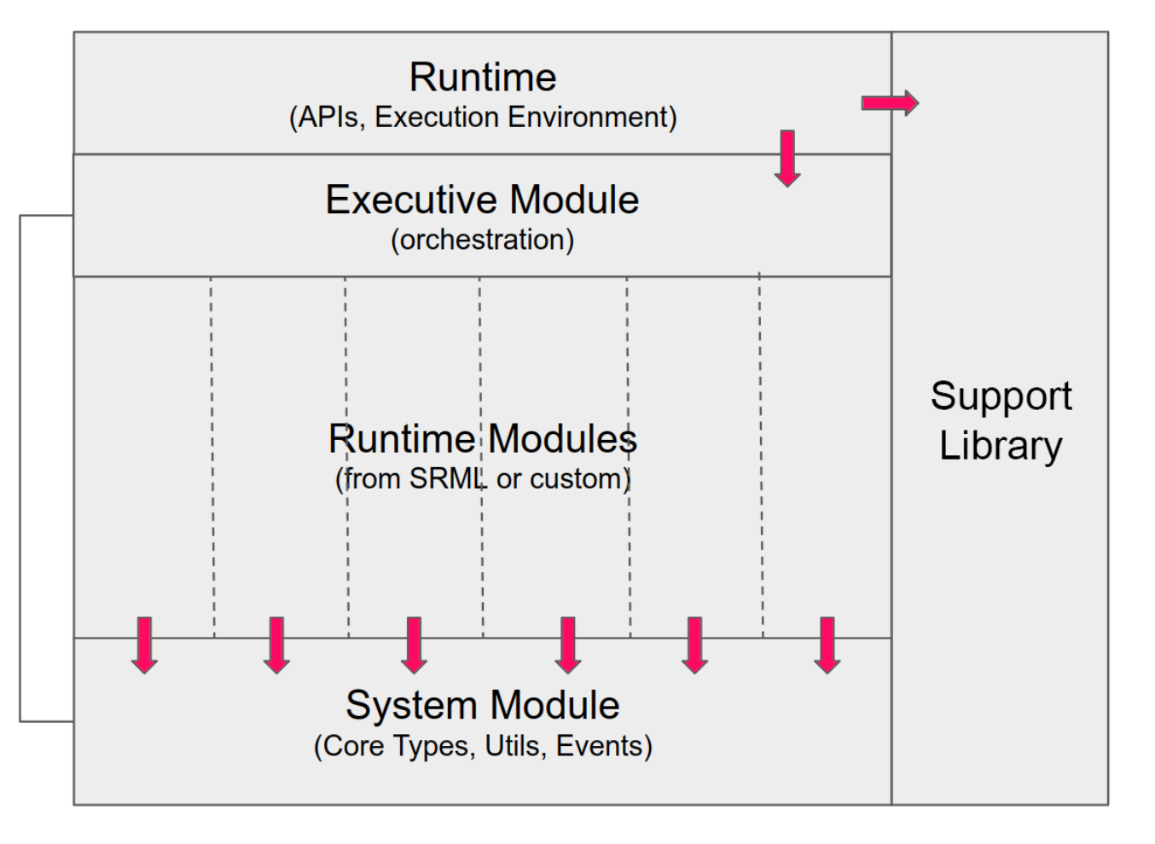
FRAME 组成
System: 底层 types, storages, functions
Support：宏, traits
Executive：runtime编排层
Pallets：功能模块

Slide 27
Questions?
官网文档：substrate.io 知乎专栏：parity.link/zhihu
kaichao@parity.io
kaichaosun

