Slide 1
Computer Network
Author: Liu Xianzhong
Email: xzliu@sei.ecnu.edu.cn
Tel:62235306 (数学馆215（东）)
13816697948
ECNU SEI

Slide 2
课程说明
教材
Andrew S.Tanenbaum，Computer Network（Fifth Edition），机械工业出版社，2011年 .
参考资料
《Data Communications Networking (5th Edition)》, Behrouz A.Forouzan, McGraw-Hill, 2013.
《Computer Networking: A Top-Down Approach (6th Edition)》, James F. Kurose and Keith W. Ross, Addison Wesley, 2012.
《计算机网络(第6版)》,谢希仁,电子工业出版社, 2013.
《Computer Networks: A Systems Approach (5th Edition)》， Larry L.Peterson, Bruce S.Davie， Morgan Kaufmann, 2012.
《Network Consultants Handbook (Cisco Press Networking Technology)》，Matthew J Castelli ，Ciso Press，2001.
其他学习资源
IEEE Communication Mag. http://www.comsoc.org/commag
ACM SIGCOMM. http://www.sigcomm.org/events/sigcomm-conference
Reproducing Network Research network systems experiments made accessible, runnable, and reproducible. https://reproducingnetworkresearch.wordpress.com/

Slide 3
主要内容
计算机网络概述
物理层
数据链路层
媒介访问控制子层
网络层
传输层
应用层*

Slide 4
Chapter 1
Introduction

Slide 5
1.1 Uses of Computer Networks
Business Applications
Home Applications
Mobile Users
Social Issues

Slide 6
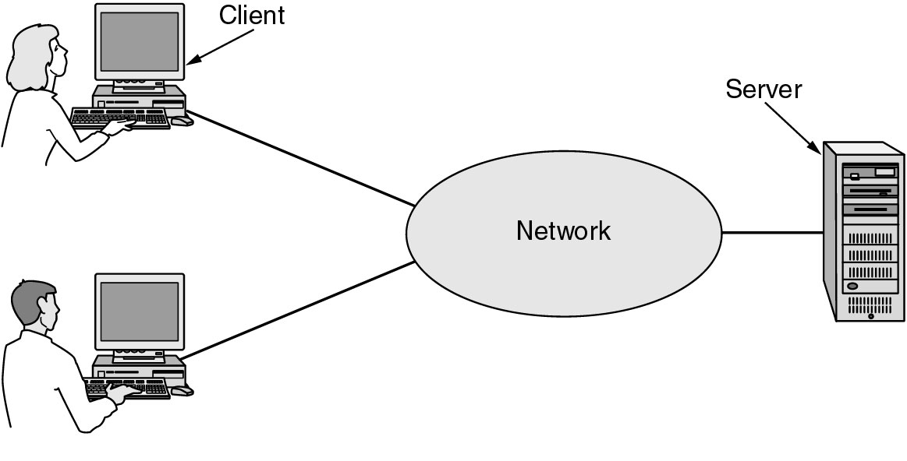
Business Applications of Networks
A network with two clients and one server.

Slide 7
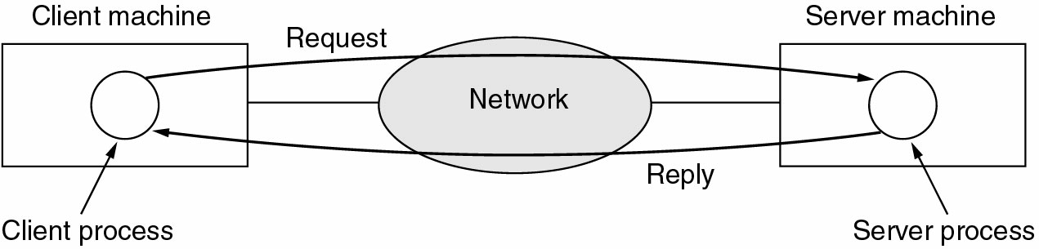
Business Applications of Networks (2)
The client-server model involves requests and replies.

Slide 8
Home Network Applications
Access to remote information
Person-to-person communication
Interactive entertainment
Electronic commerce

Slide 9
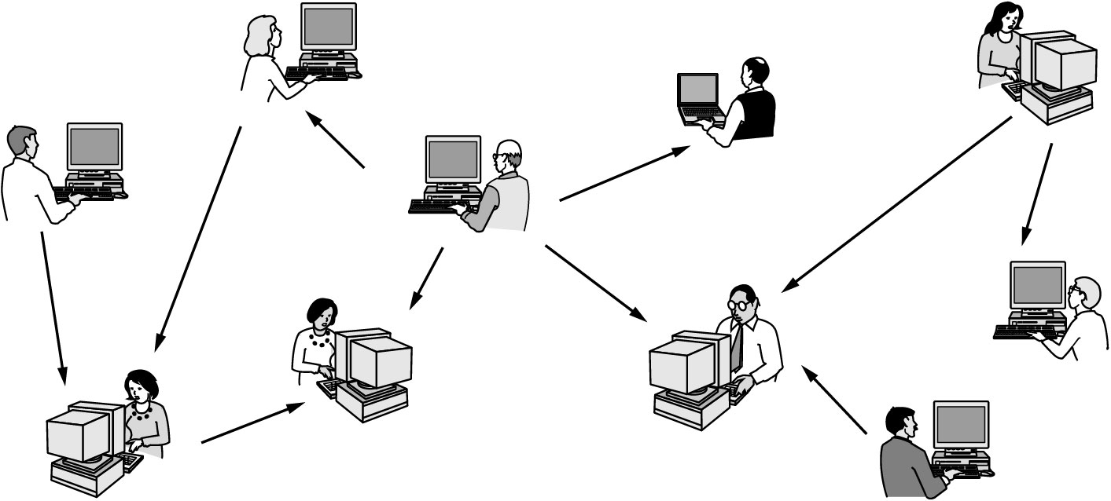
Home Network Applications (2)
In peer-to-peer(对等) system there are no fixed clients and servers.

Slide 10
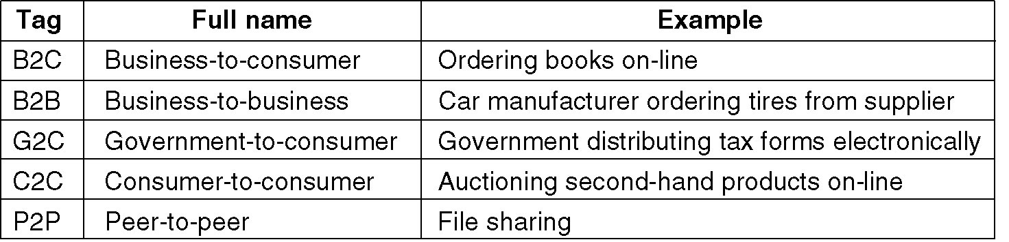
Home Network Applications (3)
Some forms of e-commerce.

Slide 11
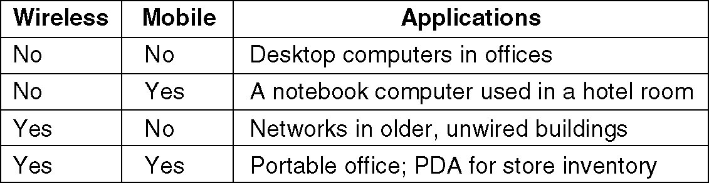
Mobile Network Users
Combinations of wireless networks and mobile computing.

Slide 12
1.2 Network Hardware
Local Area Networks
Metropolitan Area Networks
Wide Area Networks
Wireless Networks
Home Networks
Internetworks

Slide 13
Broadcast Networks(广播式网络)
Types of transmission technology
Broadcast links(广播式联接)
Point-to-point links(点-点联接)

Slide 14
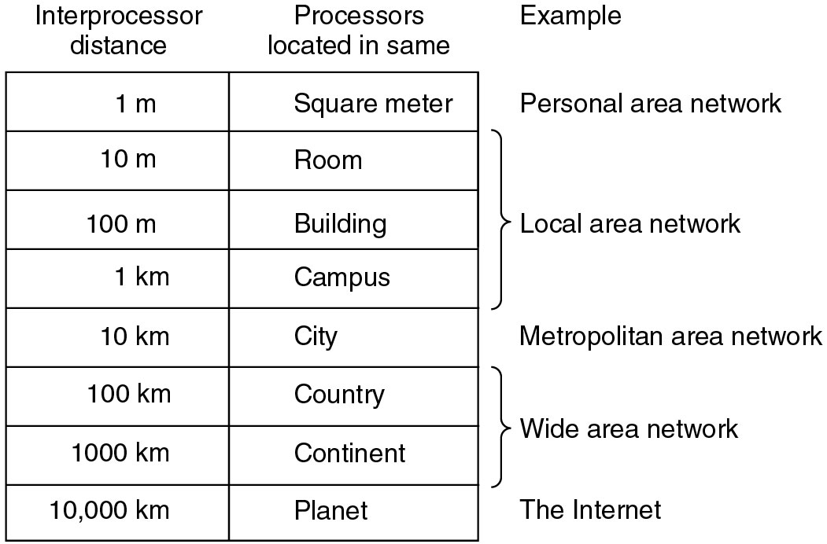
Classification of interconnected processors by scale

Slide 15
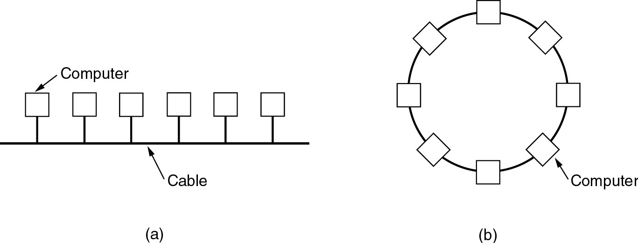
Local Area Networks
Two broadcast networks
(a) Bus (b) Ring

Slide 16
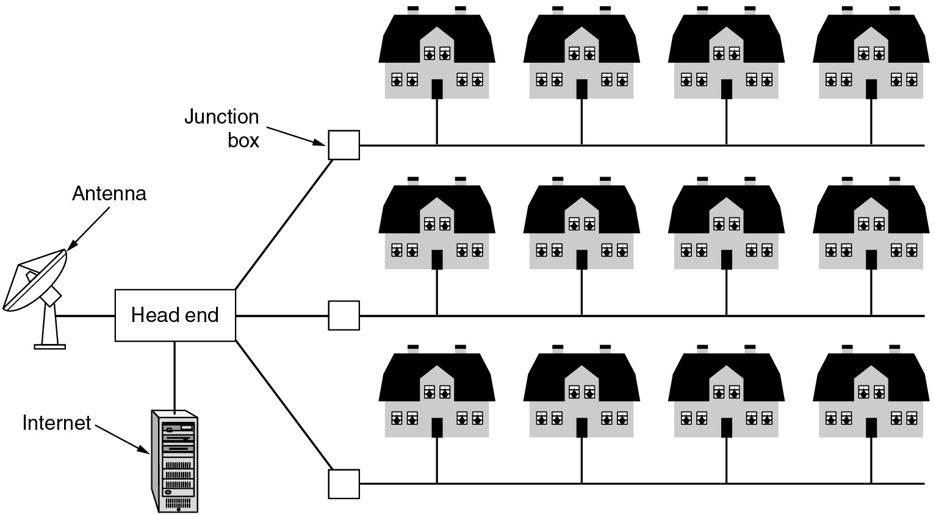
Metropolitan Area Networks
A metropolitan area network based on cable TV.

Slide 17
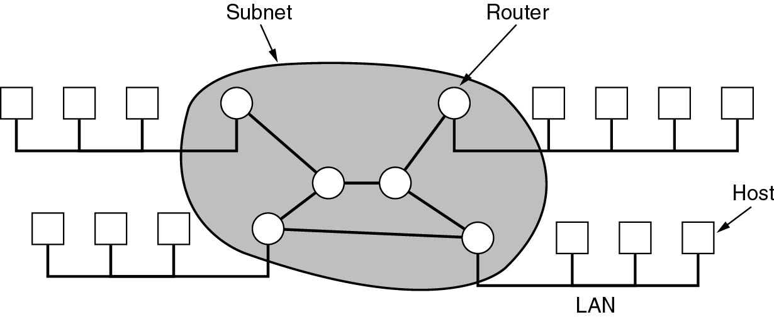
Wide Area Networks
Relation between hosts on LANs and the subnet.
Host/LAN/Router/Subnet

Slide 18
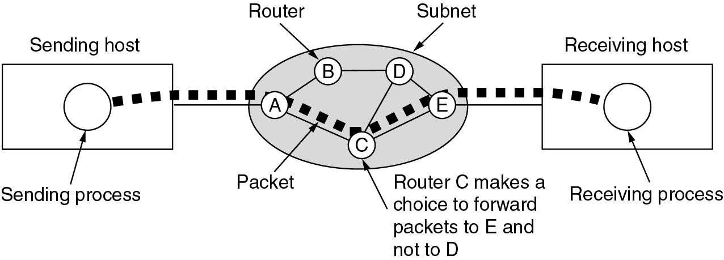
Wide Area Networks (2)
A stream of packets(分组) from sender to receiver.
Point-to-point
Store and Forward
Exchange

Slide 19
Wireless Networks
Categories of wireless networks:
System interconnection
Wireless LANs
Wireless WANs

Slide 20
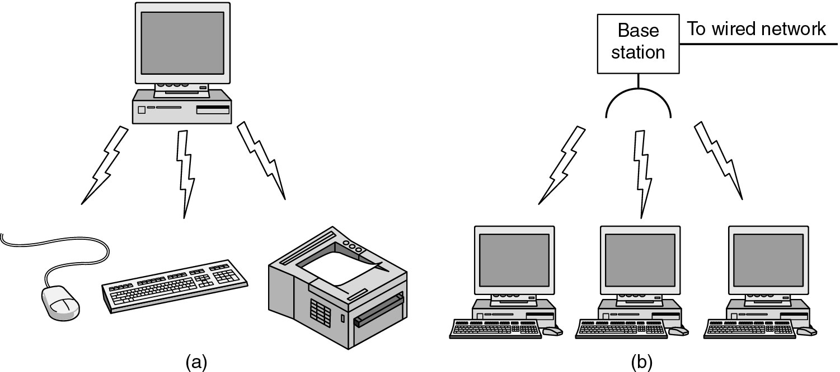
Wireless Networks (2)
(a) Bluetooth（蓝牙） configuration (b) Wireless LAN

Slide 21
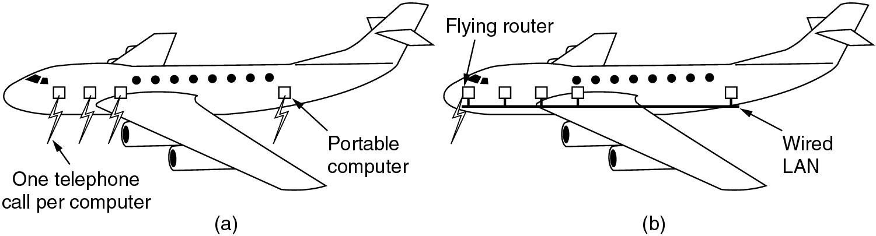
Wireless Networks (3)
(a) Individual mobile computers (b) A flying LAN

Slide 22
Home Network Categories
Computers (desktop PC, PDA, shared peripherals
Entertainment (TV, DVD, VCR, camera, stereo, MP3)
Telecomm (telephone, cell phone, intercom, fax)
Appliances (microwave, fridge, clock, furnace, airco)
Telemetry (utility meter, burglar alarm, babycam).

Slide 23
1.3 Network Software
Protocol Hierarchies
Design Issues for the Layers
Connection-Oriented and Connectionless Services
Service Primitives
The Relationship of Services to Protocols

Slide 24
Some Concepts
网络体系结构
完成计算机间的通信合作，把每个计算机互联的功能划分成有明确定义的层次，并规定同层次进程通信的协议及相邻层之间的接口服务
协议（Protocol）
协议就是为实现网络中的数据交换建立的规则标准或约定。协议由语法、语义和交换规则三部分组成，即协议的三要素。

Slide 25
接口(Interface)
分层结构中各相邻层之间要有一个接口，它定义了较低层向较高层提供的原始操作和服务。相邻层通过它们之间的接口交换信息，高层并不需要知道低层是如何实现的，仅需要知道该层通过层间的接口所提供的服务，这样使得两层之间保持了功能的独立性。

Slide 26
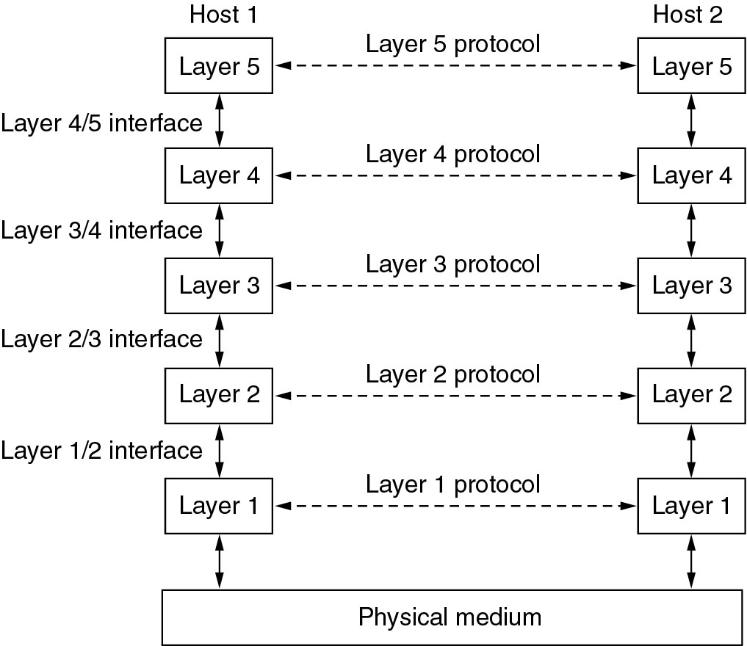
Network Software Protocol Hierarchies
Layers, protocols, and interfaces.

Slide 27
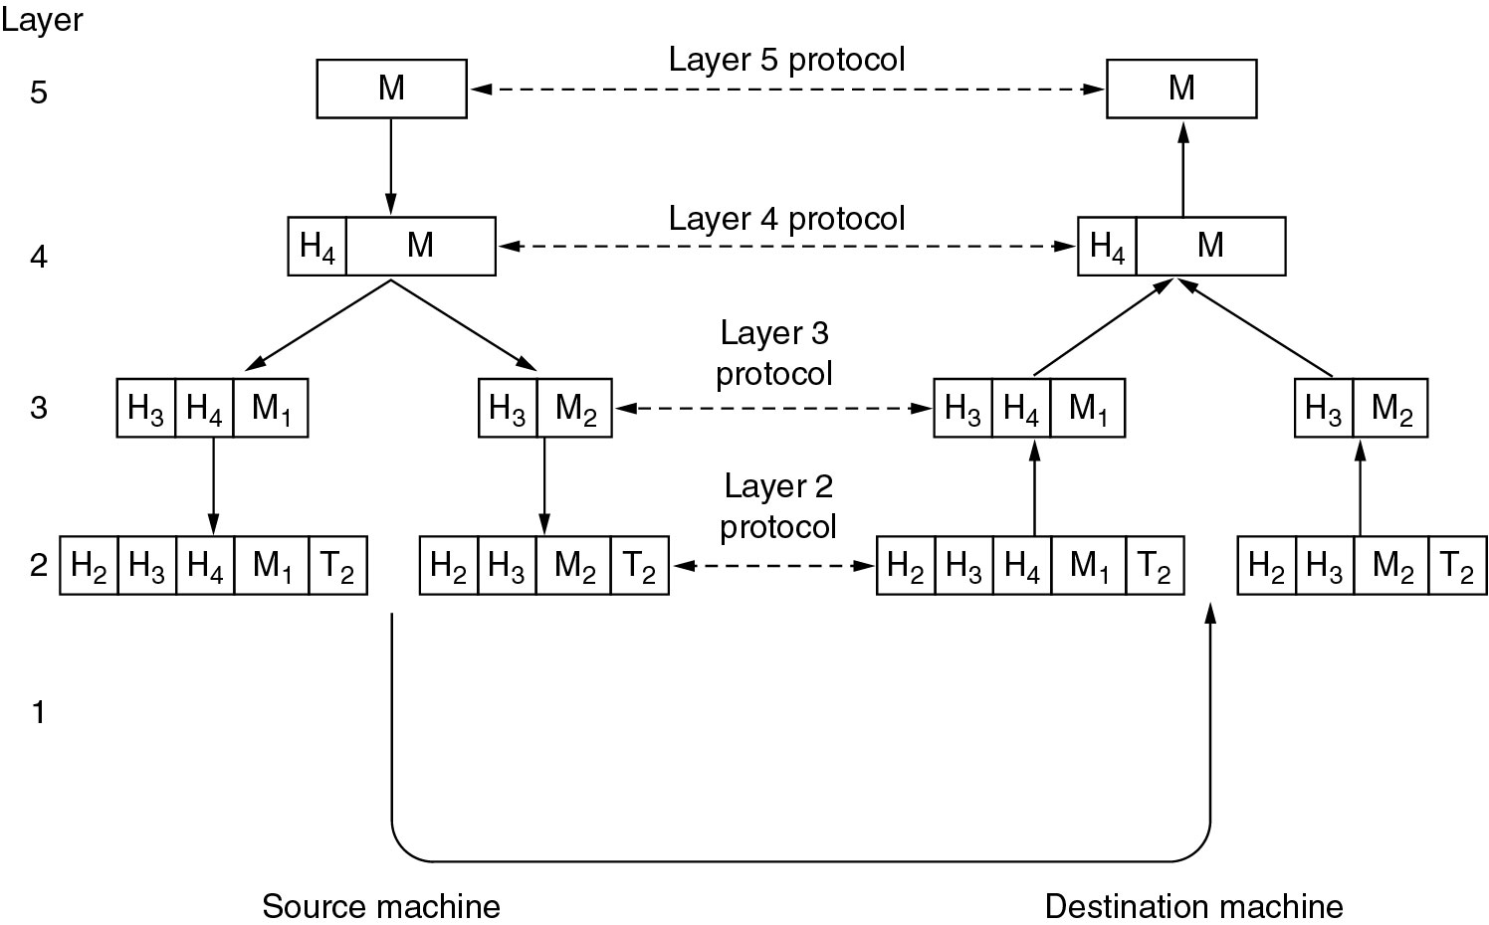
Protocol Hierarchies (3)
Example information flow supporting virtual communication in layer 5.

Slide 28
Design Issues for the Layers
Addressing(寻址)
Error Control(错误控制)
Flow Control(流量控制)
Multiplexing(复用技术)
Routing(路由)

Slide 29
Connection-Oriented and Connectionless Services(1)
Connection oriented service -
Like the phone system.
Connection Setup
Data Transfer
Connection Termination
Connectionless service -
Like the post office.
Each message has the entire address on it.
Each message may follow a different route to its destination.
Data Transfer

Slide 30
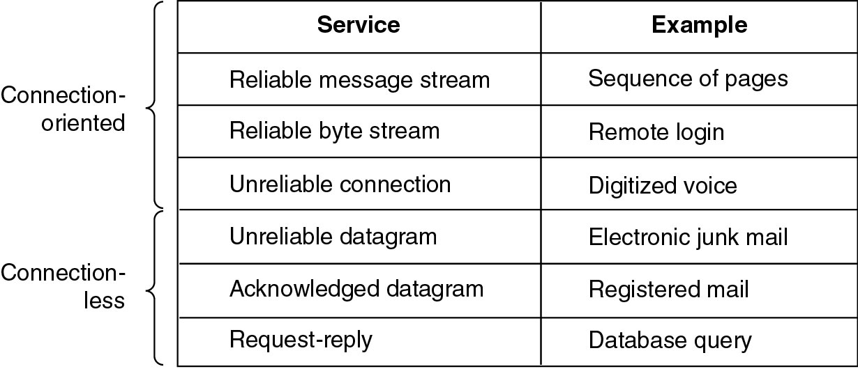
Connection-Oriented and Connectionless Services(2)
Six different types of service.

Slide 31
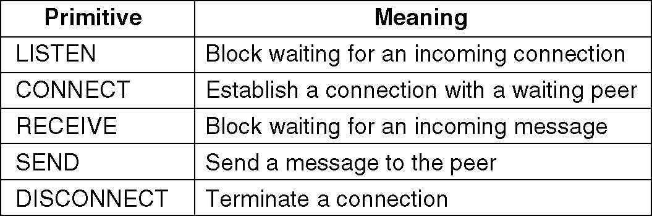
Service Primitives
Five service primitives for implementing a simple connection-oriented service.

Slide 32
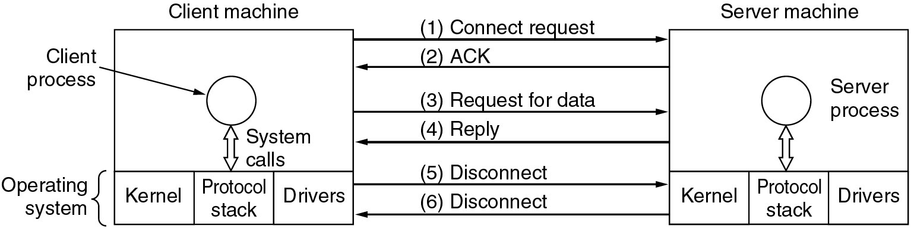
Service Primitives (2)
Packets sent in a simple client-server interaction on a connection-oriented network.

Slide 33
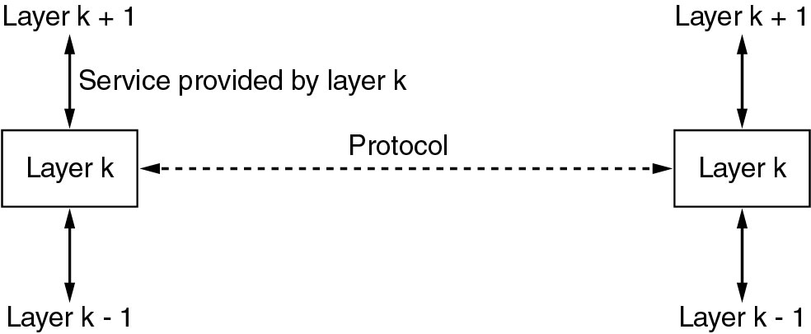
Services to Protocols Relationship
The relationship between a service and a protocol.

Slide 34
Reference Models
The OSI Reference Model
The TCP/IP Reference Model
A Comparison of OSI and TCP/IP
A Critique of the OSI Model and Protocols
A Critique of the TCP/IP Reference Model

Slide 35
开放系统互连参考模型(OSI/RM)
为了实现不同厂家生产的计算机系统之间以及不同网络之间的数据通信，国际标准化组织ISO对各类计算机网络体系结构进行了研究，并于1981年正式公布了一个网络体系结构模型作为国际标准，称为开放系统互连参考模型(OSI/RM)，也称为ISO/OSI。
“开放”表示任何两个遵守OSI/RM的系统都可以进行互连，当一个系统能按OSI/RM与另一个系统进行通信时，就称该系统为开放系统。

Slide 36
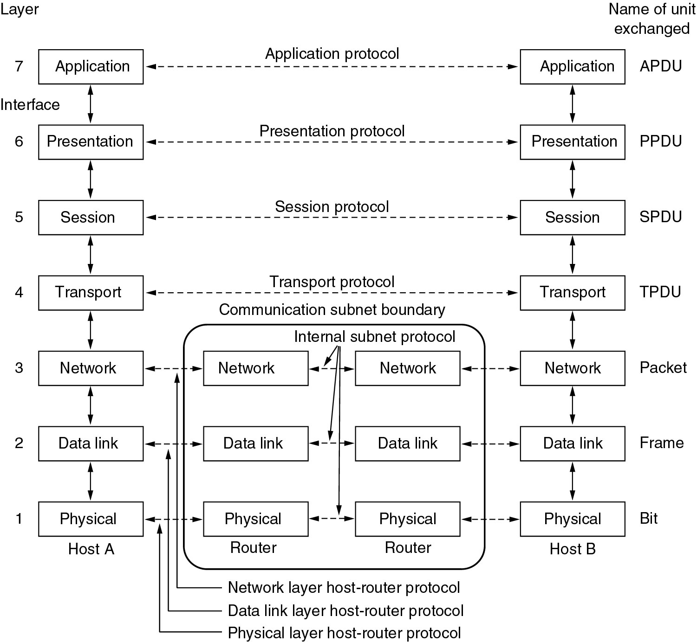
Reference Models
The OSI reference model.

Slide 37
The Physical Layer物理层
Transmitting raw bits over a communication channel.
The design issues have to do with making sure that when one side sends a 1 bit, it is received by the other side as a 1 bit, not as a 0 bit.
Represent a 1 or 0
Transmission simultaneous
Connection establishes and torn down
The network connector
Physical transmission medium

Slide 38
The Data Link Layer 数据链路层
The main task: a line that appears free of undetected transmission errors to the network layer.
the sender break up the input data into data frames, transmit the frames sequentially
If the service is reliable, the receiver confirms correct receipt of each frame by sending back an acknowledgement frame.
Flow control .
Broadcast networks: to control access to the shared channel.

Slide 39
The Network Layer 网络层
How packets are routed from source to destination.
Congestion control
Quality of service.
Heterogeneous networks interconnected.

Slide 40
The Transport Layer 传输层
Reliability -- Ensures that packets arrive at their destination. Reassembles out of order messages.
Hides network -- Allows details of the network to be hidden from higher level layers.
Service Decisions -- What type of service to provide; error-free point to point, datagram, etc.
Mapping -- Determines which messages belong to which connections.
Flow control -- keeps a fast transmitter from flooding a slow receiver
Efficiently

Slide 41
The Session Layer 会话层
On different machines to establish sessions
Various services
Dialog control (keeping track of whose turn it is to transmit)
Token management (preventing two parties from attempting the same critical operation at the same time)
Synchronization (check pointing long transmissions to allow them to continue from where they were after a crash).

Slide 42
The Presentation Layer 表示层
Concerned with the syntax and semantics of the information transmitted.
A standard encoding
Manages these abstract data structures
Allows higher-level data structures (e.g., banking records) to be defined and exchanged.

Slide 43
The Application Layer 应用层
A variety of protocols that are commonly needed by users.
WWW
File transfer
Electronic mail
Network news
Telnet

Slide 44
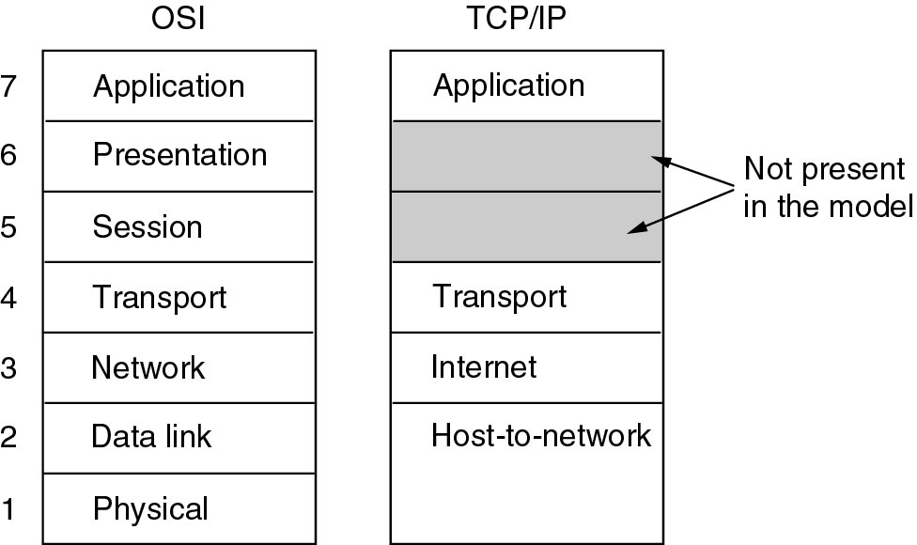
Reference Models (2)
The TCP/IP reference model.

Slide 45
TCP/IP的体系结构
OSI参考模型研究的初衷是希望为网络体系结构与协议的发展提供一种国际标准，但由于Internet在全世界的飞速发展，使得TCP/IP协议得到了广泛的应用，虽然TCP/IP不是ISO标准，但广泛的使用也使TCP/IP成为一种“实际上的标准”，并形成了TCP/IP参考模型。不过，ISO的OSI参考模型的制定，也参考了TCP/IP协议集及其分层体系结构的思想。而TCP/IP在不断发展的过程中也吸收了OSI标准中的概念及特征。

Slide 46
TCP/IP协议的特点
开放的协议标准，可以免费使用，并且独立于特定的计算机硬件与操作系统；
独立于特定的网络硬件，可以运行在局域网、广域网，更适用于互连网中；
统一的网络地址分配方案，使得整个TCP/IP设备在网中都具有唯一的地址；
标准化的高层协议，可以提供多种可靠的用户服务。

Slide 47
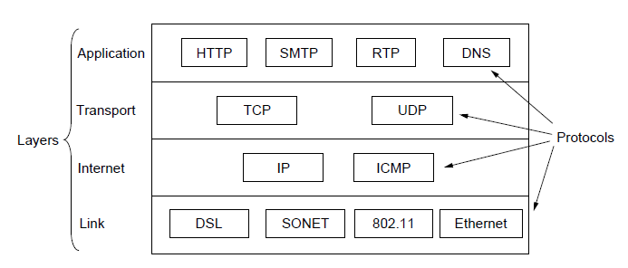
Reference Models (3)
Protocols and networks in the TCP/IP model initially.

Slide 48
The Internet Layer
To permit hosts to inject packets into any network and have them travel independently to the destination
Packets may arrive in a different order than they were sent.
Defined an official packet format and protocol called IP (Internet Protocol).
Packet routing
Avoiding congestion.
TCP/IP internet layer is similar in functionality to the OSI network layer.

Slide 49
The Transport Layer
To allow peer entities on the source and destination hosts to carry on a conversation
Two end-to-end transport protocols TCP and UDP
TCP (Transmission Control Protocol), is a reliable connection-oriented protocol
UDP (User Datagram Protocol), is an unreliable, connectionless protocol.

Slide 50
The Application Layer
Virtual terminal (TELNET), allows a user on one machine to log onto a distant machine and work there
File transfer (FTP), to move data efficiently from one machine to another
Electronic mail (SMTP)
Domain Name System (DNS) for mapping host names onto their network addresses
HTTP, the protocol for fetching pages on the World Wide Web

Slide 51
The Host-to-Network Layer
This protocol is not defined and varies from host to host and network to network.

Slide 52
Comparing OSI and TCP/IP Models
In common.
Based on the concept of a stack of independent protocols.
The functionality of the layers is roughly similar.
OSI
Has good definition of service, interface, and protocol.
Fits well with object oriented programming concepts.
Protocols are better hidden.
TCP
the protocols came first; model was just a description of the protocols. But then the model isn't good for any other protocols
TCP/IP model did not clearly distinguish between service, interface, and protocol

Slide 53
A Critique of the OSI Model and Protocols
Why OSI did not take over the world
Bad timing, TCP already in use by the time OSI came along.
Bad technology, Layers don't match reality. Influenced by IBM's SNA and telephone company.
Bad implementations

Slide 54
A Critique of the TCP/IP Reference Model
Problems:
Service, interface, and protocol not distinguished
Not a general model
Host-to-network “layer” not really a layer
No mention of physical and data link layers
Minor protocols deeply entrenched, hard to replace

Slide 55
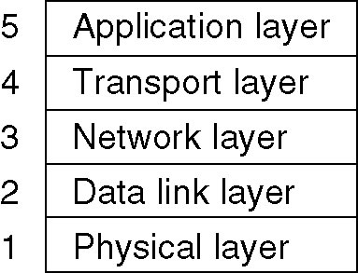
Hybrid Model
The hybrid reference model to be used in this book.

Slide 56
1.5 Example Networks
The Internet
3G mobile phone networks
Wireless LANs : 802:11
*RFID and sensor networks

Slide 57
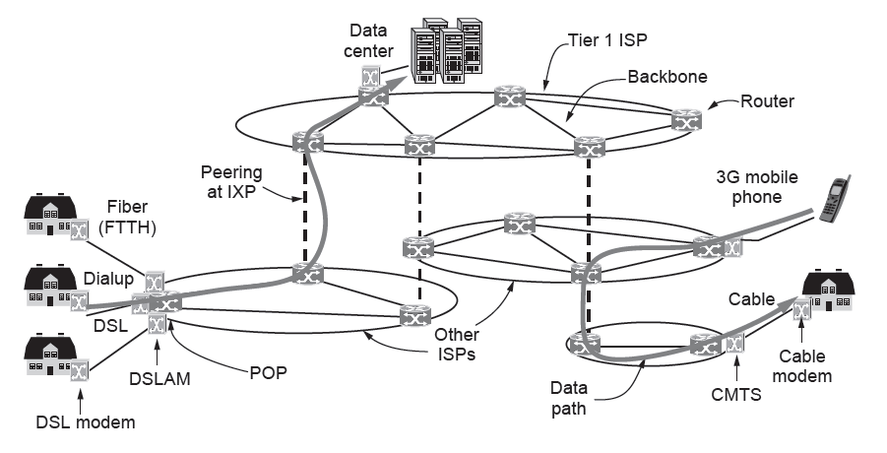
Architecture of the Internet
Architecture of the Internet

Slide 58
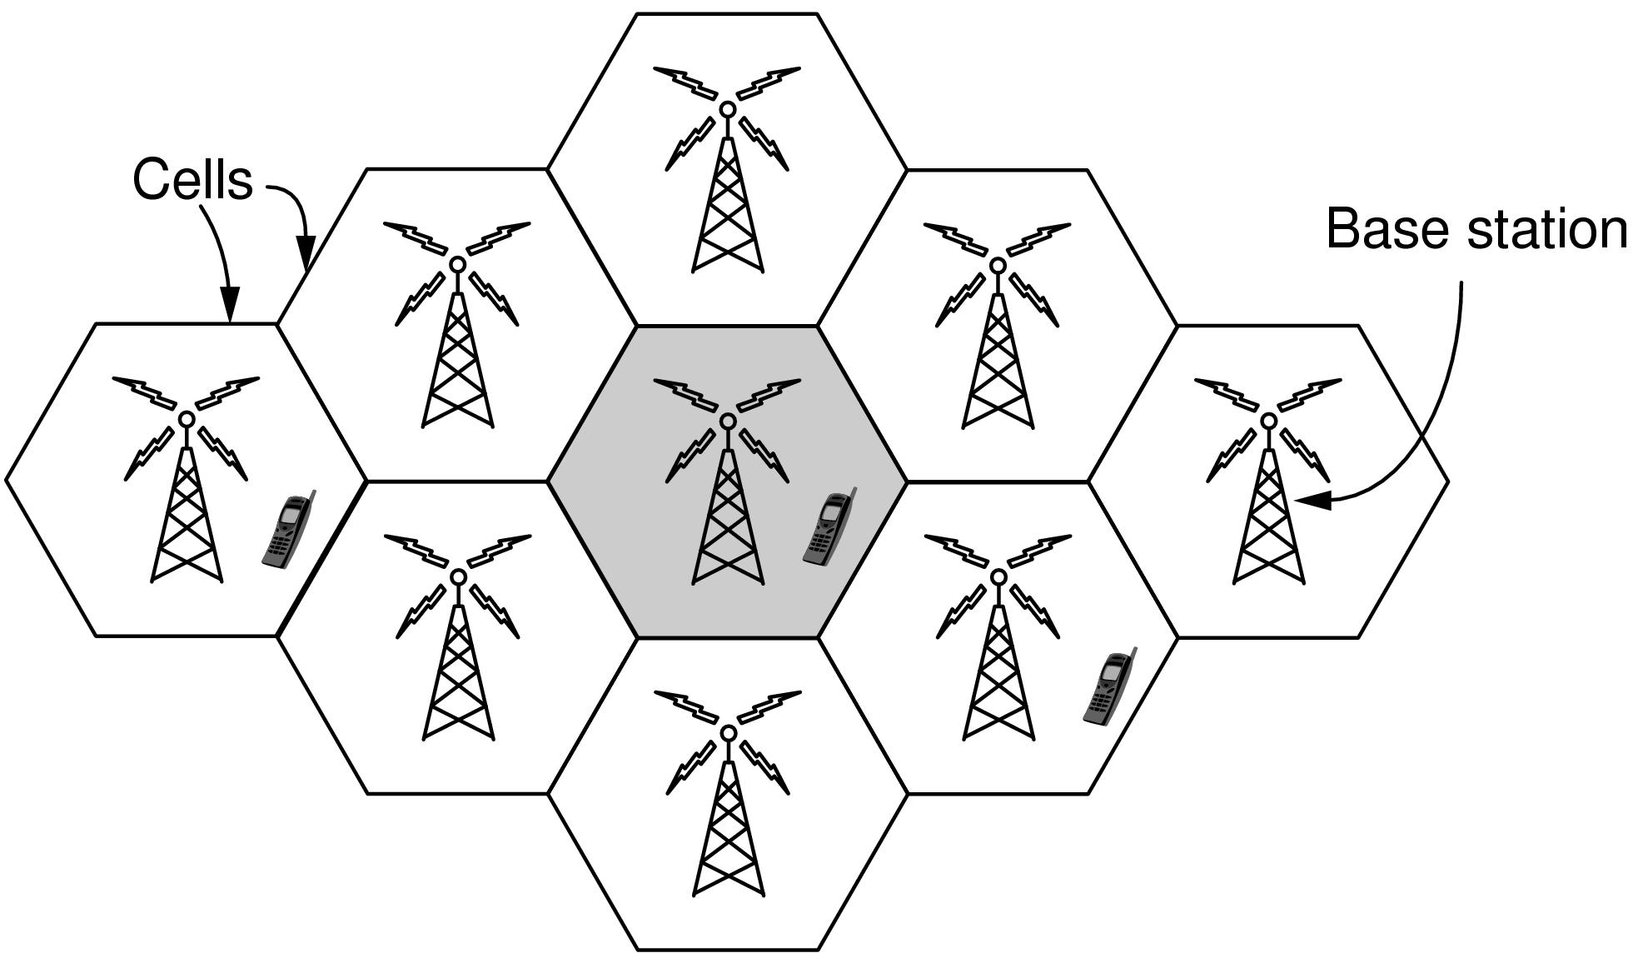
3G Mobile Phone Networks (1)
3G network is based on spatial cells; each cell provides wireless service to mobiles within it via a base station

Slide 59
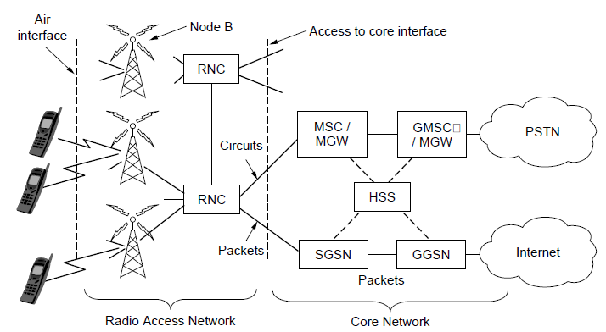
3G Mobile Phone Networks (2)
Base stations connect to the core network to find other mobiles and send data to the phone network and Internet
RNC：radio network Controller
MSC: mobile switching center
MGW: media gateway
GMSC:gateway mobile switching center
HSS: home subscriber server
SGSN: serving GPRS support node
GGSN: gateway GPRS support node

Slide 60
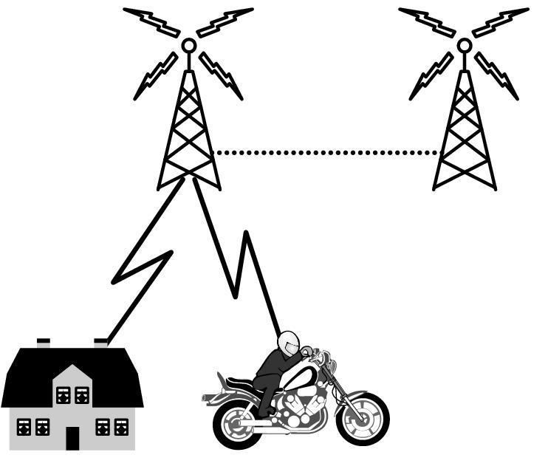
3G Mobile Phone Networks (3)
As mobiles move, base stations hand them off from one cell to the next, and the network tracks their location
Handover

Slide 61
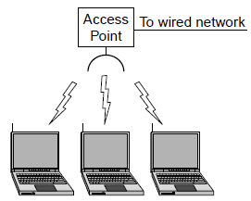
Wireless LANs (1)
In 802.11, clients communicate via an AP (Access Point) that is wired to the rest of the network.

Slide 62
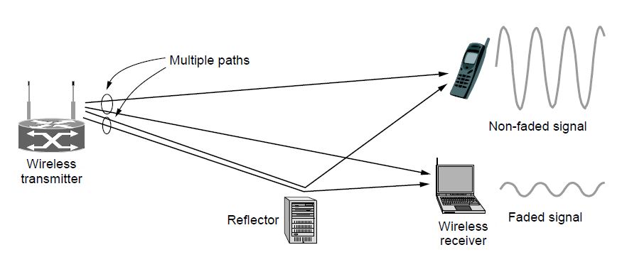
Wireless LANs (2)
Signals in the 2.4GHz ISM band vary in strength due to many effects, such as multipath fading due to reflections
requires complex transmission schemes, e.g., OFDM

Slide 63
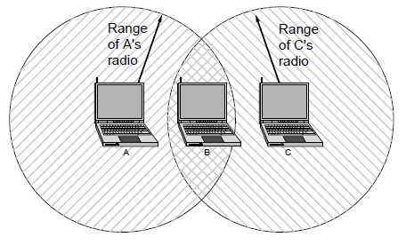
Wireless LANs (3)
Radio broadcasts interfere with each other, and radio ranges may incompletely overlap
CSMA (Carrier Sense Multiple Access) designs are used

Slide 64
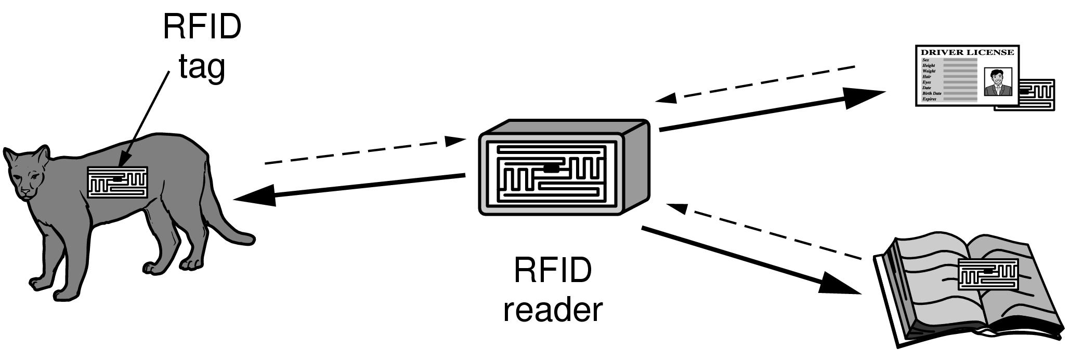
RFID and Sensor Networks (1)
Passive UHF RFID networks everyday objects:
Tags (stickers with not even a battery) are placed on objects
Readers send signals that the tags reflect to communicate

Slide 65
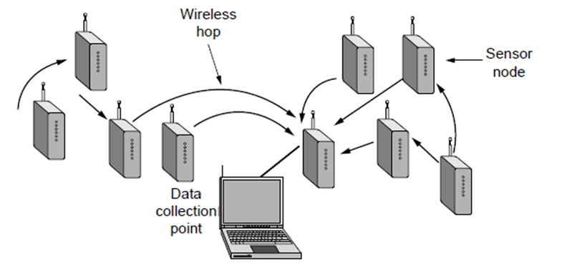
RFID and Sensor Networks (2)
Sensor networks spread small devices over an area:
Devices send sensed data to collector via wireless hops

Slide 66
Network Standardization
Who’s Who in the Telecommunications World
Who’s Who in the International Standards World
Who’s Who in the Internet Standards World

Slide 67
ITU
Main sectors
Radio communications
Telecommunications Standardization
Development
Classes of Members
National governments
Sector members
Associate members
Regulatory agencies

Slide 68
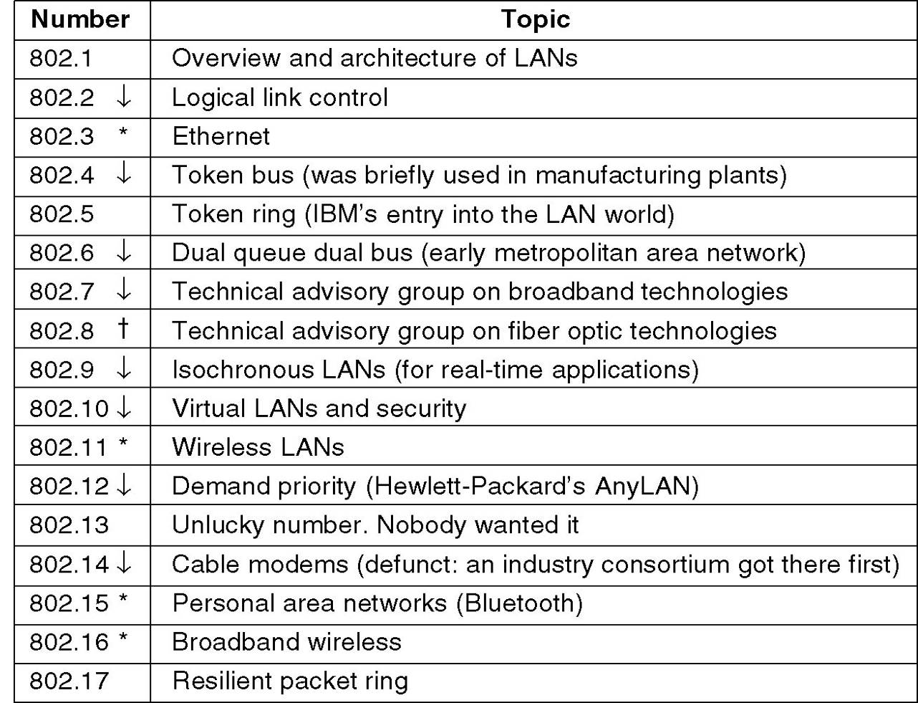
IEEE 802 Standards
The 802 working groups. The important ones are marked with *. The ones marked with ↓ are hibernating. The one marked with † gave up.

Slide 69
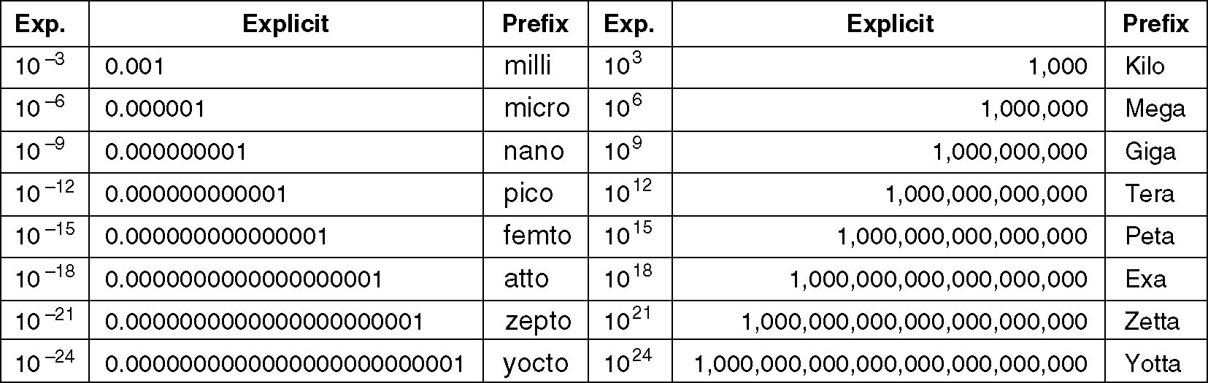
Metric Units
The principal metric prefixes.

Slide 70
作业
1.7，1.10，1.11，1.15，1.18
1,20，1.22，1.25，1.29，1.30

