Slide 1
The Transport Layer
Chapter 6
Heart of the whole protocol hierarchy.
Providing reliable, cost-effective data transport from the source to the destination
computer network

Slide 2
The Transport Service
Services Provided to the Upper Layers
Transport Service Primitives
Berkeley Sockets*
An Example of Socket Programming:
  An Internet File Server*
computer network

Slide 3
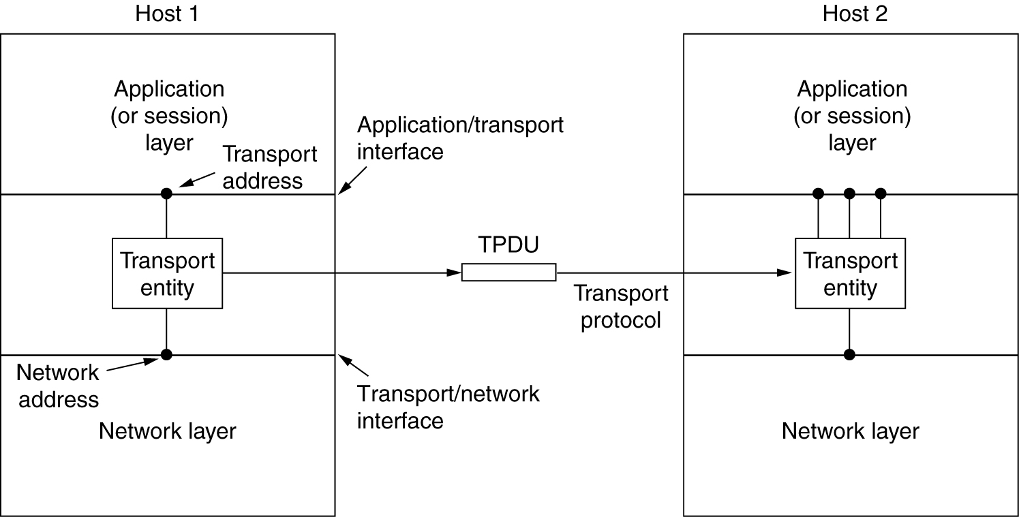
Services Provided to the Upper Layers
The network, transport, and application layers.
computer network

Slide 4
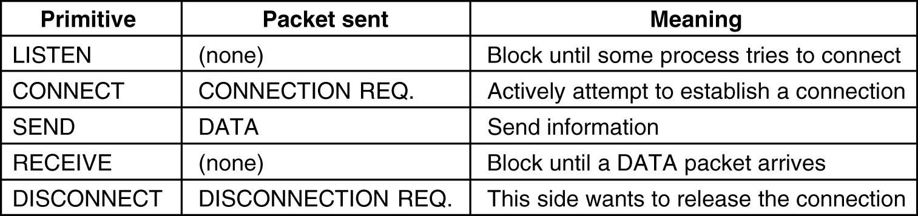
Transport Service Primitives
The primitives for a simple transport service.
computer network

Slide 5
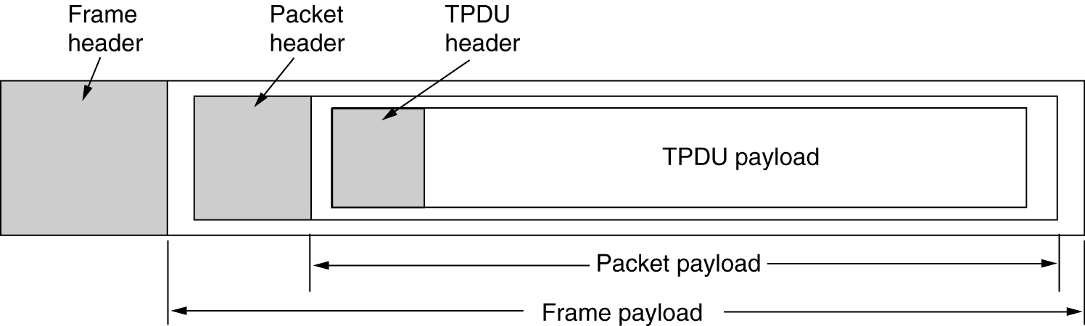
Transport Service Primitives (2)
The nesting of TPDUs, packets, and frames.
computer network

Slide 6
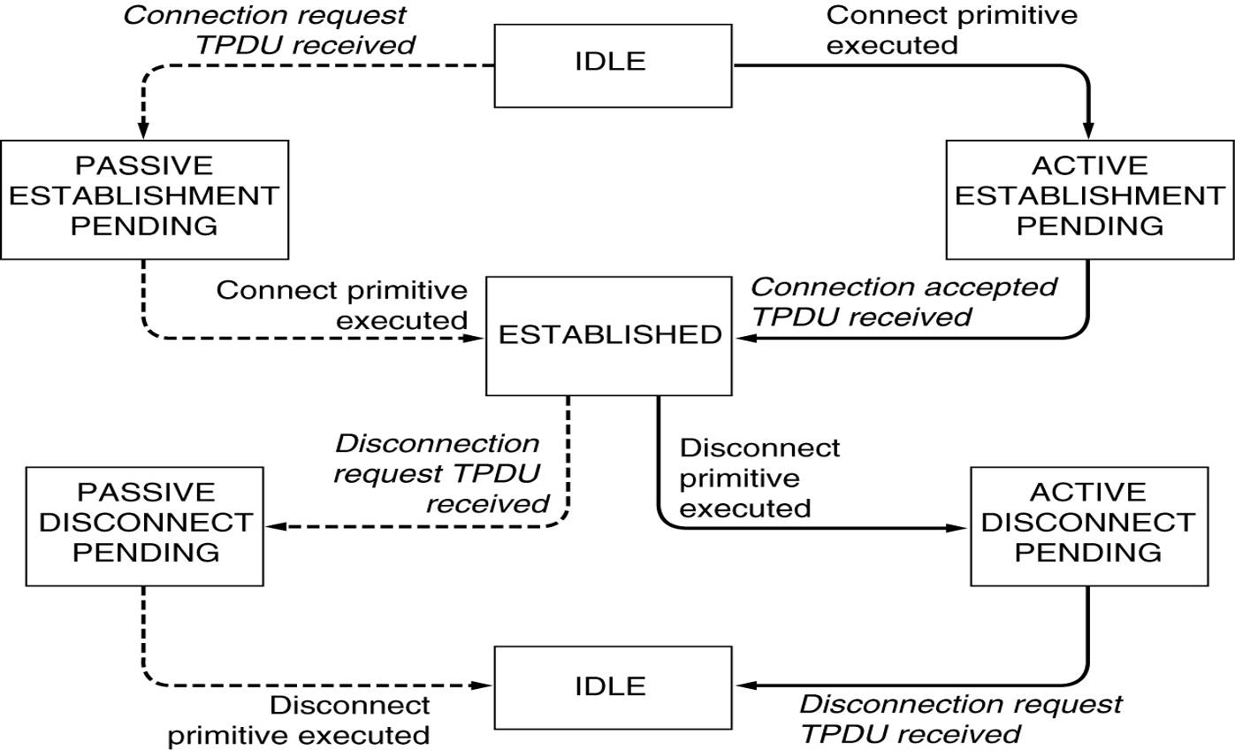
Transport Service Primitives (3)
A state diagram for a simple connection management scheme. Transitions labeled in italics are caused by packet arrivals. The solid lines show the client's state sequence. The dashed lines show the server's state sequence.
computer network

Slide 7
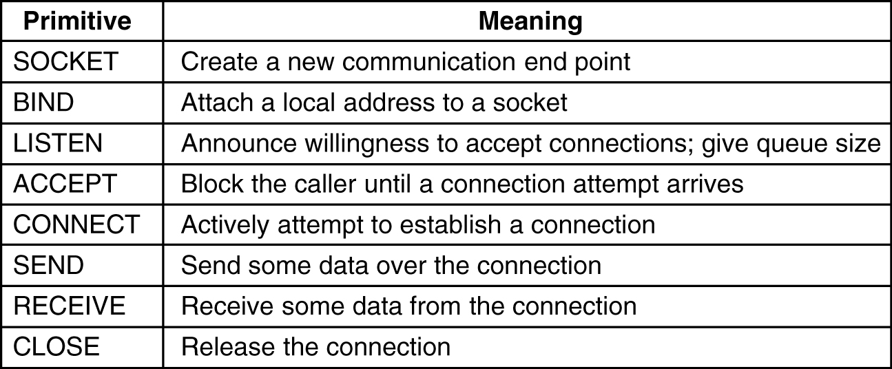
Berkeley Sockets
The socket primitives for TCP.
computer network

Slide 8
Elements of Transport Protocols
Addressing
Connection Establishment
Connection Release
Flow Control and Buffering*
Multiplexing*
Crash Recovery*
computer network

Slide 9
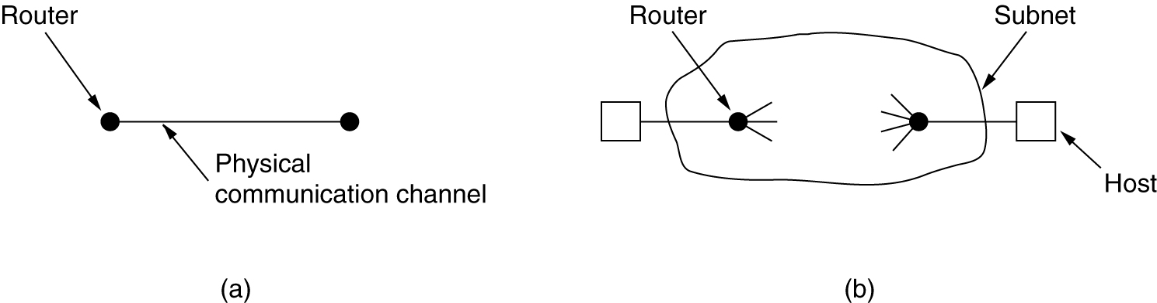
Transport Protocol
(a) Environment of the data link layer.
(b) Environment of the transport layer.
computer network

Slide 10
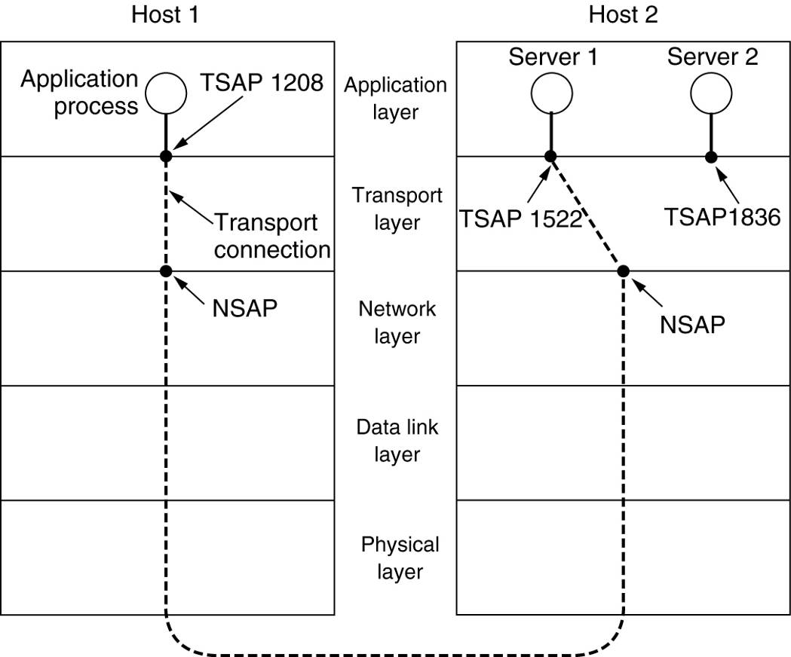
Addressing
  A mail server process listens at TSAP 1522 of host 2 to wait for an incoming call.
  An application process on host 1 issues a CONNECT request specifying TSAP 1208 as the source and TSAP 1522 as the destination.
  The mail server responds to say that it will deliver the message.
TSAPs, NSAPs and transport connections.
computer network

Slide 11
PORT
TCP、UDP 服务/端口(保留)：共有2¹⁶=65536个端口
端口号
关键字
描述
42
NAMESERVER
主机名字服务
53
DOMAIN
域名服务
UDP
67
BOOTPS
启动协议服务
69
TFTP
简单文件传输
111
SUNRPC
微系统公司RPC(远程过程调用)
20
FTP-DATA
文件传输服务(数据连接)
21
FTP
文件传输服务(控制连接)
TCP
23
TELNET
远程登录服务
25
SMTP
简单邮件服务
42
NAMESERVER
主机名字服务
53
DOMAIN
域名服务
computer network

Slide 12
Connection Establishment
Key problem is to ensure reliability even though packets may be lost, corrupted, delayed, and duplicated
  Don’t treat an old or duplicate packet as new
  (Use ARQ and checksums for loss/corruption)
Approach:
  Don’t reuse sequence numbers within twice the MSL (Maximum Segment Lifetime) of 2T=240 secs
  Three-way handshake for establishing connection
computer network

Slide 13
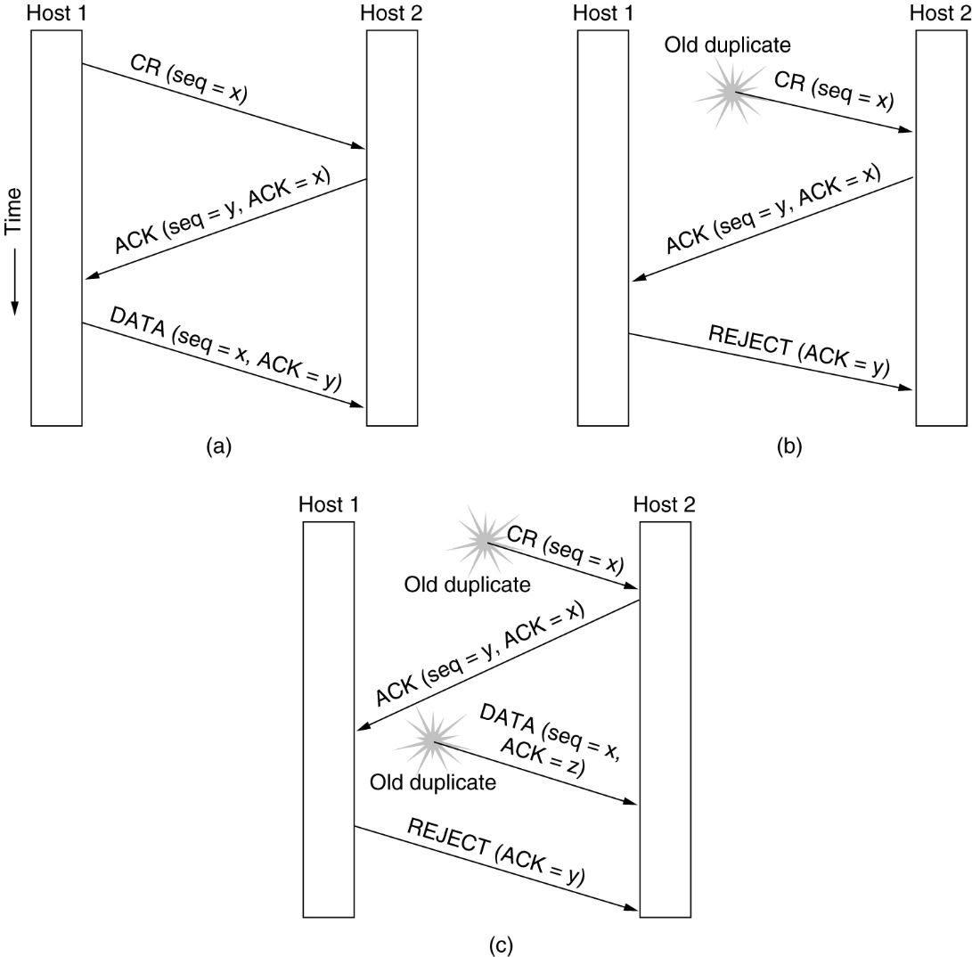
Connection Establishment (2)
Three protocol scenarios for establishing a connection using a three-way handshake. CR denotes CONNECTION REQUEST.
(a) Normal operation,
(b) Old CONNECTION REQUEST appearing out of nowhere.
(c) Duplicate CONNECTION REQUEST and duplicate ACK.
computer network

Slide 14
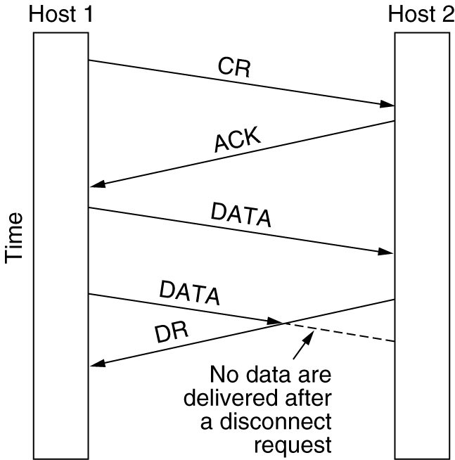
Connection Release
Abrupt disconnection with loss of data.
computer network

Slide 15
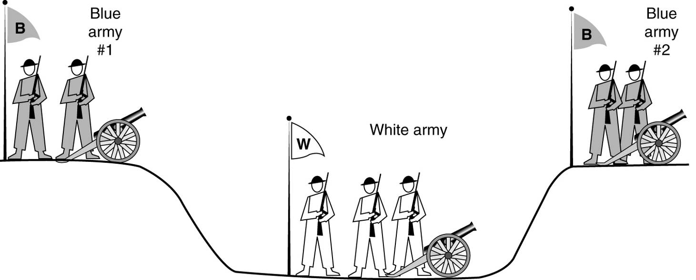
Connection Release (2)
The two-army problem.
computer network

Slide 16
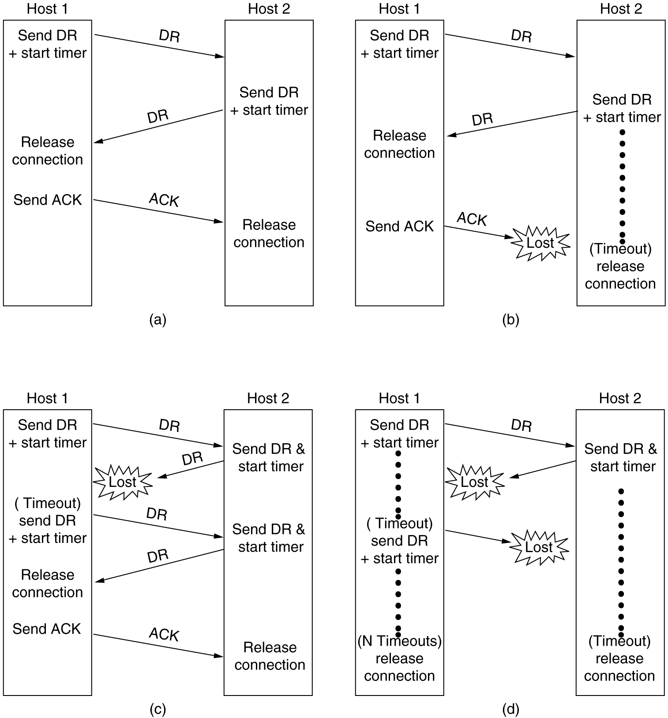
Connection Release (3)
6-14, a, b
Four protocol scenarios for releasing a connection. (a) Normal case of a three-way handshake. (b) final ACK lost.
computer network

Slide 17
Connection Release (4)
6-14, c,d
(c) Response lost. (d) Response lost and subsequent DRs lost.
computer network

Slide 18
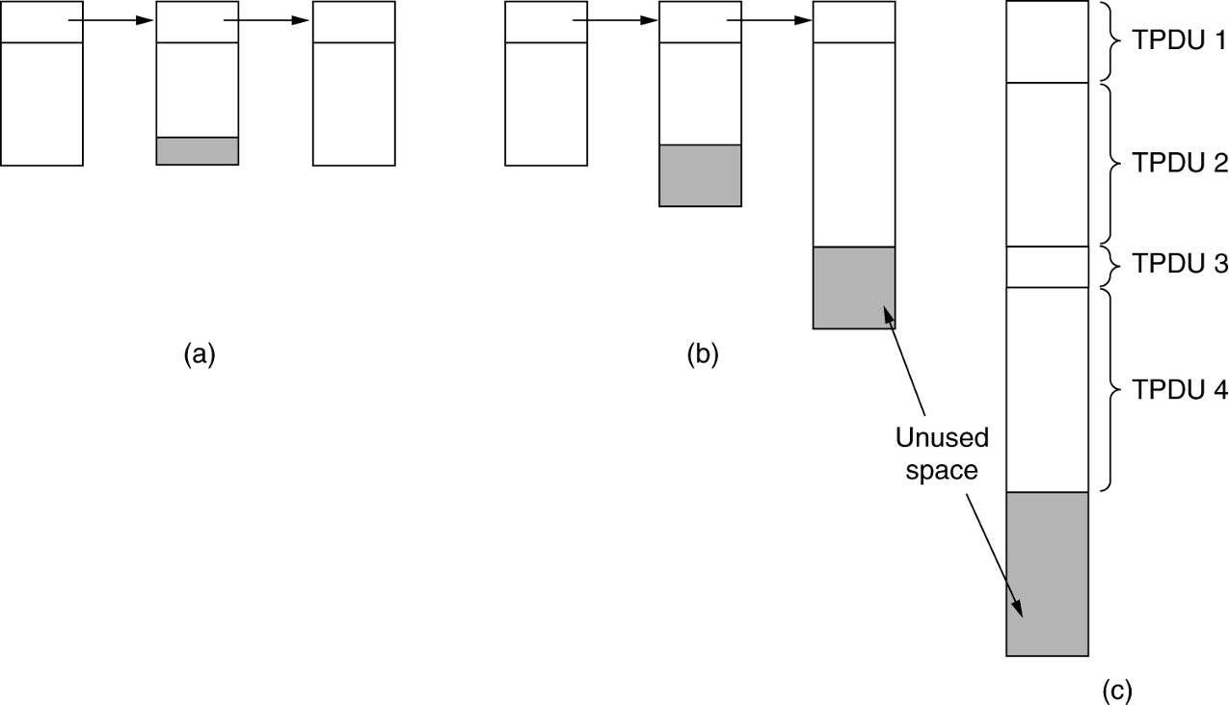
Flow Control and Buffering
(a) Chained fixed-size buffers. (b) Chained variable-sized buffers. (c) One large circular buffer per connection.
computer network

Slide 19
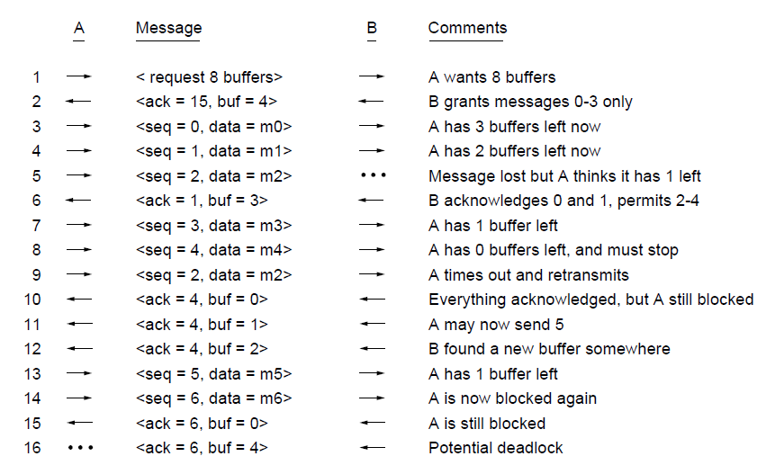
Flow Control and Buffering (2)
Flow control example: A’s data is limited by B’s buffer
B’s Buffer
0
1
2
3
0
1
2
3
0
1
2
3
0
1
2
3
1
2
3
4
1
2
3
4
1
2
3
4
1
2
3
4
1
2
3
4
2
3
4
5
3
4
5
6
3
4
5
6
3
4
5
6
3
4
5
6
7
8
9
10
computer network

Slide 20
The Internet Transport Protocols: UDP
Introduction to UDP（TFTP(port 69)、SNMP(port 161)、NFS(port 2049)、NTP(port 123)、DNS(port 53 客户端向DNS服务器查询域名)、POP3(port 110)、BOOTP(port 67、68)）
Remote Procedure Call
The Real-Time Transport Protocol
computer network

Slide 21
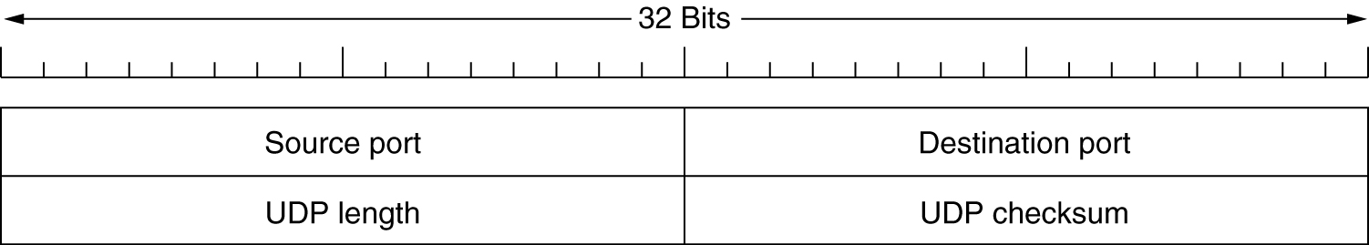
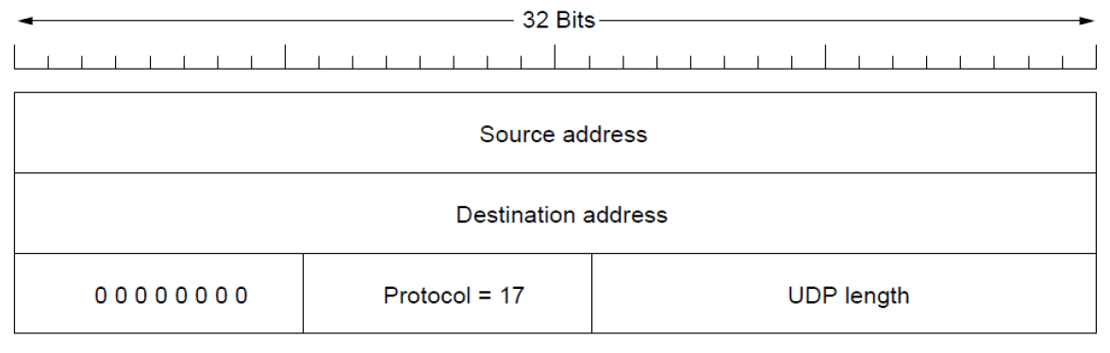
Introduction to UDP
The UDP header.
The UDP pseudoheader
computer network

Slide 22
Introduction to UDP
UDP建立在IP协议之上，它封装在IP数据区中，同IP协议一样提供无连接数据报传输。相对于IP协议，它唯一增加的能力是提供协议端口，以保证进程通信。
UDP目标端口：一个UDP端口是一个可读写的软件结构，内部有一个接收报文缓冲区。接收数据时，UDP软件要判断此目标端口是否与当前使用的端口匹配，如是，则将数据报放入相应的接收队列，否则，抛弃该数据并向源端口发送“端口不可达”的差错消息报文。
长度：以字节计的整个报文长度，最小为8，只有报头；最大65515。
校验和：它是一个可选项，以提高效率。
在利用IP传送语音和视频的时候，要利用UDP协议。
computer network

Slide 23
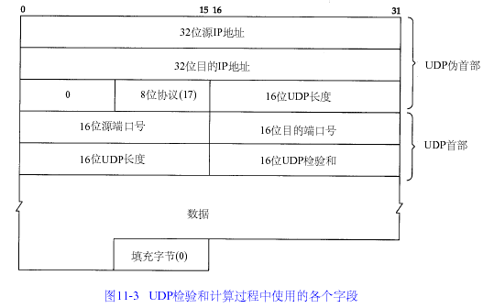
Introduction to UDP
computer network

Slide 24
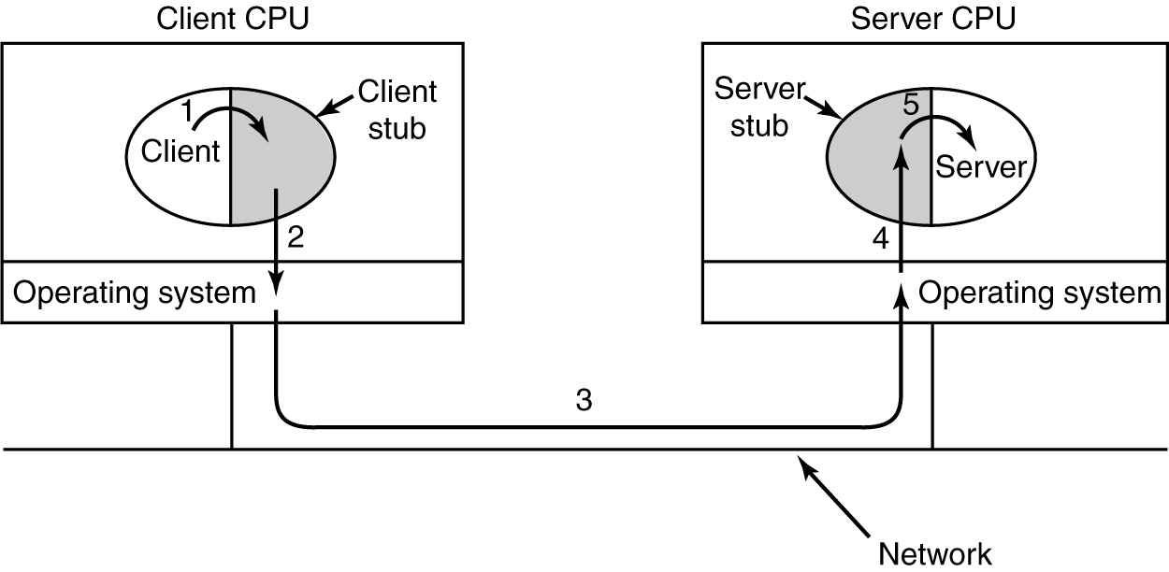
Remote Procedure Call
Steps in making a remote procedure call. The stubs are shaded.
computer network

Slide 25
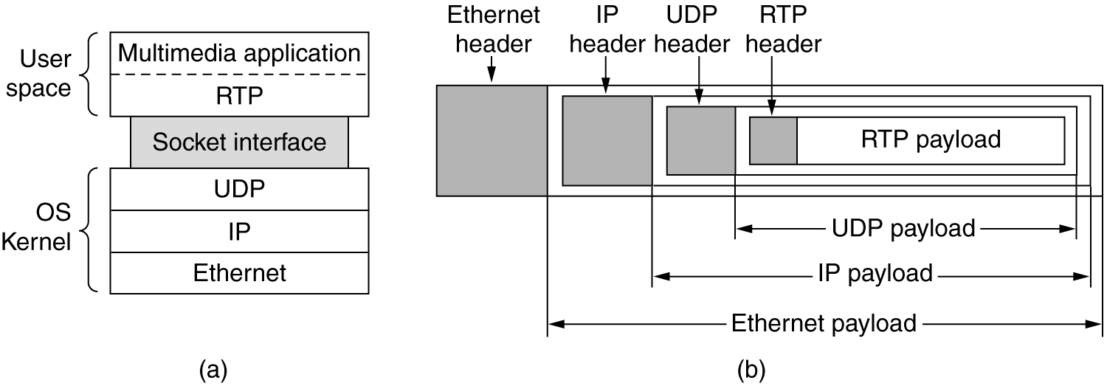
The Real-Time Transport Protocol
RTP (Real-time Transport Protocol) provides support for sending real-time media over UDP
  Often implemented as part of the application
(a) The position of RTP in the protocol stack. (b) Packet nesting.
computer network

Slide 26
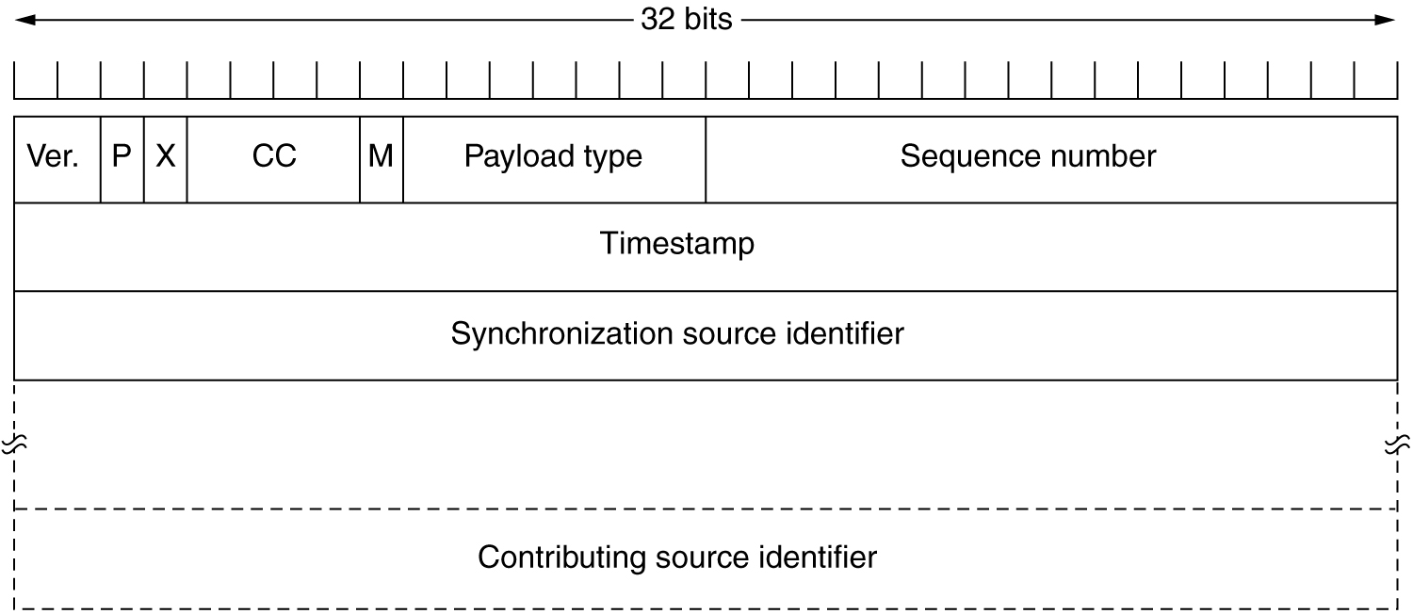
The Real-Time Transport Protocol (2)
The RTP header.
computer network

Slide 27
The Real-Time Transport Protocol (3)
Ver：RTP协议的版本号，占2位，当前协议版本号为2。
P：填充标志，占1位，如果P=1，则在该报文的尾部填充一个或多个额外的八位组(满足4字节的倍数)，它们不是有效载荷的一部分。
X：扩展标志，占1位，如果X=1，则在RTP报头后跟有一个扩展报头。
CC：CSRC计数器，占4位，指示CSRC 标识符的个数。
M: 标记，占1位，不同的有效载荷有不同的含义，对于视频，标记一帧的结束；对于音频，标记会话的开始。
PT: 有效载荷类型，占7位，用于说明RTP报文中有效载荷的类型，如GSM音频、JPEG图像等,在流媒体中大部分是用来区分音频流和视频流的，这样便于客户端进行解析。
序列号：占16位，用于标识发送者所发送的RTP报文的序列号，每发送一个报文，序列号增1。这个字段当下层的承载协议用UDP的时候，网络状况不好的时候可以用来检查丢包。同时出现网络抖动的情况可以用来对数据进行重新排序，在linux服务器中这个字段是从0开始的，同时音频包和视频包的sequence是分别计数的。
时间戳(Timestamp)：占32位，时间戳反映了该RTP报文的第一个八位组的采样时刻。接收者使用时间戳来计算延迟和延迟抖动，并进行同步控制。
同步信源(SSRC)标识符：占32位，用于标识同步信源。该标识符是随机选择的，参加同一视频会议的两个同步信源不能有相同的SSRC。
特约信源(CSRC)标识符：每个CSRC标识符占32位，可以有0～15个。每个CSRC标识了包含在该RTP报文有效载荷中的所有特约信源。
computer network

Slide 28
The Internet Transport Protocols: TCP
Introduction to TCP（Telnet（port 23）、FTP （port 21） 、SMTP （port 25） 、HTTP （port 80） 、DNS （port 53）辅域名与主域名服务器数据同步 ）
The TCP Service Model
The TCP Protocol
The TCP Segment Header
TCP Connection Establishment
TCP Connection Release
TCP Connection Management Modeling
TCP Transmission Policy
TCP Congestion Control
TCP Timer Management
Wireless TCP and UDP*
Transactional TCP*
computer network

Slide 29
Introduction to TCP
在RFC793中定义，具有以下功能：
  数据传输
  多路复用
  可靠传输
  流量控制
  连接
TCP是建立在IP协议之上，封装在IP数据区中，但它是在基于无连接的IP协议之上提供面向连接的高可靠性数据传输和与进程通信的能力。它利用确认与超时重传、滑动窗口机制进行流控和拥塞控制来保证高可靠性的，同时，为了保证可靠性，它以牺牲效率为代价，在高实时要求场合不合适。
computer network

Slide 30
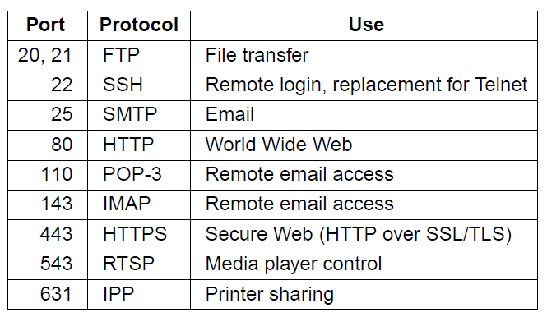
The TCP Service Model(1)
Some assigned ports.
computer network

Slide 31
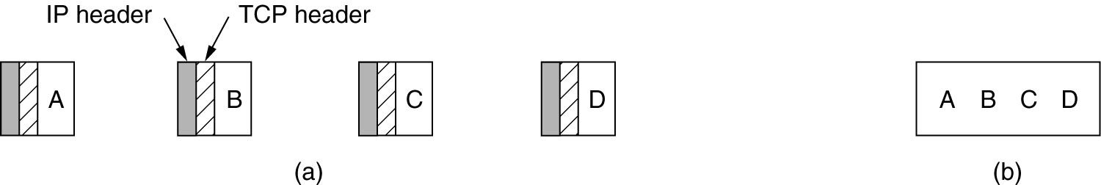
The TCP Service Model (2)
Applications using TCP see only the byte stream [right] and not the segments [left] sent as separate IP packets
(a) Four 512-byte segments sent as separate IP datagrams.
(b) The 2048 bytes of data delivered to the application in a single READ CALL.
computer network

Slide 32
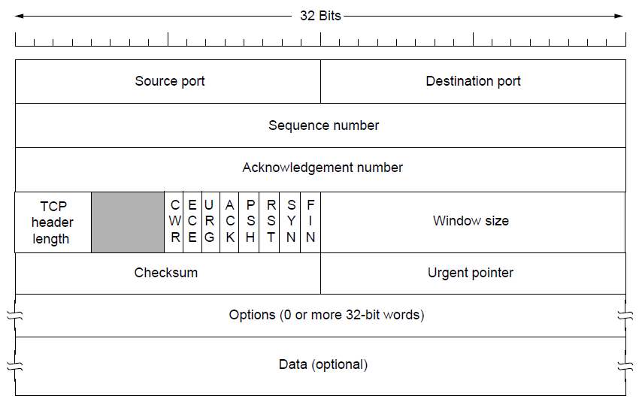
The TCP Segment Header
TCP Header.
computer network

Slide 33
TCP报文格式
序号：指出段中数据在发送端数据流中的位置。
确认号：指出本机希望下一个接收的字节的序号。
头长：指出以32比特为单位的段头长度。它是针对变长的“选项”域设计的。
码位：有些报文段是用于传输数据的，但有些报文段仅仅携带了确认信息，另一些报文段携带的是建立和关闭连接的请求。它使用“码位”来指出段的目的与内容。这8个比特各位的意义如图：
0 CWR, 拥塞控制信号
1 ECE, 显式拥塞通知
2 URG, 紧急指针字段可用
3 ACK, 确认字段可用
4 PSH, 本报文段请求急迫(PUSH)操作
5 RST, 连接复位
6 SYN, 序号同步，用于建立连接中的同步
7 FIN, 发送方字节流结束
computer network

Slide 34
TCP报文格式
由于有时发送方希望终止操作，不想接收方接收完所有的比特。如远程主机上的程序错误时就需要这种信号。TCP将数据指定为“紧急”型，接收方收到这种数据后，会不必排队而尽快通知应用程序。URG比特为1时，表明它是紧急的，其中的“紧急指针”指出了紧急数据在报文段中的结束位置。
当所有的紧急数据消失之后，TCP软件会告诉应用程序恢复正常的操作状态。PUSH位提供了数据强迫传输机制，以强迫传输当前流中的数据，而不必等待缓冲区满。远程登录中，终端的击键信号就是用PUSH操作来提供的。
computer network

Slide 35
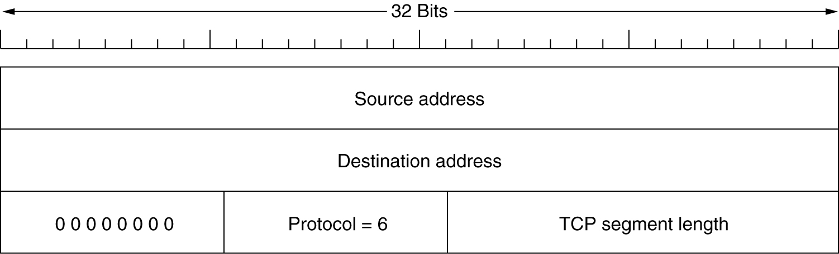
The TCP Segment Header (2)
The pseudoheader included in the TCP checksum.
computer network

Slide 36
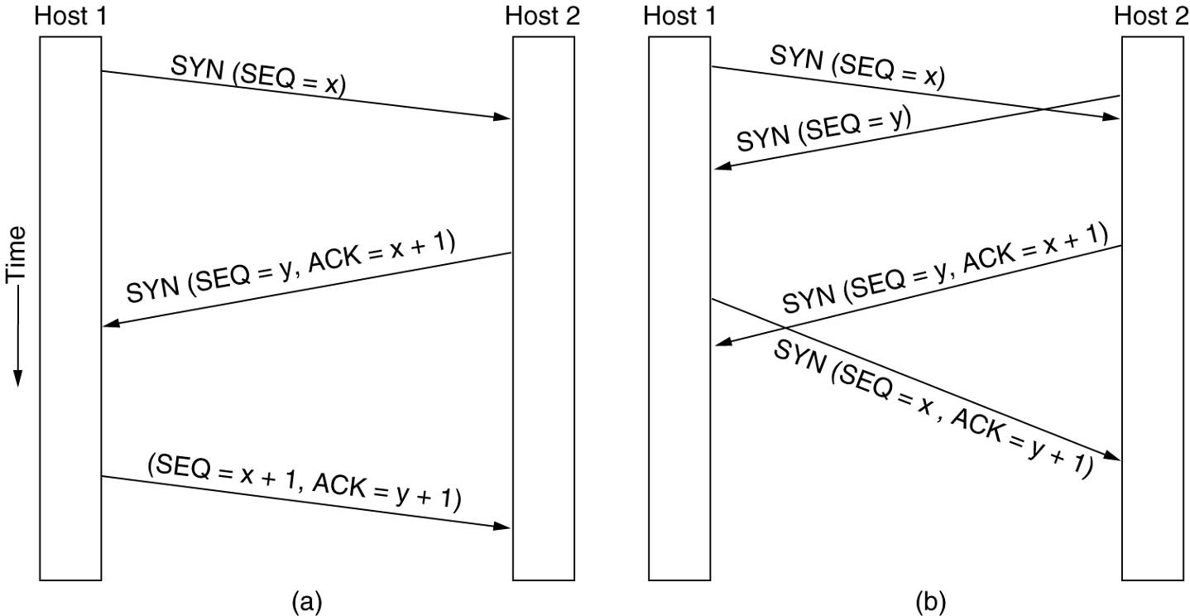
TCP Connection Establishment
6-31
(a) TCP connection establishment in the normal case.
(b) Call collision.
computer network

Slide 37
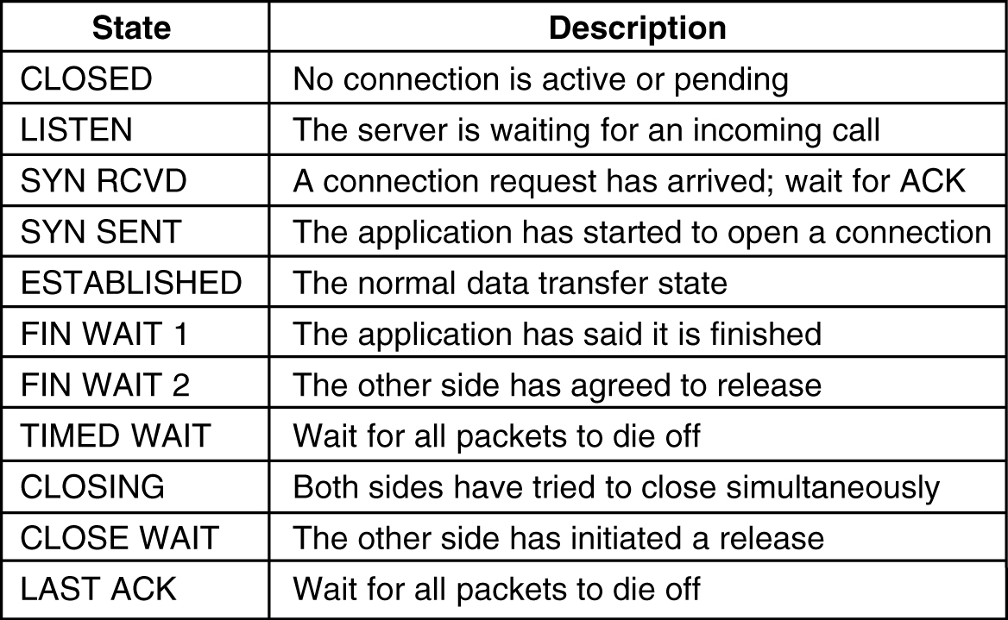
TCP Connection Management Modeling
The states used in the TCP connection management finite state machine.
computer network

Slide 38
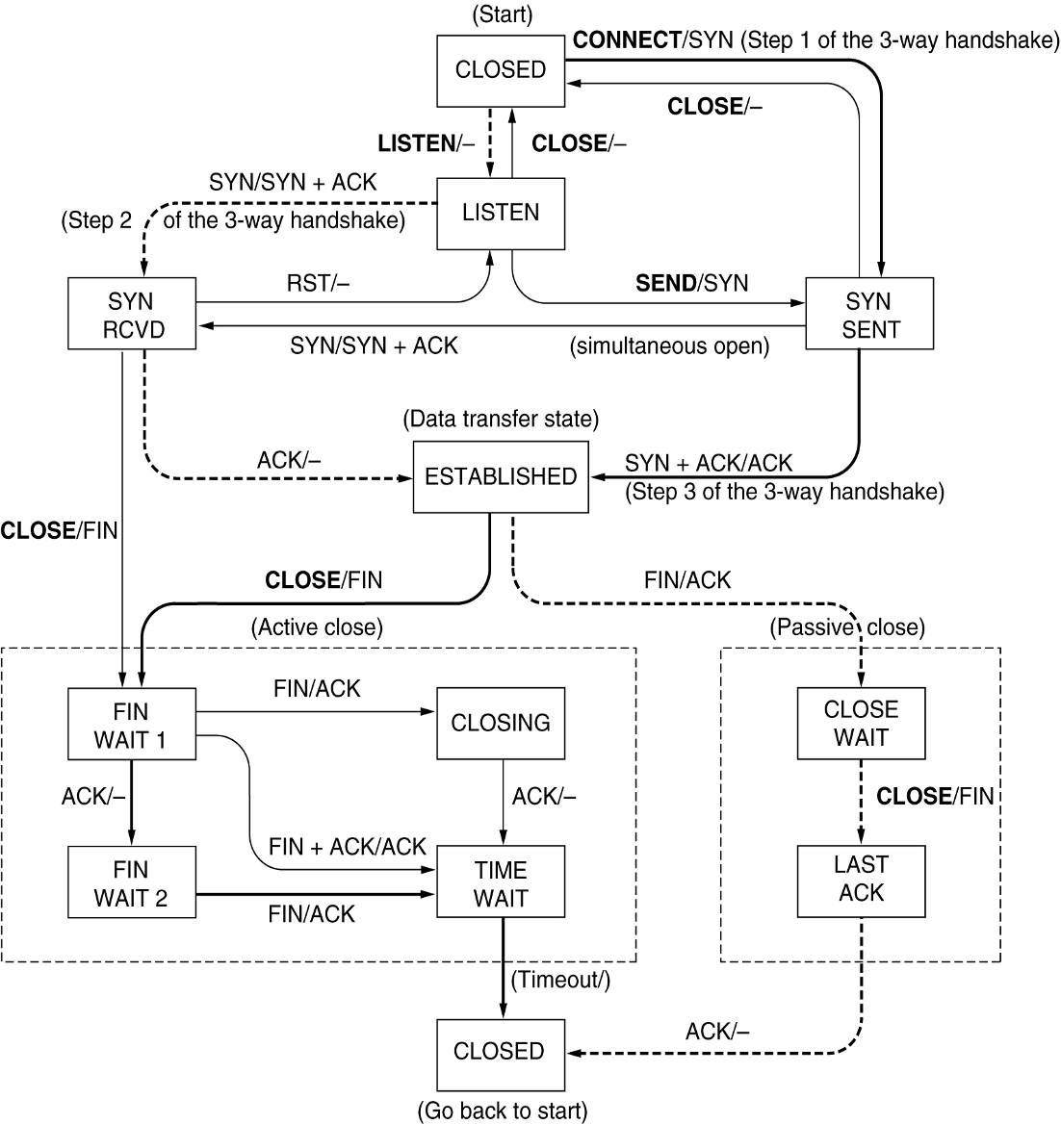
TCP Connection Management Modeling (2)
TCP connection management finite state machine. The heavy solid line is the normal path for a client. The heavy dashed line is the normal path for a server. The light lines are unusual events. Each transition is labeled by the event causing it and the action resulting from it, separated by a slash.
computer network

Slide 39
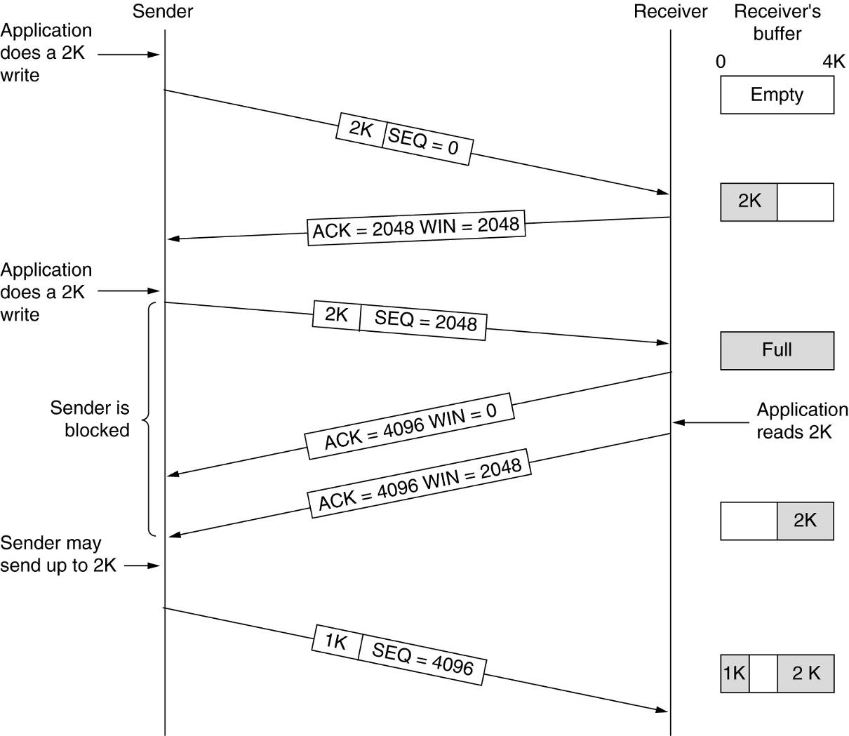
TCP Transmission Policy
Window management in TCP.
computer network

Slide 40
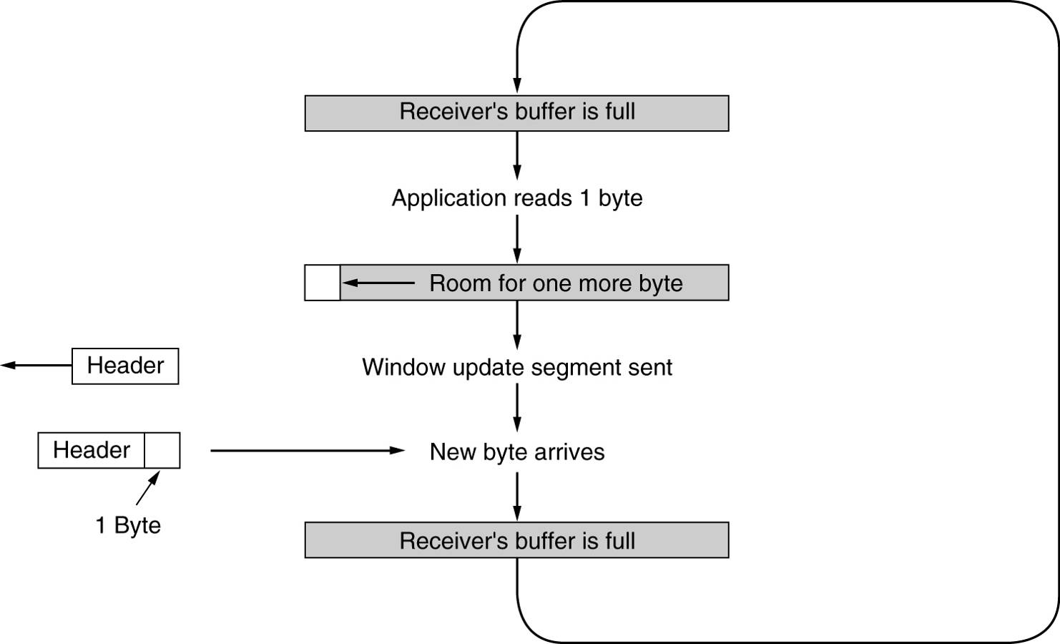
TCP Transmission Policy (2)
Silly window syndrome.
computer network

Slide 41
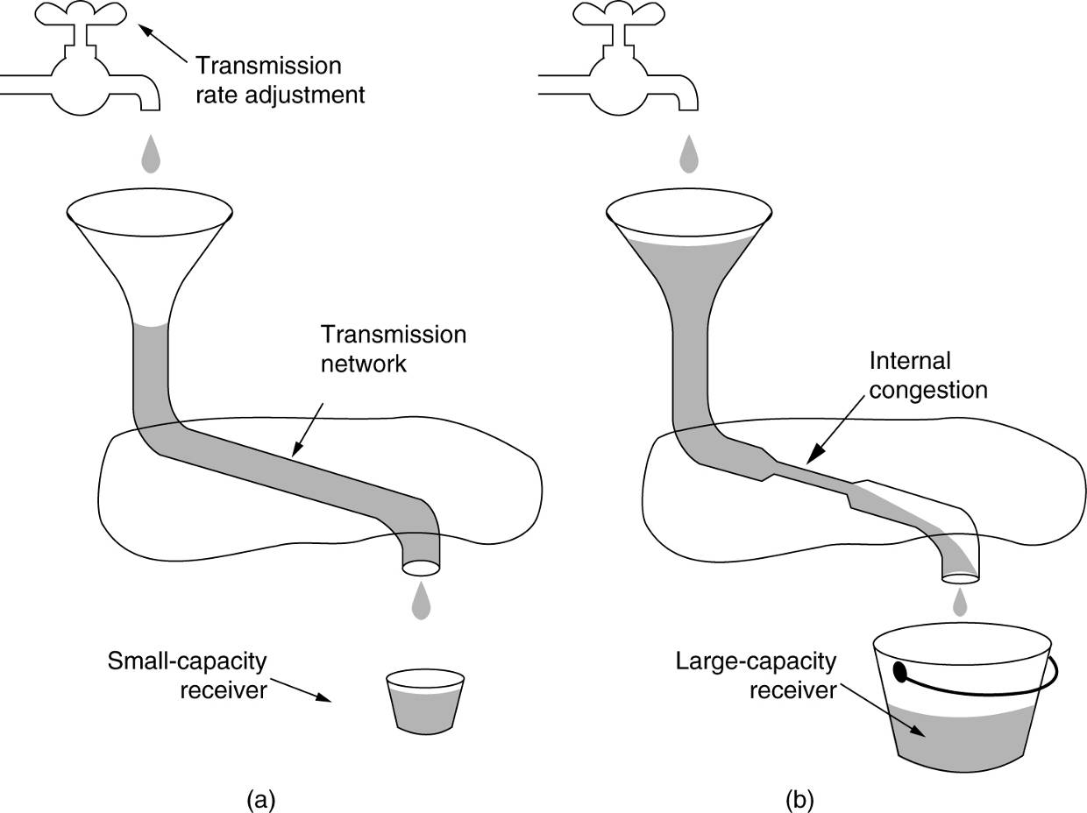
TCP Congestion Control
(a) A fast network feeding a low capacity receiver.
(b) A slow network feeding a high-capacity receiver.
computer network

Slide 42
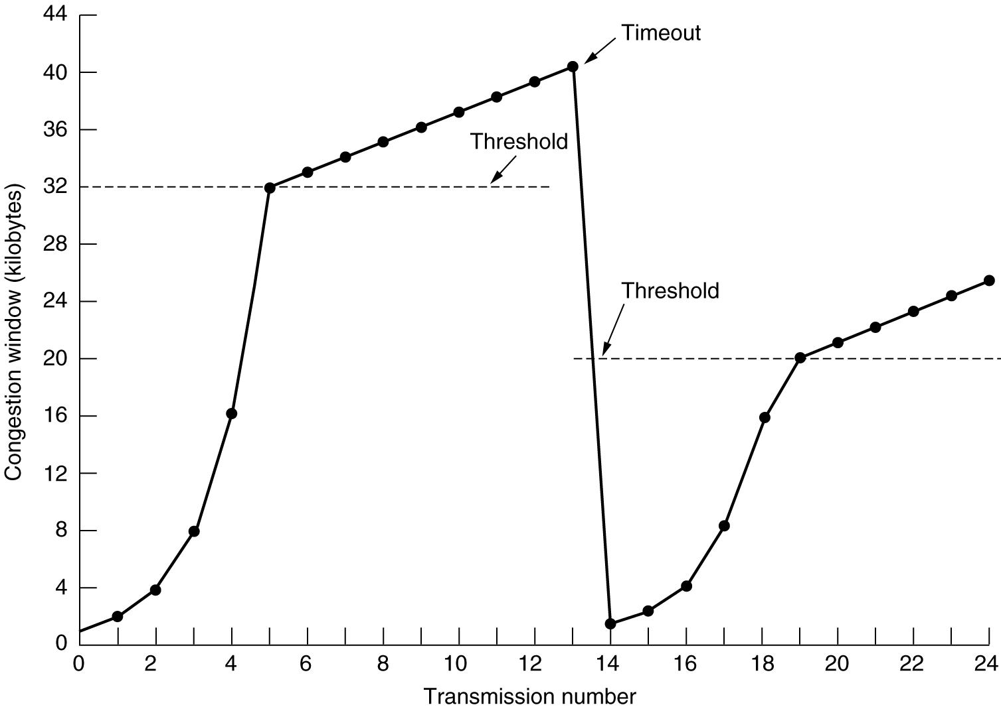
TCP Congestion Control (2)
线性递增
AIMD规则
线性递增
指数级递增
指数级递增
最大段长MSS为1KB
An example of the Internet congestion algorithm（慢速启动）.
computer network

Slide 43
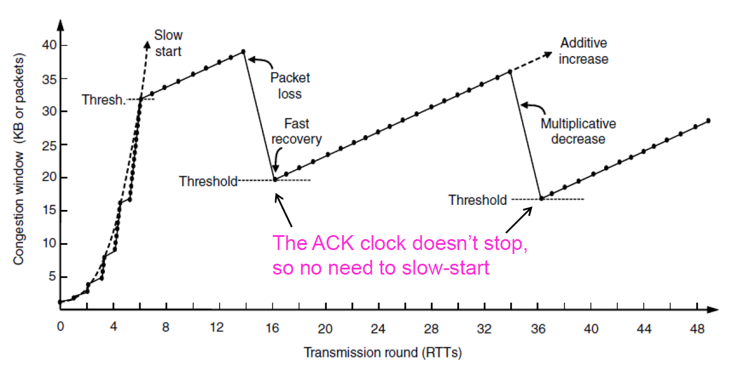
TCP Congestion Control (3)
线性递增
AIMD规则
线性递增
线性递增
指数级递增
最大段长为1KB
An example of the Internet congestion algorithm（快速恢复）.
computer network

Slide 44
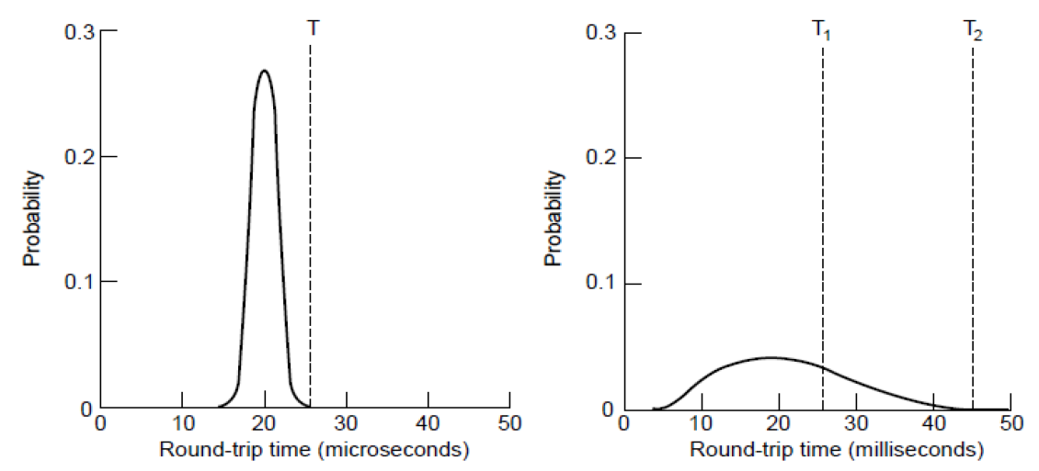
TCP Timer Management
Probability density of ACK arrival times in the data link layer.
Probability density of ACK arrival times for TCP.
computer network

Slide 45
作业
6.1, 6.2, 6.5, 6.9, 6.11, 6.26,6.28, 6.30，6.32，6.33
computer network

