Slide 1
Risk Management Framework (RMF)

Slide 2
Background
E-Government Act (2002)
FISMA (Federal Information Security Management Act) :
requires all federal agencies to develop, document, and implement an information security program
NIST (National Institute of Standards and Technology) develops:
Security standards, guidelines, and requirements (FIPS, SP) to reduce security risk for federal information
Notes:
The 2014 update mainly changed less overall reporting and more continuous monitoring in systems,
And more agency compliance
All DoD IT that receive, process, store, display, or transmit DoD information (includes research, development, test and evaluation, and DoD-controlled IT operated by a contractor)
Exception is for SCI (sensitive compartmented information)

Slide 3
Background
CNSS (Committee on National Security Systems)
OMB (Office of Management and Budget)
Mandates NIST standards
Manage federal spending on information security

Slide 4
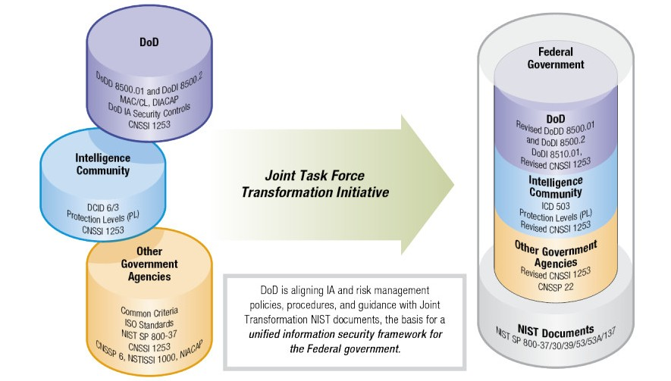
Risk Management Framework
Unified information security framework for the Federal government
also applies to
contractors
Process built
on existing policies
and standards

Slide 5
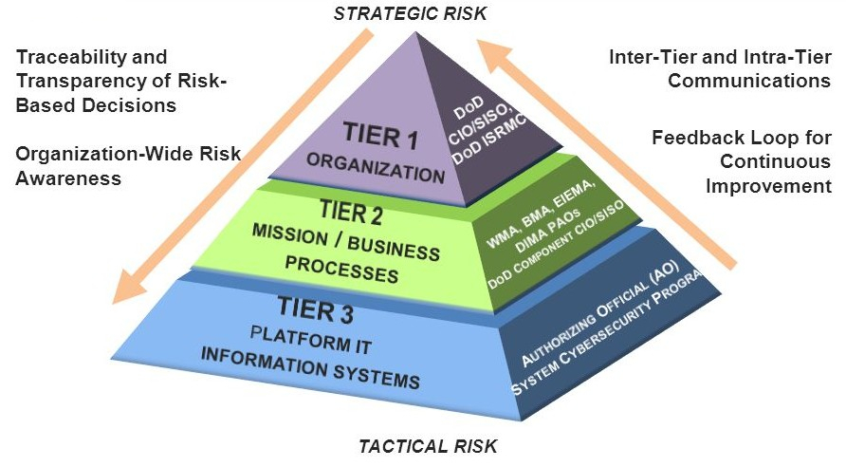
Management Tiers
Notes:
Have to apply different controls at different levels
Ex: at system level a firewall or logs
At mission level it is physical security/ hr

Slide 6
Roles
Risk Executive Function (REF) – ensures security considerations are viewed from organization-wide perspective and how they affect mission/business success, ISRMC (Information Security Risk Management Committee)
Technical Advisory Group (TAG) - provide implementation guidance for RMF
Chief Information Officer (CIO) – directs and oversees cybersecurity risk management
Senior Information Security Officer (SISO) - represents the CIO and directs and coordinates cybersecurity program, including RMF
Information System Owner (ISO) & Information Owner (IO) - categorize information system, gain approval for categorization decision and maintain it
Information System Security Officer (ISSO) – supports ISO and IO
Security Control Assessor (SCA) – assesses security controls of IS to determine effectiveness and recommends corrective actions
Authorizing Official/Designated Representative (AO) – review and approve information system security,
formally assumes responsibility for operating an IS

Slide 7
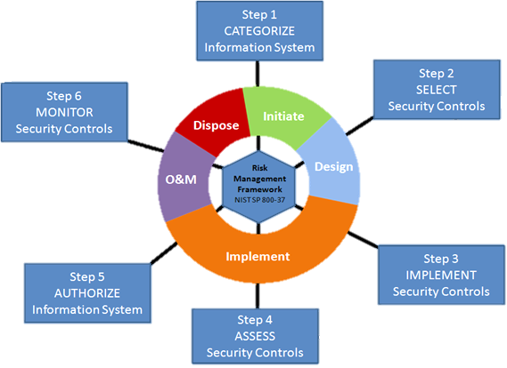
System Development Life Cycle (SDLC)
Notes:
Operation and maintenance

Slide 8
Step 1: Categorize Information System
Identify and determine value of the system and the information it processes, stores, and transmits
Criticality of information and system: value lost per time
Sensitivity of information and system: confidentiality and privacy
Main responsibility of ISO & IO
Potential worst-case impact to the organization, mission/business
Notes:
Because information security is not separate from business, but it enables business
So it must categorized according to value in money
Incorrect security categorization
Can result in overprotection and wasting resources
Underprotecting and putting operations and assets at risk
Needs to be revisited every three years or when significant change to system or business lines, or outside changes like elevated threat levels, mission changes, change in governance and legislative policies

Slide 9
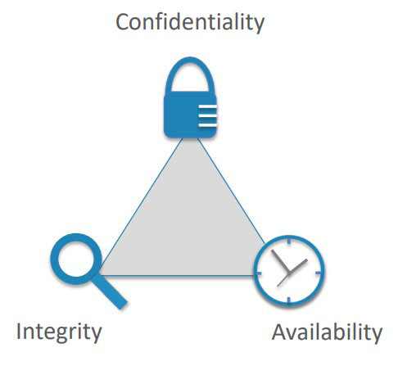
FIPS 199 (Federal Information Processing Standards)
Standards for Security Categorization of federal Information and Information Systems
Security Objectives
Confidentiality: prevent unauthorized disclosure of information (personal and proprietary)
Integrity: prevent unauthorized modification or destruction of information, and ensure non-repudiation and authenticity
Availability: prevent disruption of access to information/IS
Notes:
Determine the potential impact level of the information/IS for each of the categories (confiden, integrity, and avail)
confidentialiy: protect personal privacy and proprietary info, stealing identities and credit card infos from shopping accounts
Integrity: protect against information modification or destruction, and ensure non repudiation and authenticity, forensics
Availability: ensure timely and reliable access to the information, ddos attacks and ransomware

Slide 10
FIPS 199
Standards for Security Categorization of federal Information and Information Systems
Security Objectives
Impact Level
LOW: loss of objectives could have a low adverse impact
MODERATE: loss of objectives could have a serious adverse impact
HIGH: loss of objectives could have a catastrophic adverse impact
Notes:
Determine the potential impact level of the information/IS for each of the categories (confiden, integrity, and avail)
confidentialiy: protect personal privacy and proprietary info, stealing identities and credit card infos from shopping accounts
Integrity: protect against information modification or destruction, and ensure non repudiation and authenticity, forensics
Availability: ensure timely and reliable access to the information, ddos attacks and ransomware

Slide 11
NIST SP 800-60
Guide for Mapping the Information Types and IS to Security Categories (Confidentiality, Integrity, Availability)
Defines baseline profile for each of the listed information types
Format:
Security Category Information Type = { (confidentiality, Impact Level), (integrity, Impact Level), (availability, Impact Level) }
Notes:
Nist stands for
Baseline or the minimum
You can adjust the impact level if there is potential for a more serious impact. This needs a justification, and it needs to be approved by the AO

Slide 12
Information System Impact Level
High Water Mark: choose the highest potential impact level
Ex: Security Category contract information = { (confidentiality, Moderate), (integrity, Moderate), (availability, Low) }
Since the highest impact level for the Information Type is Moderate in the integrity security category, the high water mark for the Information System is Moderate
Notes:
For the system development information type, it has C of low, I of moderate, A or low
So high water mark would be moderate

Slide 13
System Security Plan (SSP)
Document impact levels for each Information System, based on its Information Types
If adjustments needed, write justifications for AO approval
Document system descriptions for each Information System
Document system interconnections
Register each Information System
eMASS (Enterprise Mission Assurance Support Service) :
automates generating reports, registering systems, decommissioning systems; has updated database of security controls; automates security control inheritance; security assessment collaborations
Notes:
Security control inheritance (which we will talk about later)

Slide 14
System Development Life Cycle (SDLC)
Notes:
Operation and maintenance

Slide 15
Step 2: Select Security Controls (SC)
Select baseline security controls for system based on security categorization
Tailor the security controls as needed based on risk assessment
Notes:
Fips 200: Minimum Security Requirements
sp 800-53: Recommended Security Controls
Need a balance between security and functionality (accepted risk)

Slide 16
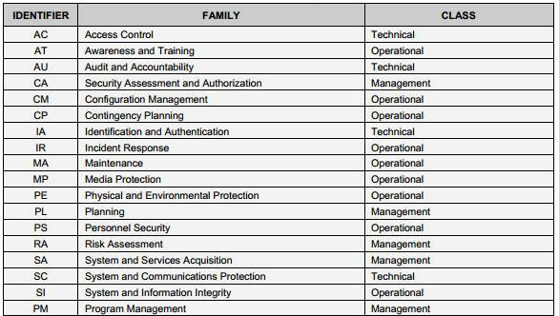
FIPS 200
Minimum Security Requirements for Federal Information and IS
Refers to SP 800-53 for actual controls
17 Families (security-related areas)
Notes:
Says that there are 17 security related areas where federal agencies must meet certain minimum requirements
Includes management, operational, and technical controls (types of security controls)
M: administrative or management methods for risk (security policy, risk and vulnerability assessments, penetration tests)
O: implemented and executed by people (not by systems) – awareness and training (clean desk – media protection, awareness against phishing), configuration and change management (systems start in a secure state), backup plans against system outages (contingency), physical protection like cameras and door locks
T: implemented and executed by system (through hardware, software, or firmware) – disable typing in passwords after certain number of attempts, encryption, antivirus, firewalls, least privelege
There may be some overlaps between the classes
Least privilege: give only required functionality to each user
For the actual requirements refer to the NIST SP 800-53

Slide 17
SSP 800-53
Baselines determined by:
Information and system category (L, M, H)
Organizational risk assessment and risk tolerance
System level risk assessment
Baselines should be tailored (or it will just be a checklist)
Used as starting point

Slide 18
Control Types
Common: organization-wide and inherited
System: have to implement specific to that system
Hybrid: combination of common and system specific
Notes:
policy for a system is deemed common but the procedures implementing the policy are deemed system-specific.

Slide 19
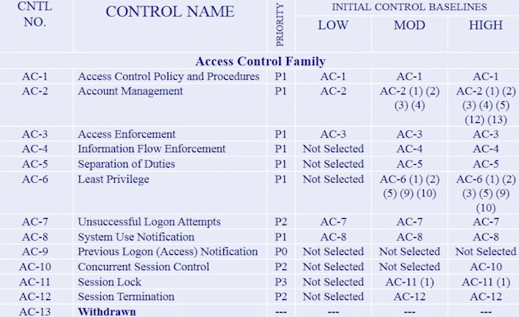
SSP 800-53 example

Slide 20
Overlays
Baseline + specific tailoring
Intent to apply to a group/larger community
Easier to apply to many at once
Overlay for IS in environments of operation (space)
Overlay for IS in nuclear power industry

Slide 21
Document Security Controls in SSP
Document Selected Security Controls in SSP (System Security Plan)
Document rationale for tailoring (controls added or removed)

Slide 22
System Development Life Cycle (SDLC)
Notes:
Operation and maintenance

Slide 23
Step 3: Implement Security Controls (SC)
Implement security controls and document how controls are deployed within the system and environment of operation (in SSP)
Notes:
Sp 800-34, sp 800-61, sp 800-128

Slide 24
Step 4: Assess Security Controls (SC)
Purpose: Determine if security controls are implemented correctly, operating as intended, and meeting the security requirements for the system

Slide 25
NIST SP 800-53A
Guide for Assessing the Security Controls in Federal Information Systems
Interview
People
Examine
Specifications (documents, policies, procedures)
Mechanisms (functionality in hardware, software)
Activities (system ops, administration, management)
Test
Mechanisms and activities

Slide 26
SAP (Security Assessment Plan)
Determine which controls are to be assessed
Select assessment procedures (penetration tests) for verifying security control compliance
Schedule for assessments
Security Control Assessor (SCA) conducts on-site validation/assessment of security controls
Notes:
Blue team

Slide 27
SAR (Security Assessment Report)
SCA documents issues, findings of the security assessments
SCA provides recommendations
Weaknesses found are added to POA&M

Slide 28
POA&M (Plan of Action and Milestones)
Corrective action plan for any found vulnerabilities
Identify type of weakness
Point of Contact (office/organization responsible for resolving weakness)
Resources Required to resolve weakness
Scheduled Completion Date
Milestones with completion dates
Changes to milestones
Identify Source of weakness
Status (ongoing/completed)
Notes:
Lack of experience or funding
Finalized ssp and sar at this point

Slide 29
Finish Fixing POA&M
SCA revalidation visits if necessary
Finalized SSP
Finalized SAR
SCA provides authorization decision recommendation to AO
Submit security authorization package to AO (SSP, SAR, POA&M)

Slide 30
Step 5: Authorize Information System (IS)
AO reviews security authorization package (SSP, SAR, POA&M) to see if risk is acceptable
AO issues an authorization decision for the IS
Notes:
Sp 800-37: guide for security certification and accreditation of federal IS
Authorize information system operation based upon a determination of the risk to
organizational operations, organizational assets, or to individuals resulting from the
operation of the information system and the decision that this risk is acceptable as
specified in NIST SP 800-37, Guide for the Security Certification and Accreditation of
Federal Information Systems.

Slide 31
Authorization Decisions
ATO (Approval to Operate)
lasts up to 3 years
implemented all assigned SC
acceptable residual risk
responsibility on AO
IATT (Interim Approval to Test)
special case for testing in an operational information environment for a short time period
DATO (Denial of Approval to Operate)
system should not be allowed to operate
IA controls or security is inadequate
Authorization Termination Date (ATD)
Notes:
lasts up to 180 days
no more than 2 consecutive IATOs
manage security weaknesses while allowing system operation

Slide 32
System Development Life Cycle (SDLC)
Notes:
Operation and maintenance

Slide 33
Step 6: Monitor Security Controls (SC)
Updates SSP, POA&M if necessary
Security impact analyses on changes to IS
Regular status reports to officials
Automated tools and configuration management
NIST SP 800-137 – Information Security Continuous Monitoring
Notes:
Need to get ao approval and it could impact the authorization decision

Slide 34
Differences from Previous DIACAP
DIACAP | RMF
DoD Information Assurance Certification and Accreditation Process | Risk Management Framework
Certification & Accreditation (C&A) | Assessment & Authorization (A&A)
Less SDLC integration | Early security mindset – stronger SDLC integration
Confidentiality Levels (Classified, Sensitive, Public) + Mission Assurance Category (MAC) Levels (I, II, III) | Impact Levels (Low, Moderate, High)
Standard for DoD only | Standard for all federal agencies and contractors
 | Reciprocity (mutual exchange of privileges ) – standards controls and common terminology
Renewed every 3 years | Continuous Monitoring
IATO (Interim Approval to Operate) – still some risk need to be fixed | ATO with Conditions
Notes:
Overall it will increase efficiency and cost savings
Trust across federal government

