Slide 1


Crew Resource Management
Module 3 Human Error and Reliability
Notes:
Welcome to this online Crew Resource Management Course.
The course is designed to enable you to:
Define CRM
Understand the background to its conception and
Appreciate the importance of CRM for safe and optimal working practices.

Slide 2
Human error – early research
Heinrich's triangle is a theory of industrial accident prevention. In a workplace, for every accident that causes a major injury, there are 29 causing minor injuries and 300 causing no injuries.
Heinrich stated: 88% of all workplace accidents and injuries are caused by ‘man-failure’
1 Major Accident
29 Accidents with minor injury
300 Accidents with no injury
Notes:
Herbert William Heinrich, an Assistant Superintendent of the Engineering and Inspection Division of Travelers Insurance Company, published a book titled 'Industrial Accident Prevention, A Scientific Approach' in 1931. One empirical finding from his 1931 book became known as Heinrich's Law: that in a workplace, for every accident that causes a major injury, there are 29 accidents that cause minor injuries and 300 accidents that cause no injuries.
Heinrich's work is claimed as the basis for the theory of behaviour-based safety, which holds that the large majority of all workplace accidents are caused by unsafe acts. Heinrich came to this conclusion after reviewing thousands of accident reports completed by supervisors, who generally blamed workers for causing accidents without conducting detailed investigations into the root causes.
According to Heinrich, 88% of all workplace accidents and injuries are caused by 'man-failure'.

Slide 3
Human error – further research
Heinrich’s was the first scientific study to report the often quoted 70-90% incidence of ‘human error’
Many more studies of accidents in aviation and other industries have concluded that 70-90% are due to ‘Human Error’
However, the modern consensus (Dekker, IOSH, many regulatory bodies, etc) is that:
The causes of accidents are far more complex than just ‘Human Error’ and involve the interaction of the human with the system, environment, equipment, procedures, competing goals etc.
Notes:
Heinrich's was the first scientific study to report the often-quoted 70-90% incidence of 'human error'.
Many more studies of accidents in aviation and other industries have concluded that 70-90% are due to 'Human Error.' However, the modern consensus, formed by Dekker, the Institution of Occupational Safety and Health, and many regulatory bodies, is that:
The causes of accidents are far more complex than just 'Human Error' and involve the interaction of the human with the system, environment, equipment, procedures, competing goals, etc.

Slide 4
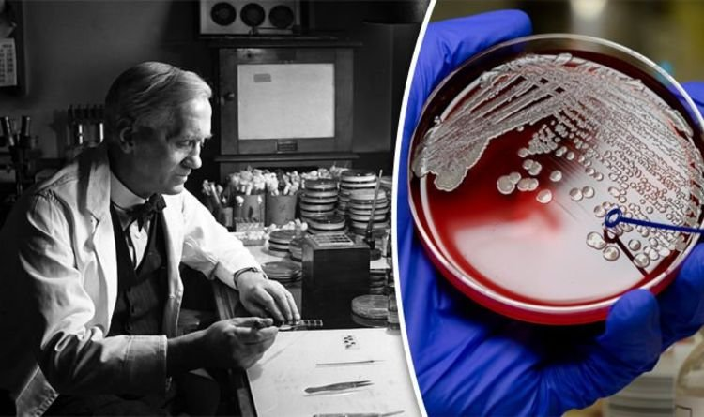
Are errors always bad?
Are errors always bad?
Errors are often associated with a negative outcome of some kind: a performance shortfall
However sometimes people perform unintended actions that turn out to be for the better. These unexpected actions are rarely designated as ‘errors’.
E.g. Alexander Fleming’s discovery of penicillin in 1928 is often described as ‘accidental’ but is rarely (if ever) described as ‘erroneous’!
LOSA data indicates that 75% of errors had no consequences
Notes:
Errors are almost always associated with a negative outcome of some kind: a performance shortfall. However, sometimes people perform unintended actions that turn out to be for the better. These unexpected actions are rarely designated as errors.
For example, Alexander Fleming’s discovery of penicillin in 1928 is often described as 'accidental', but is rarely (if ever) described as 'erroneous'.
Fleming’s legendary discovery of penicillin occurred while he was investigating staphylococcus, a common type of bacteria that causes boils and can also cause disastrous infections in patients with weakened immune systems. Before Fleming left for a two-week trip, a petri dish containing a staphylococcus culture was left on a lab bench and never placed in the incubator as intended. Somehow, in preparing the culture, a Penicillium mould spore had been accidentally introduced into the medium, perhaps coming in through a window or more likely, floating up a stairwell from the lab below where various moulds were being cultured. The temperature conditions that prevailed during Fleming’s absence permitted both the bacteria and the mould spores to grow; had the incubator been used, only the bacteria could have grown.
LOSA data indicates that 75% of errors had no consequences.

Slide 5
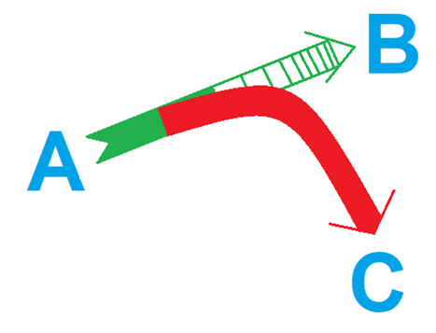
Defining human error?
Human error can be defined as
(University of Texas)
A consequence of human involvement which causes deviation from an individual’s or organisational intentions or expectations
Notes:
Human error can be defined as:
'A consequence of human involvement which causes deviation from an individual’s or organisational intentions or expectations.'
Human error refers to the mistakes, actions, or decisions made by individuals that lead to undesirable or unintended outcomes. Human error occurs in all aspects of life, including personal and professional.
Human error is a significant factor in many accidents, failures, and incidents across all industries. However, aviation is especially notable for their high probability of human errors resulting in severe harm to life, and this industry has therefore been at the forefront of efforts to reduce human errors.
Understanding human error is crucial for designing systems, procedures, and environments that minimize the likelihood and impact of errors. Approaches like human factors and ergonomics aim to improve the compatibility between humans and the systems they interact with, considering human limitations, capabilities, and potential sources of error.

Slide 6
Categorising errors
Errors are actions or inactions that fail to achieve their intended outcomes
Violations are intentional actions or inactions that break known rules, procedures or norms
However, negative consequences are not intentional
The term ‘Human Error’ is often used to encompass both errors and violations
Notes:
Errors are actions or inactions that fail to achieve their intended outcomes. Violations are intentional actions or inactions that break known rules, procedures, or norms. However, the negative consequences which may result are not intentional. The term ‘human error’ is often used to encompass both errors and violations.

Slide 7
Categorising human error
Slips
Not doing what you’re meant to do
Lapses
Forgetting to do something
Mistakes
Do the wrong thing, believing it to be right
Routine
Strong, but wrong habits (norms)
Violations
Situational
Rule breaking seen as necessary evil
Exceptional
Conscious decision to violate
Notes:
Human errors are often categorised into Slips, Lapses, Mistakes, and Violations.
Slips. These are actions that do not go as planned, while lapses are memory failures. For example, operating the flap lever instead of the (intended) gear lever is a slip. Forgetting a checklist item is a lapse. Slips are usually easy to detect quickly and do not have immediate serious consequences due to built-in system protections.
Lapses. These may be more difficult to detect and therefore may also be more likely to have consequences.
Mistakes. These are failures in the plan of action. Even if execution of the plan was correct, it would not be possible to achieve the intended outcome. Mistakes are even more dangerous because the person committing the mistake believes that he or she is doing the correct thing, and thus carries on with the action often despite a growing number of signs that things are not going right. They can be rule or knowledge-based.
Violations. These are like mistakes, but with an increased potential to deviate to an abnormal type of operation with an associated increase in risk. Many violations are tempting because often they bring benefits without any readily apparent drawbacks. Routine violations result from automatic and sometimes unconscious behaviour. They are habitual actions (strong, but wrong, habits) accepted by the workgroup as normal business and are often tolerated by the organisation and/or governing body. Employees will usually consider routine violations as low risk to themselves and the task. For example, airside drivers may always drive 10 kilometres per hour above the mandatory speed limit. Routine violations tend to occur at the skill-based level – they have become part of a person’s automated routine.
Situational violations are the result of organisational and environmental factors that make it difficult for employees not to commit violations. These factors include time pressure, lack of supervision, poor ambient conditions (for example, light, noise, and heat), insufficient resources, and a negative culture. Technicians may find themselves “signing-off” completed work on an aircraft without acquiring the necessary supervisory cross-check, either because of a lack of supervisors or because the process takes too long. Situational violations tend to occur at the rule-based level, where people take actions deemed necessary to get the job done.
Exceptional violations are rare occurrences that take place in very unusual circumstances (for example, emergencies or equipment failure). They can be the result of a conscious decision to violate or an instinctive reaction to the situation. Conscious decisions may include landing with an excessive tailwind on a long runway following a hydraulic systems failure, rather than risking further consequences during the time it takes to re-position for the preferred runway. Instinctive reactions fall much closer to the caveat that pilots may violate rules if it is safer to do so – for example, continuing with an unstable approach to land following an uncontained engine failure. Exceptional violations tend to occur at the knowledge-based level as they mostly occur in unique and unfamiliar circumstances.

Slide 8
Human error and accident causation
Errors are not limited to incidents and accidents
University of Texas LOSA studies:
Errors and violations:
60% of the flights at least one error or violation
25% of those errors and violations had consequences
Errors:
~ 33% were detected & corrected
~ 4% detected but made worse
~ 60% of errors went undetected
Human error is all around us... this is why TEM is so important!
Notes:
Not all errors cause accidents, and not all accidents are caused by errors.
Statistics from the University of Texas LOSA database show the following:
In 60% of the flights, at least one error or violation was observed, with the average per flight being 1.5.
A quarter of the errors and violations were mismanaged or had consequences, resulting in an undesired aircraft state or an additional error.
A third of the errors were detected and corrected, 4% were detected but made worse, and over 60% remained undetected.
Human error is normal and prevalent in flight operations.
If an error is committed, either by a member of the crew or someone external, it is the duty of everyone to detect that error. Using effective monitoring, cross-checking, and verification, as well as evaluating the quality of any decisions made, all contribute to error detection.

Slide 9
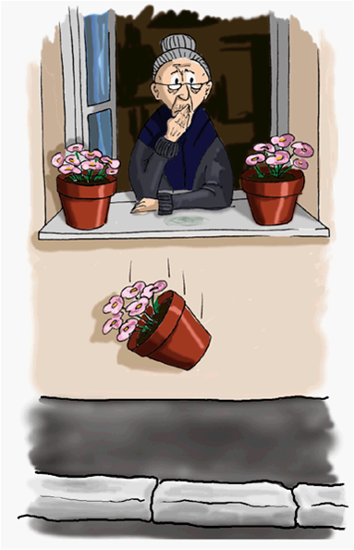
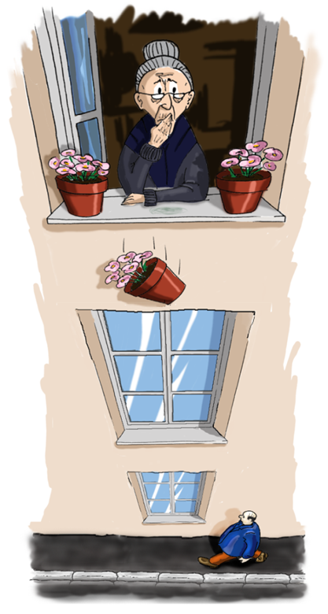
Error causes and consequences
The causes and consequences of operational errors are not linear in their magnitude
Notes:
The causes and consequences of operational errors are not linear in their magnitude. An error committed in a benign area may have very little consequence. However, the same error committed in a setting where there is a threat may have a much graver outcome.

Slide 10

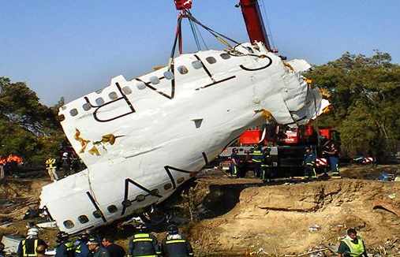
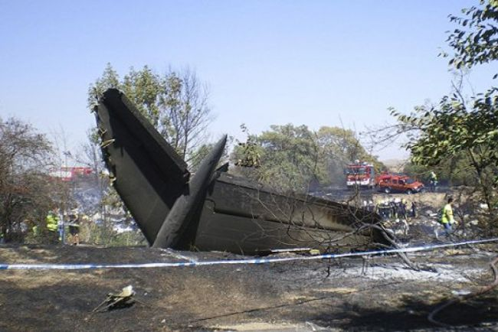
Error consequences depend on context
The same error can have completely different consequences, depending on the factors involved
Eg. Error (lapse) - Setting the flaps correctly for take-off is forgotten. Factors influencing the consequences:
Aircraft type and performance - Actual take-off weight - Runway length - obstructions ahead - Take-off configuration warning (Spanair Flight 5022)
Notes:
The consequences of a human error are unpredictable and depend on the context. In a complex system with multiple defences, an accident usually involves multiple contributing factors, some visible and others being more distant from the actual accident. The consequences of an error typically depend more on factors other than the apparent gravity of the error. The same error can have completely different consequences, depending on the factors involved. It is usually wrong to think that a big catastrophe must have been preceded by an equally serious error. More commonly, it is the number of errors and the capability of the system to contain the errors that determine the outcomes.
For example, in the case of Span-air Flight 5-zero-2-2, the error (a lapse), was that setting the flaps correctly for take-off was forgotten. Factors influencing the consequences included:
The aircraft type and performance.
Actual take-off weight.
Runway length and obstructions ahead, and
Take-off configuration warning.
This led to 1hundred-and-46 fatalities.

Slide 11
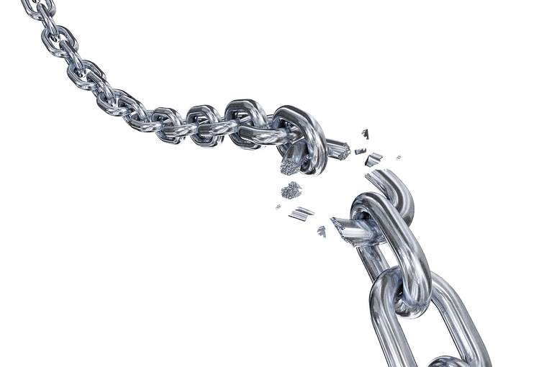
The error chain
Very few incidents are caused by a single error
In most cases, multiple “links” in the error chain
Some links may be present for years - latent failures
Other links are more immediate - active failures
If any link is broken, it may prevent an incident.
Notes:
The error chain is a concept that describes human error accidents as the result of a sequence of events that culminate in a mishap. There is seldom one predominant cause, but rather several contributing factors or errors; hence the term "error chain". There are several Error Chain Models that illustrate the concept. The following model identifies links in the chain by means of 11 cues. Just as no chain is stronger than its weakest link, breaking any one link in the chain might potentially break an error chain and prevent a mishap.
It could be suggested that flight crews, unknowingly progressing toward a mishap, might interrupt that sequence of events such that it would not occur. More than 30 accidents and incidents were examined by one group of researchers to test the concept of error chains. Each was considered from the following perspective: "If the flight crew had been trained to be proficient in recognising links in error chains, and if such links were present in the operating environment and were subsequently found, would it have caused a different response and outcome?" In each event considered, the answer was "yes". The fewest links discovered in any one accident were four; the average was seven. Yet, recognising and responding to only one link is all that is potentially necessary to change an outcome. The presence of more than one link serves to enhance the potential for timely recognition of an error chain.
While an error chain might be relatively easy to reconstruct during accident investigation, the presence of one may be difficult for a flight crew to detect as it occurs. Familiarising flight crews with the concept of the error chain will help to improve matters in this respect.

Slide 12
Managing error
Understand the nature and extent of the error or risk
Change the conditions that induce the error
Determine the behaviours that prevent or mitigate error
CRM principles and skills are key to help prevent errors occurring and error chains from developing
Remember “Avoid – Trap – Mitigate”
Avoid – prepare, plan
Trap – Monitor, challenge
Mitigate – Manage, take action, limit the consequenses
Notes:
In a complex system, errors cannot be completely prevented. Error management strategies are required:
Prevention is possible only in some specific cases and, almost without exception, requires design-based solutions.
Reduction aims at minimizing both the likelihood and the magnitude of the error.
Detection aims at making errors apparent as fast and as clearly as possible.
Recovery aims at making it easy to rapidly return the system to its safe state after an error has been committed.
Tolerance aims at making the system better able to sustain itself safely despite the error.
From a T.E.M standpoint, we should strive to ‘avoid’ errors whenever possible, develop strategies to ‘trap’ errors before they have adverse consequences, and lastly, we need to be able to use ‘mitigation’ strategies if an error has not been trapped and has resulted in some type of adverse consequence.

Slide 13
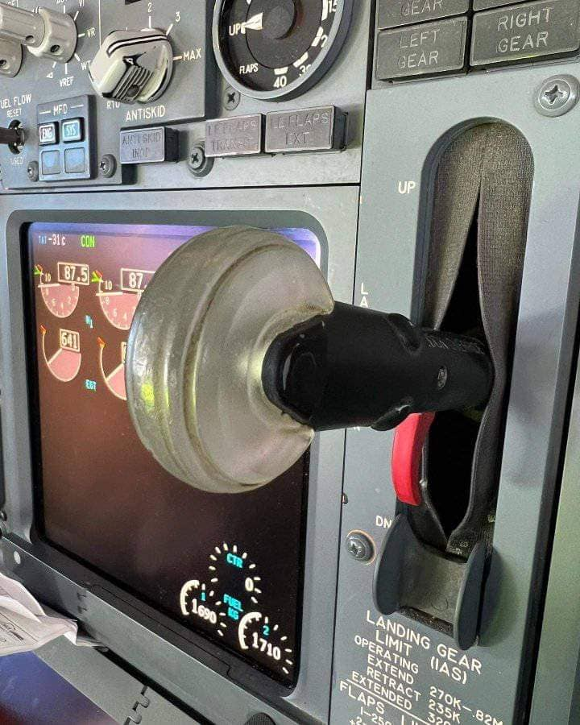
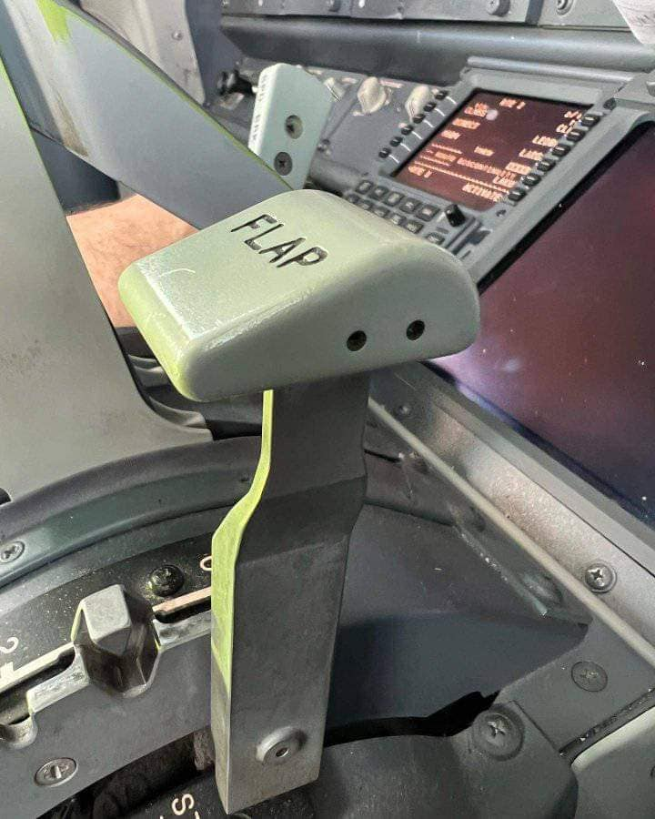
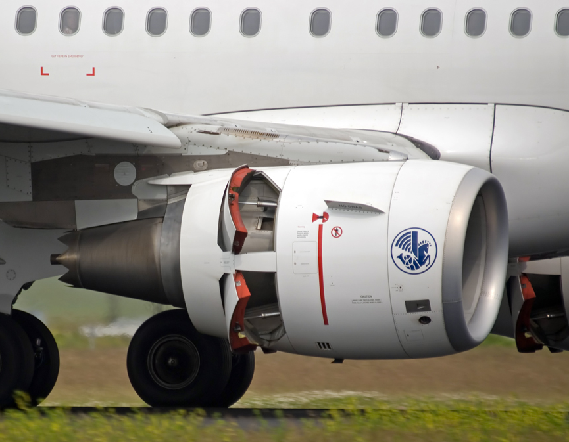
Design for error reduction and prevention
“If an error is possible, someone will make it. The designer must assume that all possible errors will occur and design so as to minimise the chance of the error.”
Flap, spoiler and gear levers shapes to symbolise their functions
Air/ground sensor system prevents incorrect deployment of thrust reversers
Notes:
Don Norman wrote, “If an error is possible, someone will make it. The designer must assume that all possible errors will occur and design so as to minimise the chance of the error.”
There are many examples in aviation of design for error reduction. A couple of examples are:
Shaping the flap, spoiler, and landing gear levers to symbolise their functions reduces slips involving the use of the wrong lever.
An air/ground sensor system prevents errors associated with raising the landing gear or deploying the thrust reversers.

Slide 14
Blaming and fault
Fundamental attribution error
When we hear of a person committing an error, we tend to attribute negative elements associated with making an error such as stupidity, laziness, carelessness, etc., to that person
We often ask ourselves how someone could be so silly as to commit a particular error
Such attribution is an error in itself, since people do not intentionally commit errors
Instead, the circumstances surrounding an error, the background, training, culture and many other factors provide the true reasons why an error occurred
Notes:
When we hear of a person committing an error, we tend to attribute negative elements associated with making an error, such as stupidity, laziness, and carelessness, to that person. We often ask ourselves, “How could someone be so silly as to commit this particular error?”. Such attribution is an error in itself, since people do not intentionally commit errors. Instead, the circumstances surrounding the error, the background, training, culture, and many other factors provide the true explanation for why an error occurred.

Slide 15
Reliability
What factors may affect reliability?
Age
State of mind
Physical health
Attitude
Emotions
Cognitive biases
Notes:
What are the factors that may affect our reliability to perform safely?
...Age, – the older we get, the less reliable our memory is, our hearing and sight may be less acute, and it becomes more difficult to learn new skills and take in new information.
...State of mind, – a negative state of mind can create a bias that ‘everything is bad’ and it becomes more difficult to visualise a positive outcome to a situation.
...Physical health, – physical health might prevent or restrict us from doing our jobs properly, and in turn can influence our state of mind.
...Attitude, – a person’s attitude can change throughout their career. When new to a role very often people are keen and willing to learn. This attitude can change as we get older and established in our job roles. People can become resistant to change. Organisational culture can also influence a person’s attitude.
...Emotions, – emotions can be triggered by outside influences or internal influences. People might find it difficult to return to work after an incident investigation or a family bereavement. Emotions can be triggered by job security worries or financial issues.
...Cognitive biases, - cognitive bias refers to systematic patterns of thinking or judgment that deviate from rational and objective reasoning. It involves the tendency of the human mind to make errors in perception, memory, and decision-making, due to various psychological factors. These biases can influence our interpretation of information, affect our judgements, and impact our decision-making processes. Common cognitive biases include anchoring bias, confirmation bias, hindsight bias, and continuation bias.

Slide 16
Reliability
What factors may improve reliability?
Experience
Focused attention
Good physical and mental health
Keep emotions in check
Positive attitude
Training and reporting
Awareness of cognitive biases
Human performance is constantly variable, from day-to-day and from person-to-person
Ideally the system will be designed to tolerate the normal range of variations in human performance
Notes:
Here are some factors that may improve reliability:
Experience.
Focused attention.
Good physical and mental health.
The ability to keep emotions in check.
A positive attitude.
Training and reporting, and
Awareness of cognitive biases.
A point that could be drawn from these two slides is that human performance is constantly variable. From day-to-day and from person-to-person. Ideally, the system will be designed to tolerate the normal range of variations in human performance.

Slide 17
Summary
The issue is not how we define human error, or even who is to blame, but rather how to prevent errors
It is essential to flight safety that we maintain a proper focus on how to recognise and interrupt the hazardous sequence of events that precedes a mishap.
Threats require crew attention and management if safety margins are to be maintained
Threats can be countered and errors managed by the defences provided by CRM skills
Notes:
The issue is not how we define human error, or even who is to blame, but rather how to prevent errors. It is essential to flight safety that we maintain a proper focus on how to recognise and interrupt the hazardous sequence of events that precedes a mishap. Threats require crew attention and management if safety margins are to be maintained. Threats can be countered, and errors managed by the defences provided by C.R.M. skills.

Slide 18

Quiz
Notes:
Please now complete the end of module quiz which can be found on the Learning Management System.

