Slide 1
Advanced Methods for Predictive Analytics
Glen Martin, Niels Peek, David Jenkins & Hannah Lennon
Notes:
This is a 15-minute lecture that gives an overview of the tutorial and gives tutors and students the opportunity to introduce themselves.

Slide 2
Motivation
Predictive Analytics and Clinical prediction models (CPMs) are becoming abound in the statistical, medical and informatics literature
They play a key role in making medicine more preventive, precise, and personalised
The opportunity for developing CPMs is fuelled by the ongoing data revolution in health and care
It is important the informaticians are aware of best practice and latest developments

Slide 3
Intended Learning Objectives
By the end of this tutorial, attendees will
Have a demonstrable understanding of best practices in the development and validation of CPMs
Be able to identify the differences between internal and external validation, and communicate why both are important
Have gained an awareness of different types of modelling techniques that can be used for predictive analytics, and an awareness of new and emerging techniques.
Be able to communicate common pitfalls in the development and validation of CPMs and how to avoid them.

Slide 4
Schedule
08.30 - 08.45 Welcome and introduction
08.45 - 09.00 Clinical Prediction Models: Real-world examples
09.00 - 09.20 Seven steps for developing a prediction model
09.20 - 10.00 Logistic regression + practical
10.00 - 10.20 Break
10.20 - 11.30 Survival analysis + practical
11.30 - 13.00 Validation / Pitfalls / Reporting of CPMs + practical
13.00 - 14.00 Lunch break
14.00 - 15.15 Machine Learning + practical
15.15 - 15.40 Advanced topics
15.40 - 16.10 Questions

Slide 5
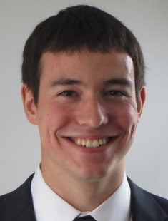
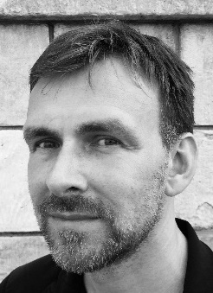

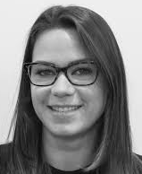
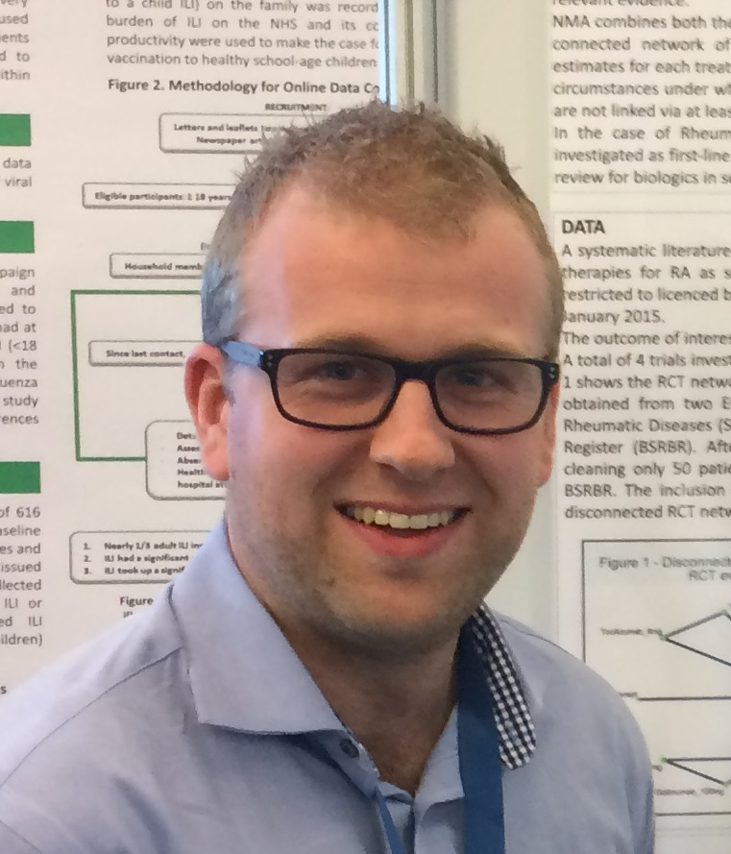
About the tutors
Dr Glen Martin Lecturer in Health Data Sciences
The University of Manchester Manchester, UK
Prof Niels Peek Professor of Health Informatics
The University of Manchester Manchester, UK
Mr David Jenkins Research Associate in Medical Statistics
The University of Manchester Manchester, UK
Dr Hannah Lennon Researcher, Statistican
WHO International Agency for Research on Cancer Lyon, France

Slide 6
About you
Take a few minutes to introduce yourself to your neighbour, and tell them
where you are from
what is your background
why you are here
and what you would be doing if you were not here

Slide 7

Questions?

