Slide 1
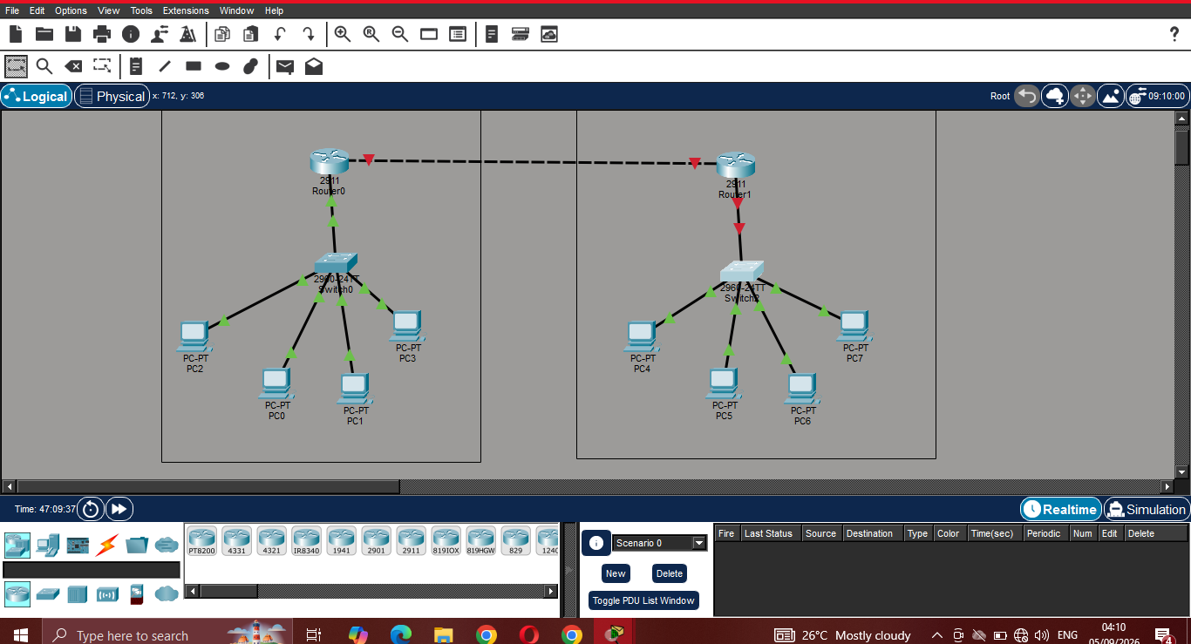
Cisco Router & Switch
Initial Configuration and Network Connectivity Lab
Mini Project Presentation
Group: ____________________
Students: ______________________________
Department/Class: ______________________
Date: _________________________________
Completed Packet Tracer topology

Slide 2
Lab Objectives
The project focuses on initial device configuration, security, addressing, and connectivity.
Configure router hostnames using the assigned group ID.
Secure privileged EXEC and console/user EXEC access.
Configure remote management using SSH and VTY lines.
Encrypt passwords and configure a legal login banner.
Assign IPv4 addresses and activate router interfaces.
Configure switch management IP addresses and default gateways.
Configure PC default gateways and verify end-to-end connectivity.
Save the running configuration for future use.
Cisco Packet Tracer | Initial Router & Switch Configuration
2

Slide 3
Network Topology
Two routers connect two separate LANs, each containing one switch and four PCs.
Figure: Packet Tracer topology created for the mini project
Cisco Packet Tracer | Initial Router & Switch Configuration
3

Slide 4
IP Addressing & Subnetting
The lab brief contains both /24 and /29 references; this addressing table follows the configured screenshots (/24).
Segment | Network | Mask | Purpose | Example Gateway
LAN 1 | 192.168.10.0 | 255.255.255.0 | Router 1 LAN | 192.168.10.1
LAN 2 | 192.168.20.0 | 255.255.255.0 | Router 2 LAN | 192.168.20.1
R1–R2 Link | 10.0.0.0 | 255.255.255.252 | Inter-router link | 10.0.0.1 / 10.0.0.2
S1 Management | 192.168.10.0 | 255.255.255.0 | VLAN 1 | 192.168.10.1
S2 Management | 192.168.20.0 | 255.255.255.0 | VLAN 1 | 192.168.20.1
PC Networks | 192.168.10.x / 20.x | 255.255.255.0 | End devices | Router LAN IP
Subnetting Note
Professional Recommendation
The presentation requirement mentions 192.168.10.0/29, while the provided topology and device screenshots were configured with /24 masks.
Use one addressing scheme consistently. Confirm the required mask with the instructor before final submission.
Cisco Packet Tracer | Initial Router & Switch Configuration
4

Slide 5
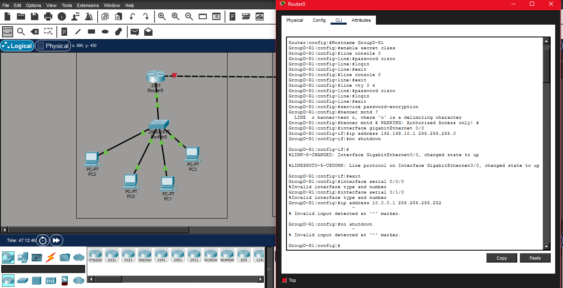
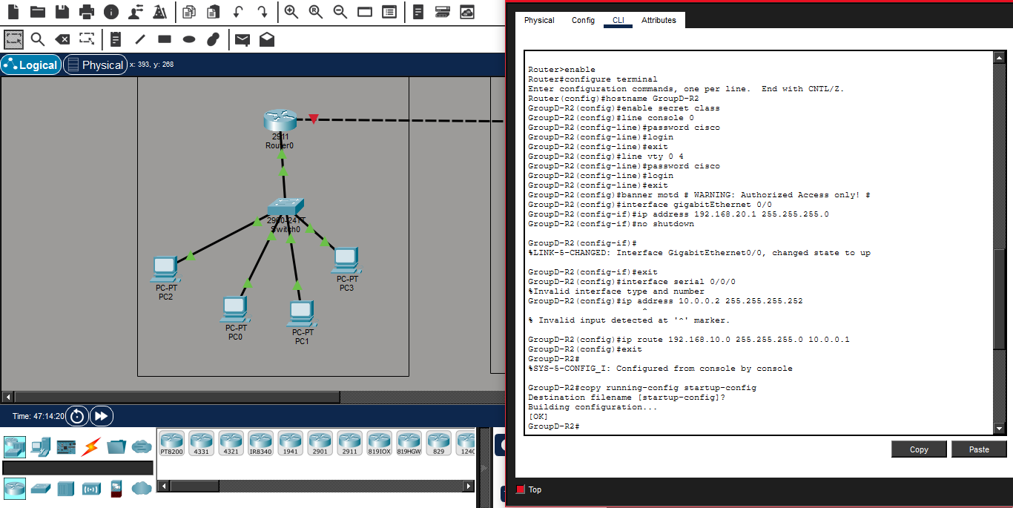
Router Initial Configuration
Router 1 and Router 2 were configured with hostnames, passwords, password encryption, and a warning banner.
Router 1 configuration evidence
Router 2 configuration evidence
Security Controls Demonstrated
Hostname • enable secret • console password • VTY password • service password-encryption • legal warning banner
Cisco Packet Tracer | Initial Router & Switch Configuration
5

Slide 6
Interface Configuration & Activation
Router LAN interfaces were assigned IPv4 addresses and activated using the no shutdown command.
Router 1 LAN Interface
interface gigabitEthernet 0/0 ip address 192.168.10.1 255.255.255.0 no shutdown
Router 2 LAN Interface
interface gigabitEthernet 0/0 ip address 192.168.20.1 255.255.255.0 no shutdown
Router interface configuration shown in Packet Tracer
Cisco Packet Tracer | Initial Router & Switch Configuration
6

Slide 7
SSH Remote Access Configuration
Secure remote access is configured using a local username, domain name, RSA keys, and SSH version 2.
1. Local User
2. Domain Name
username admin secret <password>
ip domain-name group.local
3. RSA Keys
4. SSH Version
crypto key generate rsa
ip ssh version 2
5. VTY Lines
line vty 0 4 login local transport input ssh
Security Benefit
SSH encrypts remote management traffic and is preferred over unsecured Telnet for administrative access.
Cisco Packet Tracer | Initial Router & Switch Configuration
7

Slide 8
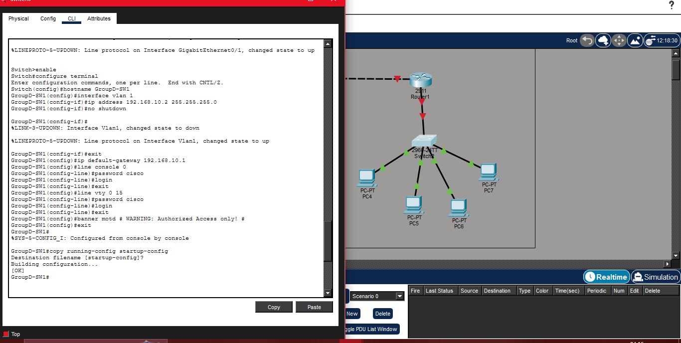
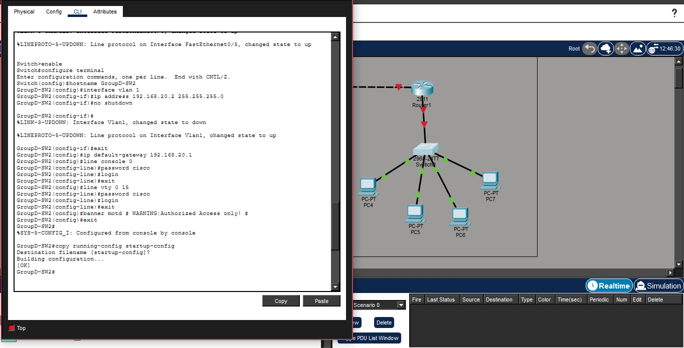
Switch Management Configuration
Each 2960 switch receives a VLAN 1 management address and a default gateway pointing to its local router.
Switch 1 configuration
Switch 2 configuration
Key Commands
interface vlan 1 | ip address <management-IP> <mask> | no shutdown | ip default-gateway <router-IP>
Cisco Packet Tracer | Initial Router & Switch Configuration
8

Slide 9
Connectivity Testing & Troubleshooting
Verification should confirm local gateway access, same-LAN communication, remote-LAN routing, and SSH management.
Local Tests
Remote Tests
SSH Test
ping 192.168.10.1 ping 192.168.10.4 Expected result: successful replies
ping 192.168.20.1 ping <remote PC> Requires a working R1–R2 link and correct routes
ssh -l admin 192.168.10.1 Confirms secure remote login configuration
Issue Observed in the Configuration
Recommended Solution
The screenshots show attempts to configure Serial interfaces on 2911 routers that returned “Invalid interface type and number.” This indicates that the selected router/module does not provide those Serial interfaces.
Connect the two routers using available GigabitEthernet interfaces, or install a compatible Serial module before configuring Serial interfaces. Then verify with show ip interface brief.
Cisco Packet Tracer | Initial Router & Switch Configuration
9

Slide 10
Conclusion
Summary of the skills developed during the Cisco Packet Tracer mini project.
What We Configured
What We Learned
Problems & Solutions
• Router hostnames • Privileged EXEC security • Console and VTY access • Password encryption • Login banner • Router IPv4 interfaces • Switch VLAN 1 management • Default gateways • Saved configurations
• Basic Cisco IOS navigation • Interface activation • IPv4 addressing • Default gateway operation • Remote management concepts • SSH security • Connectivity testing • Systematic troubleshooting
Problem: interface mismatch Solution: verify available ports Problem: inconsistent subnet masks Solution: confirm and standardize addressing Problem: connectivity failures Solution: check IPs, masks, gateways, routes, and interface status
Thank You — Questions & Discussion
Cisco Packet Tracer | Initial Router & Switch Configuration
10

