Slide 1
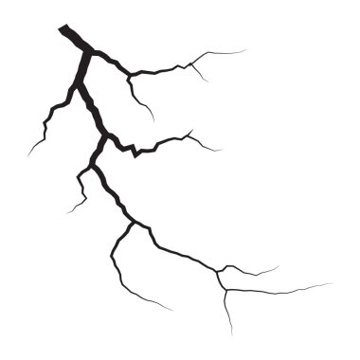
Data Analysis on Natural Disasters: Earthquake
Columns = 22
time
latitude
longitude
depth
mag
magType
place
type
horizontalError
locationSource
magSource
MagError
Depth Error
Source: Natural Disaster Dataset from U.S Geological Survey (USGS) Dec 2024 -Jan 2025.
Method: Matplotlib plotting
Comparing: Natural Disasters, Earthquake, Places, Magnitude, Dates & Times
January 2025 David Antwi

Slide 2
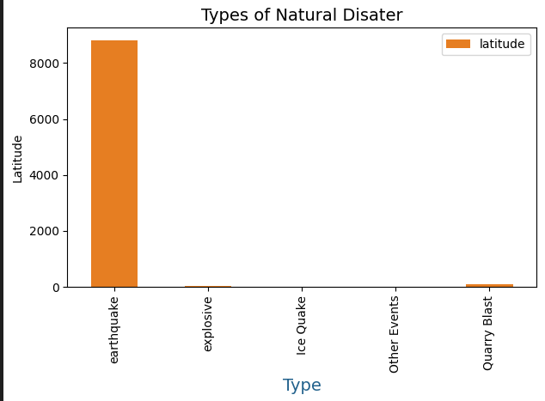
Comparing other natural disasters and its latitude
Latitude: it tells you how far north or south the earthquake occurred from the equator

Slide 3
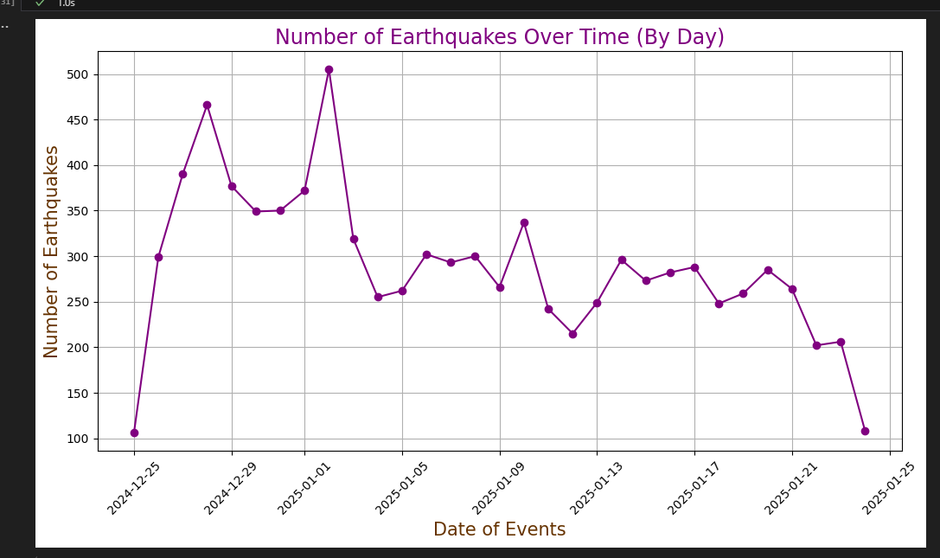
Earthquakes: sudden violent shaking of ground, causing great destruction, as a result of movements within the earth's crust or volcanic action.

Slide 4
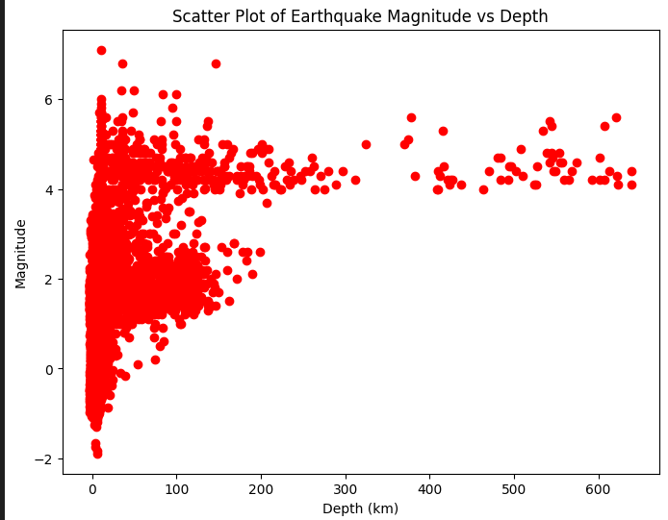
Magnitude: The measure of the size of earthquake or amount of energy release.
Varies depend on place, distance, type of surface material, and other factors

Slide 5
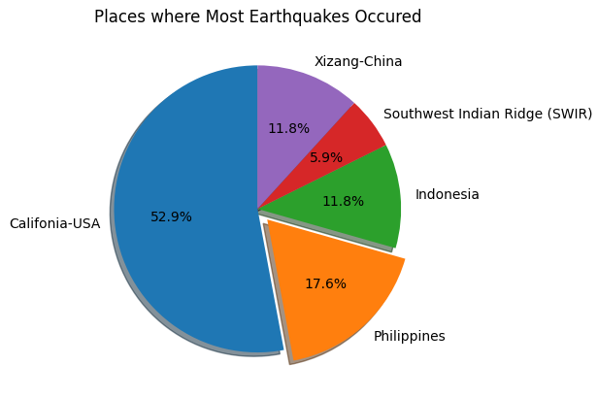
Conclusion & Findings
1st – USA Califonia, Naveda
5th – SWIR: is a mid-ocean ridge located along the floors of the south-west Indian Ocean and south-east Atlantic Ocean.

Slide 6

Any Questions?
Thank you

