Slide 1

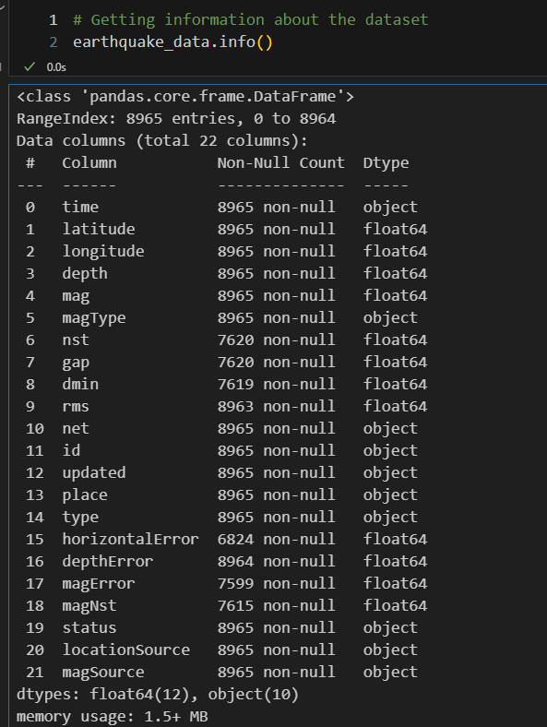
Data Analysis on Natural Disasters: Earthquake
Natural Disaster Dataset from U.S Geological Survey (USGS) Dec 2024 -Jan 2025.
Source-https://earthquake.usgs.gov/earthquakes/feed/v1.0/summary/all_month.csv
Method: Matplotlib
Comparing: Natural Disasters, Earthquake, Places, Magnitude, Dates & Times
January 2025 David Antwi

Slide 2
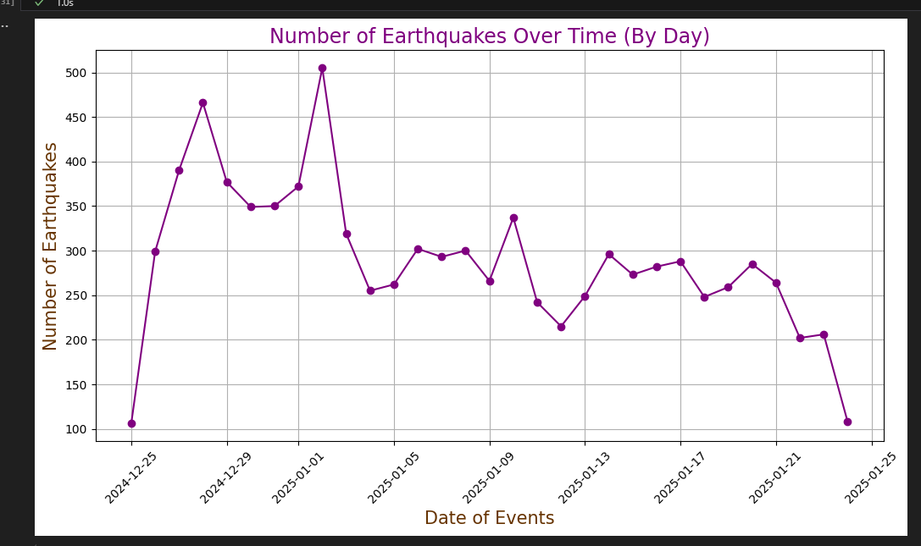
Earthquakes: sudden violent shaking of ground, typically causing great destruction, as a result of movements within the earth's crust or volcanic action.

Slide 3
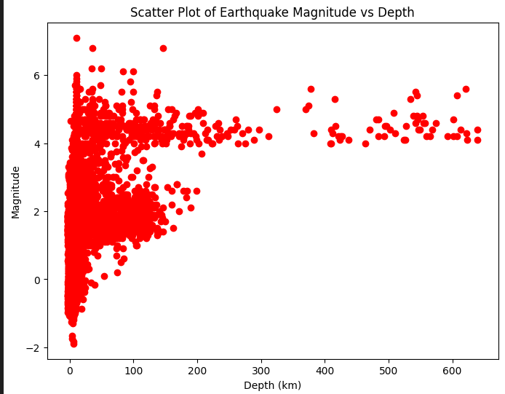
Analysis of data within the last month
Magnitude: The measure of the size of earthquake or amount of energy release.
Varies depend on place, distance, type of surface material, and other factors

Slide 4
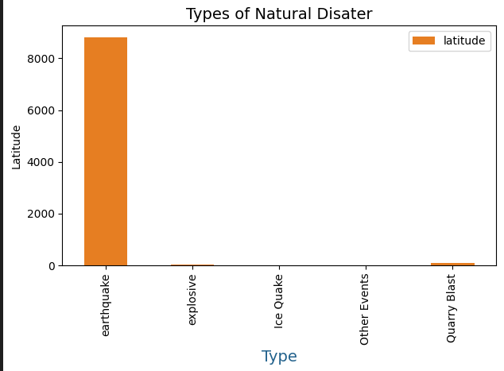
Comparing other natural disasters and its latitude
Latitude: it tells you how far north or south the earthquake occurred from the equator

Slide 5
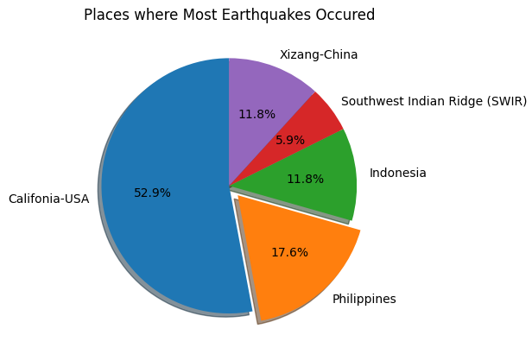
Conclusion & Findings

Slide 6

Any Questions?
Thank you

