Slide 1

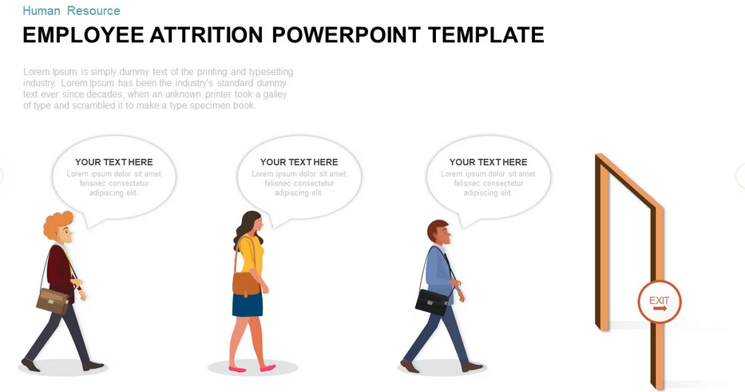
Predicting Employee Attrition to Avoid Workflow Disaster
What is Attrition?
Motivation: My story as IT Helpdesk Analyst
Problem: Unplanned attrition creates operational chaos. Can we predict it early?
Solution/Aim: A ML model to flag at-risk employees in advance
Methodology: Supervised ML Techniques
March 2025 David Antwi

Slide 2

Data Source
Dataset
Key Columns
Attrition: Target variable
BusinessTravel
Department: 3(S, R&D, HR)
DistanceFromHome
EducationField: 6
EnvironmentSatisfaction
Gender: Males (882), Females (588)
JobRole: 9
JobSatisfcation
MaritalStatus: M(45%),S(32), D(22%)
MonthlyIncome
NumCompaniesWorked
OverTime
WorkLifeBalance
YearsAtCompnay
Kaggle: IBM HR Analytics Employee. CSV
Year: from 2014–2015
Size: 230.00 KB
Rows: 1,470 records
Columns: 35 Columns
Grouped: Demographics, Department, Job Details, Compensation, Experience & Tenure, Satisfaction Metrics, Education/ Training
Data Cleaning
Replaced Missing values with 0
Attrition: Converted to Binary
Gender: (female': 0, 'male’: 1)
Columns Dropped: EmpNumber,EmployeeCount, Over18, StandardHours, DailyRate,MonthlyRate,HourlyRate
Categorical Columns replaced with numerical values: BusinessTravel, Department, EduField, JobRole,

Slide 3
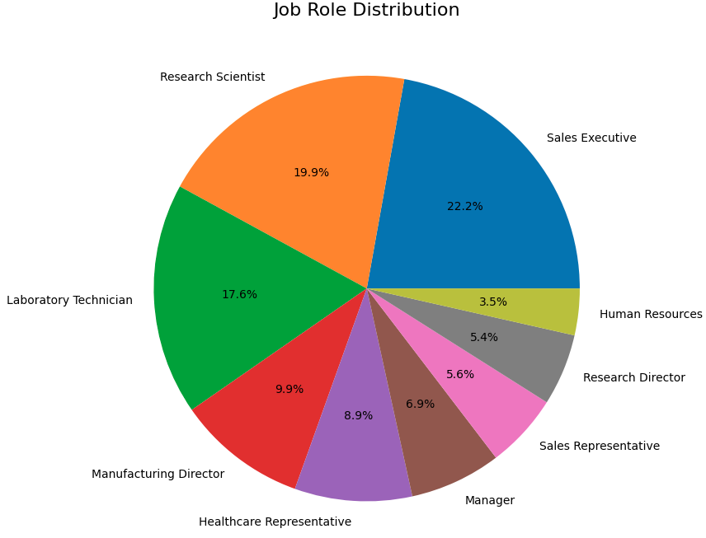
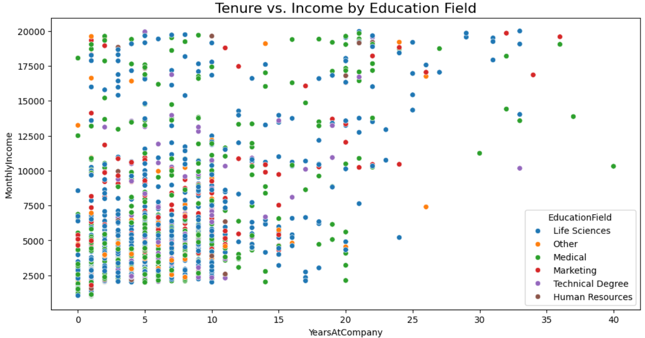
Exploratory Data Analysis
Key Insights:
Monthly income shows wide variability across tenure and education fields,
Significant diversity in earning potential within the organization
Key Insights:
Sales Executive 22.2%
HR 3.5%

Slide 4
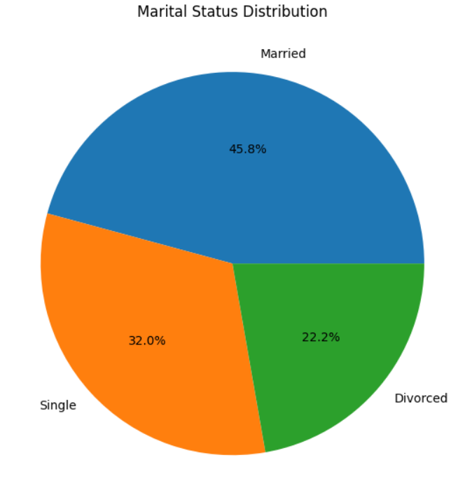
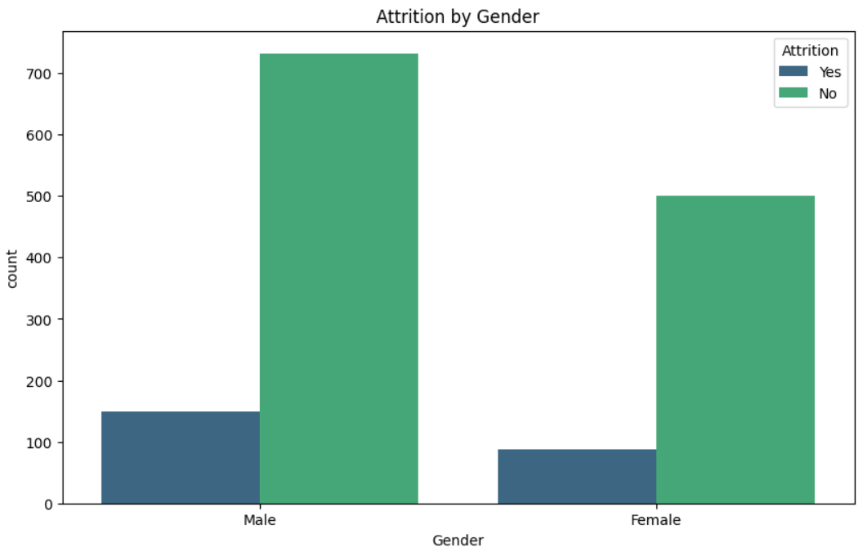
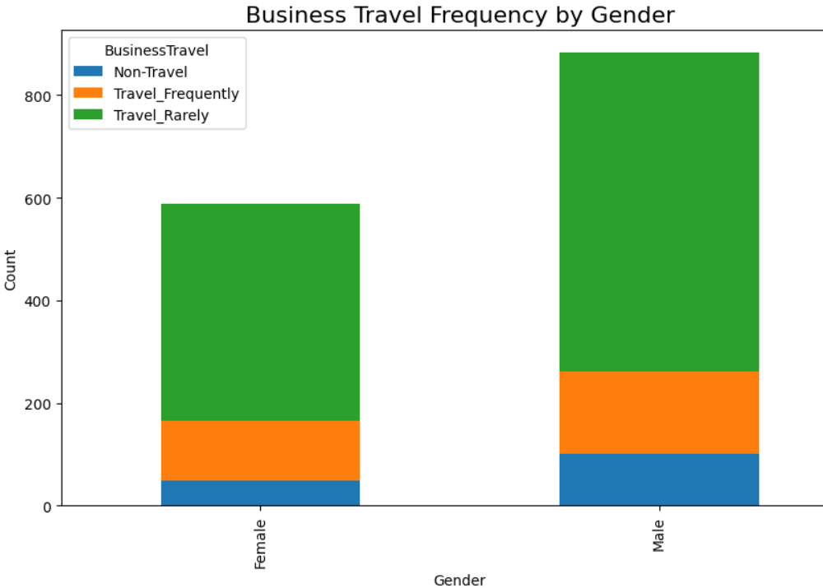
Exploratory Data Analysis
Key Insights:
Marital Status: Nearly half (45.8%) of employees are married, potentially influencing stability and attrition trends.
Attrition by Gender: Males show higher attrition rates compared to females, signaling a need for tailored retention strategies.
Business Travel: Males generally travel more frequently , which could impact job satisfaction and attrition differently for each gender

Slide 5
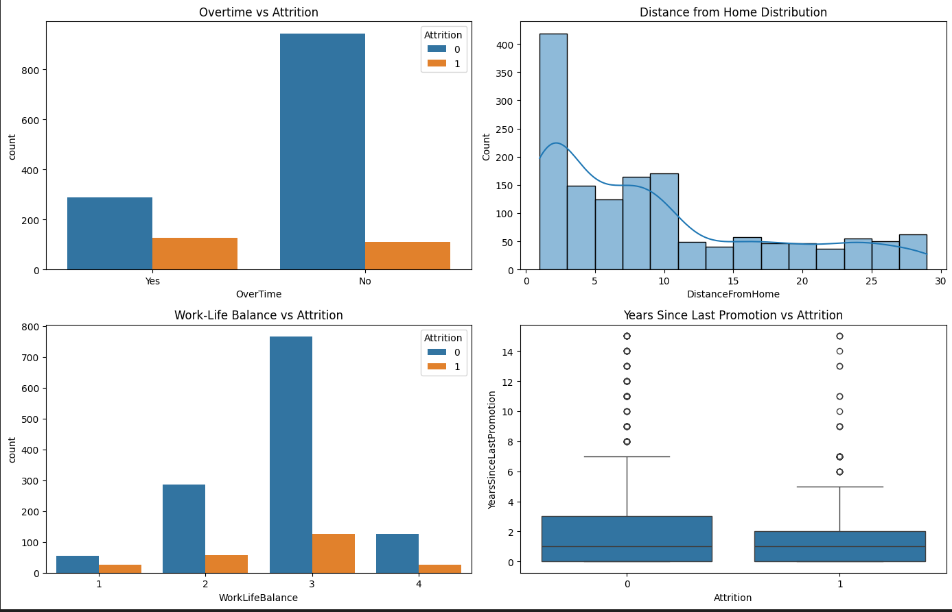
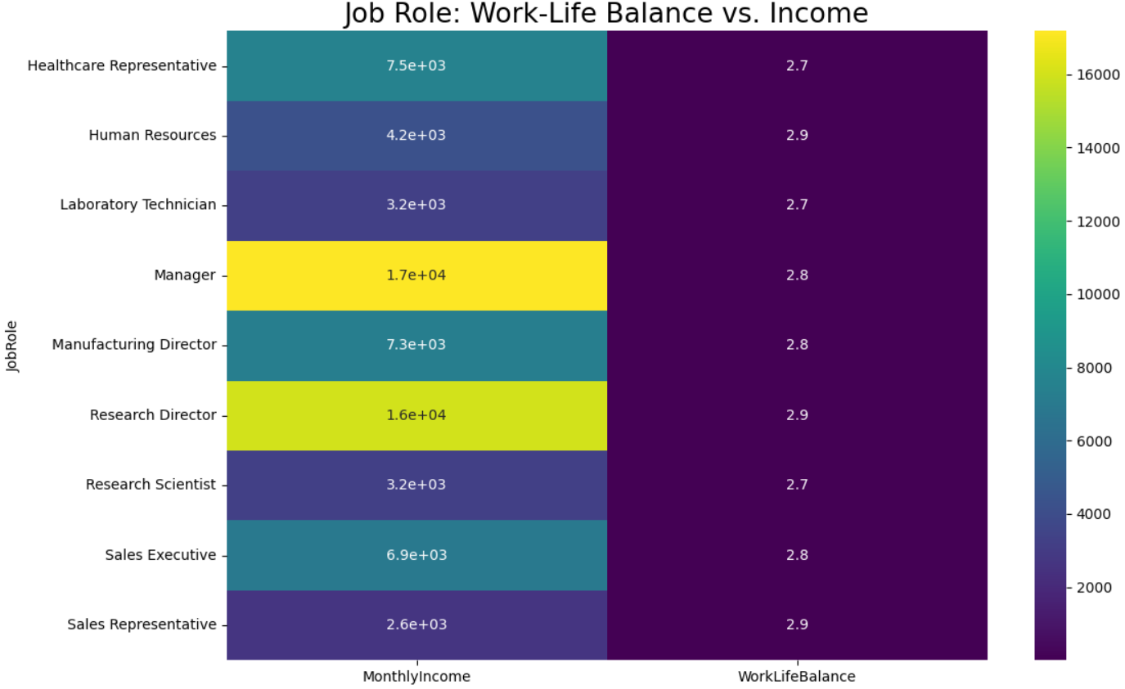
Exploratory Data Analysis
Key Insights:
Employees with a better work-life balance and no overtime exhibit the lowest attrition rates.

Slide 6
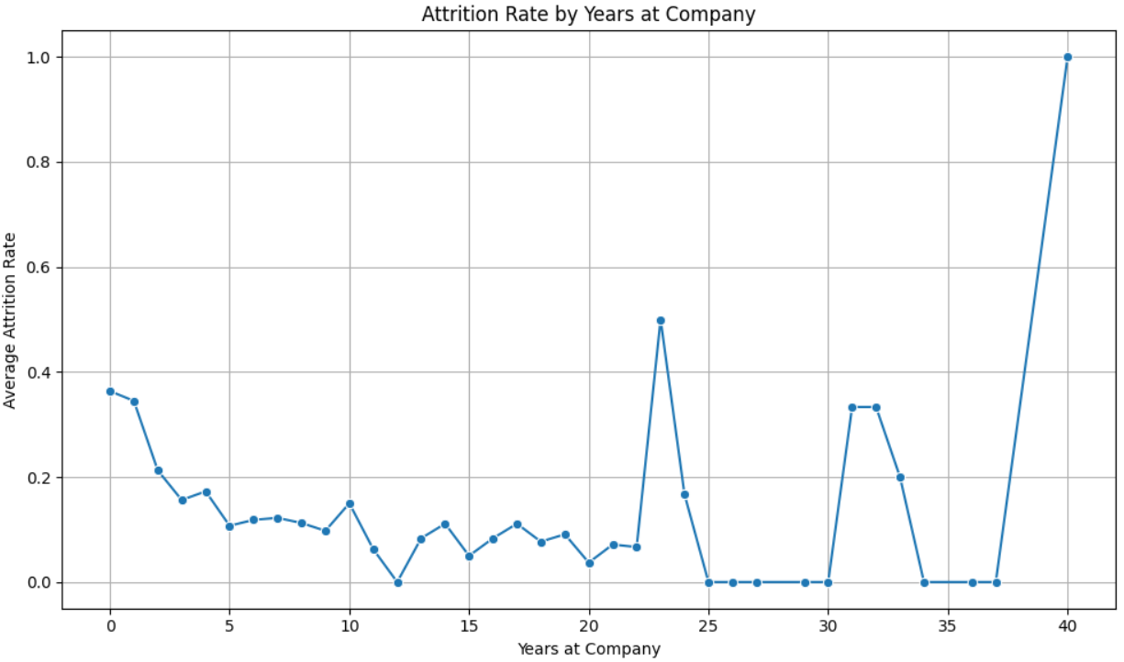
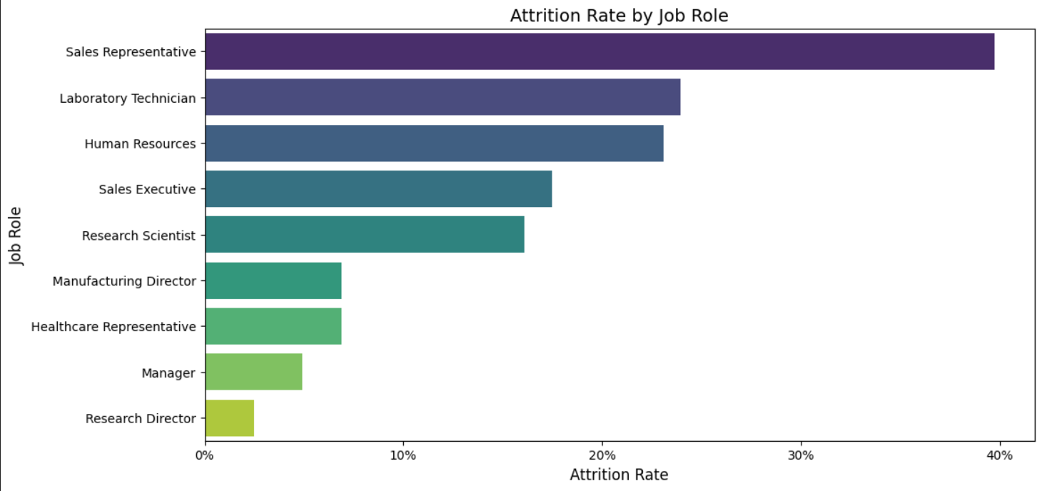
Exploratory Data Analysis
Key Insights:
Sales Representatives with highest attrition rate, highlighting the need for targeted retention efforts in this role
Key Insights:
employees with 20 and 40 years of tenure show significantly elevated attrition rates, indicating potential challenges with long-term employee engagement.

Slide 7
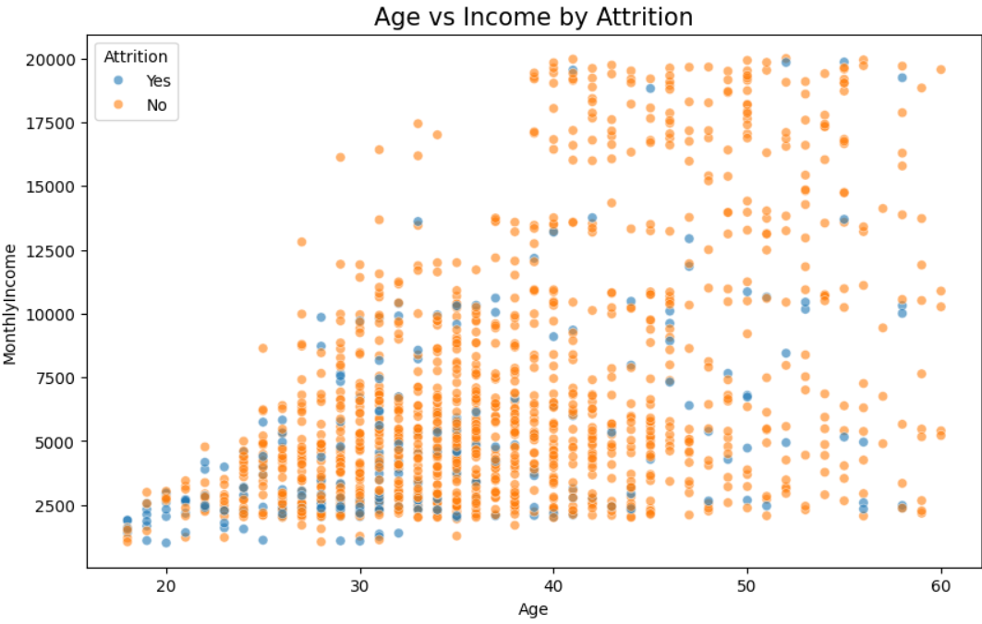
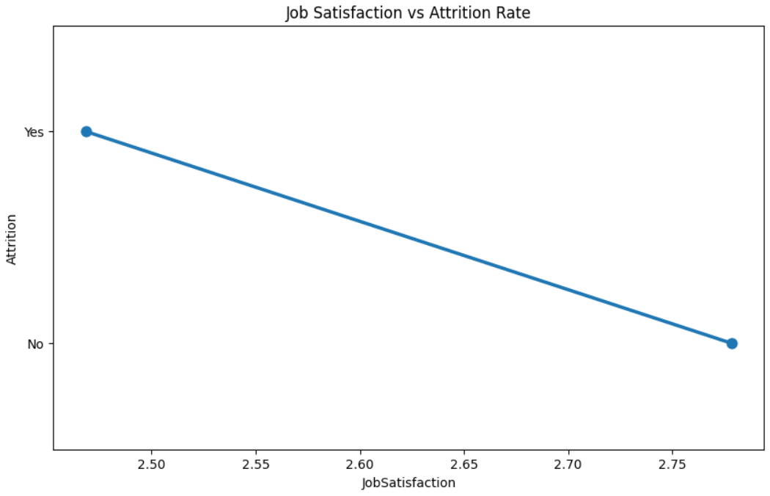
Exploratory Data Analysis
Key Insights:
Job satisfaction strongly correlates with reduced attrition rates, emphasizing the importance of employee well-being initiatives.
Key Insights:
Employees with higher monthly incomes are less likely to experience attrition

Slide 8
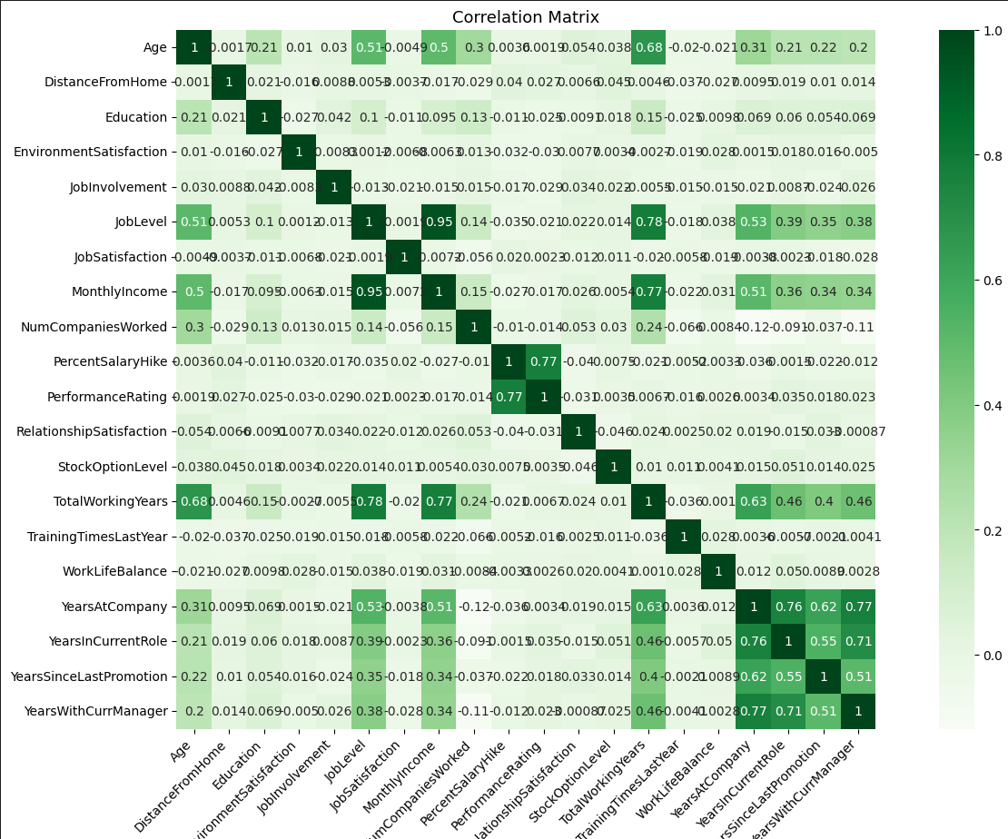
Exploratory Data Analysis
Key Insights:
Employees in the age group of 26-35 high attrition rates
Lower job satisfaction and higher work-life imbalance strongly correlate with increased attrition rates,
frequent business emp travel are more prone to attrition,
Long-serving employees (20+ years of tenure) have a noticeable spike in attrition
Attrition is significantly higher among single employees

Slide 9
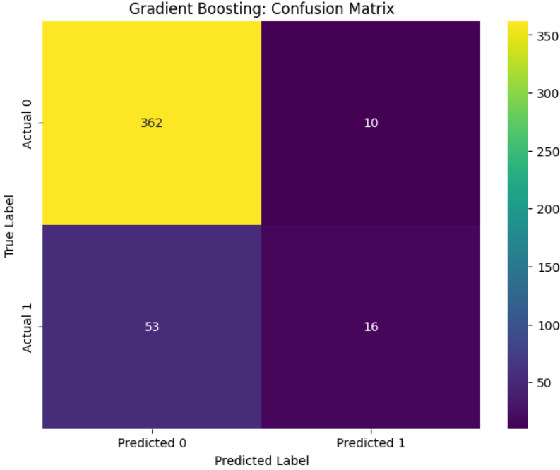
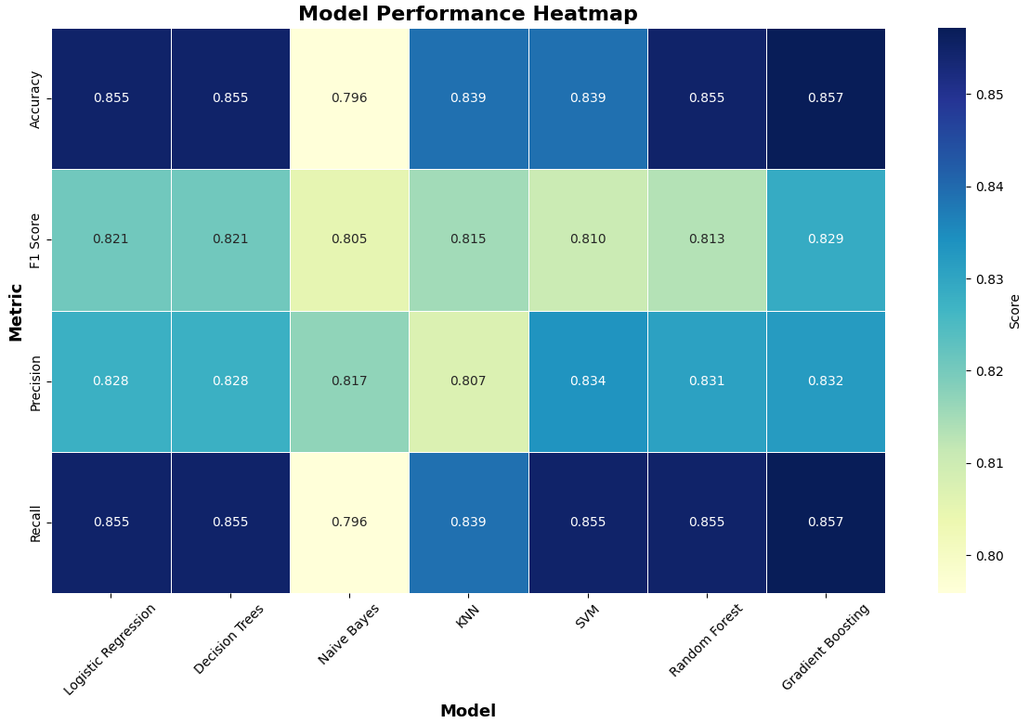
Methodology
Confusion Matrix
(362): Correct predictions ,no attrition.
(10): Incorrectly predicted attrition employees a stayed.
(53): Missed attrition, employees left but were predicted to stay.
(16): Correct predictions of attrition cases
Supervised ML Algorithms: 7 Models
Model Splitting & Training
Standard Scaler: Prevent bias
Training: (70% of the data)
Testing: (30% of the data)
Random State: 30
Target: Attrition
Features: 23
Best Model: Gradient Boost
Accuracy: 86% good overall performance.
F1 Score: 83%, biased, e dominance of the "No Attrition" class in the dataset.
Handles Imbalanced Classes e.g.Only 16% of employees left, an imbalanced classification problem.
Minimize errors
Directly translates to cost savings and employee retention strategies.

Slide 10
Conclusion
Recommendation
Limitation
Actionable Insights
•Address Class Imbalance
*Model Tuning
Privacy Concerns
Model Accuracy
Dependence on Data Quality
Business Actions
Cost saving for firms, reduce attrition 20% saves 500k/year if 50 go
Implement monthly workload scoring for high-risk teams
Address overtime policies.
Adjust salaries for high-risk roles.
Unknown Attrition reasons
Change of Management
More Details Needed for future predictions
Improve manager-employee relationships
Automated alert system for managers when key roles hit 65% exit risk".
Benefit: Could reduce unplanned attrition by 40% in 18 months
More Details Needed for future predictions
Unreal dataset from IBM
Ethical Considerations
Attrition rate might cause severe organizational changes
Thank you

