Slide 1

Modeling Taxi Out Delay at JFK Airport
Aim: Predicting Taxi Out Delay:
Linear Regression Approach
Source: flight take-off data JFK Airport
Nov 2019-Jan 2020
February 2025 David Antwi

Slide 2

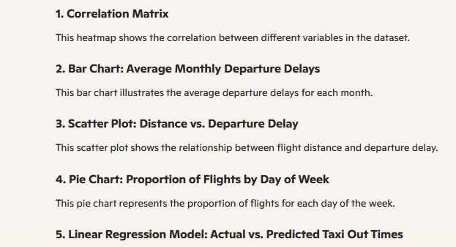
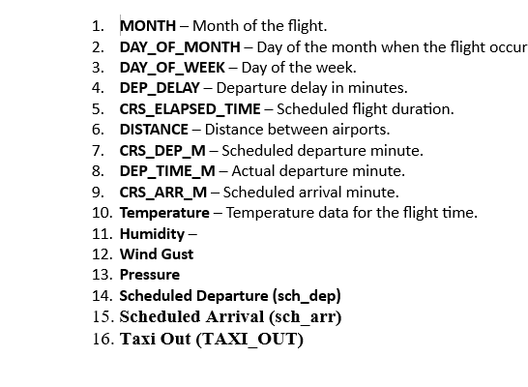
Analysis of the data
Methodology: Exploratory Data Analysis(EDA)
Data Cleaning
Model Implementation

Slide 3
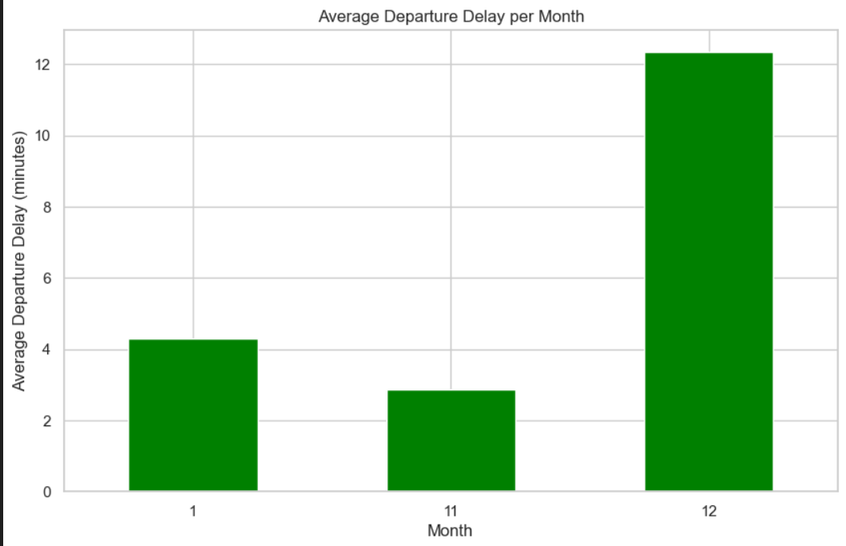
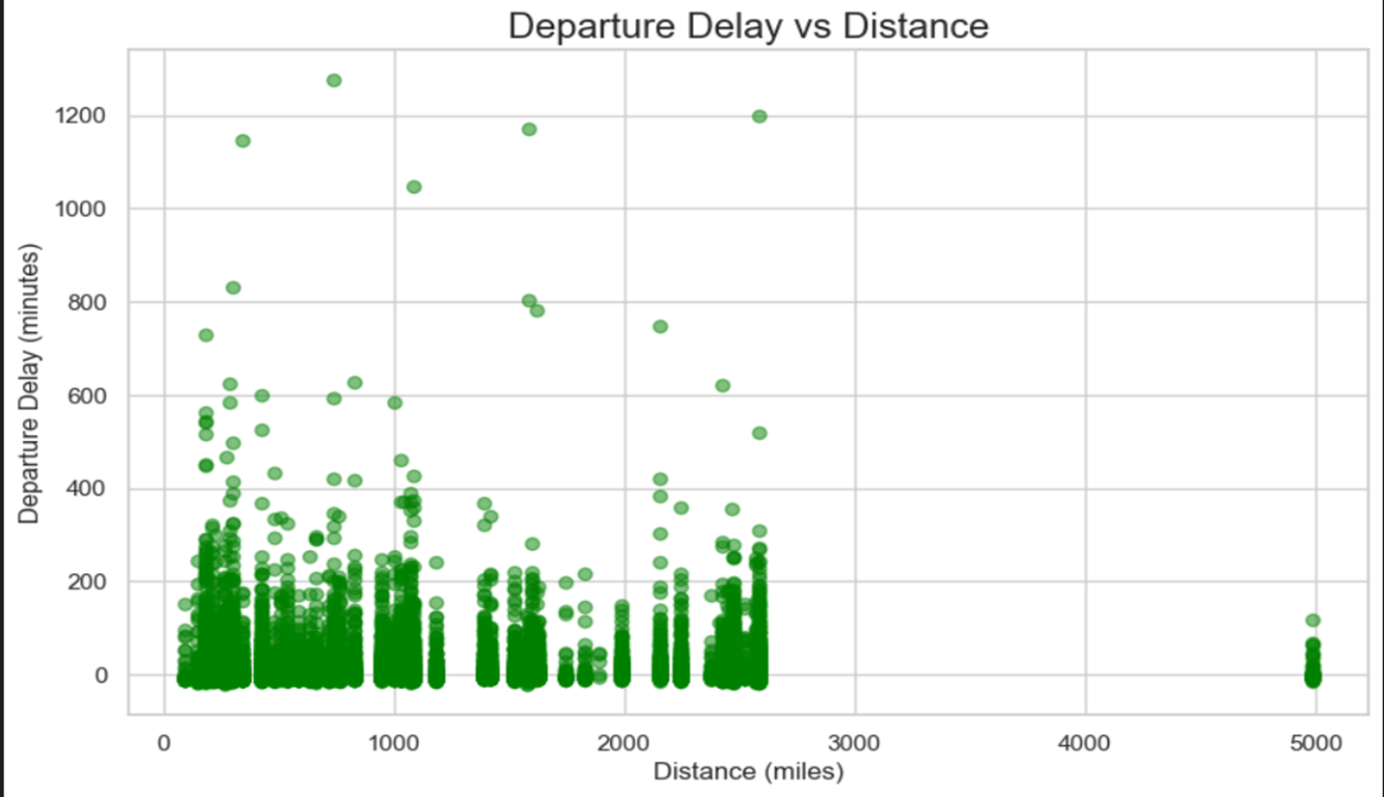
Bar chart: Average Departure Delay per Month
Scatter Plot: Departure Delay vs Distance
Showing which months have higher or lower average delays
This scatter plot will help identify if longer flights tend to have more delays.

Slide 4
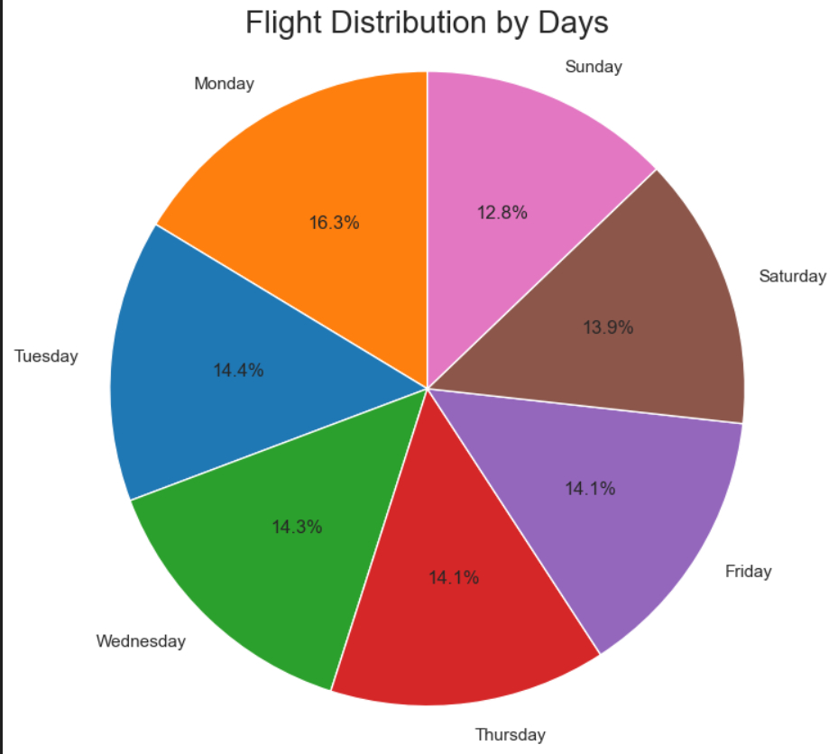
Pie Chart - Distribution of Flights by Day of the Week
This pie chart will show how the flights are distributed across the days of the week.

Slide 5
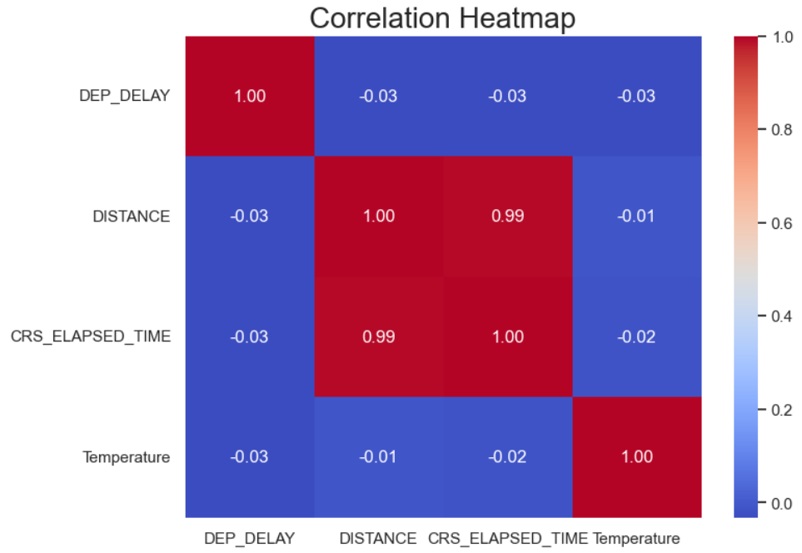
Correlation Matrix
To see how different numerical columns (e.g., departure delay, distance, temperature) correlate with each other, use a heatmap:
This heatmap will help you see which variables are positively or negatively correlated.

Slide 6
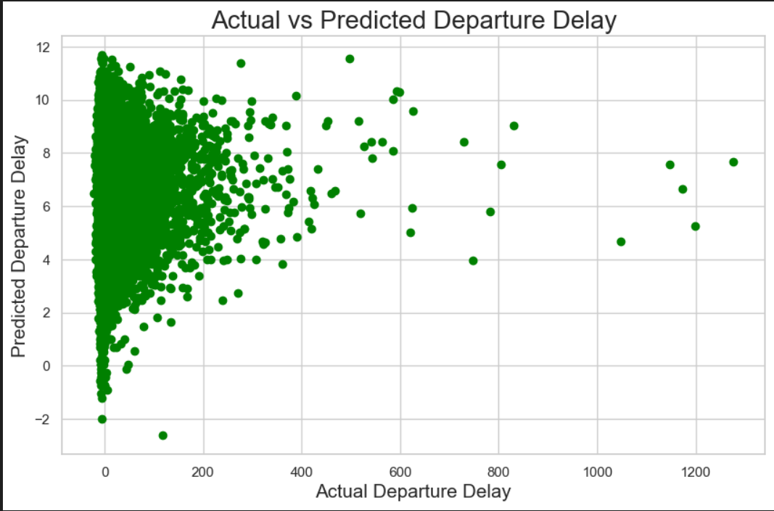
Predicting Departure Delay (Linear Regression)
Linear regression predict departure delays based on features like distance and temperature.

Slide 7

Conclusion
There might be clear monthly patterns in departure delays.
Longer flights could correlate with longer delays.
Temperature may or may not have an effect on delays, depending on the dataset.
The heatmap may show strong correlations between scheduled departure time and actual departure time
More data and different models such as the Decision Tree Classification & Accurate Score Metrics are needed
Thank you

