Slide 1

Analyzing the Fraud Dataset
Aim: Predicting Fraudulent Transactions: Supervised ML Techniques
Outline : Data Visualisation Tools
Exploratory Data Analysis (EDA)
Comparing ML Model
Conclusions & Recommendations
28 February 2025 David Antwi

Slide 2
Data Cleaning
Dataset (fraud.csv)
1,048,575 entries
11 Columns
'step': 'Time_Step',
'type': 'Transaction_type',
'amount': 'Transaction_amount',
'nameOrig': 'Origin_account',
'oldbalanceOrg': 'Origin_old_balance',
'newbalanceOrig': 'Origin_new_balance',
'nameDest': 'Destination_account',
'oldbalanceDest': 'Destination_old_balance',
'newbalanceDest':'Destination_new_balance',
'isFraud':'Is_fraud',
'isFlaggedFraud':'Is_flagged_fraud'
Data Cleaning
Renamed Columns
Columns Dropped: Origin_account','Destination_account','Is_flagged_fraud'
Converted Transaction Type to numerical values
'PAYMENT’: 0,
'TRANSFER': 1,
'CASH_OUT': 2,
'TRANSFER': 3,
'DEBIT’:4
Replaced Missing values with 0
Label encoder

Slide 3
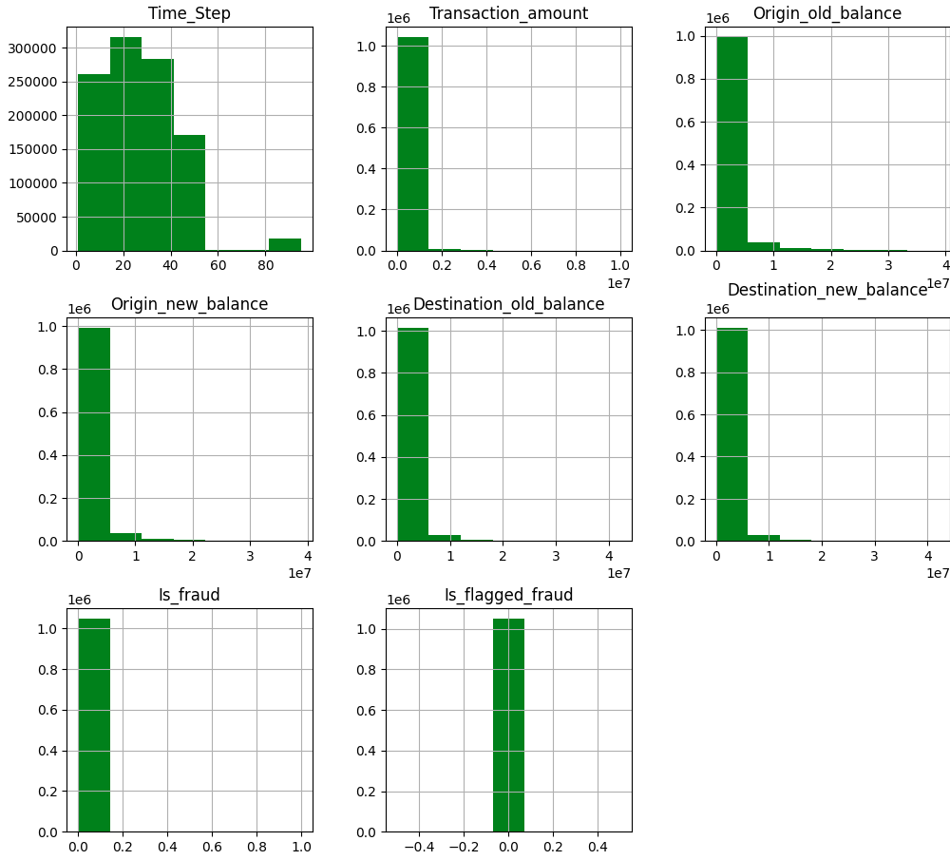
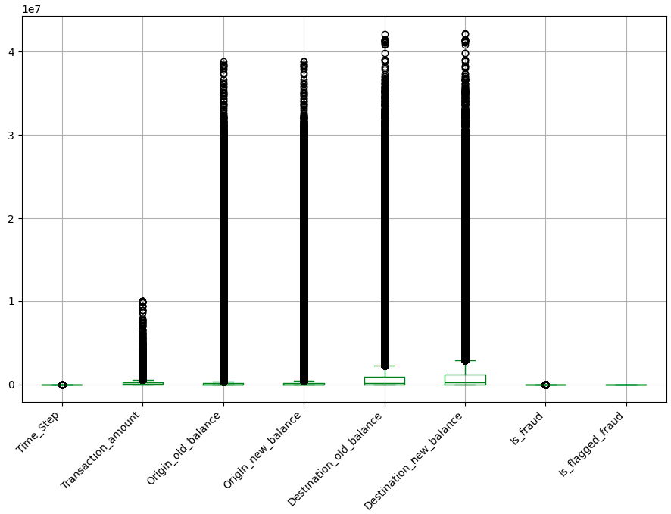
Exploratory Data Analysis
Boxplot and Histogram charts: checking for outliers

Slide 4
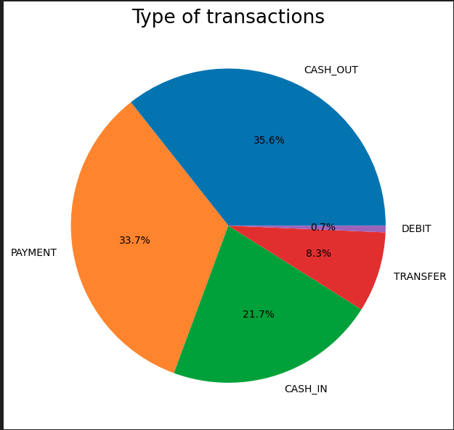
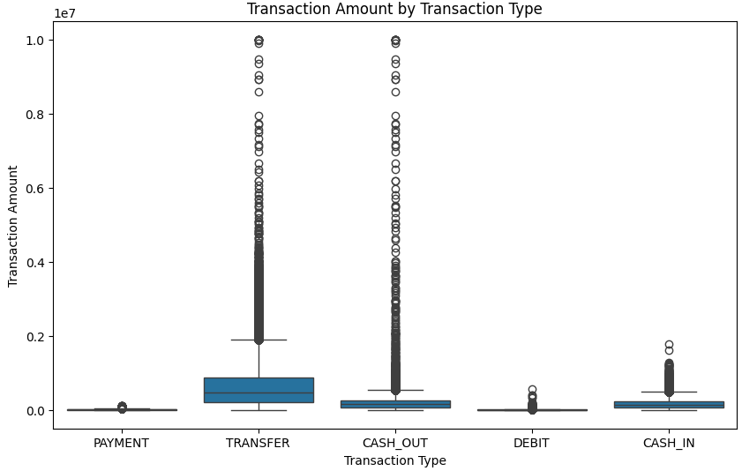
Exploratory Data Analysis
Pie chart showing: Types of Transactions
chart showing Transaction Type Vs Amount

Slide 5
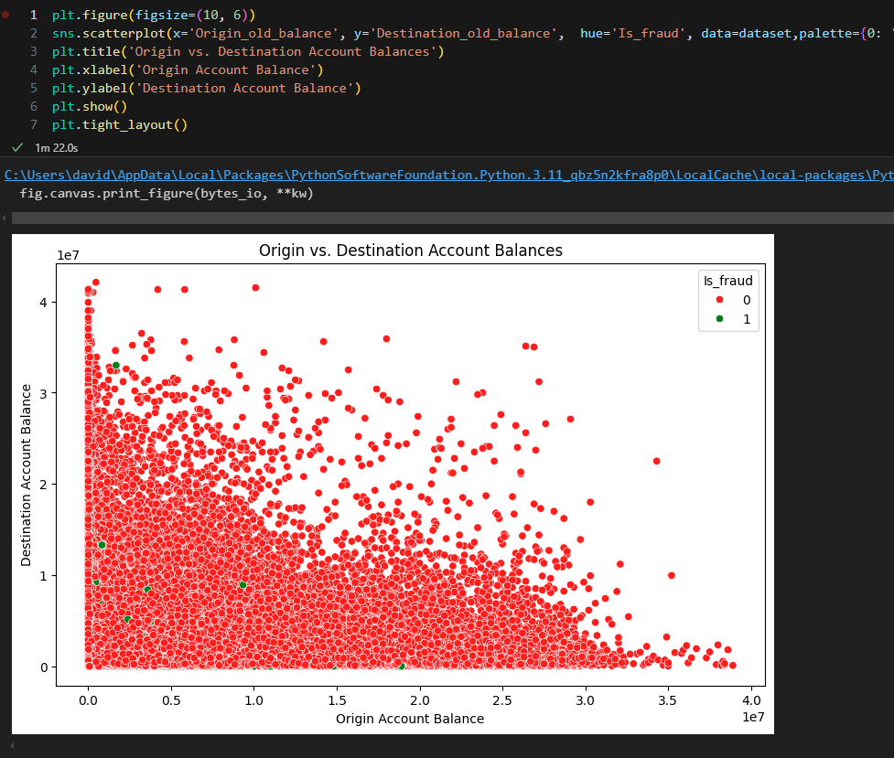
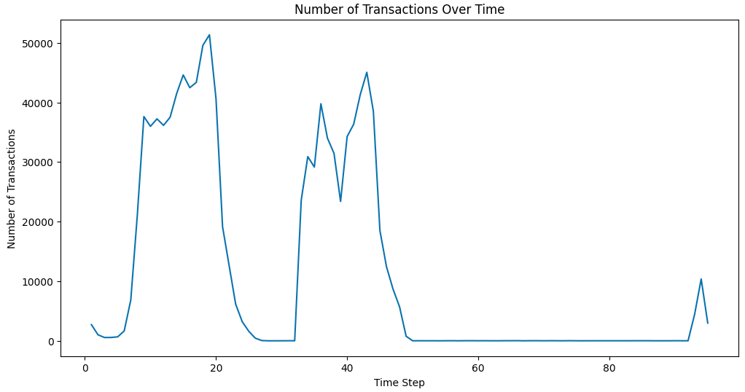
Exploratory Data Analysis
Pie chart showing: Types of Transactions
chart showing Number of Transaction over time

Slide 6
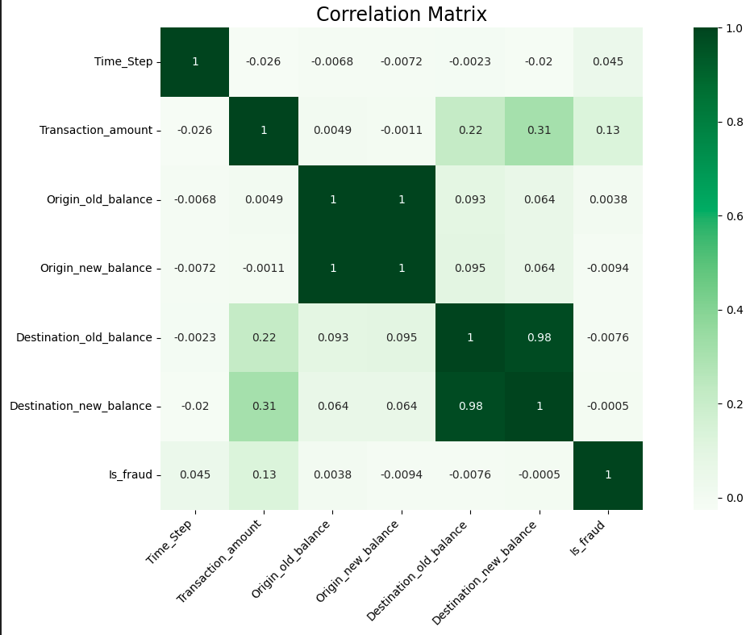
Correlation Matrix
Key Insights:
Transaction Amount: Slightly linked to fraud (0.13 correlation).
Destination Balances: Highly correlated (0.98), likely redundant.
Origin Balances: Weak correlation, not strong fraud predictors.
Time_Step: No significant correlation with fraud.

Slide 7
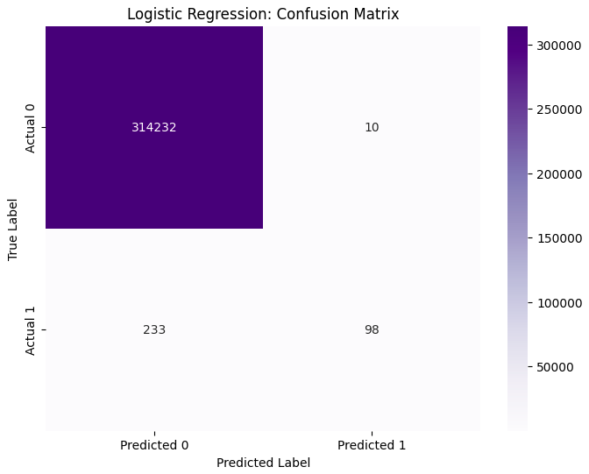
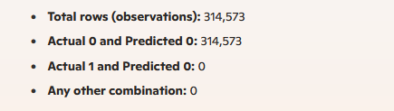
Supervised Machine Learning Algorithms
Logistics Regression
Model Splitting
Splits into training and testing sets
Training = (70% of the data)
Testing = (30% of the data)
Later balanced it
Random State = 30
Model Accuracy = 0.9992275242948377
F1 Score = 0.9992275242948377

Slide 8
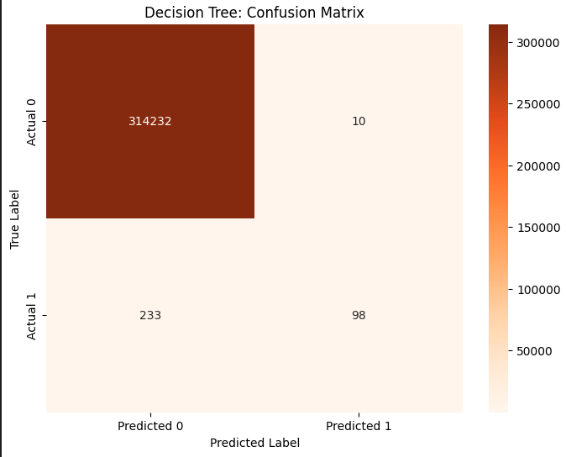
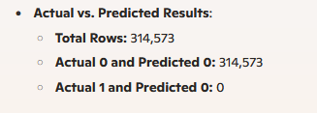
Supervised Machine Learning Algorithms
Decision Tree
Model Accuracy = 0.9992275242948377
F1 Score = 0.9889070806982115

Slide 9
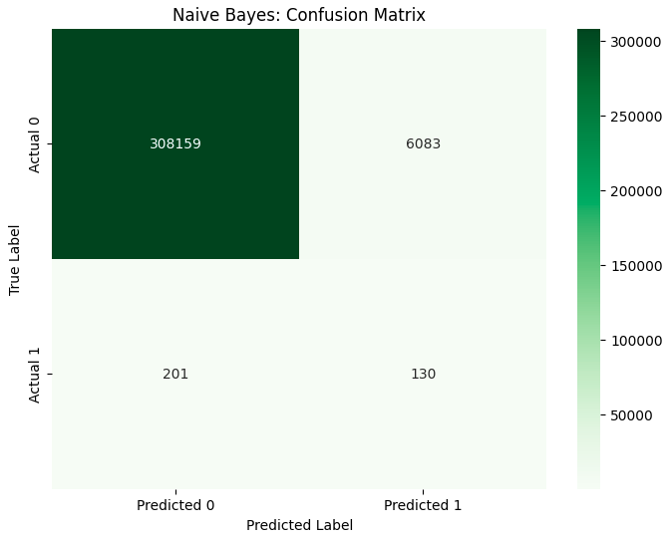
Supervised Machine Learning Algorithms
Naïve Bayes
Model Accuracy = 0.9800237146862573
F1 Score = 0.9889070806982115

Slide 10
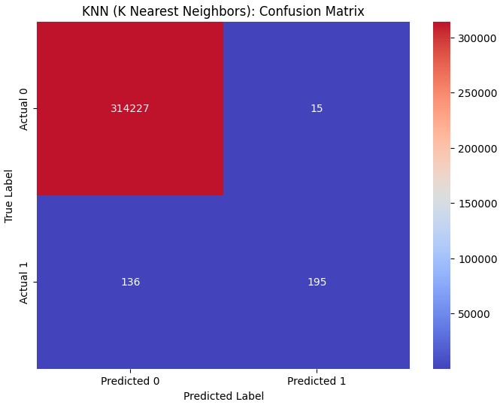
Supervised Machine Learning Algorithms
KNN (K Nearest Neighbors)
Model Accuracy = 0.9995199842325947
F1 Score = 0.9994663502949942

Slide 11
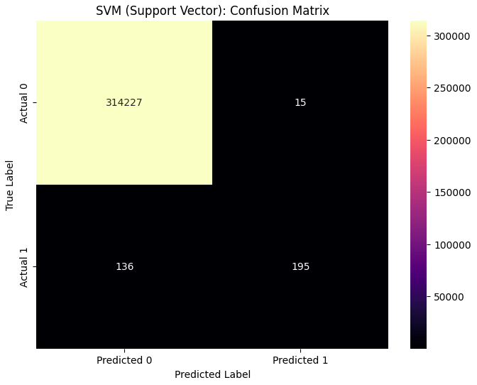
Supervised Machine Learning Algorithms
SVM (Support Vector)
Model Accuracy = 0.9995199842325947
F1 Score = 0.9989420132570787

Slide 12
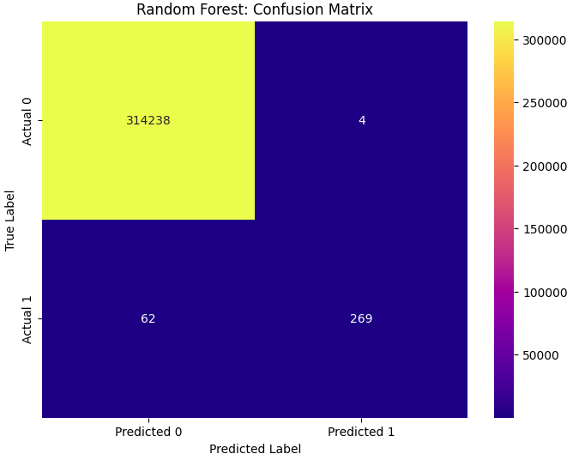
Supervised Machine Learning Algorithms
Random Forest Model
Model Accuracy = 0.9997801278907292
F1 Score = 0.9997801278907292

Slide 13
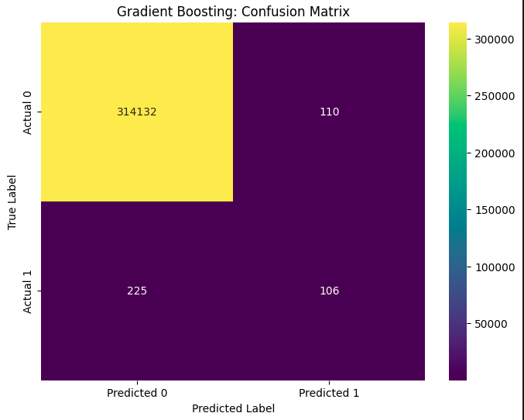
Supervised Machine Learning Algorithms
Gradient Boosting
Model Accuracy = 0.9989350643570809
F1 Score = 0.9989350643570809

Slide 14
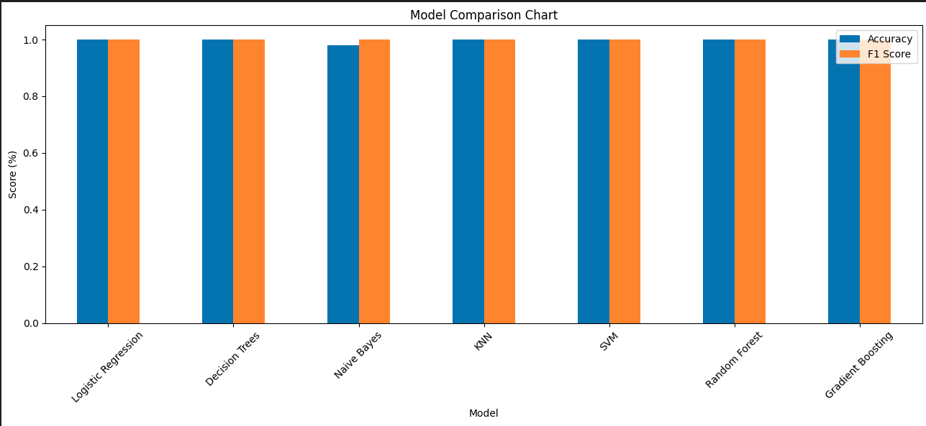
Conclusion
Model Accuracy F1 Score
0 Logistic Regression 0.999228 0.999803
1 Decision Trees 0.999228 0.999803
2 Naive Bayes 0.980024 0.998907
3 KNN 0.999520 0.999467
4 SVM 0.999520 0.999842
5 Random Forest 0.999790 0.999780
6 Gradient Boosting 0.998935 0.998823

Slide 15

Conclusion
Overfitting: High accuracy may indicate overfitting, requiring careful validation.
Data Quality: Enhancing data quality and balance improves model reliability.
Fraud Detection: The slight positive correlation between Transaction_amount and Is_fraud suggests, larger transactions might be more suspicious and worth investigating.
Continuous Monitoring: Regular monitoring ensures consistent performance over time.
Thank you

