Slide 1

Analyzing the Titanic Dataset
Aim: Predicting No. of Survivors: Logistics Regression Approach
Methodology: Logistics Regression Approach
Exploratory Data Analysis(EDA)
Panda, Matplotlib
Accuracy Score
Outline: Intro & background
Data Cleaning & Prep, EDA
Machine Learning Model Predictions
Conclusions
February 2025 David Antwi

Slide 2
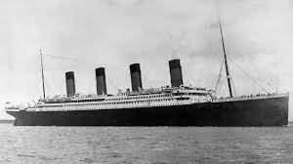
Background
Dataset (train.csv)
About 891 entries
12 Columns
PassengerId
Survived
Pclass
Name
Sex :
Age,
SibSp (No. of siblings or spouses aboard the Titanic) ,…Parch: No. of parents or children aboard the Titanic)
Ticket
Fare
Cabin
Embarked - port of embarkation
Starting Location: Southampton, England
Destination: New York, USA
Maiden Voyage: Began on April 10, 1912 –
1st journey of new ship
Date of Sinking: April 15, 1912
To understand: patterns in survival rates
Data Cleaning
Replaced Nan values in Age & Fare with mean values
No column dropped
Converted Sex Column to numerical values
(female': 0, 'male’: 1)
Replaced Missing values with 0
Clean data ensures accurate analysis

Slide 3
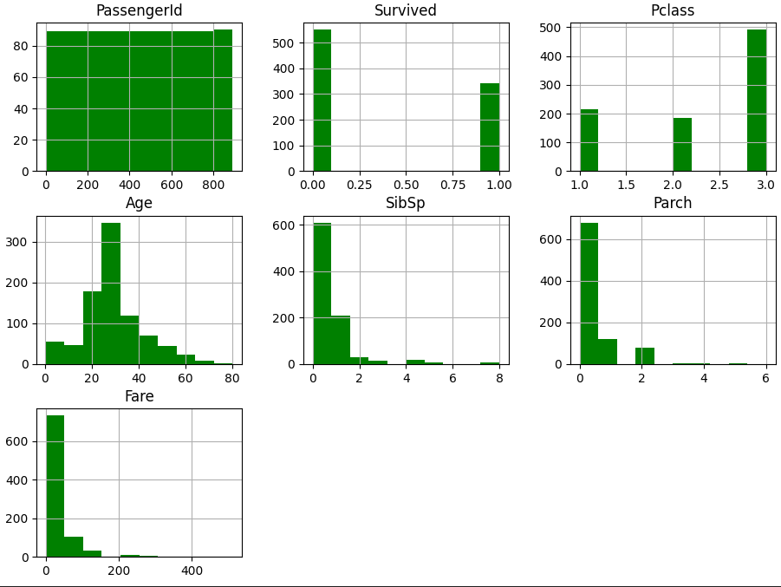
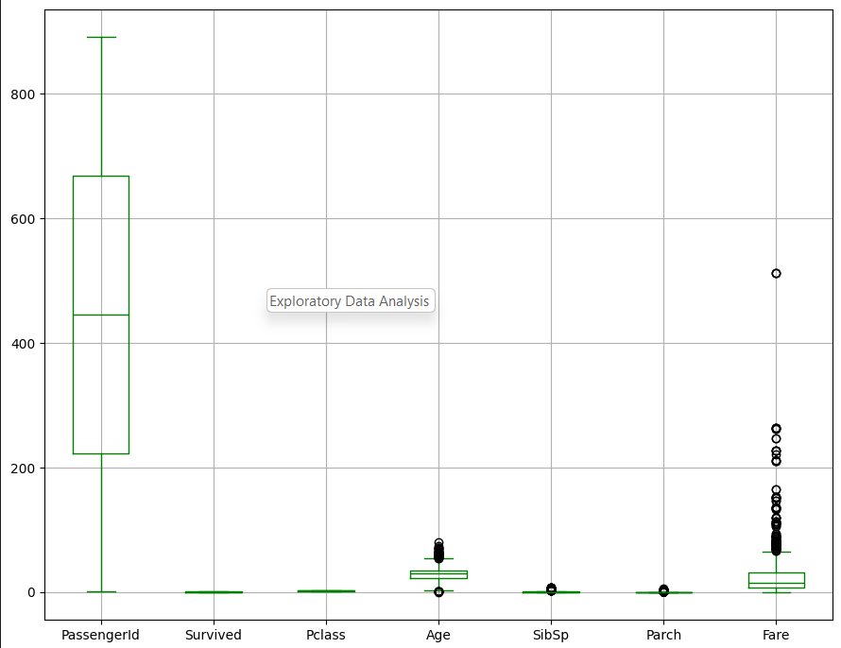
Exploratory Data Analysis
Boxplot and Histogram charts: checking for outliers

Slide 4
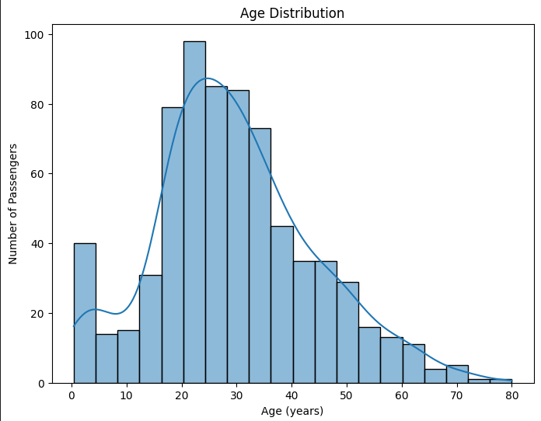
Exploratory Data Analysis
Bar chart showing: Age Distribution of Passengers
Key Insights:
Peaks may indicate common age groups (e.g., young adults or middle-aged passengers).
Gaps or low counts could reflect fewer children or elderly passengers

Slide 5
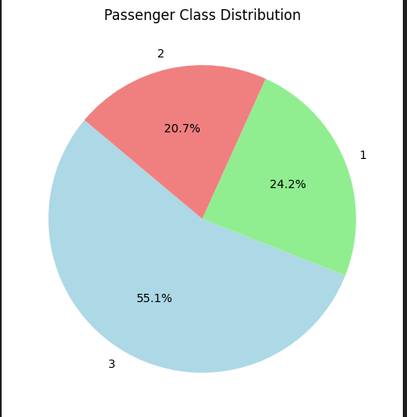
Exploratory Data Analysis
Pie chart showing: Passengers Class Distribution
Key Insights:
First Class (20.7%): smallest group wealthiest
Second Class (24.2%): A moderate-sized group, often middle-class
Third Class (55.1%):majority of passengers, typically working-class or immigrants.

Slide 6
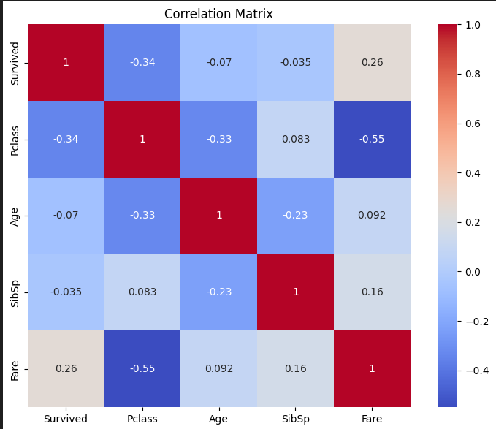
Correlation Matrix
Key Insights:
Socioeconomic Status (Pclass & Fare):
Strong predictor of survival.
Higher-class and higher-paying passengers were more likely to survive.
Age:
Minimal impact on survival.
Slight trends observed class/fare.
Family Size (SibSp):
Weak relationship with fare.
No significant impact on survival.

Slide 7
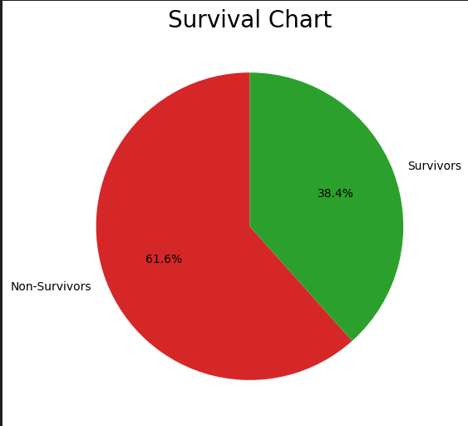
Logistics Regression
Model training
Independent Values
'PassengerId','Pclass','Age','Sex', 'SibSp', 'Fare’
Dependent Value
Survived
Model Splitting
Splits into training and testing sets
Training = (80% of the data)
Testing = (20% of the data)
Random State = 30
Method: random split in the train_test_split
Survival Chart before Predictions
38.4% Survivors = 342 Passengers
61.6% Non- Survivors = 549 Passengers

Slide 8
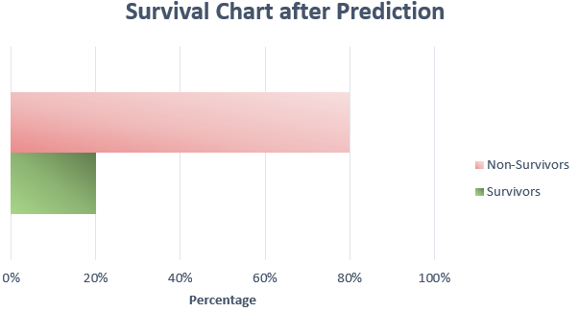
Conclusion
Survival Chart after Prediction
20.9% Survivors = 179 Passengers
79.9.% Non- Survivors = 712 Passengers
20.09% (179/891) survived, differing from initial of 342 survivors.
The logistic regression model shows discrepancies
in predicting survival outcomes.
Misclassifications indicate a need for better feature
engineering and hyperparameter tuning.
A data frame comparing actual vs. predicted outcomes
highlights model performance patterns.
Metrics like precision & recall are needed for
comprehensive evaluation; consider advanced techniques to improve accuracy.
Thank you

