Slide 1
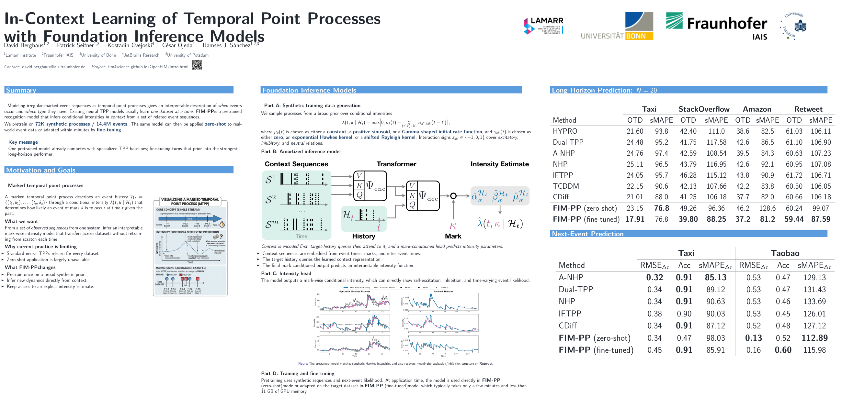





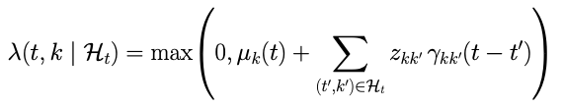
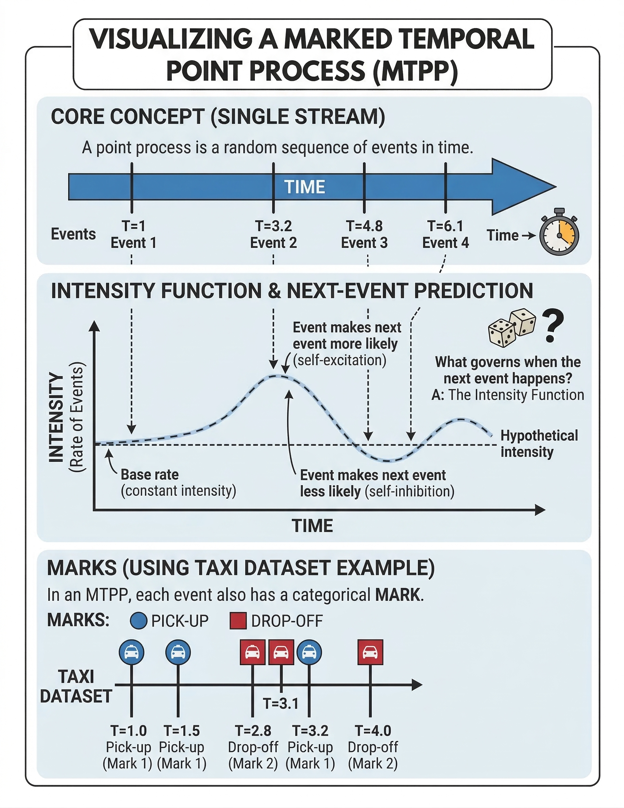
Modeling irregular marked event sequences as temporal point processes gives an interpretable description of when events occur and which type they have. Existing neural TPP models usually learn one dataset at a time. FIM-PP is a pretrained recognition model that infers conditional intensities in context from a set of related event sequences. We pretrain on 72K synthetic processes and 14.4M events. The same model can then be applied zero-shot to real-world event data or adapted within minutes by fine-tuning.
Part A: Synthetic training data generation
We sample processes from a broad prior over conditional intensities
where μₖ(t) is chosen as either a constant, a positive sinusoid, or a Gamma-shaped initial-rate function, and γₖₖ′(t) is chosen as either zero, an exponential Hawkes kernel, or a shifted Rayleigh kernel. Interaction signs zₖₖ′ ∈ {−1, 0, 1} cover excitatory, inhibitory, and neutral relations.
Key message One pretrained model already competes with specialized TPP baselines; fine-tuning turns that prior into the strongest long-horizon performer.
Marked temporal point processes
A marked temporal point process describes an event history Hₜ = {(t₁, k₁), ..., (tₙ, kₙ)} through a conditional intensity λ(t, k | Hₜ) that determines how likely an event of mark k is to occur at time t given the past.
What we want
From a set of observed sequences from one system, infer an interpretable mark-wise intensity model that transfers across datasets without retraining from scratch each time.
Why current practice is limiting
Standard neural TPPs relearn for every dataset.
Zero-shot application is largely unavailable.
What FIM-PP changes
Pretrain once on a broad synthetic prior.
Infer new dynamics directly from context.
Keep access to an explicit intensity estimate.

