Slide 1


Santa Clara Oceanic Utilities Transmitter
S.C.O.U.T
John Ryan Myrdal, David Chousal Cantu, Isabella Rodriguez
Notes:
Hello everyone. We are Team SCOUT, which stands for Santa Clara Oceanic Utilities Transmitter. Our project focuses on developing an affordable and scalable reef monitoring buoy for shallow coastal environments. The motivation for this project comes from the increasing need for continuous reef monitoring, particularly in regions where coral reefs play an important environmental and economic role. In this presentation, we will discuss the problem space, stakeholder needs, initial scope, and how our team is positioned to address this challenge.

Slide 2

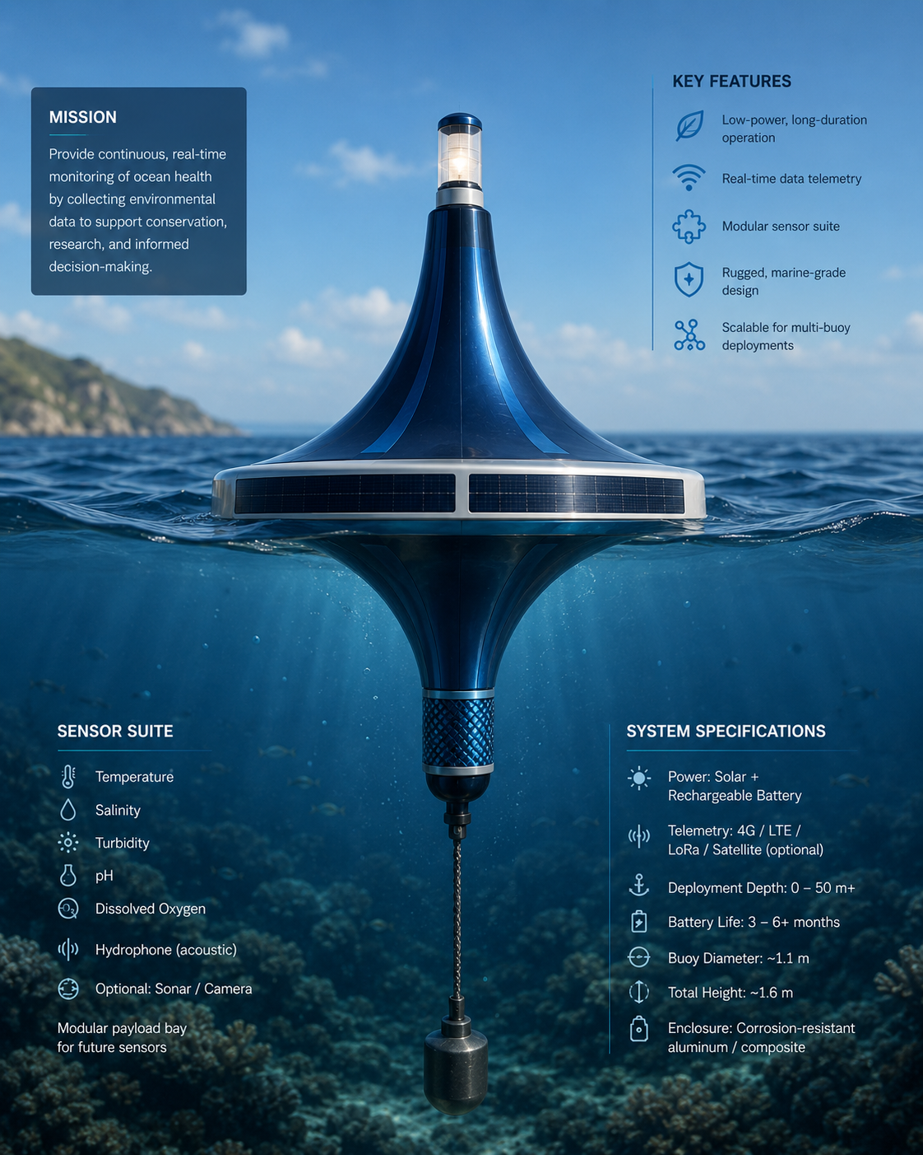
CONTENTS
Background/Motivation
Problem Needs Statement
Stakeholders and Ecosystem Dimensions/factors to consider
Initial project scope
Team roles and assets
Technical electives/Courses
Conclusions
References
Notes:
This presentation begins with the background and motivation behind the project, followed by the problem and stakeholder needs we identified. We will then discuss the project ecosystem, initial technical scope, team roles, and supporting technical coursework. Finally, we will conclude with the intended direction of the project moving forward.

Slide 3


SCOUT
Background & Motivation
Reefs support:
Biodiversity
Fisheries
Tourism
Coastal protection
Growing Threats
Warming oceans
Water quality decline
Storms & human impacts
Monitoring Gap
Expensive
Infrequent
Hard to scale
Why This Area
Inspired by Kāneʻohe Bay reefs
Guided by Makai Ocean Engineering & SCU EPIC Lab
Notes:
Coral reefs are essential ecosystems that support biodiversity, fisheries, tourism, and coastal protection. However, reefs are increasingly threatened by warming ocean temperatures, declining water quality, storms, and other human impacts.
At the same time, effective reef monitoring remains difficult. Existing approaches are often expensive, infrequent, and difficult to scale across multiple sites, creating significant gaps in environmental data.
This project was inspired by reef systems in Kāneʻohe Bay, Hawai‘i, along with discussions and guidance from Makai Ocean Engineering and the SCU EPIC Lab, which helped shape the direction of the project.

Slide 4
SCOUT
Current Limitations
Limited continuous data
High monitoring costs
Sparse coverage
Stakeholder Need
Continuous monitoring
Early stress detection
Better conservation decisions
Stakeholders
NGOs / conservation
Governments / MPAs
Researchers
Coastal communities
Key Drivers
Climate change
Water quality shifts
Limited infrastructure
Problem Needs Statement
Coral reef stakeholders currently lack an affordable, scalable, and continuous method for monitoring shallow-water reef environmental conditions.
Notes:
Many reef stakeholders currently lack access to affordable and continuous environmental monitoring. Existing methods often rely on short deployments or periodic observations, making it difficult to detect environmental stress or changing reef conditions over time.
Stakeholders including conservation organizations, researchers, government agencies, and coastal communities require better long term environmental visibility to support informed conservation and management decisions.
This leads to our problem statement: coral reef stakeholders currently lack an affordable, scalable, and continuous method for monitoring shallow water reef environmental conditions.

Slide 5

SCOUT
Stakeholders & Ecosystem
Primary Stakeholders
Conservation organizations
Government agencies
Reef researchers
Coastal communities
Resorts / ecotourism
Stakeholder Challenges
Limited reef data
High monitoring cost
Difficult long-term tracking
Limited site coverage
Project Ecosystem Factors
Climate change
Water quality variability
Storm exposure
Reef accessibility
Cost & scalability constraints
Notes:
This project involves several important stakeholder groups, including conservation organizations, government agencies, reef researchers, coastal communities, and ecotourism stakeholders that rely on healthy reef systems.
Across these groups, common challenges include limited reef data, high monitoring costs, difficulty maintaining long term tracking, and limited site coverage.
The broader ecosystem also introduces important constraints that influence design decisions, including climate change, changing water quality, storm exposure, reef accessibility, and cost and scalability limitations. These factors help define what a practical and effective monitoring solution must consider.

Slide 6
SCOUT
Initial Project Scope
Initial Focus
Shallow-water reef monitoring
Long-term environmental sensing
Surface deployment near reefs
Shore-side data transmission
MVP Data Types
Temperature
Water quality indicator
Potential acoustic monitoring
Expected Challenges
Waterproofing
Power management
Marine growth / biofouling
Storm survivability
Reliable communication
Current Boundaries
Shallow water focus
Reef-adjacent deployment
Modular future expansion
Notes:
Our initial project focus is shallow water reef monitoring through a surface deployed buoy system positioned near reef environments. The goal is to support long term environmental sensing while transmitting collected data to a shore side system.
For a minimum viable product, we intend to focus on a realistic and manageable sensing package. Current targets include temperature monitoring, a water quality indicator, and potentially acoustic monitoring to better understand reef ecosystem activity.
We also anticipate several engineering challenges, including waterproofing, power management, marine biofouling, storm survivability, and reliable communication.
To maintain a focused scope, the project will initially remain limited to shallow water, reef adjacent deployments while allowing for modular expansion in the future.

Slide 7
SCOUT
Roles & Assets
GENG - John Ryan | ELEN - Isa | CSEN - David
Waterproofing | Hardware & Power | Shore-side Computer
Buoy Design | Embedded Systems | Data Organization
Sensor Integration | Radio Communication | Statistical Analysis
Marine Logistics | Battery & Solar Systems | Future ML Integration
Team Assets
Marine engineering experience (Makai Ocean Engineering)
Multidisciplinary engineering team
SCU faculty & lab support
Notes:
Our team is intentionally multidisciplinary to address the range of technical requirements involved in this project.
As the General Engineering lead, my responsibilities include waterproofing, buoy design, sensor integration, and marine logistics. Our Electrical Engineering team member is responsible for embedded systems, radio communication, hardware integration, and power systems. Our Computer Science and Engineering team member focuses on shore side data organization, statistical analysis, and future machine learning integration.
One of our key strengths is relevant technical exposure and support. The team benefits from marine engineering experience through Makai Ocean Engineering, faculty and laboratory support from Santa Clara University, and a team structure aligned with the technical challenges of the project.

Slide 8
SCOUT
Technical Electives
GENG - John Ryan | ELEN - Isa | CSEN - David
Marine systems / fluids | Embedded systems | Data systems
Materials & manufacturing | Wireless communication | Machine learning
Mechatronics / controls | Power electronics | Signal processing
Power electronics
Purpose
Support sensing, power, communication, and analysis challenges
Notes:
This project also aligns closely with our technical coursework and academic backgrounds.
General Engineering coursework in marine systems, materials, manufacturing, mechatronics, and controls supports the physical design and deployment aspects of the buoy.
Electrical Engineering coursework contributes expertise in embedded systems, wireless communication, and power electronics, all of which are critical for sensing and long term deployment.
Computer Science and Engineering coursework in data systems, machine learning, and signal processing supports how collected environmental data may be organized, analyzed, and interpreted.
Together, these technical backgrounds help support the sensing, power, communication, and analytical requirements of SCOUT.

Slide 9


COMPETITOR AT A GLANCE
Conclusions
01
02
Key Takeaways
Project Direction
Coral reefs face growing environmental stress
Current monitoring is limited and difficult to scale
Stakeholders need improved long-term environmental insight
Focus on shallow-water reef monitoring
Prioritize affordability, durability, and scalability
Build toward long-term reef conservation impact
Notes:
In conclusion, coral reefs face increasing environmental stress while current monitoring systems remain costly, limited, and difficult to scale.
SCOUT seeks to address this challenge by focusing on an affordable, durable, and scalable shallow water reef monitoring platform capable of supporting long term environmental monitoring.
At this stage, the primary focus is developing a realistic minimum viable product while evaluating the technical feasibility of a system that may ultimately support improved reef conservation and environmental decision making.

Slide 10
[1] National Oceanic and Atmospheric Administration, “Coral Reef Conservation Program,” NOAA. [Online]. Available: NOAA Coral Reef Conservation Program￼. [Accessed: May 31, 2026].
[2] Hawai‘i Institute of Marine Biology, “Hawai‘i Institute of Marine Biology,” University of Hawai‘i at Mānoa. [Online]. Available: Hawai‘i Institute of Marine Biology (Kāneʻohe Bay)￼. [Accessed: May 31, 2026].
[3] Navid Shaghaghi, informational interview, EPIC Lab, Santa Clara University, Santa Clara, CA, USA, personal communication, May 2026.
[4] R. Argall, informational interview, Makai Ocean Engineering, Kailua, HI, USA, personal communication, May 2026.
[5] OpenAI, “ChatGPT,” OpenAI, San Francisco, CA, USA. [Online]. Available: ChatGPT￼. [Accessed: May 31, 2026].
References

