Slide 1
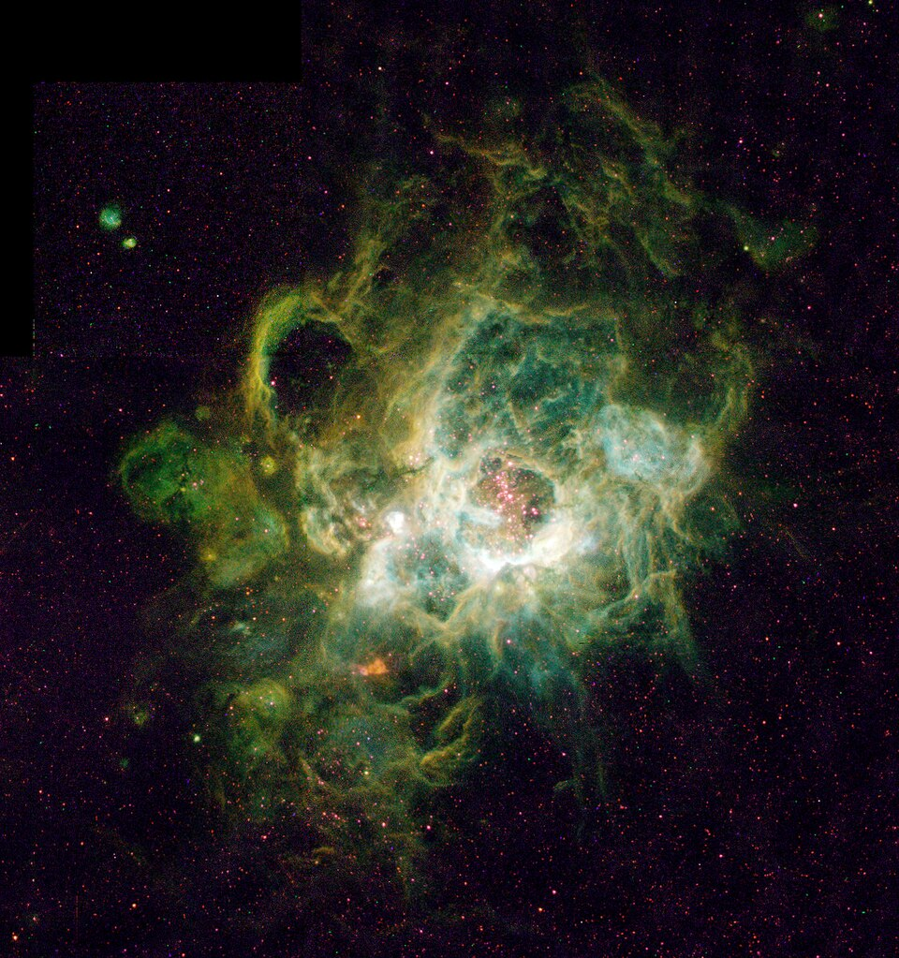

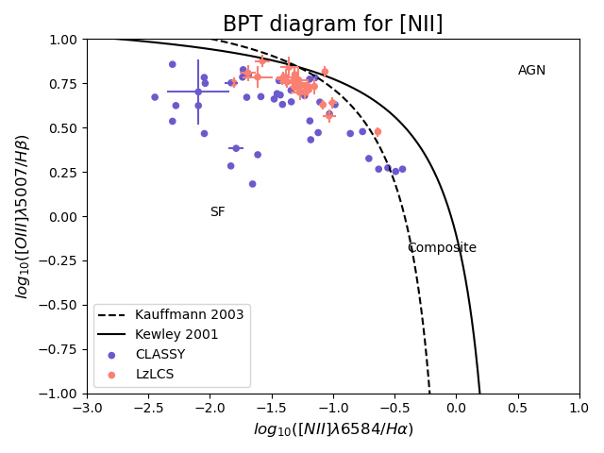
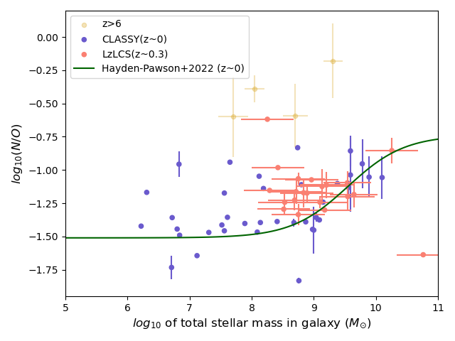
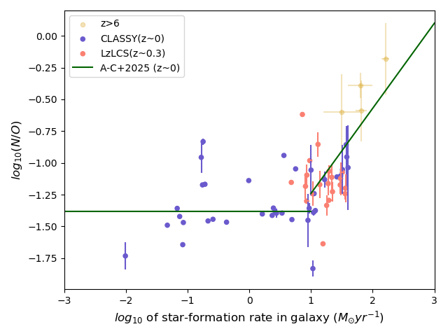
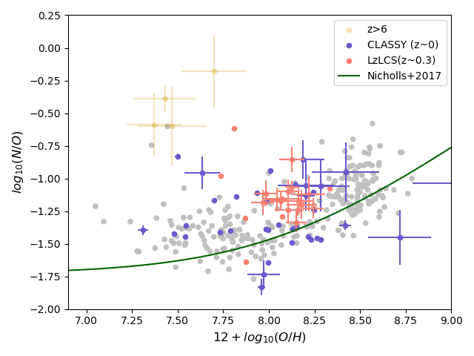
The Chemical Composition of Star-forming Galaxies
David Clayton Supervisor: Dr. Karla Z. Arellano-Córdova
Introduction
The chemical composition of the galaxies is a crucial aspect in understanding the evolution of galaxies in the Universe. To understand the evolution of chemical abundances in galaxies informs us about the nucleosynthetic and astrophysical processes that caused the chemical composition to be what it is: Gas flow, star-formation etc.
HII regions are clouds of gas in star-forming regions of the interstellar medium that are ionised by large, hot stars. The emission spectra from these regions is sensitive to the temperature, density and chemical composition.
By deriving the chemical composition of the HII regions in galaxies, and comparing them to physical properties of the galaxy, such as stellar mass and star-formation rate (SFR), we can construct relations to predict abundances based on their properties, and investigate if galaxies at different redshifts (cosmic times) obey the same relations.
Results
The BPT diagram (fig. 1) verifies that the CLASSY and LzLCS galaxies are indeed ionised by star-forming regions. The N/O – 12 + log(O/H) relation is shown in fig. 2, with a sample of low-z background galaxies for comparison, and an empirical fitting relation for low-z galaxies taken from Nicholls 2017 [3].
Results(contd.)
The relations between N/O and stellar mass are shown in fig. 3. The relation between N/O and SFR are shown in fig. 4. Low-z empirical fitting relations [4][5] are shown in green, and a sample of high-z comparison galaxies are shown in gold.
Fig. 3: N/O – mass relation Fig. 4: N/O – SFR r
Conclusions
We can see that the CLASSY galaxies follow the empirical scaling relations fairly well, however, the LzLCS galaxies are heavily clustered in parts of the diagrams, with large error bars. Therefore, whether the LzLCS galaxies have the same profile as local galaxies is indeterminate. The high-z comparison galaxies show an obvious disobedience of the low-z empirical relations, suggesting that the chemical enrichment of galaxies evolves over cosmic time.
Methods
Two samples of galaxies were investigated. The CLASSY sample is a selection of 45 local (z<0.2) star-forming galaxies with high SFRs and bright UV spectra, making them good analogues for high-redshift galaxies.[1] The LzLCS sample is a selection of 27 low-redshift (0.2<z<0.4) galaxies chosen for large fluxes of ionising photons (Lyman continuum emitters)[2].
We derived the abundances of nitrogen and oxygen using the so-called “direct-method”, which is a highly reliable method that derives the abundance with an estimate of the temperature, itself estimated from the emission spectrum
We derived the N/O abundance ratio, and the metallicity Z = 12+log(O/H), and obtained the stellar mass and SFR from literature
Fig. 1: BPT diagrams showing the ionisation mechanism that results in the following emission lines. Almost all galaxies are in the SF (star-forming) region.
References
[1]: D.A. Berg et al., ApJS, 261, 31 (2022)
[2]: S.R. Flury et al, ApJ, 260, 1 (2022)
[3]; D.C. Nicholls et al, MNRAS, 466, 4403 (2017)
[4]: C. Hayden-Pawson et al, MNRAS, 512, 2867 (2022)
[5]:K.Z. Arellano-Cordova et al, MNRAS, 544, 1588, (2025)
Fig 2: N/O – O/H relation: A sample of high-z galaxies are shown to compare

