Slide 1
DATA ANALYTICS PROJECT
Northwind
Sales Analytics
A complete guide to analysing customer behaviour, order patterns, and operational performance across six key business dimensions

Slide 2

OVERVIEW
Project Scope and Objectives
What We're Analysing
Expected Outcomes
This project examines six critical business areas: customer purchasing patterns, order performance, employee productivity, product inventory, supplier relationships, and shipping efficiency. By connecting data across multiple tables, we uncover actionable insights that drive strategic decisions.
Identify high-value customers and churn risks, optimise inventory levels, improve delivery performance, enhance workforce planning, and strengthen supplier partnerships. These insights support marketing, sales, and operational improvements across the organisation.

Slide 3

ANALYSIS AREAS
Six Dimensions of Business Intelligence
Customer Analysis
Order Analysis
Understanding purchasing behaviour, identifying high-value customers, and tracking order frequency to reduce churn
Evaluating sales performance, tracking revenue trends, and optimising fulfillment processes
Employee Analysis
Product Analysis
Examining workforce distribution, tenure patterns, and workload allocation
Assessing inventory levels, pricing strategies, and product performance across categories
Supplier Analysis
Shipper Analysis
Evaluating supplier reliability, geographic distribution, and procurement efficiency
Monitoring delivery performance, shipment volume, and logistics optimisation

Slide 4
METHODOLOGY
Six-Step Implementation Process
Understand the Dataset
Review all tables including Customers, Orders, OrderDetails, Products, Employees, Suppliers, Shippers, and Categories. Map relationships and identify data quality issues.
Data Preparation
Clean data using Excel and SQL. Remove duplicates, fix formatting inconsistencies, handle missing values, and create calculated columns for analysis.
Data Analysis
Execute SQL queries to summarise key metrics. Calculate total revenue, average order values, customer segments, and product performance indicators.
Power BI Modeling
Import cleaned datasets, establish table relationships, and create DAX measures for revenue, customer lifetime value, and performance metrics.
Visualisation
Build interactive dashboards with charts, tables, and KPIs. Display trends, comparisons, and performance metrics across all analysis dimensions.
Insights & Reporting
Summarise findings and provide actionable recommendations for marketing strategies, sales optimisation, and operational improvements.

Slide 5
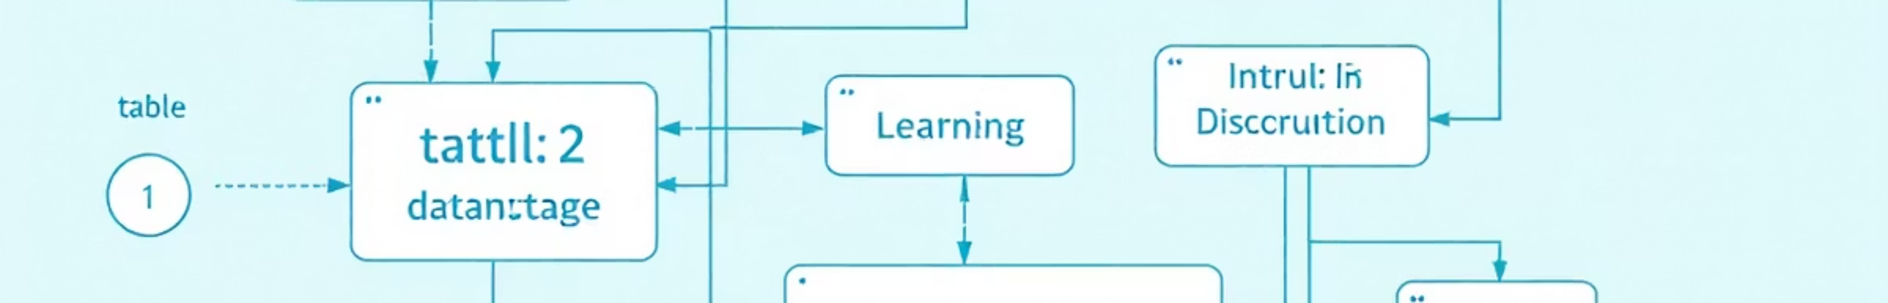
STEP 1-2
Data Foundation: Understanding and Preparation
Dataset Review
Excel Preparation
SQL Foundation
Begin by mapping all table relationships. OrderID connects Orders to OrderDetails, ProductID links Products to OrderDetails, and CustomerID ties Orders to Customers. Check for missing data and duplicates.
Import all CSV files, remove duplicates, standardise formatting, and handle null values. Create calculated columns such as Total_price using Quantity × UnitPrice adjusted for discounts.
Load datasets into database tables with proper primary and foreign keys. Write queries to clean data, remove duplicates, and create aggregated tables for revenue by customer, product, and region.

Slide 6
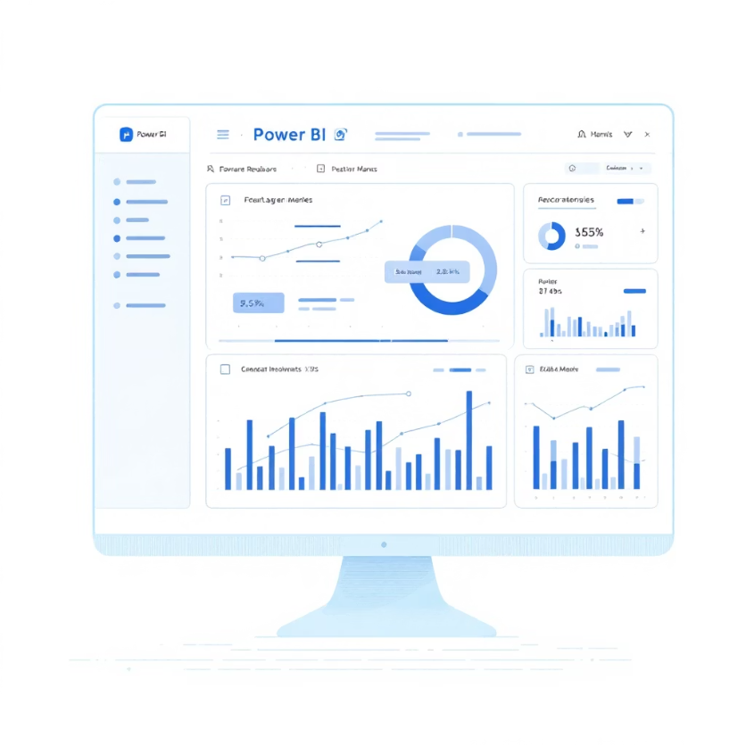
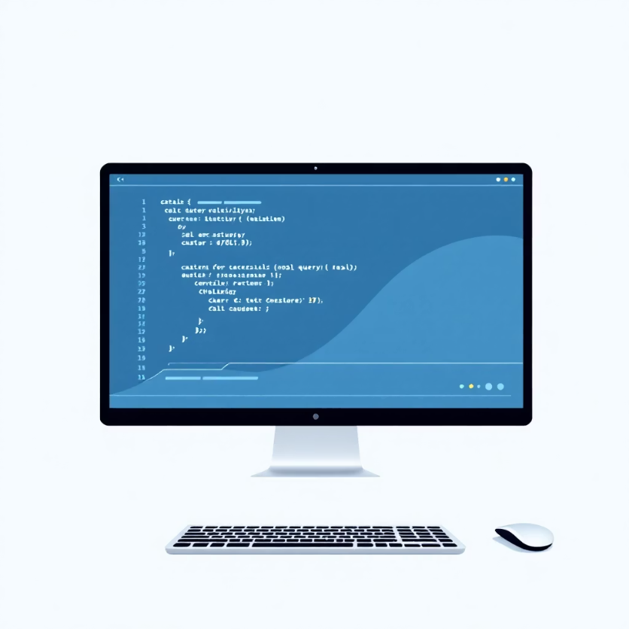
Analysis and Modelling Excellence
SQL Analysis Queries
Execute comprehensive queries to explore and summarise the dataset:
Calculate total revenue, order count, and average order value
Determine orders per customer and identify top-selling products
Measure employee performance through orders handled and tenure analysis
Assess supplier and shipper reliability metrics
Power BI Data Modeling
Create relationships between imported tables and build DAX measures including Total Revenue, Average Order Value, and Customer Lifetime Value calculations for deeper insights.

Slide 7
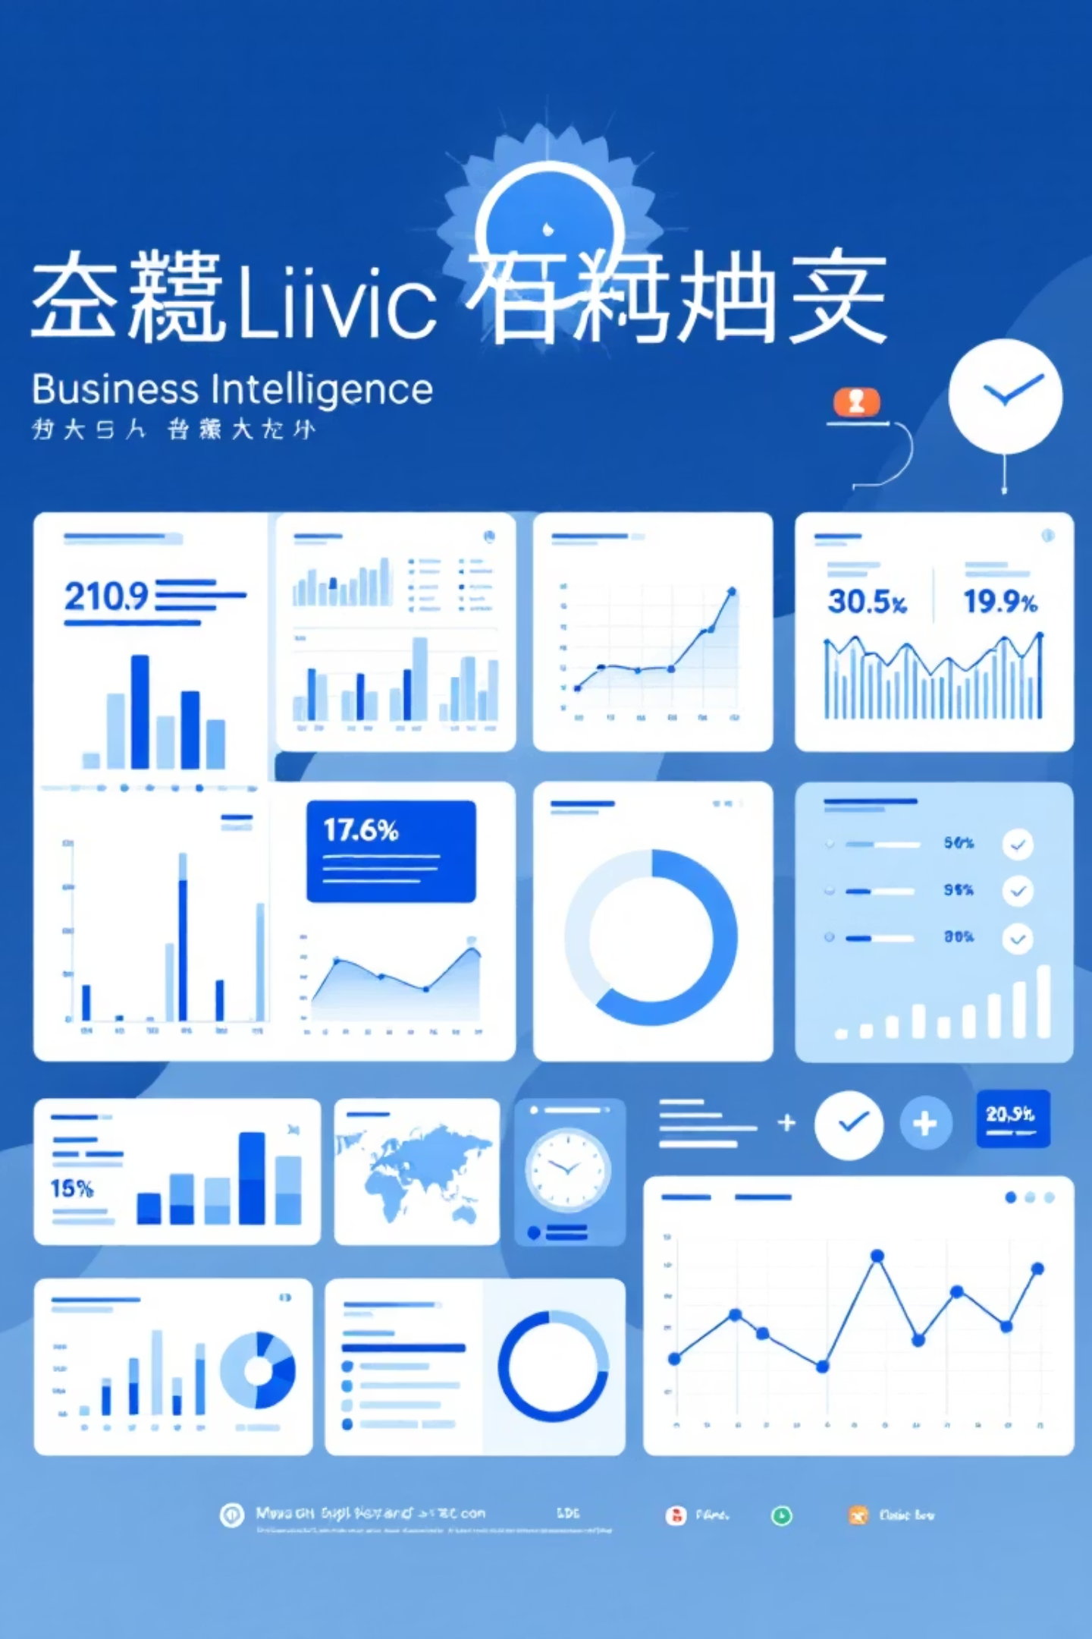
DASHBOARD DESIGN
Visualisation Strategy
Customer Dashboards
Order & Product Views
Display total revenue, top customers by spend, order frequency distribution, and customer lifetime value segments with trend analysis
Show monthly and quarterly trends, average order values, discount impact, top-selling products, stock levels, and category performance
Operations Metrics
Track employee order handling, tenure statistics, supplier product counts, shipping performance, and delivery time analysis
Utilise bar charts, line graphs, pie charts, detailed tables, and prominent KPI cards to create an intuitive, actionable dashboard experience.

Slide 8
KEY INSIGHTS
Expected Analytical Discoveries
Customer Intelligence
Product Performance
Workforce Efficiency
Supply Chain Excellence
Identify your most valuable customers, understand purchase frequency patterns, and detect early warning signs of potential churn risks
Discover best-selling items, optimise inventory levels, manage stock efficiently, and refine pricing strategies based on demand
Highlight employees with highest order processing rates, balance workload distribution, and support performance evaluation processes
Evaluate supplier reliability, assess shipper performance, reduce delivery times, and strengthen procurement relationships

Slide 9




RECOMMENDATIONS
Actionable Business Strategies
Marketing Optimisation
Target high-value customers with personalised campaigns. Re-engage at-risk customers with retention programmes. Leverage purchase patterns for cross-selling opportunities.
Sales Enhancement
Focus efforts on top-performing products and regions. Adjust pricing strategies based on demand analysis. Develop promotions around seasonal trends.
Operations Excellence
Optimise inventory to prevent stockouts and overstock. Improve employee training based on performance gaps. Strengthen partnerships with reliable suppliers and shippers.

Slide 10
1
2
Data Collection & Cleaning
Analysis & Modeling
Gather all datasets and complete the preparation phase using Excel and SQL within the first two weeks
Execute SQL queries, build Power BI data models, and create DAX measures over the following three weeks
3
4
Dashboard Development
Insights & Reporting
Design and build interactive visualisations across all six analysis dimensions
Document findings, prepare recommendations, and present actionable insights to stakeholders in the final phase

