Slide 1


King County Housing Market presented by: Abdillah Aldeghaither, Abdullah Alhujailan, David Deans, Santosh Gurung (Feroz), Huy Pham

Slide 2


Agenda:
Objectives
Introduction
Data Exploration
Market Analysis
Regression Analysis
Recommendation and conclusion

Slide 3


Objectives
To understand the current real estate market of the king county.
To analyze the favorable conditions to invest on the housing market.
To see if Seattle (King county) is a good fit for Mr. Jacob Kawalski to start his business.

Slide 4

In this video three economists summarize the overall housing market of King county especially of Seattle area.
https://youtu.be/8nGi7vOQ8iE

Slide 5
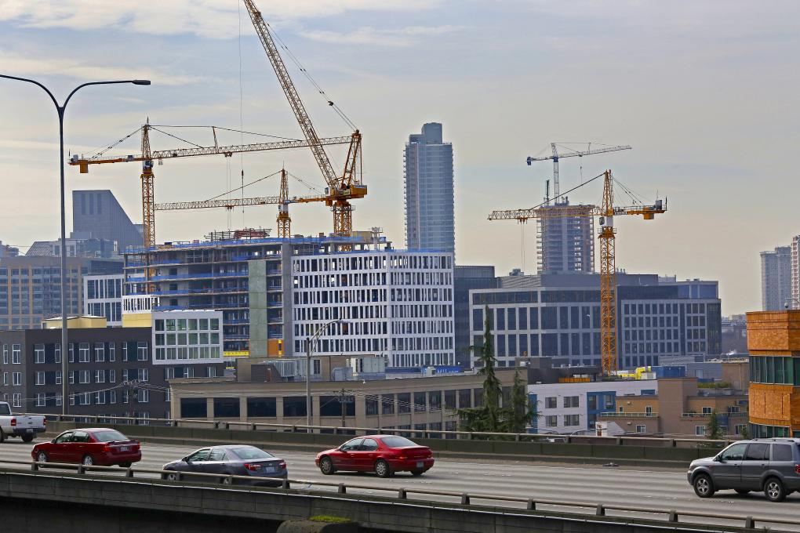

Introduction
King County has become a modern day boomtown with the rapid technological development and increase in tech giants.
The housing market has skyrocketed in the last few years.
Seattle has been the country’s hottest real estate market for 21 months in a row since 2016.
King County’s population(2,204,229) in 2019, a 15.6% increase from 2010.
Seattle’s median house price hit $700,000.

Slide 6
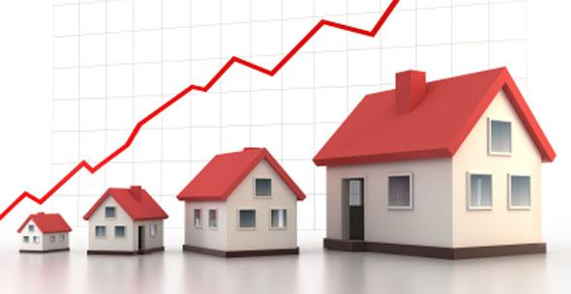
Data Exploration
price ($450,000).
King County’s median home
3 bedroom, 2 and a quarter bathroom built in 1975
lot size of 7619 sq. ft. and an interior of 1910 sq. ft.

Slide 7
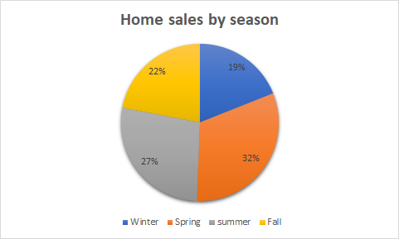
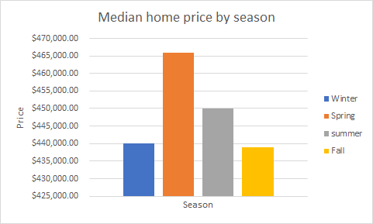
Market Analysis
Highest volume of sales occurs in the Spring at 32%, followed by Summer, Fall, and Winter(figure 1).
median home price peaks in the Spring and Summer and dips in the Winter and Fall (Figure 2).

Slide 8
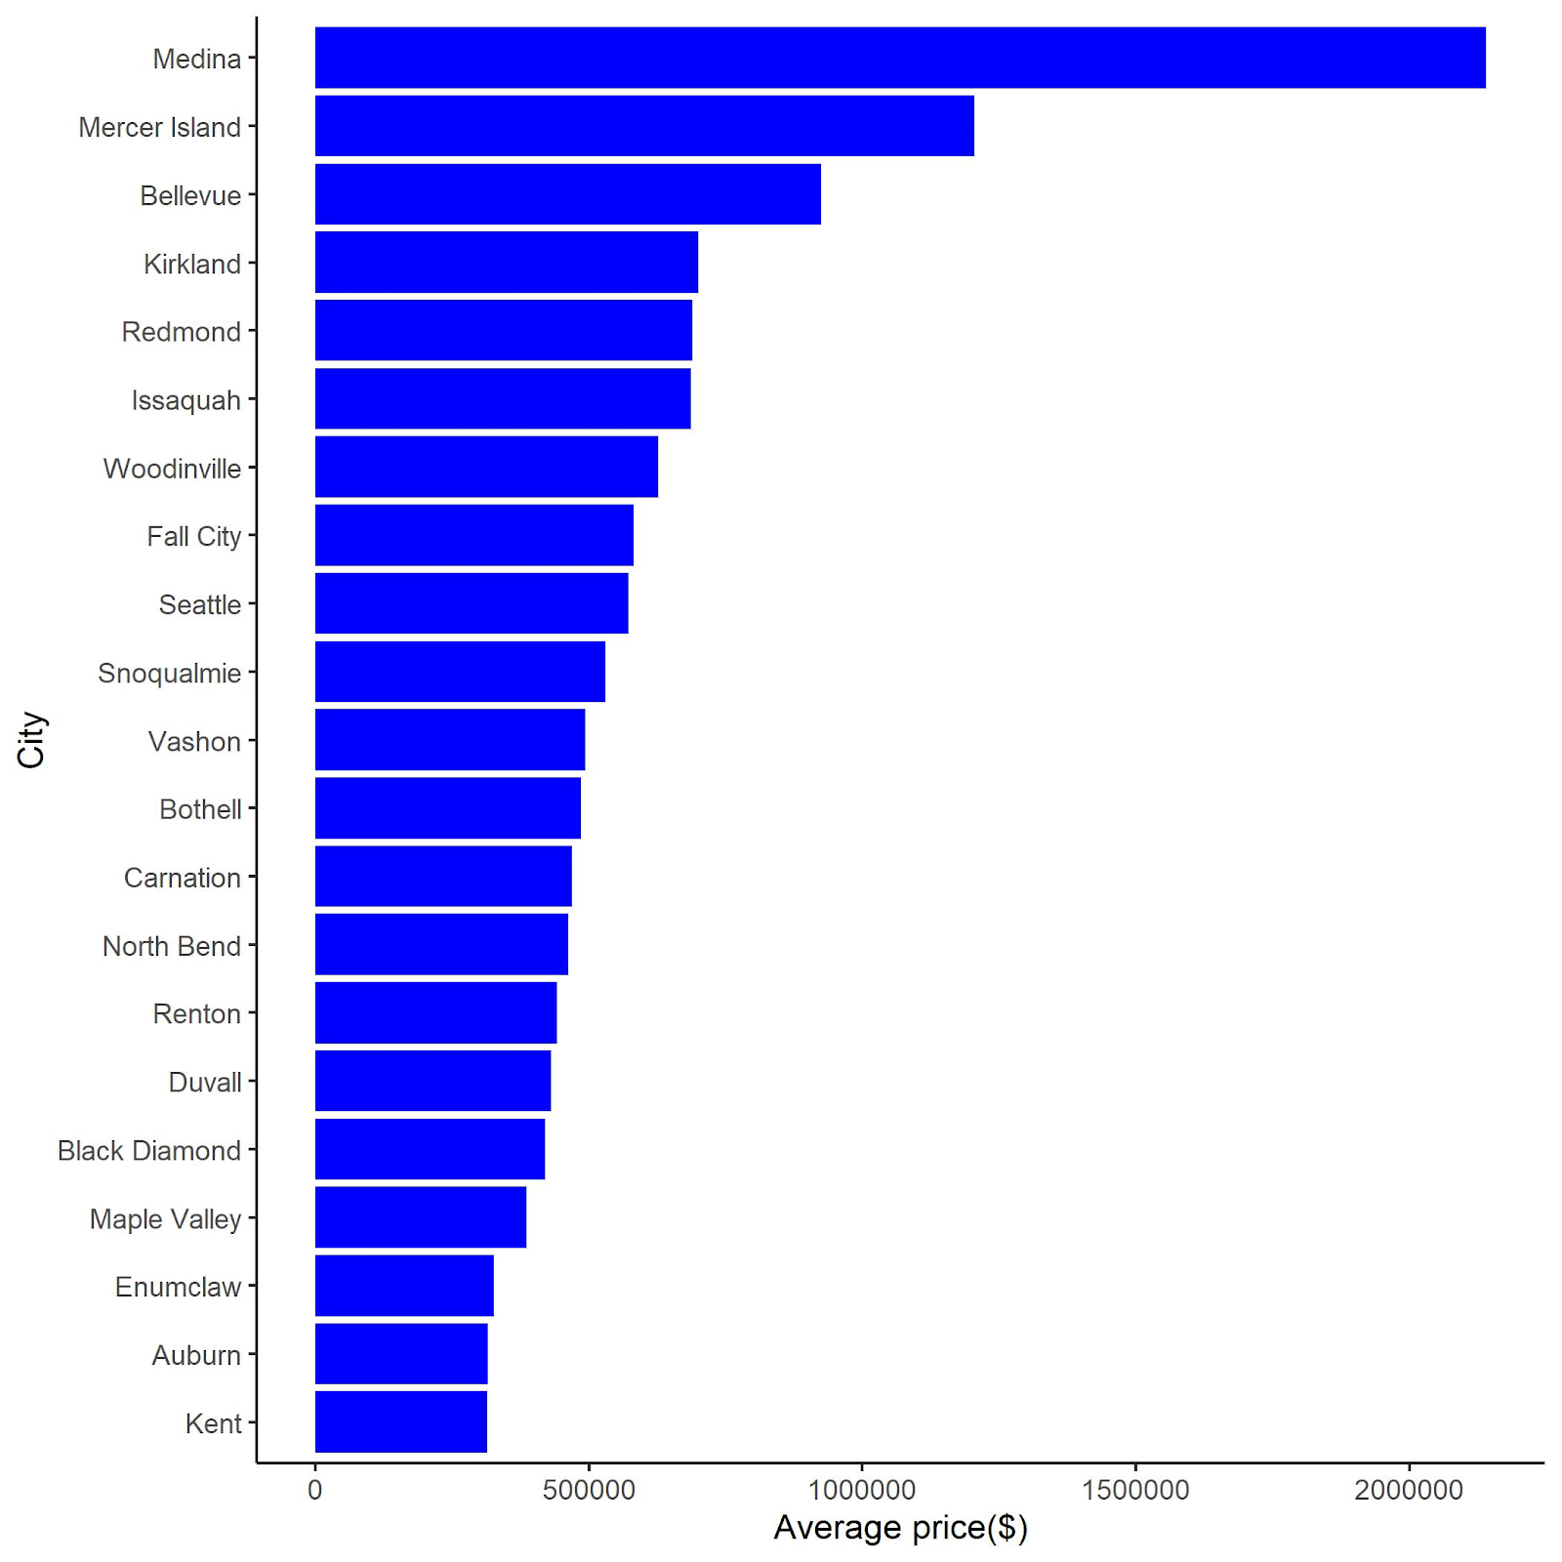


Measure of the average price of homes sold by neighborhood
Medina tops the list of average home price with over $2 millions followed by mercer island.
Housing price can be impacted by neighborhood quality, school quality, and a plethora of factors.

Slide 9
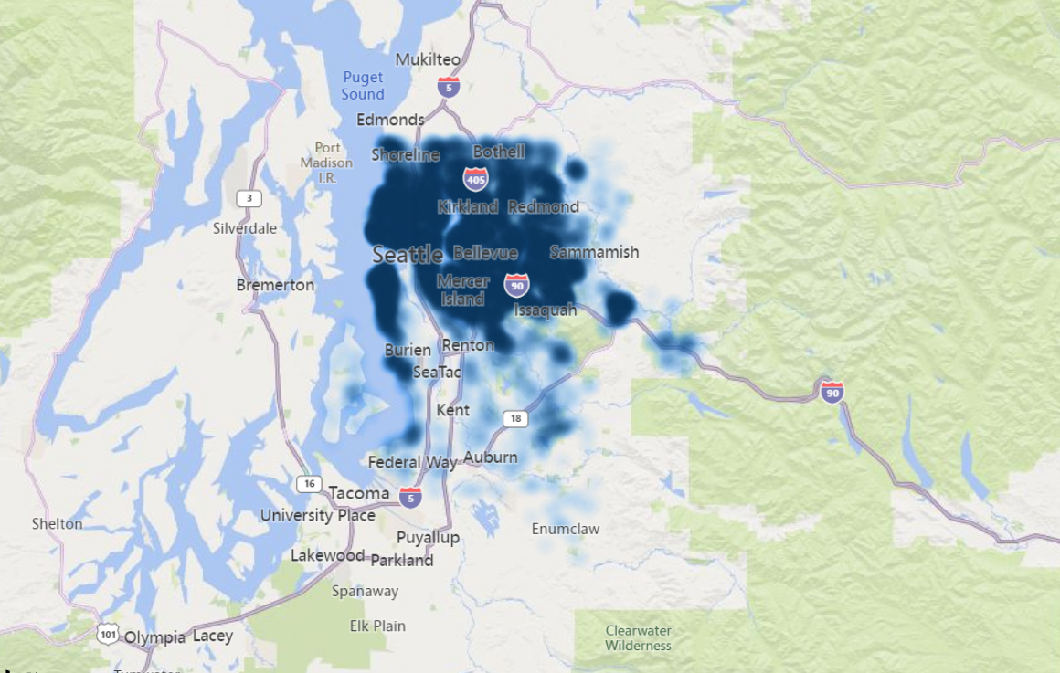
The hit map on the left displays the location and price.
The darker the spot, the higher the price.
Very heavy premium on property value inside the main metropolitan area of Seattle, Mercer Island, and Bellevue.
Renton, Kent, Auburn, and surrounding communities do not have the same premium.
Cheaper properties available for purchase on Southward.
Heat Map by Location and Price

Slide 10
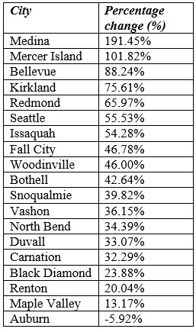
Regression Analysis
The table on the left shows, on average, the predicted percentage change in price caused by selling houses in cities other than Kent, holding season and house variables constant.
Cities are referenced against Kent.
As shown in the regression table, all cities have a positive returns in comparison to Kent in terms of house prices except for Auburn.

Slide 11

Recommendations
We recommend not to invest in the current situation as it is being forecasted to get crashed But
During the sunny seasons, we believe you would have the most success in your business endeavors over the darker seasons.
recommendation to enter as a buyer during either the Winter or Fall and be prepared to capitalize on your investments in the Spring
It’s important to keep in mind this can be impacted by neighborhood quality, school quality, and other factors. A poor quality home in Medina does not necessarily promise a better return than an exemplary property in Seattle. Higher sale price does not necessarily mean a higher return on investment.

Slide 12

Conclusions
There is an increased possibility of volatility in the market.
An estimated 70% of economists forecast an imminent recession, which may be the keystone to a changing market.
Washington entering it’s first trade deficit with China in recent years.
Strong job growth and tight supplies have fueled the housing market, leading some to fear that it is a bubble.
Experts say the housing market is vulnerable to rising interest rates, job losses due to tariffs and local policies against development.
This is not necessarily a good time to invest in housing market.

Slide 13

https://youtu.be/dxXuLLGjORM

Slide 14


