Slide 1

BSol Measles Participatory System Modelling Workshop
David Ellis
Senior Public Health Analyst
Birmingham City Council

Slide 2
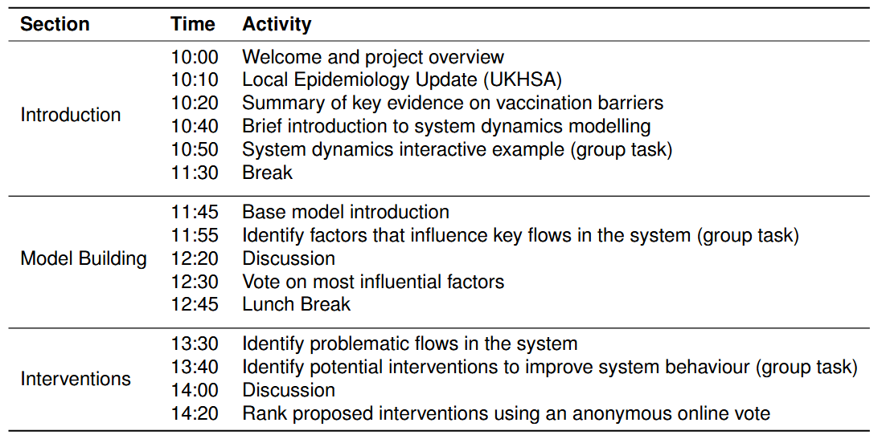

Agenda

Slide 3
Housekeeping
No fire drills planned for today
If the fire alarm does go off, head down the main stairs and out the door you came in from
Full-room discussions will be recorded and transcribed. For transparency, the transcriptions will be made publicly available in an anonymised format.
Smaller group discussions will not be recorded.
All transcriptions, code, models, and publicly available data will made available on the project’s GitHub repository David-Ellis/Measles-System-Dynamics-BSol

Slide 4
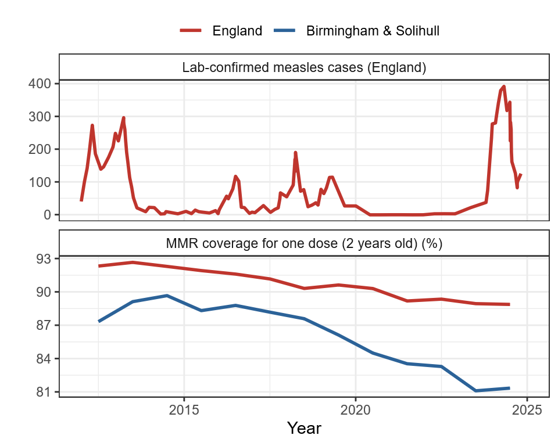
Background (1)
Having “eliminated” measles in the UK in 2016, regular outbreaks are becoming the new normal.
This is happening in the context of falling MMR vaccination coverage, particularly in Birmingham & Solihull
The reasons for this reduction are multifaceted and correlates strongly with ethnicity and socioeconomic factors
Data from UK Health Security Agency

Slide 5
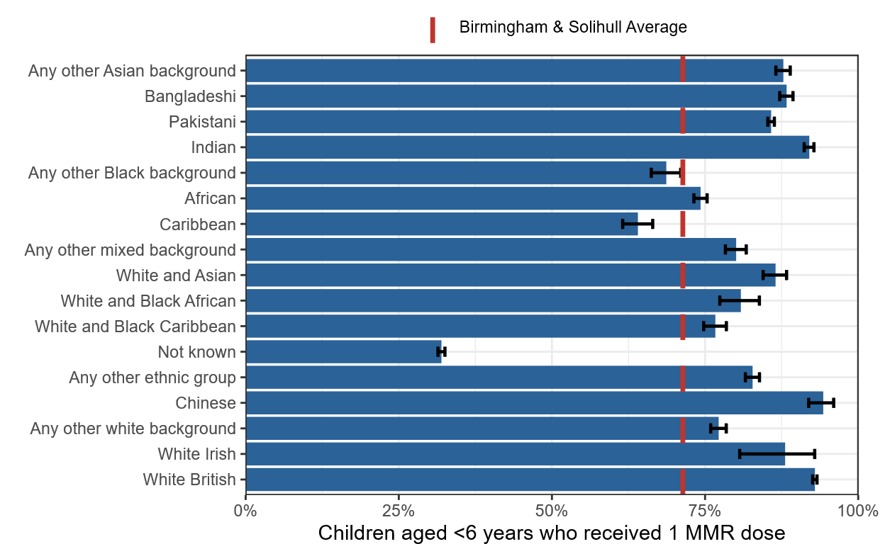
Background (2)
All ethnic groups other than Chinese, Indian, and White Irish have significantly lower MMR coverage than the White British population
During the Birmingham outbreak from Oct 2023 to April 2024 the infection rate for Black African residents was eight times greater than the White British population
Data from the NHS Federated Data Platform

Slide 6
Project Overview
How can a decision support model be used to facilitate the development of interventions to increase measles vaccination rates and reduce negative outcomes, particularly amongst lower-uptake ethnic groups?
The research aims are as follows:
Conduct a participatory modelling workshop with expert stakeholders to design a theoretical model for measles vaccinations and outcomes in Birmingham and Solihull, and to identify and prioritise key interventions to be modelled,
Develop a computational model calibrated using historical vaccination, notification, and hospitalisation data,
Integrate most highly prioritised interventions to simulate the expected impact on the modelled behavioural science factors, vaccination rates, and health outcomes.

Slide 7
Pause for questions

Slide 8
Local Epidemiology Update

Slide 9
Epidemiology of measles in Birmingham 20th March 2026 Produced by Field Services Midlands Official sensitive: not for sharing

Slide 10
These slides have been removed from the public upload as requested by UKHSA

Slide 11
Barriers to MMR Vaccination

Slide 12
Language Barriers
Ingredients
Language barriers and low reading ability arose as a key issue.
Many parents in BSol speak little English and therefore struggle to benefit from English-only flyers
Others are unable to read in any language.
This finding mirrors that of a 2024 systematic review on the barriers and enablers to MMR uptake among disadvantaged, minority, or underserved populations.
Concerns about the ingredients and safety of the vaccine varied by community.
Muslim participants expressed concerned about pork gelatine and the option of a pork-free vaccine
This again mirrors global research where the most cited religiously motivated barriers to measles vaccination were:
Animal-derived gelatines used in the vaccine production
Use of aborted human foetus tissue to make the rubella component of the MMR vaccine

Slide 13
Autism Links
Accessibility
Muslim/Afro-Caribbean communities, fears about possible links to autism were also seen to be important, while these were less important for the Romani traveller community
A 2023 systematic review found the risk of autism to be the most cited concern about the vaccine
Birmingham support staff working with unaccompanied asylum-seeking children (UASC) said that UASC often arrive with missing vaccination records, and that there often isn’t enough time within appointments to give the required immunisations
A 2025 review found that many migrants living in Europe don’t know how to access vaccine services and don’t know what they’re eligible for, including fears of costs.
A 2019 systematic review found that parents from Gypsy, Roma, and Traveller populations faced unique accessibility barriers due to their transient residency as well as regular discrimination and exclusion within the healthcare system.

Slide 14
Trust
Other Factors
Some participants reported a general mistrust of government sources, particularly if associated with the ‘Home Office’ and ‘immigration’.
A general preference was raised for information to come from healthcare professionals and local community/faith leaders.
A lack of trust in the healthcare system has also been found to be a barrier to vaccination in the UK
Belief that children are given too many vaccines too soon
Low perceived benefit of vaccination
Previous experience of vaccine side-effects

Slide 15
Discussion

Slide 16
System Dynamics

Slide 17
System Dynamics Overview
System dynamics is a novel method for simulating complex systems including stocks, flows, and feedback loops with the ability to include abstract factors such as information flows.
Birth rate
Death rate
Births
Deaths
Population
Flow
Flow
Stock

Slide 18


System Dynamics Example
Rabbit birth rate
Fox birth rate
Rabbit natural death rate
Fox death rate
Rabbit predation rate

Slide 19
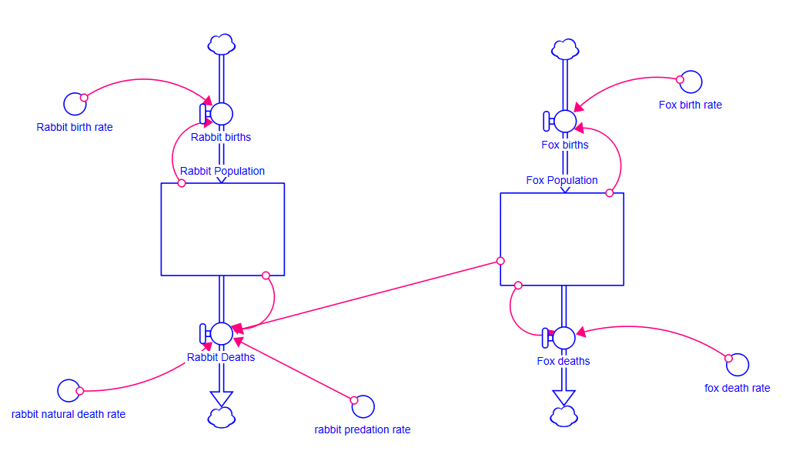
System Dynamics Example - Simulation

Slide 20
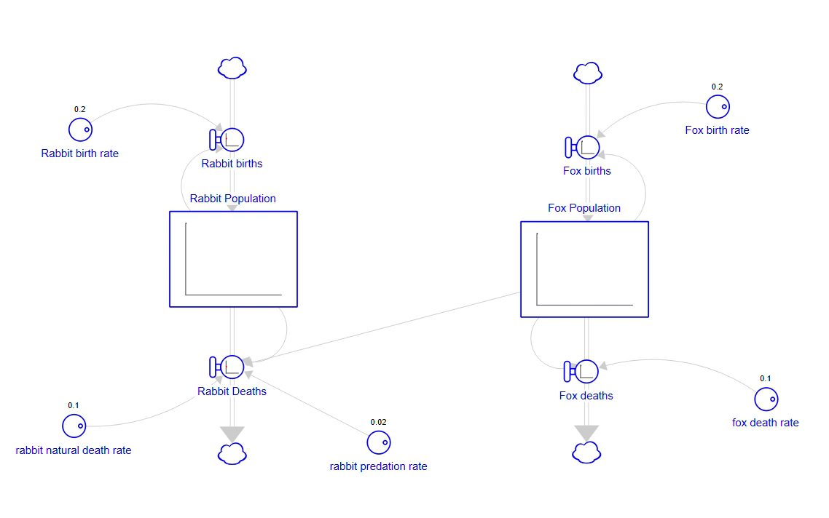
System Dynamics Example - Simulation

Slide 21
System Dynamics Example 2
Rabbit birth rate
Fox birth rate
Rabbit natural death rate
Fox death rate
Rabbit predation rate

Slide 22
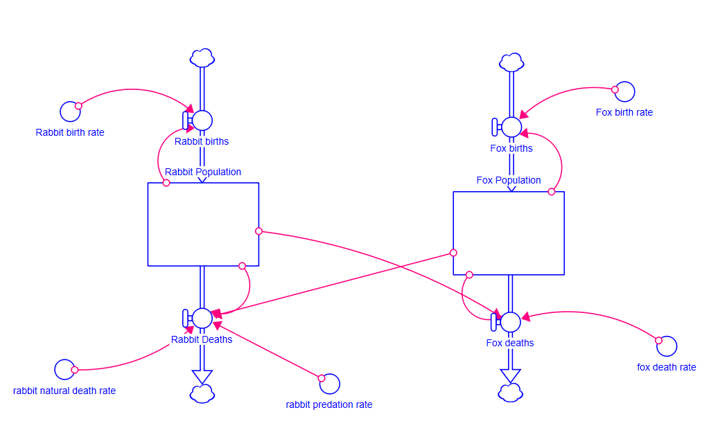
System Dynamics Example 2 - Simulation

Slide 23
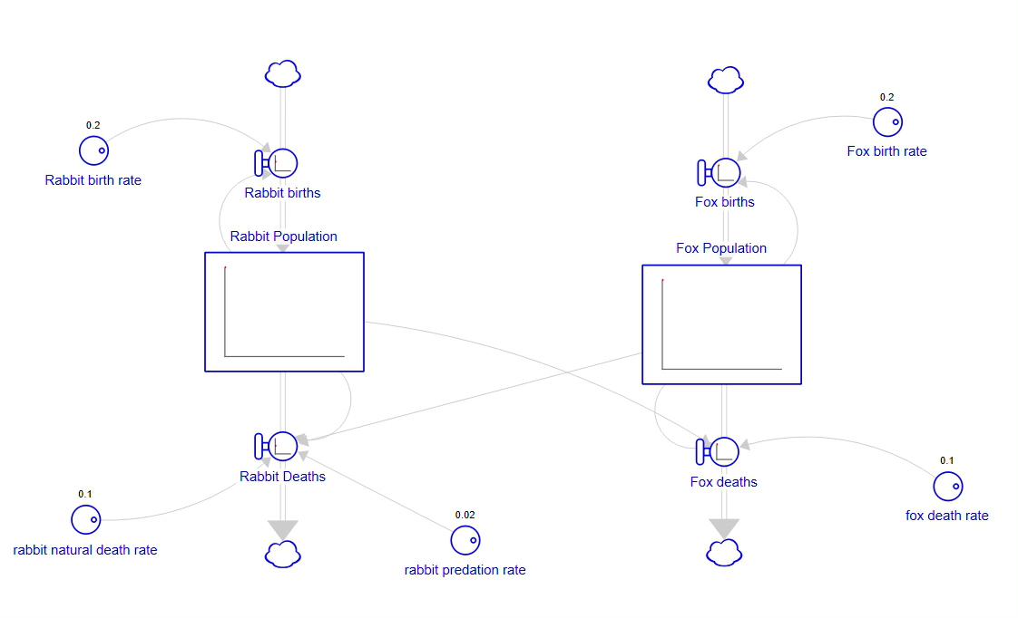
System Dynamics Example 2 - Simulation

Slide 24
Activity – Part 1 Draw a simple system showing money in your bank account. What makes it go up and what makes it go down?

Slide 25
Activity – Part 2 Take what you’ve drawn and boil it down to the key driving factors.

Slide 26


Break (~15 minutes)

Slide 27
Measle System Flow Variables

Slide 28
Base model
Migration
Susceptible
Infected
Recovered
Births
Infections
Recovery
Vaccination
Death from disease
Hospitalisation
Vaccinated
Hospitalised
Recovery
Death from disease
*Each stock is vectorised by ethnicity

Slide 29
Base model
Migration
Susceptible
Infected
Recovered
Births
Infections
Recovery
Vaccination
Death from disease
Hospitalisation
Vaccinated
Hospitalised
Recovery
Death from disease

Slide 30
Base model
Infection rate
Recovery rate
Migration
Susceptible
Infected
Recovered
Births
Infections
Recovery
Vaccination
Death from disease
Hospitalisation
Vaccinated
Hospitalised
Recovery
Vaccination
rate
Death from disease

Slide 31
Base model
Infection rate
Recovery rate
Susceptible
Infected
Recovered
Births
Infections
Recovery
Vaccination
Death from disease
Hospitalisation
Vaccinated
Hospitalised
Recovery
Vaccination
rate
Death from disease
Parents’ willingness to vaccinate

Slide 32
Activity – Part 1 Use the sticky notes and pens to include as many factors influencing the system as possible and their interactions. Think about how ethnicity impacts these flows IF you feel there’s an urgent need for another stock in the model, add it in!

Slide 33
Discussion

Slide 34
Activity – Part 2 You each have 3 small stickers. Walk around the room and use these to vote on factors that you think are most important

Slide 35

Lunch break
(~45 minutes)

Slide 36
Measle System Interventions

Slide 37
Discussion: Where are the problem flows in the system?
Infection rate
Recovery rate
Migration
Susceptible
Infected
Recovered
Births
Infections
Recovery
Vaccination
Death from disease
Hospitalisation
Vaccinated
Hospitalised
Recovery
Vaccination
rate
Death from disease
Parents’ willingness to vaccinate

Slide 38
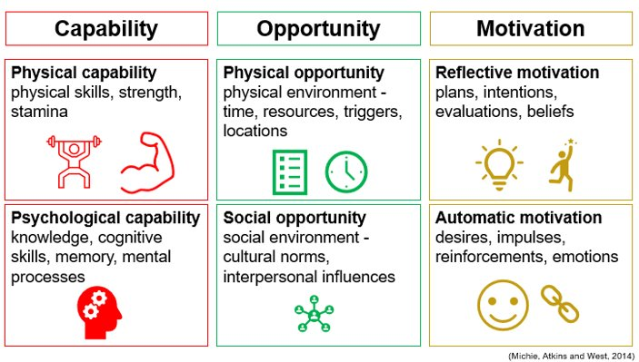
COM-B Model
When thinking about behaviour change interventions, it can be helpful to think about the COM-B model
This model can help us to understand behaviour and what needs to change for a behaviour to occur

Slide 39
Activity – Part 1 In your groups, think about a range of potential and existing interventions that we might implement to reduce measles infections. These may be reactive or preventative

Slide 40
Discussion

Slide 41
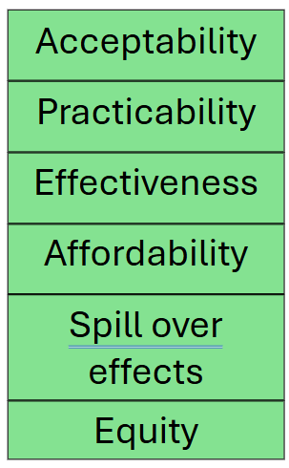
Ranking our interventions
The APEASE criteria can be a useful tool when assessing how “good” we think these interventions will be.
An intervention that might be 100% effective, might be completely impractical or unaffordable

Slide 42
Activity – Part 2 Discuss in your groups which interventions you think are the most worth pursuing. Choose two or three to present back to the room.

Slide 43
Intervention ranking
Ranking Measles Interventions - Mentimeter

Slide 44
Thank you for participating!

