Slide 1
ICIP 2026 · TAMPERE, FINLAND
PatchBandit
Budget-Aware Adaptive Adversarial Patches for Black-Box Object Detection
Pedram MohajerAnsari · Amir Salarpour · David Fernandez · Mert D. Pesé
School of Computing, Clemson University, USA
Presenting: David Fernandez
github.com/pedram-mohajer/PatchBandit
Notes:
Good morning everyone. My name is David Fernandez, and today I'll be presenting our work, PatchBandit: Budget-Aware Adaptive Adversarial Patches for Black-Box Object Detection. This is joint work with my co-authors Pedram MohajerAnsari, Amir Salarpour, and Dr. Mert Pese from the School of Computing at the TigerLab at Clemson University.

Slide 2
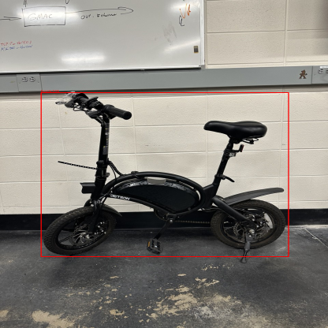
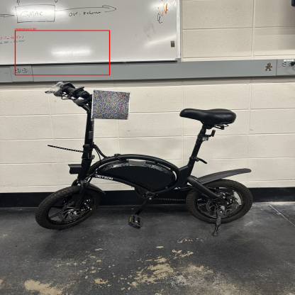
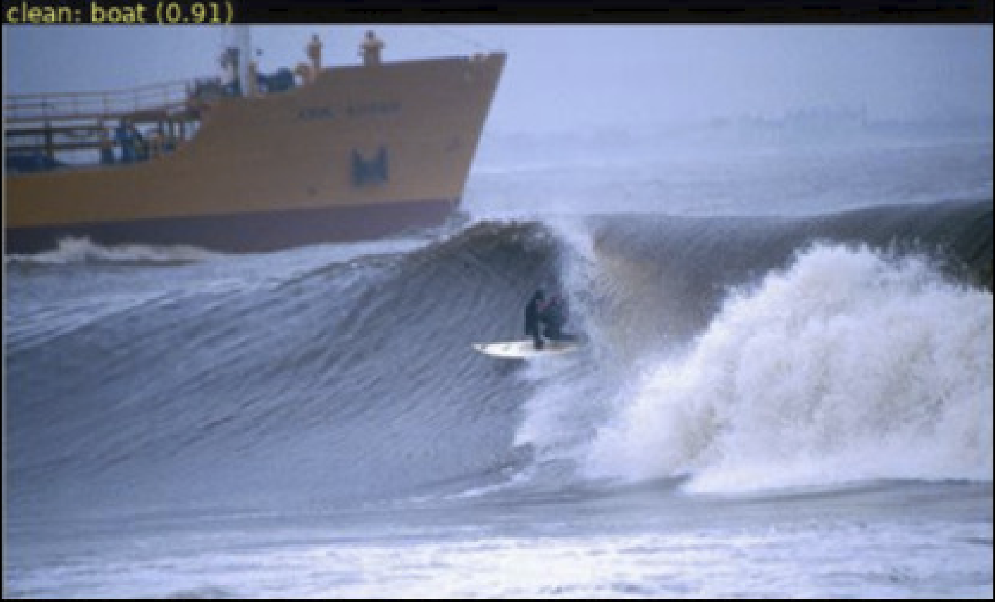
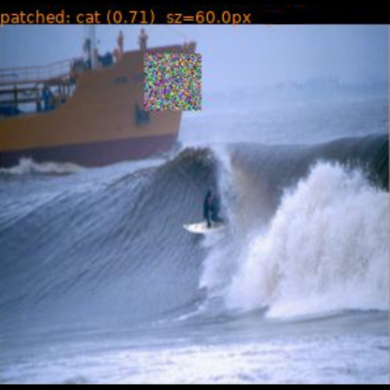
MOTIVATION
A Small Printed Patch Can Fool a Detector
Object detectors are at the center of autonomous driving, robotics and surveillance.
A single printed patch can be reused, scaled and repositioned across scenes.
Most deployed detectors are score-only black boxes; no gradients, no internals.
Clean physical: bicycle (0.95)
Patched: motorbike (0.36)
How far can queries alone suppress detection, and how small can the patch be?
Clean digital: boat (0.91)
Patched: cat (0.92)
PATCHBANDIT · ICIP 2026
2
Notes:
Object detectors are everywhere in safety-critical systems — autonomous driving, robotics, surveillance. Like classifiers, they are vulnerable to adversarial perturbations.
The most practical threat is the adversarial patch: a small printed pattern placed in a scene, captured by the camera. A single patch can be reused, scaled and repositioned across many scenes.
On the left, a clean physical scene: the detector identifies a bicycle at 95% confidence. With our patch, the top prediction flips to motorbike at 36%.
Below, the same idea digitally: a 60-pixel patch flips a clean boat detection to cat.
Both of those were produced without any access to the model's gradients or weights . Which raises the question of how far an attacker without knowledge of the model can get, and how small the patch can stay. Prior work doesn't fully answer it.

Slide 3
WHY IT MATTERS
Three Gaps in Prior Patch Attacks
01
Joint optimization
Location, texture and size are rarely optimized together under a tight query budget.
02
Visual footprint
Success is seldom tied to patch area, despite its importance for real-world stealth.
03
EOT ≠ plain-view success
Averaging over transformations can mask failure on the actual deployed camera view.
OUR CLAIM
PatchBandit closes all three at once
PATCHBANDIT · ICIP 2026
3
Notes:
Three gaps explain why.
First, very few black-box attacks jointly optimize where to place the patch, what texture to use and how large it needs to be, all under a tight query budget.
Second, papers report whether the attack worked, but usually not how big the patch had to be. That matters. A patch covering a third of the image will be noticed by anyone looking at it.
Third, many attacks are evaluated with Expectation over Transformation, or EOT. That means performance is averaged over rotations, scales and lighting changes. The problem is that a good average can hide a failure on the plain camera view, and that plain view is exactly what a deployed detector sees. PatchBandit addresses all three at once.

Slide 4
RELATED WORK
Positioning Against Prior Black-Box Attacks
Method
Threat model
Reported result
Query cost
Brown '17 [5]
White-box
98–99% top-1 targeted (digital)
Gradient-based, universal
DPATCH '18 [6]
White-box
VOC07 mAP 65.7% → 0%
40×40 px universal patch
Patch of Invisibility '23 [12]
Black-box
AP ↓ 43 pp
~110,000 queries
PatchBandit (ours)
Black-box
77.5% strict suppression
49 median queries
Roughly 1000× fewer queries than the closest black-box baseline, with a smaller footprint.
White-box universals still matter where gradients are exposed, but that threat model is less representative of commercial detectors.
PATCHBANDIT · ICIP 2026
4
Notes:
So how does that compare to what's already out there?
White-box patches, like Brown et al.'s original adversarial patch and DPATCH, get very high success: 98 to 99 percent. But they need gradient access, and they train one large, fixed patch meant to work everywhere.
The closest black-box comparison, Patch of Invisibility, works under the same score-only constraint we do, but needs around 110,000 queries per image.
PatchBandit reaches 77.5% strict suppression in that same setting, using a median of just 49 queries: about three orders of magnitude fewer, with a much smaller patch.
White-box methods still matter when gradients are actually available, but that's a less realistic threat model for most deployed detectors.

Slide 5
THREAT MODEL
Score Queries Only, No Gradients
The detector f returns only confidence scores. No gradients, no weights.
The attacker controls the patch texture θ , its location ℓ, and, adaptively, its size.
The original top class t has clean confidence s₀ = c(I, t) .
STRICT SUCCESS CRITERION
s₀ − c_{plain}(θ,ℓ) ≥ Δ_{min} AND c_{plain}(θ,ℓ) ≤ τ_{abs}
Δ_{min} = 0.25
τ_{abs} = 0.10
The attacker can query
The attacker cannot access
Detections · Confidence scores
Gradients · Model weights · Architecture internals
EOT is logged separately; it is never substituted for strict success.
PATCHBANDIT · ICIP 2026
5
Notes:
So what exactly does black-box mean here? We assume a score-based detector: you query it with an image, and it hands back detections and confidence scores. That's it. No gradients, no weights, no access to the architecture itself. Everything in this talk operates under that constraint.
For a clean image, the detector's top predicted class has a clean confidence score, which we call s-zero.
The attacker controls three things: the patch's texture, its location, and, adaptively, its size.
We declare an attack successful only under a strict condition, shown here: the confidence on the original top class has to drop by at least 0.25, and the resulting confidence has to fall below an absolute cap of 0.10. That's a deliberately strict test on the plain image.
One thing worth flagging now, because it matters for how we report results later: we do track EOT robustness separately, but we never substitute it for this criterion. A patch that only works when averaged over transformations, but fails on the plain view, doesn't count as a success in our reporting.

Slide 6
METHOD
Three Steps, Repeated Under Budget
01
02
03
Place
Optimize
Grow?
Contextual Thompson sampling picks a promising cell of the 5×5 candidate grid.
A NES zeroth-order update improves the patch pixels. No gradients required.
Upsample to the next rung of the size ladder only if reward stalls for τ_{grow} iterations.
LOOP
Repeats until strict success is met or the query budget T is exhausted
PATCHBANDIT · ICIP 2026
6
Notes:
So that's the target we're optimizing against. Now, how does PatchBandit actually hit it? Each iteration of the attack loop does three things.
First, it a candidate location on the image.
Second, it optimizes: NES, a zeroth-order method, updates the patch's pixel values without ever touching a gradient.
Third, it checks whether progress has stalled, and if it has, it grows the patch to the next size on a predefined ladder.
That loop repeats until either the strict success condition from the last slide is met, or the query budget runs out. The key idea is that placement, texture, and size are all being adapted together, rather than fixing any one of them ahead of time.
Let's look at each of these three steps in more detail, starting with placement.

Slide 7
PLACEMENT
Sampling Where the Patch Will Hurt Most
Each candidate cell carries a 4-D context vector:
  box proximity
  texture variance
  a border flag
A linear-reward posterior is sampled every iteration to pick the most promising cell.
Search is biased toward object-bearing, high-contrast regions, with no RL training needed.
Placement adapts every iteration, with no fixed template.
sampled cell
5 × 5 candidate placement grid
PATCHBANDIT · ICIP 2026
7
Notes:
Placement is the first step. We break the image into a grid of candidate locations, here a 5 by 5 grid, and score every cell using a small context vector: proximity to the nearest ground-truth box, local texture variance, and whether the cell touches the image border. At each iteration, we sample from a over these features and pick the most promising cell.
You can see that highlighted cell sits right on the bycycle in this example. That's the bias at work: it steers the search toward object-bearing, high-contrast regions, without needing a full reinforcement learning policy to get there.
And this placement isn't fixed once and left alone. It's resampled every iteration, so the attack can move if a better cell turns up. Once a location is chosen, the next step is deciding what to actually put there

Slide 8
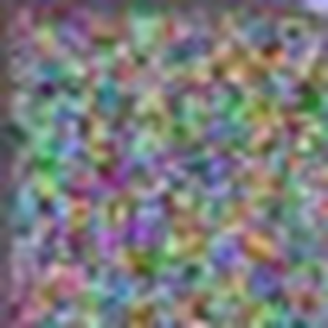

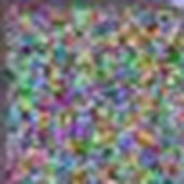


OPTIMIZATION & GROWTH
NES Updates, Growing Only When Needed
Sample M random perturbations of the patch pixels.
Query the detector; estimate reward as the drop in top-class confidence.
Take a stochastic ascent step, no gradients required.
SIZE LADDER
m₁ < m₂ < … < m_{L}
40
60
80
120
160
REWARD
patch side length in pixels.
r(θ,ℓ) = s₀ − c(PASTE(I,θ,ℓ), t)
Grows only if reward stalls for τ_{grow} iterations.
PATCHBANDIT · ICIP 2026
8
Notes:
We update the patch's actual pixel values using Natural Evolution Strategies, or NES, a method that never needs a gradient from the model.
We try a batch of small random changes to the current patch, query the detector to see how much each one lowers the target class's confidence, and then step in the direction that helped the most. That's the reward you see here: the drop in the original top class's confidence.
On top of that, we have the size ladder on the right, with the actual optimized patch texture growing across five sizes. We start small, and we only grow to the next size if the reward hasn't improved for a set number of iterations, what we call the growth patience. This is really the core efficiency idea of the paper: the patch only gets bigger when it actually needs to, which is what keeps our median footprints so small.

Slide 9
EXPERIMENTAL SETUP
Three Detector Architectures, One Protocol
YOLOv5
One-stage CNN
PROTOCOL
18 controlled variants, each toggling exactly one design knob.
Faster R-CNN
Two-stage CNN
YOLOS
METRICS
ViT-backbone transformer
Strict success rate
Confidence drop
These three colors identify the detectors throughout the rest of the deck.
Patch area
Query count
Joint cost J
PATCHBANDIT · ICIP 2026
9
Notes:
So that's the method.
We tested it aganst three different detector architectures r: YOLOv5, a one-stage CNN; Faster R-CNN, a two-stage CNN; and YOLOS, which is built on a vision transformer instead of a CNN backbone. Same protocol, same budget, all three.
We run 18 controlled variants, each one changing a single design element: growth patience, query schedule, whether contextual placement is turned on or off, stealth bias, EOT robustness. That lets us isolate what's actually driving performance instead of guessing.
Across all of it, we track five things: strict success rate, confidence drop, patch area, query count, and a joint cost metric that combines queries and footprint into one number. Let's start with the headline results.

Slide 10
RESULTS
Strong Suppression Across Architectures
YOLOv5
77.5%
YOLOv5
49 median queries · 8.3% area
Faster R-CNN
89.7%
Faster R-CNN
8 median queries · 0.9% area
YOLOS
59.1%
YOLOS
290 median queries · 8.3% area
Strict success rate: confidence drop ≥ 0.25 and residual confidence ≤ 0.10
PATCHBANDIT · ICIP 2026
10
Notes:
Here are results.
PatchBandit reaches 77.5% strict suppression on YOLOv5, 89.7% on Faster R-CNN, and 59.1% on YOLOS.
So on both CNN-based detectors we're seeing strong suppression, and on the transformer-based one it's still substantial, just less pronounced. That gap is itself an interesting finding about how these architectures differ in robustness, and it's something we'll come back to.
What's maybe more interensting is how cheap this is. Look at the values on the right: median query count is just 49 for YOLOv5 and only 8 for Faster R-CNN, with median patch areas under 10% of the image in both cases. YOLOS needs more queries, around 290, but the patch stays just as compact.
So high success, low query cost, small footprint, all at once. The next question is where that success comes from as the patch grows.

Slide 11
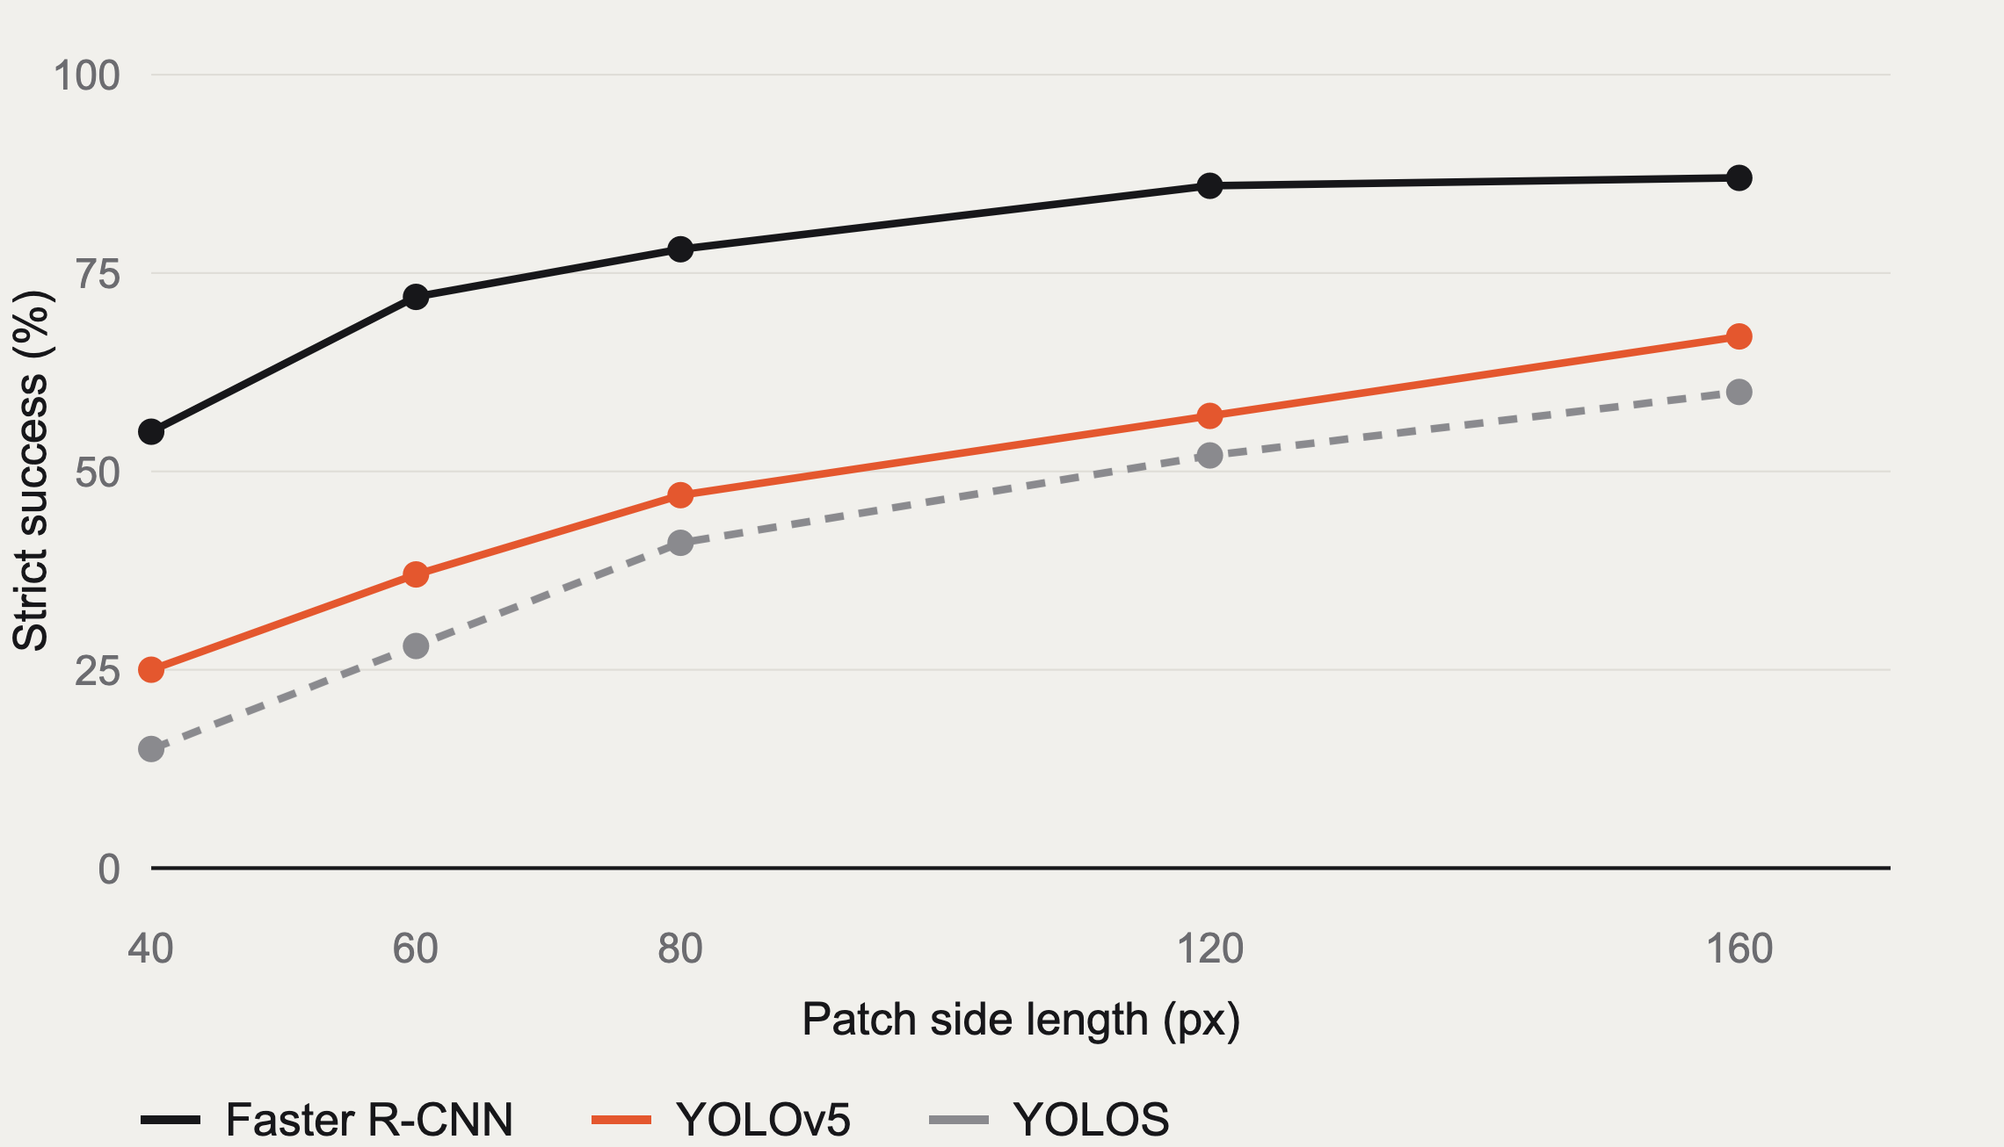
GROWTH DYNAMICS
Most Gains Come at Small Patch Sizes
Adaptive growth banks most of its success before reaching full patch size.
Large patches are used only when they are actually needed.
Faster R-CNN clears 70% by 60 px.
PATCHBANDIT · ICIP 2026
11
Notes:
This plot shows how success accumulates as we allow the patch to grow.
The pattern that matters is that most of the gains happen early, at small or moderate patch sizes.
Faster R-CNN, in black, climbs fastest: already above 70% success by just 60 pixels, leveling off around 85 to 87% by 120 pixels.
YOLOv5, in orange, climbs a bit more gradually, reaching 65 to 70% by full size.
YOLOS, in gray, is the slowest and steadiest of the three, reaching about 40% by 80 pixels and leveling off near 60% at 160 pixels.
The takeaway, here, is that adaptive growth is doing real work. It avoids paying for a large, obvious patch in the cases where a small one already gets the job done. Large patches only get used when they're actually needed.
Now, is that actually better than just picking a fixed patch size from the start? Let's check.

Slide 12
EFFICIENCY
Adaptive Growth Beats Fixed-Size Patches
Detector
Configuration
Strict %
Area %
Joint cost J
YOLOv5
PatchBandit
77.5
8.32
4.080
fixed–160
71.1
14.79
0.887
Faster R-CNN
PatchBandit
89.7
0.92
0.074
fixed–160
79.6
14.79
0.740
YOLOS
PatchBandit
59.1
8.32
24.089
fixed–160
55.4
14.79
5.178
A fixed–80 baseline cuts footprint but loses far more success: 48.2 / 66.2 / 36.0% strict.
J_{frac} = median queries × (median area / 100); lower is more query- and footprint-efficient.
PATCHBANDIT · ICIP 2026
12
Notes:
On every detector, PatchBandit wins on both success and footprint at once.
In this table: fixed 160 is a version of the attack where the patch size is locked at 160×160 pixels for the entire attack
On YOLOv5: 77.5% strict success at 8.3% patch area, versus 71.1% for fixed-160 at nearly double the area, 14.8%. On Faster R-CNN: 89.7% versus 79.6%, and the area gap is even larger, under 1% versus 14.8%. On YOLOS: 59.1% versus 55.4%, same thing.
Now look at the joint cost column, which combines queries and area into one number, where lower is better.
Our results show that fixed-160 actually has a lower joint cost on YOLOv5 and YOLOS. It gets there by spending very few queries, just paste one big patch and optimize in place, while our method spends more queries growing the patch step by step. So raw query efficiency isn't the argument for adaptive growth.
The argument is what fixed-160 pays for that efficiency with: a highly visible patch, nearly double the footprint, for a lower success rate. Faster R-CNN is the one detector where PatchBandit wins outright on all three numbers: higher success, a tenth of the area, and the lowest joint cost.

Slide 13
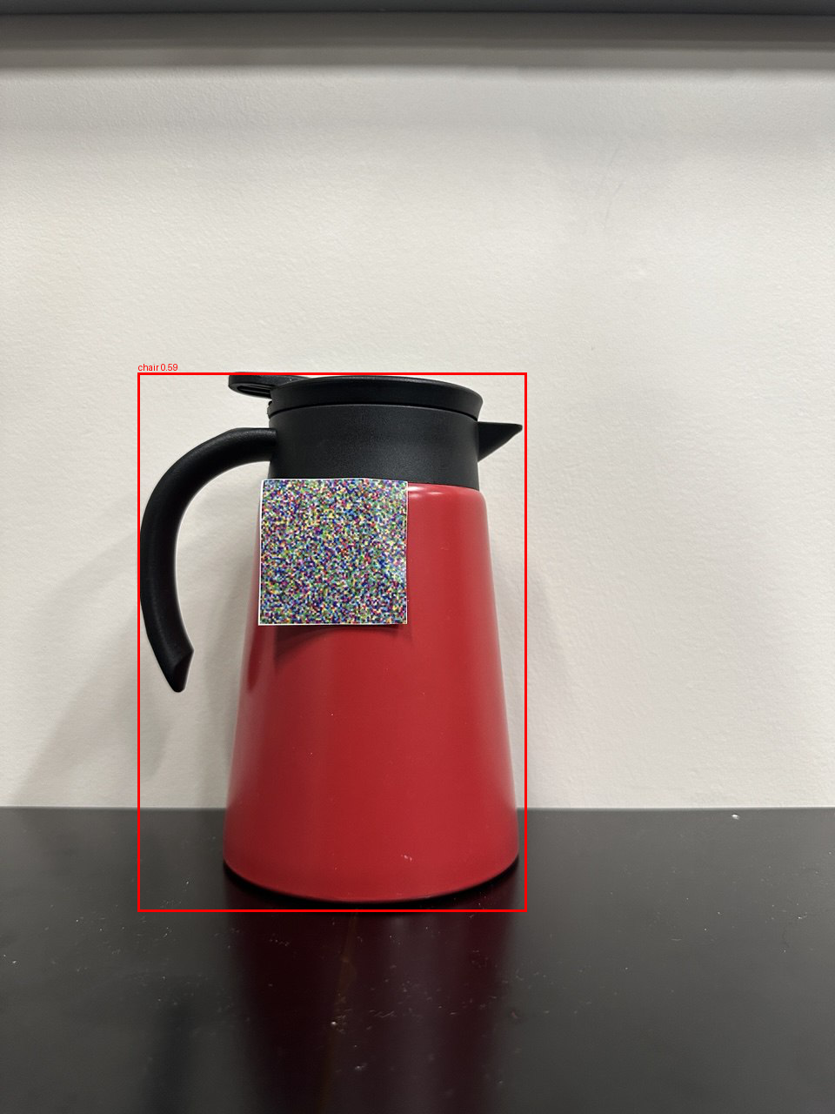
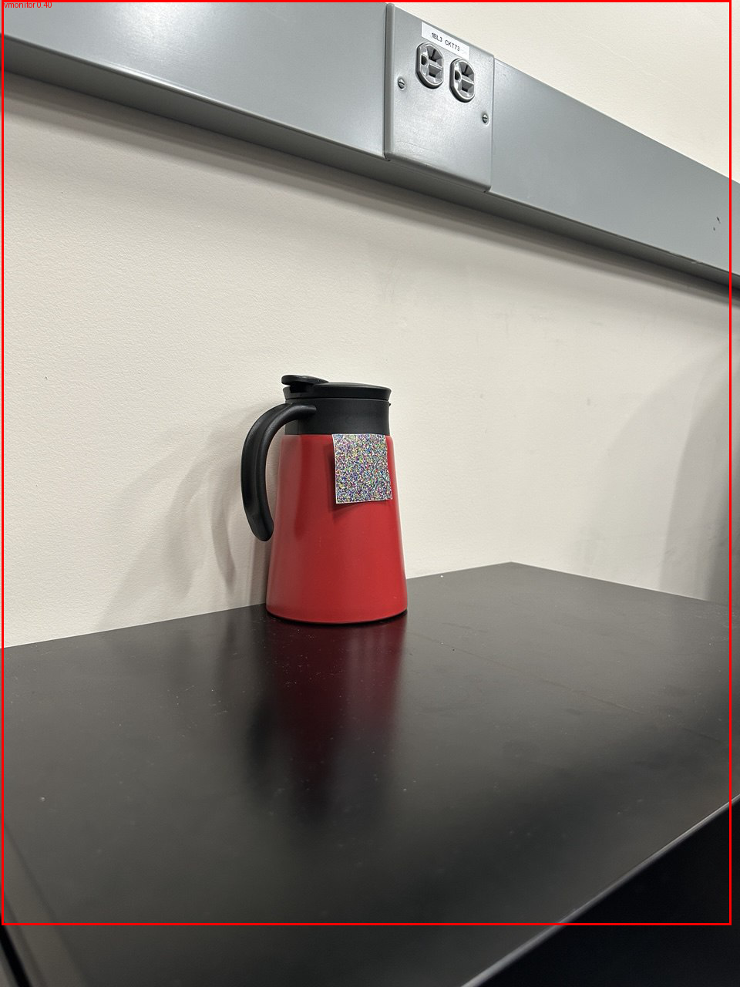
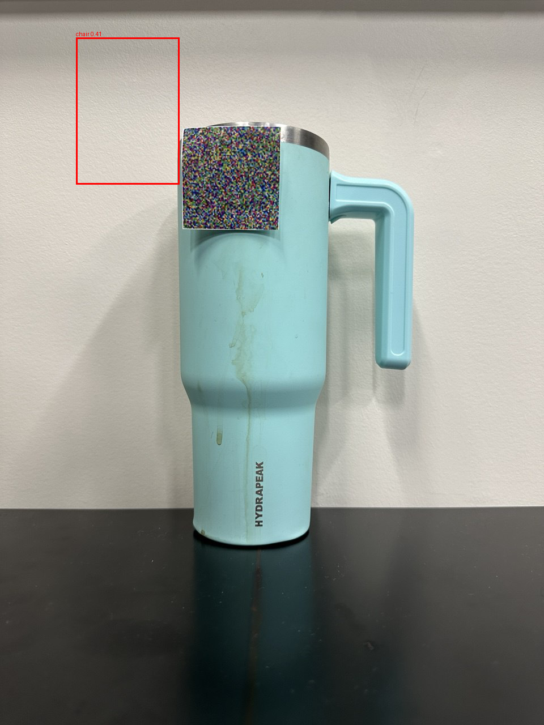
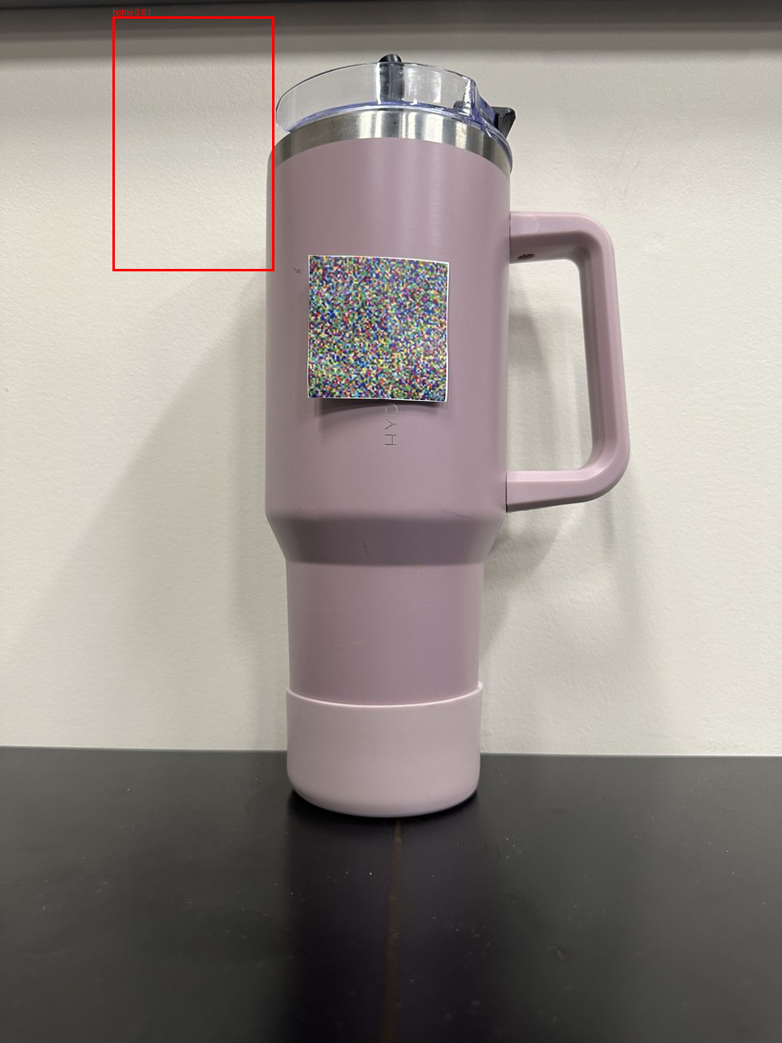
PHYSICAL PILOT
Digital Patches Transfer to the Real World
Frontal
Tilted
Transfer #1
Transfer #2
chair (0.59)
tvmonitor (0.35)
bottle (0.41)
bottle (0.81)
Misclassified
Misclassified
Wrong box, low confidence
Wrong box
PILOT
One printed patch, four conditions (including two bottle instances never seen during optimization)
PATCHBANDIT · ICIP 2026
13
Notes:
Finally, we checked whether a patch optimized entirely in simulation transfers to the real world. We took a patch trained entirely in simulation, printed it, and tested it on a bottle under different viewpoints, distances, and, importantly, on bottles it had never seen during training.
In clean conditions, YOLOv5 detects the bottle above 90% confidence, every time. With the patch on: frontal view, misclassified as a chair. Second view, misclassified as a tv monitor.
Then we swapped in two new bottles the patch never saw during optimization. Transfer number one, still wrong: low confidence, wrong box. Transfer number two, wrong box again, and this time confidently wrong.

Slide 14
CONCLUSION
Compact, Budget-Aware Patches Are a Real Threat
Contextual Thompson-sampling placement, NES texture updates and progress-triggered growth, all in one score-only attack loop.
Strict plain-view suppression anchors every result; EOT is audited, never substituted.
Strong suppression on CNN detectors, substantial suppression on a transformer detector.
Where you put the patch matters as much as what is on it.
77.5%
89.7%
59.1%
YOLOv5
Faster R-CNN
YOLOS
PATCHBANDIT · ICIP 2026
14
Notes:
To wrap upPatchBandit combines three pieces into one score-only attack loop: contextual Thompson sampling for placement, NES for gradient-free texture updates, and a growth policy that only adds size when progress stalls.
Every result we've shown is anchored on strict, plain-view suppression. EOT is something we track and report, but never something we substitute for that stricter test.
Across three very different architectures, that gets us strong suppression on the CNN-based detectors, and still substantial suppression on the transformer-based one. You can see that summarized in the numbers at the bottom: 77.5%, 89.7%, 59.1%.
And the placement result matters beyond just this paper. Where you put the patch turns out to matter as much as what's actually printed on it, which is easy to overlook if you only think about patch attacks as a texture optimization problem.
That's PatchBandit. Happy to take questions.

Slide 15
Thank you
Questions?
Pedram MohajerAnsari · Amir Salarpour · David Fernandez · Mert D. Pesé
School of Computing, Clemson University, USA
Presenting: David Fernandez
github.com/pedram-mohajer/PatchBandit
Notes:
Thank you very much. This work was done with my co-authors Pedram MohajerAnsari, Amir Salarpour and Mert Pese at Clemson University, and the code is available at the link on screen. I'm happy to take any questions.

