Slide 1
MIPS assembly
2/18/2023
Dr. Shahram Taheri

Slide 2
Computer
What’s in a computer?
Processor, memory, I/O devices (keyboard, mouse, LCD, video camera, speaker), disk, CD drive, …
2/18/2023
Dr. Shahram Taheri

Slide 3
A Typical Computer
Processor
Memory
register
ALU
data
0011100..111
0011100..111
0011100..111
instruction
I/O device
00111111..111
00111011..111
2/18/2023
Dr. Shahram Taheri

Slide 4
Program and Data
Programs consist of instructions and data
  Instructions are also represented as 0’s and 1’s
A program is executed instruction by instruction
2/18/2023
Dr. Shahram Taheri
Notes:
CDA3100

Slide 5
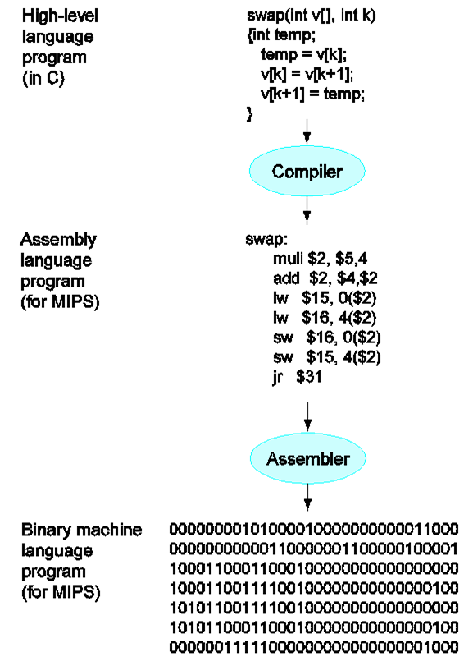
2/18/2023
Dr. Shahram Taheri
Notes:
CDA3100

Slide 6
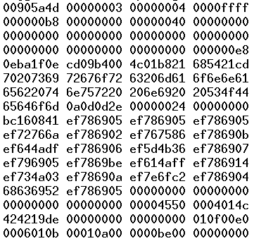
GoogleEarth.exe
2/18/2023
Dr. Shahram Taheri
Notes:
CDA3100

Slide 7
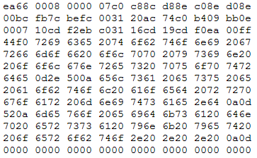
Linux Kernel
2/18/2023
Dr. Shahram Taheri
Notes:
CDA3100

Slide 8
Registers and ALU
A processor has registers and ALU
  Registers are where you store values (e.g., the value of a variable)
  The values stored in registers are sent to the ALU to be added, subtracted, anded, ored, xored, …, then the result is stored back in a register. Basically it is the heart of the processor and does the calculation.
2/18/2023
Dr. Shahram Taheri

Slide 9
Memory
Memory is modeled as a continuous space from 0 to 0xffff…ffff.
Every byte in the memory is associated with an index, called address.
Given the address to the memory hardware, we can read the content in that byte.
Given the address and a byte value, we can modify the content in the memory at that addres.
2/18/2023
Dr. Shahram Taheri

Slide 10
Why are we learning assembly
Comparing to higher level languages such as C, assembly languages
  are more difficult to write, read, and debug.
  have poor portability – Every processor has its own assembly language. The code you wrote for MIPS is NOT going to run on Intel processors.
Then why are we learning it?
  After learning the first assembly language, the second will be MUCH easier
  It brings us closer to the processor, which is the goal of this course.
2/18/2023
Dr. Shahram Taheri

Slide 11
MIPS ISA
There are many different Instruction Set Architectures designed for different applications with different performance/cost tradeoff
  Including Intel-32, PowerPC, MIPS, ARM ….
We focus on MIPS architecture
  Microprocessor without Interlocked Pipeline Stages
  A RISC (reduced instruction set computer) architecture
    In contrast to CISC (complex instruction set computer)
  Similar to other architectures developed since the 1980's
  Almost 100 million MIPS processors manufactured in 2002
  Used by NEC, Nintendo, Cisco, Silicon Graphics, Sony, …
2/18/2023
Dr. Shahram Taheri
Notes:
CDA3100

Slide 12
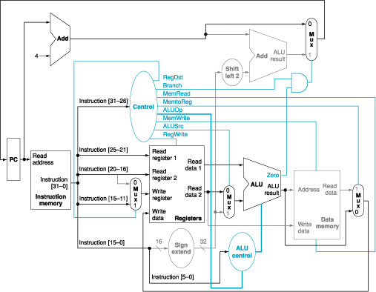
A peek into the future…
2/18/2023
Dr. Shahram Taheri
Notes:
CDA3100

Slide 13
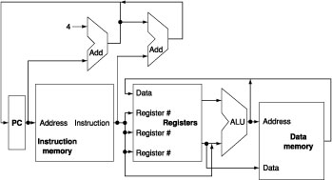
Abstract View of MIPS Implementation
2/18/2023
Dr. Shahram Taheri
Notes:
CDA3100

Slide 14
MIPS Instruction Set
An instruction is a command that hardware understands
  Instruction set is the vocabulary of commands understood by a given computer
  It includes arithmetic instructions, memory access instructions, logical operations, instructions for making decisions
2/18/2023
Dr. Shahram Taheri
Notes:
CDA3100

Slide 15
Arithmetic Instructions
Each MIPS arithmetic instruction performs only one operation
  Each one must always have exactly three variables
  add a, b, c # a = b + c
    Note that these variables can be the same though
  If we have a more complex statement, we have to break it into pieces
2/18/2023
Dr. Shahram Taheri
Notes:
CDA3100

Slide 16
Arithmetic Instructions
Example
  f = (g + h) – (i + j)
2/18/2023
Dr. Shahram Taheri
Notes:
CDA3100

Slide 17
Arithmetic Instructions
Example
  f = (g + h) – (i + j)
  add t0, g, h # temporary variable t0 contains g + h
  add t1, i, j # temporary variable t1 contains i + j
  sub f, t0, t1 # f gets t0 – t1
2/18/2023
Dr. Shahram Taheri
Notes:
CDA3100

Slide 18
Operands of Computer Hardware
In C, we can define as many as variables as we need
  In MIPS, operands for arithmetic operations must be from registers
  MIPS has thirty-two 32-bit registers
2/18/2023
Dr. Shahram Taheri
Notes:
CDA3100

Slide 19
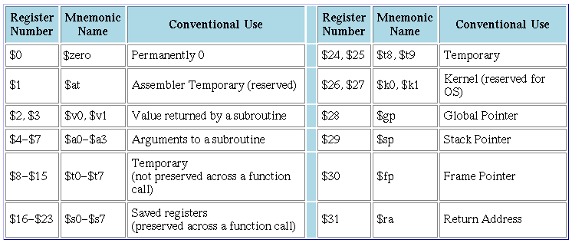
MIPS Registers
2/18/2023
Dr. Shahram Taheri
Notes:
CDA3100

Slide 20
Arithmetic Instructions
Example
  f = (g + h) – (i + j)
  #In MIPS, add can not access variables directly
  #because they are in memory
  # Suppose f, g, h, i, and j are in $s0, $s1, $s2, $s3, $s4 respectively
  add $t0, $s1, $s2 # temporary variable t0 contains g + h
  add $t1, $s3, $s4 # temporary variable t1 contains i + j
  sub $s0, $t0, $t1 # f gets t0 – t1
2/18/2023
Dr. Shahram Taheri
Notes:
CDA3100

Slide 21
Memory Operands
Since variables (they are data) are initially in memory, we need to have data transfer instructions
  Note a program (including data (variables)) is loaded from memory
  We also need to save the results to memory
  Also when we need more variables than the number of registers we have, we need to use memory to save the registers that are not used at the moment
Data transfer instructions
  lw (load word) from memory to a register
  sw (store word) from register to memory
2/18/2023
Dr. Shahram Taheri
Notes:
CDA3100

Slide 22

Using Load and Store
Memory address in load and store instructions is specified by a base register and offset
  This is called base addressing
2/18/2023
Dr. Shahram Taheri
Notes:
CDA3100

Slide 23
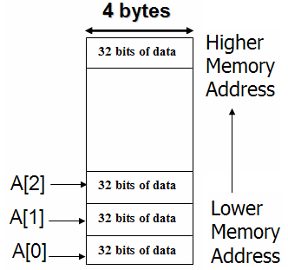
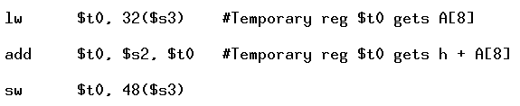
Using Load and Store
How to implement the following statement using the MIPS assembly we have so far?
  Assuming the address of A is in $s3 and the variable h is in $s2
  A[12] = h + A[8]
2/18/2023
Dr. Shahram Taheri
Notes:
CDA3100

Slide 24
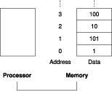
Specifying Memory Address
Memory is organized as an array of bytes (8 bits)
2/18/2023
Dr. Shahram Taheri
Notes:
CDA3100

Slide 25
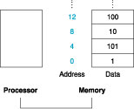
Specifying Memory Address
MIPS uses words (4 bytes)
  Each word must start at address that are multiples of 4
  This is called alignment restriction
  Big Endian
2/18/2023
Dr. Shahram Taheri
Notes:
CDA3100

Slide 26
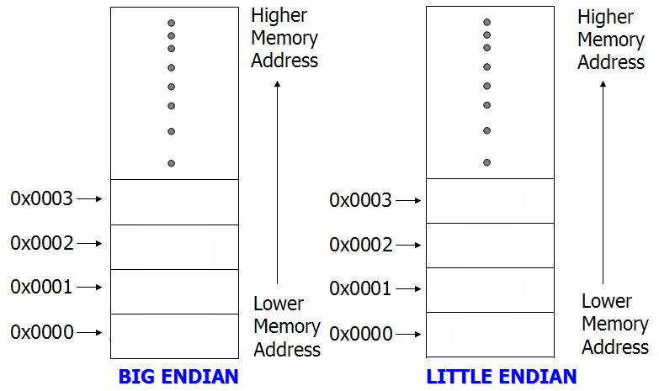
Example of Endianness
Store 0x87654321 at address 0x0000, byte-addressable
2/18/2023
Dr. Shahram Taheri
Notes:
CDA3100

Slide 27
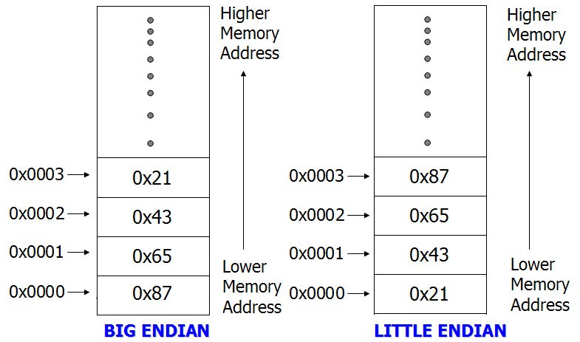
Example of Endianness
Store 0x87654321 at address 0x0000, byte-addressable
2/18/2023
Dr. Shahram Taheri
Notes:
CDA3100

Slide 28
MIPS Assembly Programs
Consists of MIPS instructions and data
  Instructions are given in .text segments
    A MIPS program can have multiple .text segments
  Data are defined in .data segments using MIPS assembly directives
    .word, for example, defines the following numbers in successive memory words
  See Appendix A A.10 (pp. A-45 – A-48) for details
2/18/2023
Dr. Shahram Taheri
Notes:
CDA3100

Slide 29
Exercise 1
Suppose we have an array with starting address stored in $s0. We want to add the content of the first three elements, and put the result in the fourth element?
  A[3] = A[2] + A[1] + A[0]
2/18/2023
Dr. Shahram Taheri

