Slide 1
Number Representation
Prepared by
Dr. Shahram Taheri

Slide 2
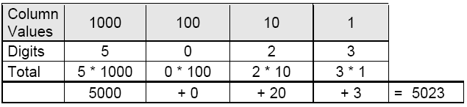
Decimal Numbering System
We humans naturally use a particular numbering system

Slide 3
Decimal Numbering System
For any nonnegative integer , its value is given by
Here d₀ is the least significant digit and d_{n} is the most significant digit

Slide 4
General Numbering System – Base X
Besides 10, we can use other bases as well
In base X,
Then, the base X representation of this number is defined as d_{n}d_{n-1}…d₂d₁d_{0.}
The same number can have many representations on many bases. For 23 based 10, it is
23_{ten}
10111_{two}
17_{sixteen}, often written as 0x17.

Slide 5
Commonly Used Bases
Base | Common Name | Representation | Digits
10 | Decimal | 5023_{ten} or 5023 | 0-9
2 | Binary | 1001110011111_{two} | 0-1
8 | Octal | 11637_{eight} | 0-7
16 | Hexadecimal | 139F_{hex} or 0x139F | 0-9, A-F
Note that other bases are used as well including 12 and 60
Which one is natural to computers?
Why?

Slide 6
Meaning of a Number Representation
When we specify a number, we need also to specify the base
For example, 10 presents a different quantity in a different base
☺
There are 10 kinds of mathematicians. Those who can think binarily and those who can't... http://www.math.ualberta.ca/~runde/jokes.html

Slide 7
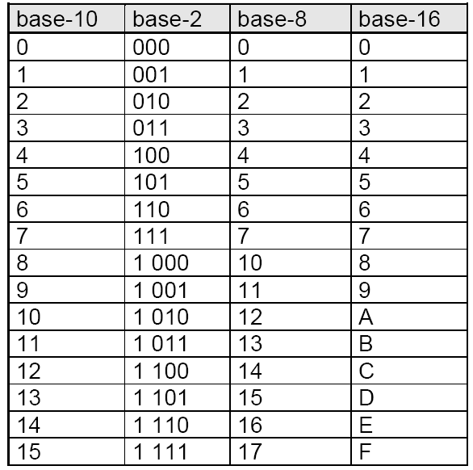

Slide 8
Question
How many different numbers that can be represented by 4 bits?

Slide 9
Question
How many different numbers that can be represented by 4 bits?
Always 16 (2⁴), because there are this number of different combinations with 4 bits, regardless of the type of the number these 4 bits are representing.
Obviously, this also applies to other number of bits. With n bits, we can represent 2^{n} different numbers. If the number is unsigned integer, it is from 0 to 2^{n}-1.

Slide 10
Conversion between Representations
Now we can represent a quantity in different number representations
How can we convert a decimal number to binary?
How can we then convert a binary number to a decimal one?

Slide 11
Conversion From Binary to Decimal
Converting from binary to decimal. This conversion is based on the formula:
d = d_{n-1}2^{n-1} + d_{n-2}2^{n-2} +…+ d₂2² + d₁2¹ + d₀2⁰
while remembering that the digits in the binary representation are the coefficients.
For example, given 101011_{two}, in decimal, it is
2⁵ + 2³ + 2¹ + 2⁰ = 43.

Slide 12
Conversion From Decimal to Binary
Converting from decimal to binary:
Repeatedly divide it by 2, until the quotient is 0.
Write down the remainder, the last remainder first.
Example: 11_{ten} is 1011_{two}
Quotient | Remainder
5 | 1
2 | 1
1 | 0
0 | 1

Slide 13
Conversion From Decimal to Binary
Why can a binary number be obtained by keeping on dividing it by 2, and why should the last remainder be the first bit?
The decimal number can be represented by the summation of the powers of 2:
d = d_{n-1}2^{n-1} + d_{n-2}2^{n-2} +…+ d₂2² + d₁2¹ + d₀2⁰
For example, 19 = 16 + 2 + 1 = 1 * 2⁴ + 0 * 2³ + 0 * 2² + 1 * 2¹ + 1 * 2⁰.
The binary representation is the binary coefficients.
So 19_{ten} in binary is 10011_{two}.
So the conversion is to find the coefficients. Easiest way to do so is to repeatedly divide it by 2.
For example, 19 = 1 * 10¹ + 9 * 10⁰. How do you get the 1 and 9? You divide 19 by 10 repeatedly until the quotient is 0, same as binary!

Slide 14
Conversion between Base 16 and Base 2
Extremely easy.
From base 2 to base 16: divide the digits in to groups of 4, then apply the table.
From base 16 to base 2: replace every digit by a 4-bit string according to the table.
Because 16 is 2 to the power of 4.

Slide 15
Addition in binary
39_{ten} + 57_{ten} = ?
How to do it in binary?

Slide 16
Addition in Binary
First, convert the numbers to binary forms. We are using 8 bits.
39_{ten} -> 00100111₂
57_{ten} -> 00111001₂
Second, add them.
00100111
00111001
01100000

Slide 17
Addition in binary
The addition is bit by bit.
We will encounter at most 4 cases, where the leading bit of the result is the carry:
0+0+0=00
1+0+0=01
1+1+0=10
1+1+1=11

Slide 18
Subtraction in Binary
13_{ten} – 10_{ten} = ?

Slide 19
Subtraction in Binary
1101
1010
0011
Do this digit by digit
1. 1-0 -> 1
2. 0-1, cannot do it because 0 is less than 1, so have to borrow, meaning looking to the left to find the first 1, in this case, it is the immediate left neighbor, so we borrow 1 from it, reducing it to 0, while we have 10 which is 2. 2-1 = 1, so we write 1 down as the current digit
3. 0-0 -> 0, remember the borrow!
4. 1-1 -> 0

Slide 20
Subtraction in Binary
17_{ten} – 10_{ten} = ?

Slide 21
Subtraction in Binary
10001
01010
00111
Do this digit by digit
1. 1-0 -> 1
2. 0-1, cannot do it because 0 is less than 1, so have to borrow, meaning looking to the left to find the first 1. In this case, the immediate left neighbor, call it A, is also 0, so it will try to borrow from its left neighbor, call it B. B is 1, so A can borrow from B, reducing B to 0. A is now 10 (2 in decimal), but it has to lend us a 1, so it reduces to 1. We borrowed from A, we become 10 (2 in decimal), so we can handle the subtraction and we write 1 down as the current digit
3. 1-0 -> 1, remember the borrow!
4. 0-1, remember the borrow, cannot do it, but can borrow, so becomes 1.
5. 0-0 -> 0, remember the borrow

Slide 22
Subtraction in binary
Do this digit by digit.
No problem if
0 - 0 = 0,
1 - 0 = 1
1 – 1 = 0.
When encounter 0 - 1, set the result to be 1 first, then borrow 1 from the next more significant bit, just as in decimal.
Borrow means setting the borrowed bit to be 0 and the bits from the bit following the borrowed bit to the bit before the current bit to be 1.
Think about, for example, subtracting 349 from 5003 (both based 10). The last digit is first set to be 4, and you will be basically subtracting 34 from 499 from now on.

Slide 23
Signed Numbers
Two’s complement in n bits:
The negative of a two’s complement is given by inverting each bit (0 to 1 or 1 to 0) and then adding 1, ignore any carry beyond n bits (take only the lower n bits).
If numbers are represented in n bits:
the positive numbers are from 0000…01 to 0111…11,
0 is all 0: 0000…00,
the negative numbers are from 1000…00 to 1111…11.
The leading bit is called the “sign bit”: 0 means non-negative, 1 means nagative

Slide 24
Signed numbers
What is (-57_{ten}) in binary in 8 bits?
00111001 (57_{ten} in binary)
11000110 (invert)
11000111 (add 1)

Slide 25
Question
What is the range of numbers represented by 2’s complement with 4 bits?
The answer is [-8,7].
This is because all numbers with leading bit being 1 are negative numbers. So we have 8 of them. Then 0 is all 0. Then seven positive numbers.

Slide 26
Two’s Complement Representation
Type (C) | Number of bits | Range (decimal)
char | 8 | -128 to 127
short | 16 | -32768 to 32767
int | 32 | -2,147,483,648 to 2,147,483,647
long long | 64 | -9,223,372,036,854,775,808 to 9,223,372,036,854,775,807
n+1 bits (in general) | n+1 | -2^{n} to 2^{n} - 1

Slide 27
Why use 2’s complement? (Not required)
If you think about it, x in 2’s complement with n bits is just 2^{n}-x.
Consider 01101 +(– 00011) = 01101 – 00011 = 01010 (13-3=10 in decimal).
01101 – 00011 = 01101 + 100000 – 00011 – 100000
= 01101 + (100000 – 00011) – 100000
= 01101 + 11101 – 100000 = 101010 – 100000
= 01010
11101 is the 2’s complement of 00011.
Means that computer (the adder) does not have to be specifically redesigned for dealing with negative numbers, make life easier for the computer
The reason is, assume you are subtracting a with b , where 2^{n-1}>a>b>0. Note that a-b=a+2^{n}-b-2^{n}. But 2^{n}-b is the 2’s complement of b. So if represented in binary forms, a+2^{n}-b will be having a 1 bit in bit n and some thing in bit 0 to bit n-2 equal to a-b. Bit n-1 will be 0. So you take what is in bit 0 to bit n and it must be a-b.

Slide 28
Subtraction with 2’s Complement
How about 39_{ten} + (-57_{ten})?

Slide 29
Subtraction with 2’s Complement
First, what is (-57_{ten}) in binary in 8 bits?
00111001 (57_{ten} in binary)
11000110 (invert)
11000111 (add 1)
Second, add them.
00100111
11000111
11101110

Slide 30
Converting 2’s complement to decimal
What is 11101110_{ten} in decimal if it represents a two’s complement number?
11101110 (original)
11101101 (after minus 1)
00010010 (after inversion)

Slide 31
Two’s Complement Representation
Sign extension
We often need to convert a number in n bits to a number represented with more than n bits
From char to int for example
This can be done by taking the most significant bit from the shorter one and replicating it to fill the new bits of the longer one
Existing bits are simply copied

Slide 32
Sign Extension Example
31 | 30 | 29 | 28 | 27 | 26 | 25 | 24 | 23 | 22 | 21 | 20 | 19 | 18 | 17 | 16 | 15 | 14 | 13 | 12 | 11 | 10 | 9 | 8 | 7 | 6 | 5 | 4 | 3 | 2 | 1 | 0 |  | -3_{ten} -3_{ten} -3_{ten}
 |  |  |  |  |  |  |  |  |  |  |  |  |  |  |  |  |  |  |  |  |  |  |  | 1 | 1 | 1 | 1 | 1 | 1 | 0 | 1
 |  |  |  |  |  |  |  |  |  |  |  |  |  |  |  | 1 | 1 | 1 | 1 | 1 | 1 | 1 | 1 | 1 | 1 | 1 | 1 | 1 | 1 | 0 | 1
1 | 1 | 1 | 1 | 1 | 1 | 1 | 1 | 1 | 1 | 1 | 1 | 1 | 1 | 1 | 1 | 1 | 1 | 1 | 1 | 1 | 1 | 1 | 1 | 1 | 1 | 1 | 1 | 1 | 1 | 0 | 1
- How about unsigned numbers?

Slide 33
Sign Extension Example: Unsigned
31 | 30 | 29 | 28 | 27 | 26 | 25 | 24 | 23 | 22 | 21 | 20 | 19 | 18 | 17 | 16 | 15 | 14 | 13 | 12 | 11 | 10 | 9 | 8 | 7 | 6 | 5 | 4 | 3 | 2 | 1 | 0 |  | 252_{ten} 252_{ten} 252_{ten}
 |  |  |  |  |  |  |  |  |  |  |  |  |  |  |  |  |  |  |  |  |  |  |  | 1 | 1 | 1 | 1 | 1 | 1 | 0 | 0
 |  |  |  |  |  |  |  |  |  |  |  |  |  |  |  | 0 | 0 | 0 | 0 | 0 | 0 | 0 | 0 | 1 | 1 | 1 | 1 | 1 | 1 | 0 | 0
0 | 0 | 0 | 0 | 0 | 0 | 0 | 0 | 0 | 0 | 0 | 0 | 0 | 0 | 0 | 0 | 0 | 0 | 0 | 0 | 0 | 0 | 0 | 0 | 1 | 1 | 1 | 1 | 1 | 1 | 0 | 0

Slide 34

Unsigned and Signed Numbers
Note that bit patterns themselves do not have inherent meaning
We also need to know the type of the bit patterns
For example, which of the following binary numbers is larger?

Slide 35
Unsigned and Signed Numbers
Note that bit patterns themselves do not have inherent meaning
We also need to know the type of the bit patterns
For example, which one is larger?
Unsigned numbers?
Signed numbers?

