Slide 1
SmartCamera Branch Model

Slide 2
2016/01/28 1.0
Initial version
2016/02/26 1.1
Refine branch naming with new product & chip
2016/03/22 1.2
Define Module
Refine Solution
Refine SCM_CI

Slide 3
Overview
Maintainability for customer MP branch
GIT / Gerrit versioning system
Adopting TV branching model to leverage existing IT tools

Slide 4
Glossary
Module
Product / Chip / Solution
G/C/B type Project / Branch
GIT / branch / manifest / repo

Slide 5
Module / SCM_CI
Module is basic unit to build up a Solution
version / feature / release
Single version tag
1+ Gerrit Git project path
included via manifest/module/<Module ID>.xml in Solution manifest

Slide 6
Rule
1 Product + 1 Chip + 1 Branch => 1 Solution
<Product>--<Chip>/<Branch>
or
<Product>--<Chip>_<Branch>
For 1 Product + 1 Chip, there must be 1 G type Branch
C type Branch must be based on G type Branch
Each G/C type Branch Solution must have a specific GIT repo manifest (ex: default.xml)
Name of Branch is limit to 60 char length
Module included in manifest must have the same Branch to identify Solution
Deep Branch Rule: If a Module is included as library / binary in the Solution, the source of the Module is suggested to have the same unique branch for “cherry-pick” type bug fixing code merge

Slide 7
Example
Product:
MIX ( MI based LinuX solution ), ignored as default
RTOS
Chip:
I1 / I3
Solution & manifest : branch
G_HQ_iNfinity_MIX
SmartCamera/MIX/manifest : I1/master
C_SZ_iNfinity_MIX_cust01
SmartCamera/MIX/manifest : I1/cus01
G_HQ_iNfinity_RTOS
SmartCamera/RTOS/manifest : RTOS--I1/master
G_HQ_iNfinity3_MIX
SmartCamera/MIX/manifest : I3/master

Slide 8
Branch Alias
The “/” used in Branch name is for access control in Gerrit. But it can cause problems in file system
The “/” is replaced with “_” at many places
Example:
MIX--I1/master = MIX--I1_master = I1_master = I1/master
RTOS--I1/master = RTOS--I1_master

Slide 9
Example
SmartCamera/MIX/manifest/default.xml : I1/master
<?xml version="1.0" encoding="UTF-8"?>
<manifest>
<remote name="hcgit04" fetch="../.." />
<default revision="I1/master" remote="hcgit04" sync_c="true"/>
<include name=“module/IPCM_build.xml" />
<include name=“module/IPCM_kernel.xml" />
<…>
<project name="mstar/IPCM/doc" path="doc" />
<project name="mstar/project/iNfinity" path="project/I1" />
</manifest>

Slide 10
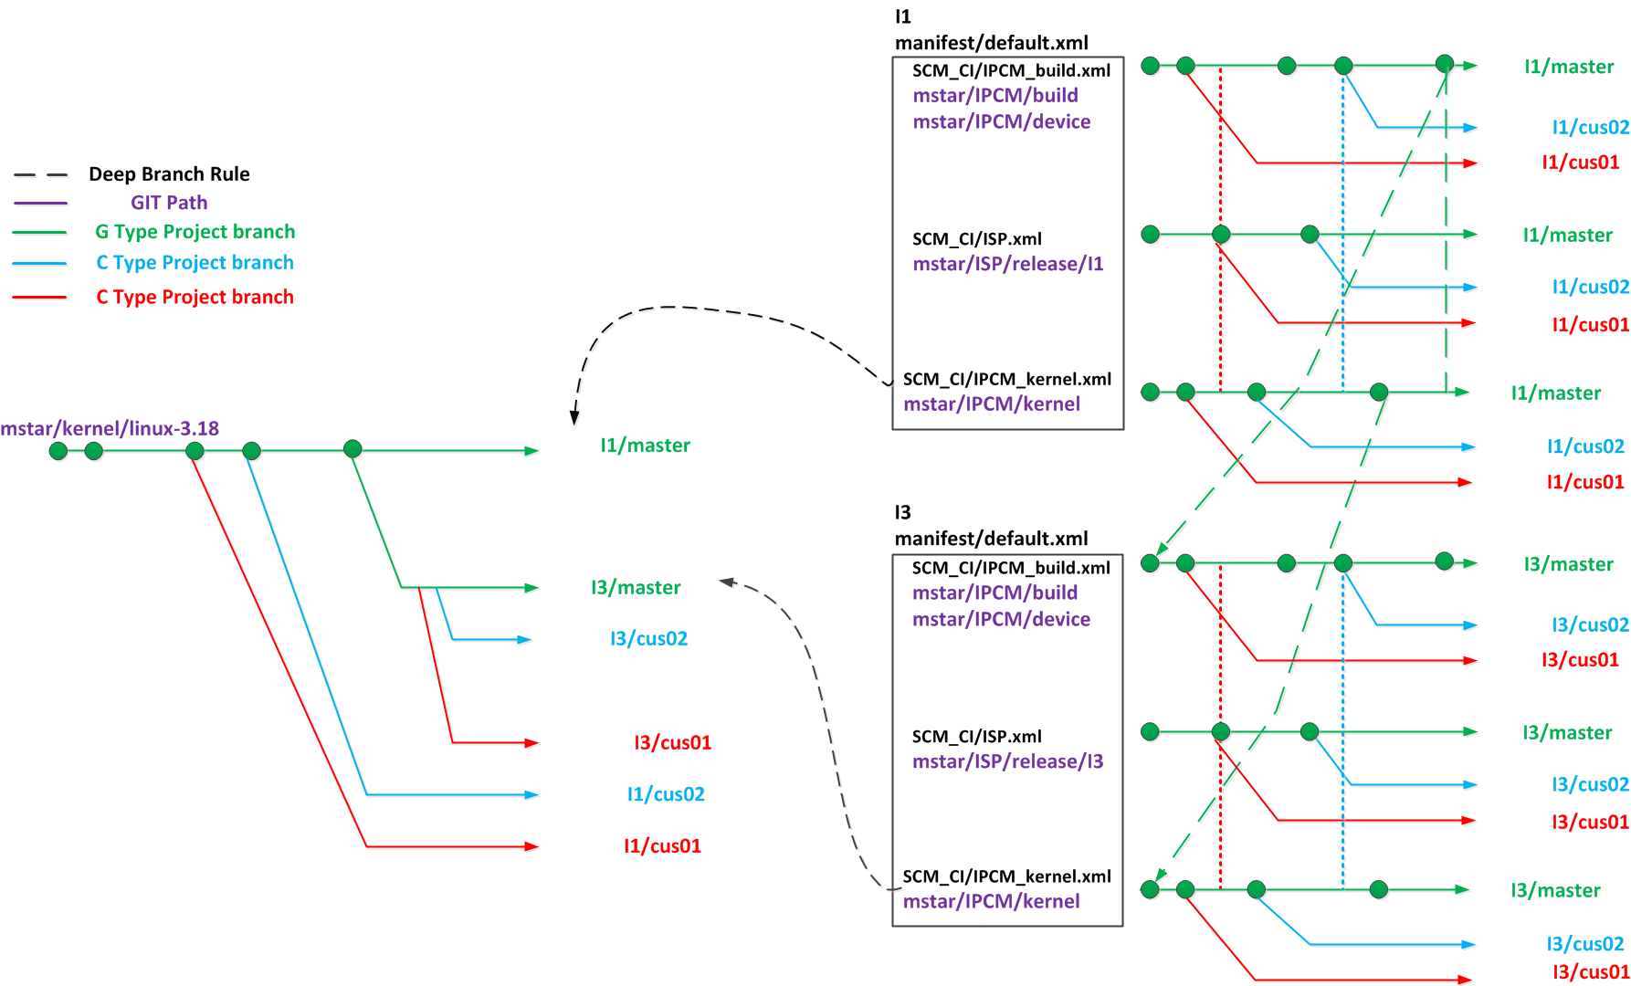
Example

Slide 11
Task
Module list table
Refine current SDK build to match the new branch model
Create the G/C type Project(s)
Create the branches according to the new branch model and G/C Project(s)
Versioning Tag
For single git project , the MVXV lib tag is used
For repo with multiple git project, use following tag:
YYMMDDHHMM-<PRODUCT>--<CHIP>_<BRANCH>
The branch alias rule should be apply. So for the MIX solution, the version tag may be 1701012233-I1_master
The tag should be put into delivery by certain method
Snapshot of repo can be used with the version tag for tracking

