Slide 1

Survival Analysis of Hard Drives by David Kuralt

Slide 2
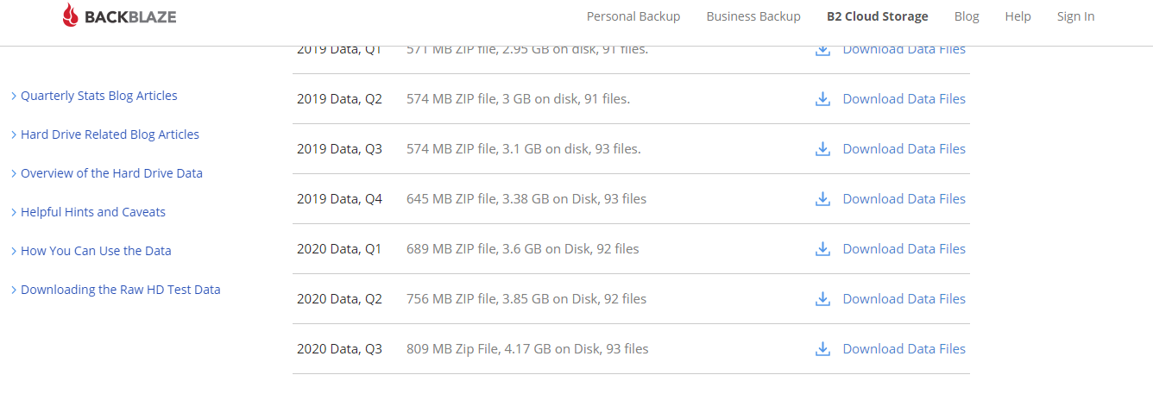
Here’s the Data!

Slide 3
October 1, 2019 through September 30, 2020
Seagate Exos X14 12 TB
Toshiba MG Series Enterprise 14 TB
18,470 hard drives
106 failures
25 removed without failing
17,395 hard drives
74 failures
3 removed without failing

Slide 4
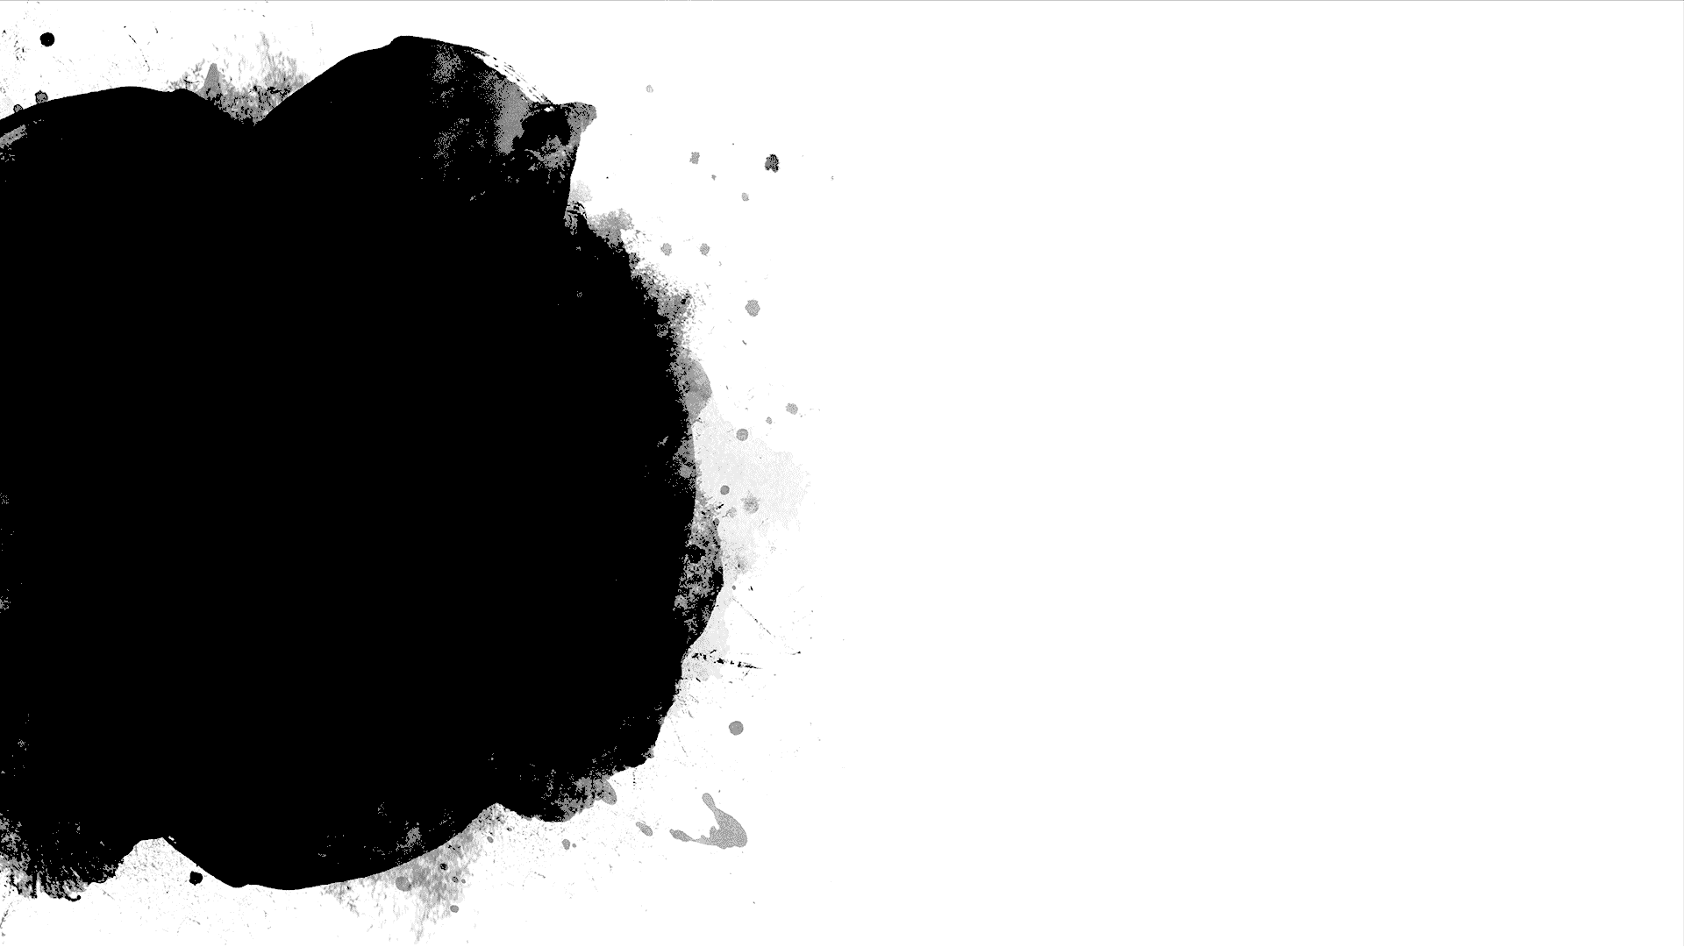
Survival Analysis
Is called Reliability Analysis when considering performance of technology
Involves an Observation Period which is 10/1/2019 through 9/30/2020

Slide 5
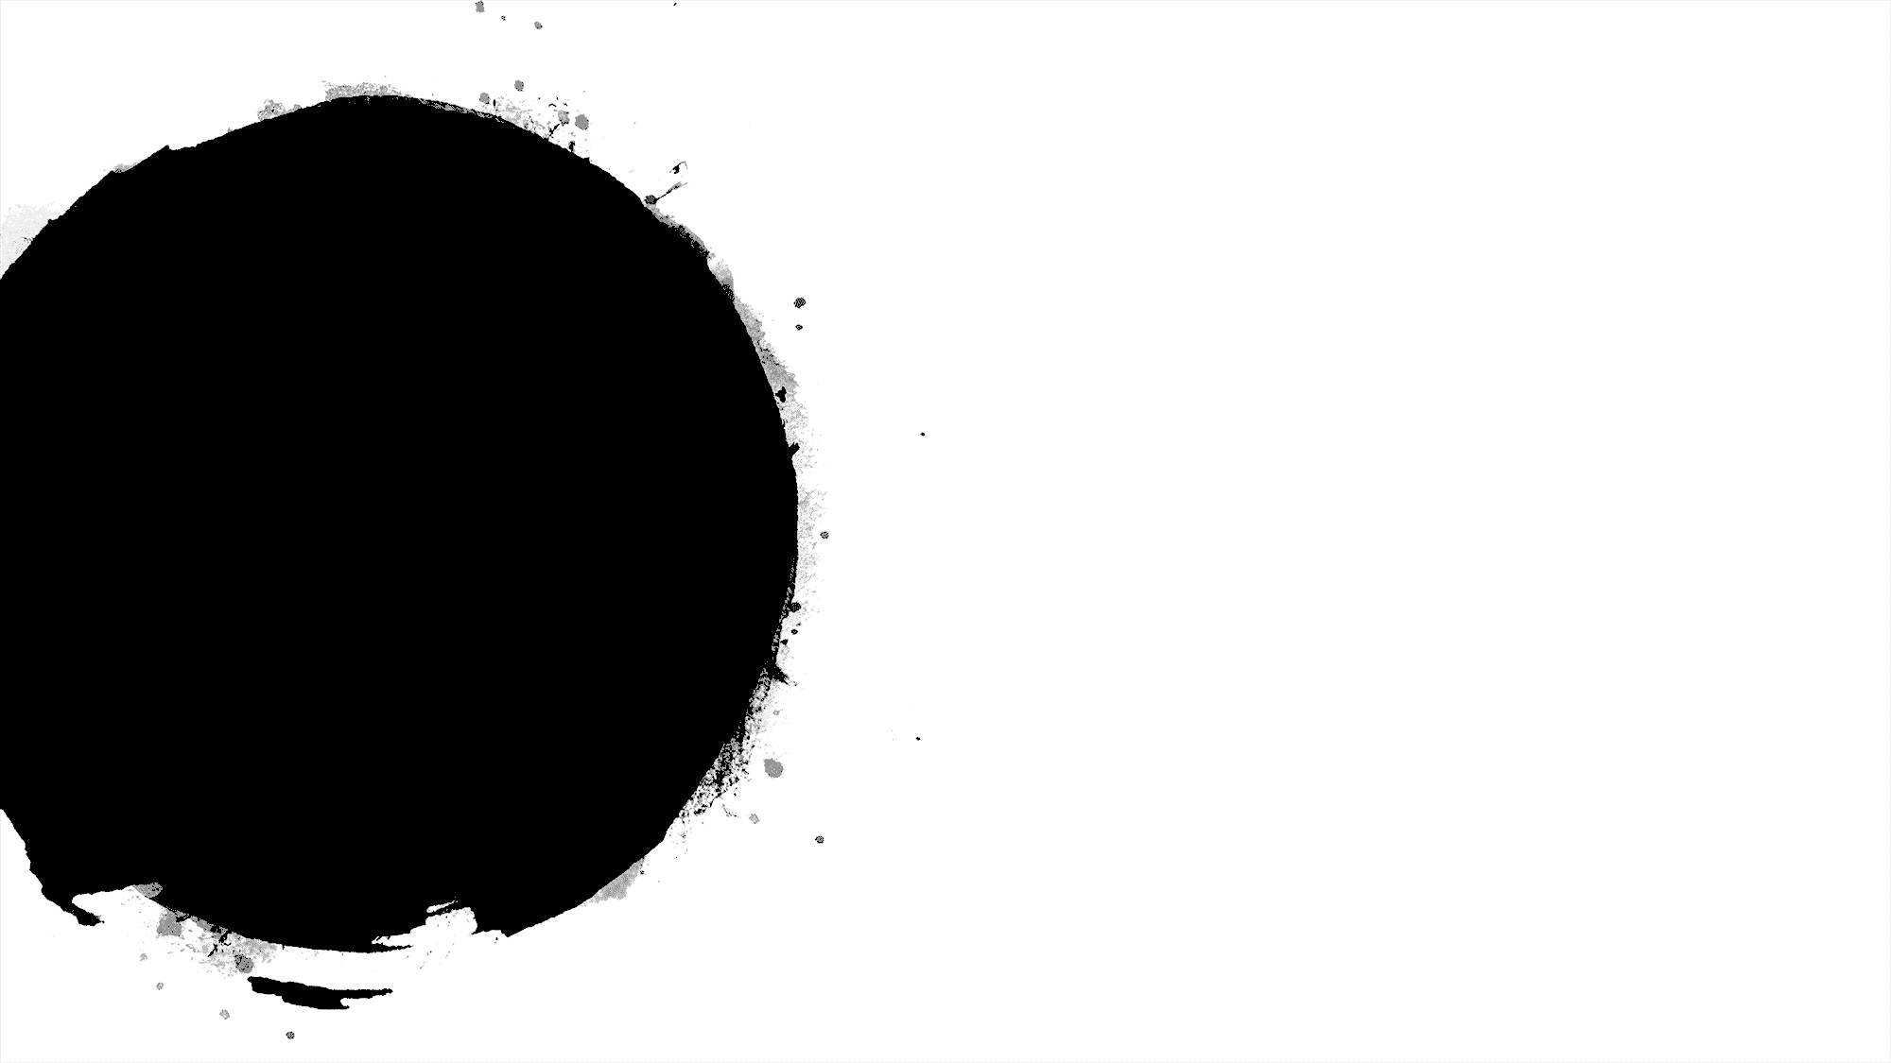

Participants in the study
Are the hard drives, themselves
Enter and leave the study throughout the observation period
Experience an event when a malfunction is severe enough to replace the hard drive
Can be pulled from the study for reasons other than malfunction

Slide 6
Censoring
Occurs when a hard drive does not experience an event during the observation period
Occurs when a hard drive is pulled from service during the observation period without having experienced an event
These are examples of “right censoring”

Slide 7

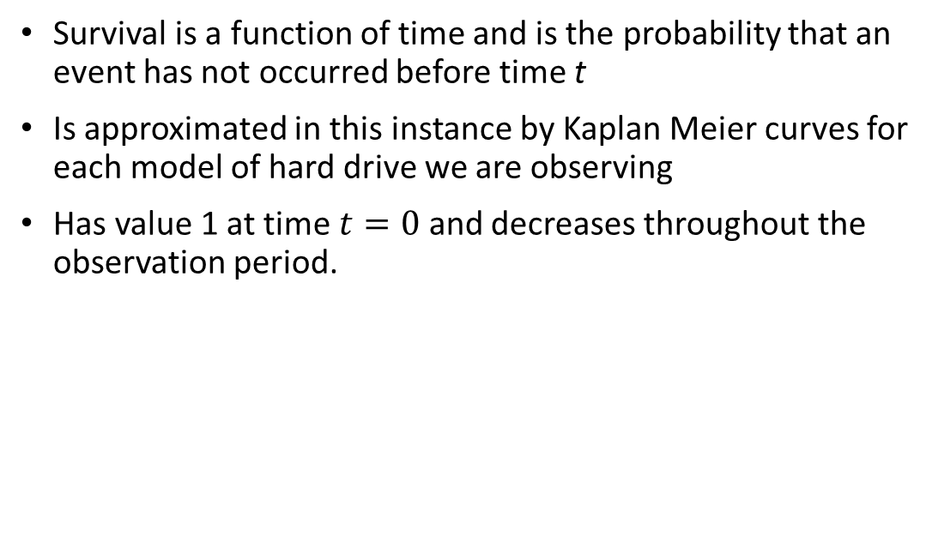
Survival function and Kaplan Meier curves
Survival is a function of time and is the probability that an event has not occurred before time t
Is approximated in this instance by Kaplan Meier curves for each model of hard drive we are observing
Has value 1 at time $t=0$ and decreases throughout the observation period.

Slide 8
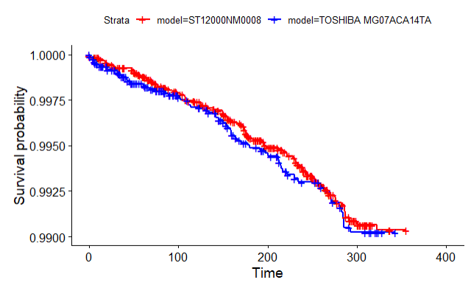
Kaplan Meier Curves

Slide 9

Log rank test
Is a test comparing the Kaplan Meier curves for each hard drive model
Tests the null hypothesis that there is no difference in the survival functions of the two hard drive models
Is based on the chi-square test

Slide 10
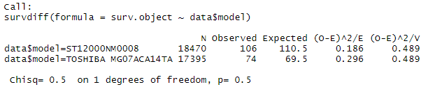
Log Rank Test results

Slide 11
The need to consider covariates
No reason to reject the null hypothesis of the log rank test
Our only consideration has been the model of hard drives
Other attributes of a hard drive contribute to the probability of failure

Slide 12
Self-Monitoring Analysis Reporting Technology
SMART 09: Power-on hours
SMART 05: Reallocated sectors count
SMART 187: Reported uncorrectable errors
SMART 188: Command timeout
SMART 197: Current pending sector count
SMART 198: Uncorrectable sector count

Slide 13
Our covariates
Model: either Seagate or Toshiba
Power-on hours: either “long” or “short”
5 errors: either “some” or “none”

Slide 14
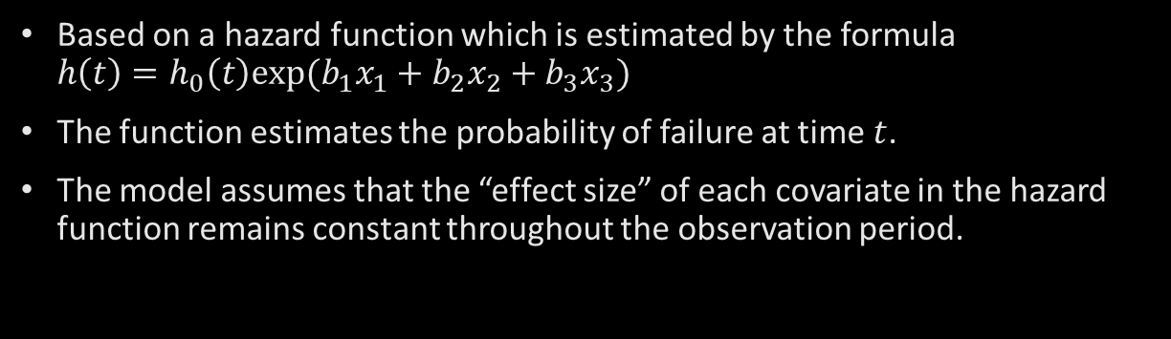
Cox Proportional Hazards model
Based on a hazard function which is estimated by the formula $h\left(t\right)=h_{0}\left(t\right)exp(b_{1}x_{1}+b_{2}x_{2}+b_{3}x_{3})$
The function estimates the probability of failure at time $t$.
The model assumes that the “effect size” of each covariate in the hazard function remains constant throughout the observation period.

Slide 15


The hazard function:
$x_{1}$ is 0 if Seagate and 1 if Toshiba
$x_{2}$ is 0 if none of the five errors and 1 if some of the five errors
$x_{3}$ is 0 if greater than 4,603 hours and 1 otherwise
$e^{b_{1}},e^{b_{2}},e^{b_{3}}$ are the size effects, or proportion of risk of failure, associated with each covariate
R performs multiple linear regression on the equation $\ln{h\left(t\right)=\ln{h_{0}\left(t\right)+}}b_{1}x_{1}+b_{2}x_{2}+b_{3}x_{3}$ to determine $b_{1},b_{2},b_{3}$

Slide 16
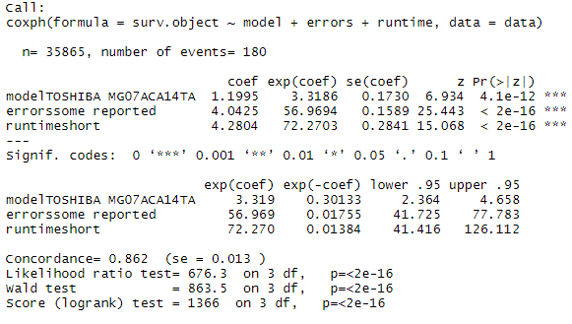
Results of the analysis

Slide 17
Reasons to be skeptical

Slide 18
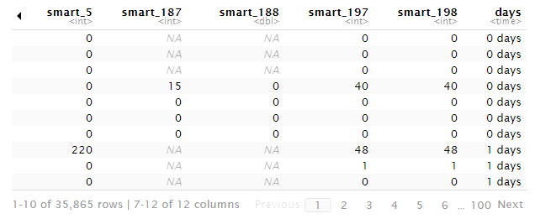
A lot of NA values for the five errors

Slide 19
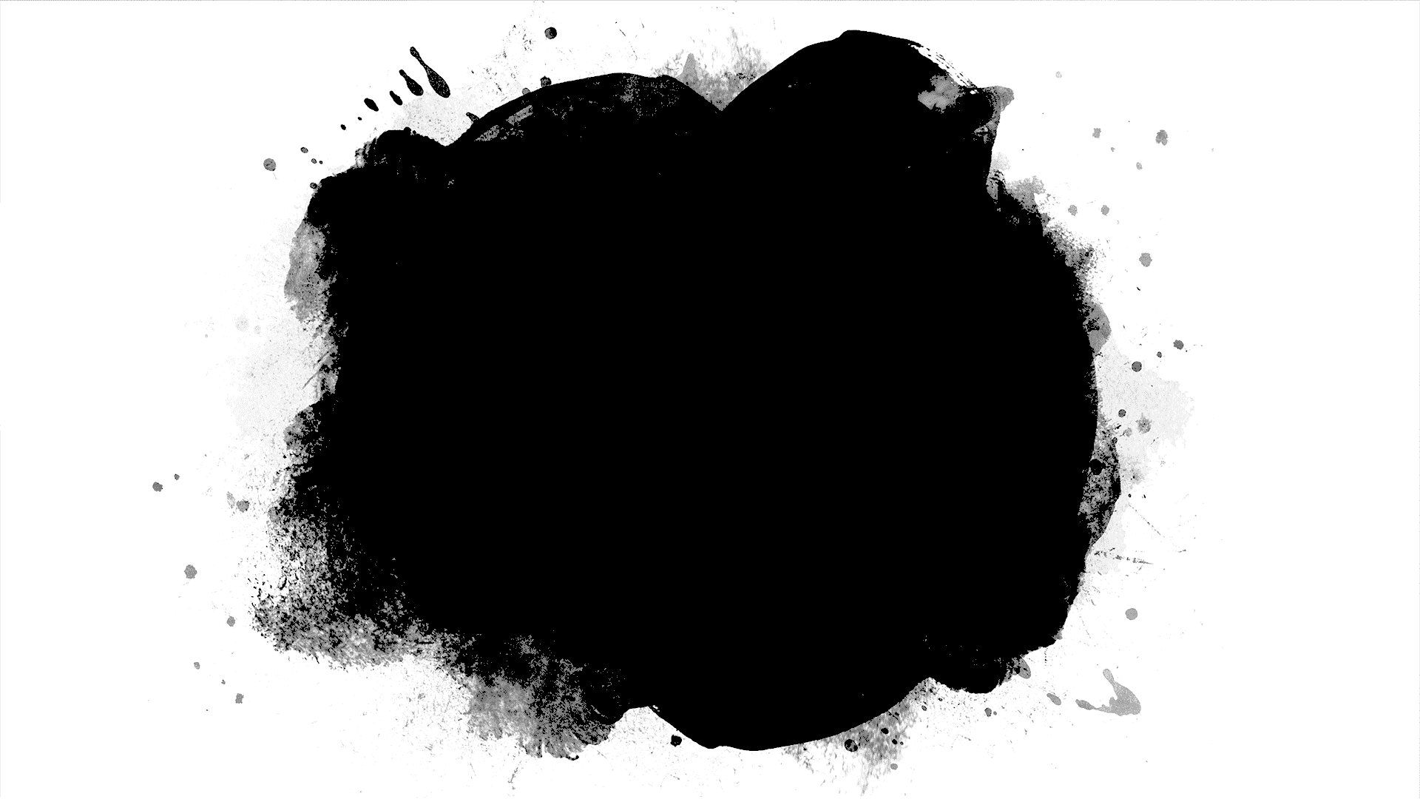
Standards for defining when a particular error occurs, and criteria for reporting these errors, differ from one hard drive manufacturer to the next

Slide 20

The most compelling evidence supporting the conclusion that both hard drive models are of excellent quality is the tiny proportion of each model that failed during the year.

