Slide 1
A Multi-Year Reddit Engagement Dataset
Comment-level engagement prediction: score, reply count, controversiality
443K
comments
151K
threads
160K
unique authors
11 yrs
2014 - 2025
property | value
records | 443,211
threads (posts) | 151,249
unique authors | 159,826
subreddits | 5 (r/Conservative, r/politics, r/worldnews, ...)
months sampled | 23 (2014-01 to 2025-09)
split: random (by thread) | 354,658 train / 88,553 test
split: temporal (by month) | 383,083 train / 60,000 test
One record = one comment, with its ancestor chain as context. Splits are disjoint by thread, so no thread appears on both sides.

Slide 2
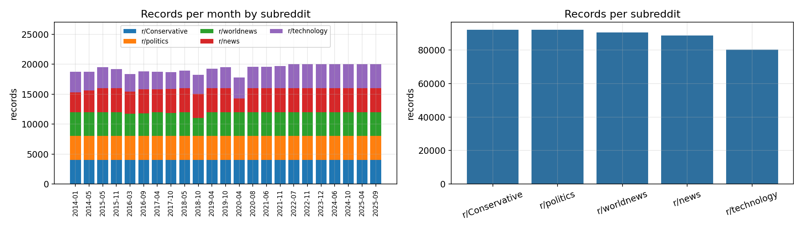
Coverage
23 months x 5 subreddits, balanced by design
subreddit | records | share
r/Conservative | 92,000 | 20.8%
r/politics | 92,000 | 20.8%
r/worldnews | 90,402 | 20.4%
r/news | 88,632 | 20.0%
r/technology | 80,177 | 18.1%
Sampling
• Months chosen across 2014-2025; each screened so the controversiality field is actually populated.
• Per cell: up to 1,500 threads, max 6 comments per thread, capped at 4,000 records.
• Comments in the final 2 days of a dump are dropped - their replies fall into the next month's file.

Slide 3
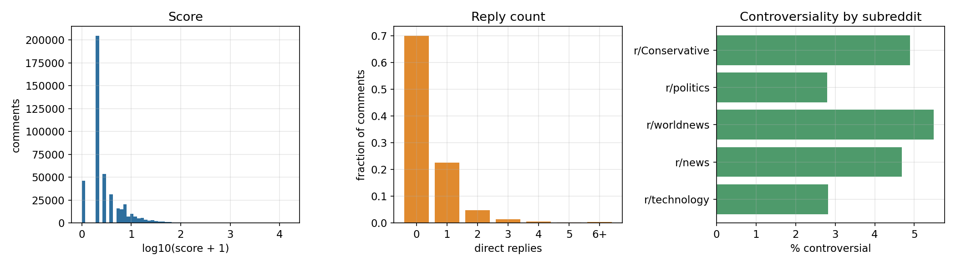
Prediction Targets
Three engagement signals per comment
target | mean | median | p90 | p99 | max
score (upvotes) | 5.1 | 1 | 9 | 58 | 15552
width (direct replies) | 0.43 | 0 | 1 | 4 | 235
controversiality (0/1) | 0.0416 | 0 | 0 | 1 | 1
70% of comments receive no reply | 18,455 controversial (4.16%) | score is heavy-tailed and is fuzzed by Reddit

Slide 4
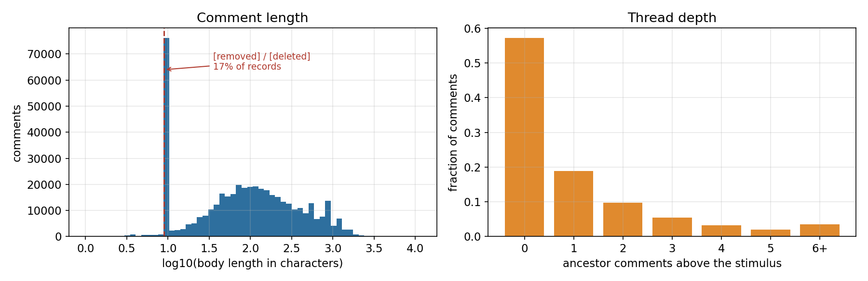
Comment Properties
Text length and position in the thread
property | mean | median | p90 | max
body length (characters) | 221 | 91 | 626 | 11390
body length (words) | 34 | 16 | 94 | 1644
top-level comments (no ancestor) | 57% | - | - | -
body is [removed] or [deleted] | 16.8% | - | - | -
74,329 comments (17%) carry no text but still have engagement labels - decide to keep or filter.

Slide 5
Planned Analyses
What this dataset is sized to answer
What predicts engagement: text or thread structure?
One model class, swapped feature blocks (structural / lexical / semantic), with a noise block of matched width as a control. 60K test records resolve differences to ~0.002.
1
How fast does the model go stale?
Train on the earliest months and test forward, up to a 95-month horizon - eight years, versus the 16 months previous work could reach.
2
Two-part reply modelling
70% of comments get no reply, so split the target: will anyone reply at all (balanced 70/30), then how many given at least one.
3
Add thread-level context
57% of comments are top-level and have no ancestor features at all. Joining post score and age from the submission dumps should fill that gap.
4
Analyses 1-3 run on the dataset as it stands; 4 needs the submission dumps joined in.

