Slide 1
Social Media World Model
Benchmark, Generalization & Reply-Summary Evaluation
• Task: predict a stimulus comment's engagement — score, controversiality, reply width, reply summary
• Headline metric: Spearman ρ (scale-invariant ranking) + pairwise accuracy; macro-F1 for controversiality
• What's new: 18 baselines (was 6) · cross-domain · temporal · data-scaling · LLM-as-judge on summaries
• Data: Reddit r/politics (7,596 train / 1,900 test) + 5 subreddits × 3 months for generalization
Qwen3-4B LoRA fine-tuned on H20 GPUs via GitHub Actions runner

Slide 2
1 · Main Benchmark (r/politics, 1,900 test)
Cheap supervised models lead; conversation structure carries most of the signal
Model | score ρ | width ρ | contr F1 | type
quantile_gbm (LightGBM) | 0.760 | 0.687 | 0.557 | tabular
feature_gbdt | 0.759 | 0.676 | 0.424 | tabular
structural_prior (NO text) | 0.750 | 0.670 | 0.415 | graph-only
gnn (reply-tree) | 0.745 | 0.676 | 0.494 | graph NN
llm_reghead Qwen3-4B | 0.731 | 0.663 | 0.494 | LLM+heads
llm_sft Qwen3-4B (JSON) | 0.724 | 0.541 | 0.545 | LLM SFT
encoder (DistilBERT) | 0.720 | 0.642 | 0.494 | encoder
Qwen3-32B zero-shot | 0.482 | 0.477 | 0.311 | LLM 0-shot
Qwen3-4B zero-shot | 0.374 | 0.508 | 0.223 | LLM 0-shot
Key findings
• Structure > text. A text-free structural prior (ρ=0.750) and a reply-tree GNN (0.745) rival the best text model.
• Cheap wins. A sub-second LightGBM beats every LLM on ranking.
• Reg-head > JSON. llm_reghead lifts SFT 0.724→0.731 (score), 0.541→0.663 (width), 0% parse failures vs 81%.
• Fine-tuning helps LLMs a lot. Qwen3-4B 0.374→0.724; tuned 4B beats zero-shot 32B.

Slide 3
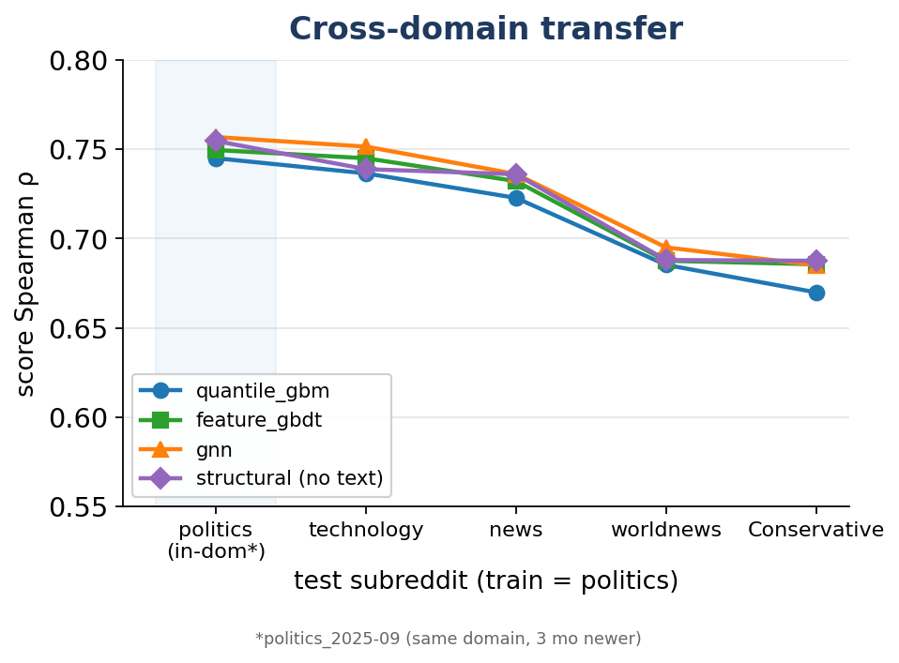
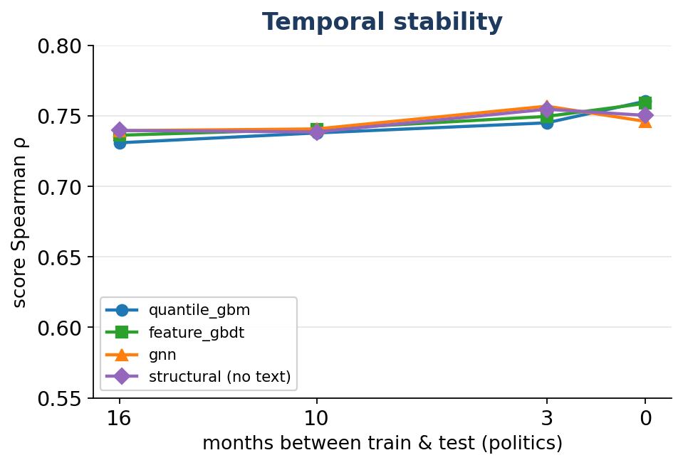
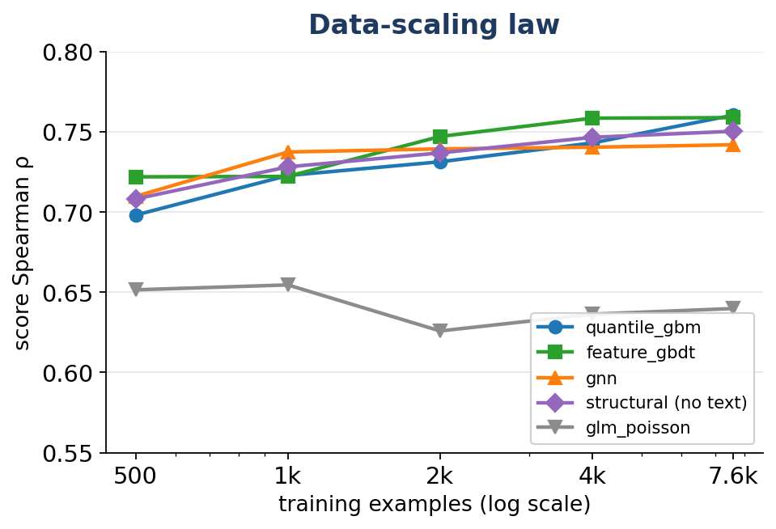
2 · Generalization: is it a world model?
Trains on politics, transfers across domains & time; keeps improving with data
Takeaways
• Cross-domain: graceful — only ≈0.02–0.09 ρ drop to 4 unseen subreddits; structural/GNN transfer best.
• Temporal: very stable — ≤0.03 ρ over 16 months back; engagement dynamics don't rot. Time-shift < domain-shift.
• Scaling: tree models monotonic & NOT saturated at 7,596 → more data should help; linear GLMs saturate early.

Slide 4
3 · Reply-Summary Quality — LLM-as-Judge (Qwen3-32B)
200 common records rated 1–5 vs the gold reference summary
Model | mean | 1 | 2 | 3 | 4 | 5
Qwen3-4B zero-shot | 2.12 | 11 | 156 | 32 | 0 | 1
Qwen3-32B zero-shot | 2.07 | 13 | 161 | 26 | 0 | 0
llm_sft Qwen3-4B | 1.95 | 33 | 148 | 16 | 3 | 0
Overall conclusions
• Conversation STRUCTURE is the dominant, domain/time-transferable signal.
• A cheap LightGBM is the strongest, most scalable world model — beats fine-tuned & 32B LLMs on ranking.
• Numeric channel is strong (ρ≈0.76) and generalizes; TEXT (reply summary) channel is not yet usable.
• Numeric-vs-text trade-off: the SFT model best on numbers is the worst summarizer.
• Next: dedicated summary decoder; imbalance-aware controversiality; scale the dataset.
Findings
• Summary forecasting is unsolved. All ~2/5 — predicting the content/sentiment of UNSEEN future replies is genuinely hard.
• Fine-tuning HURT it. SFT is worst (1.95) with the most 'unrelated' 1s — LoRA-SFT traded text quality for numeric/JSON.
• Scale doesn't help. 32B ≈ 4B zero-shot.
• Judge is reliable. Discriminates 1/3/4–5 with specific reasons; 0% parse failures.

