Slide 1
Profiler
A Place to Debug

Slide 2
CPU https://developer.android.com/studio/profile/cpu-profiler
Memory https://developer.android.com/studio/profile/memory-profiler
Network https://developer.android.com/studio/profile/network-profiler
Energy https://developer.android.com/studio/profile/energy-profiler

Slide 3
CPU
Memory https://developer.android.com/studio/profile/memory-profiler
Network
Energy

Slide 4
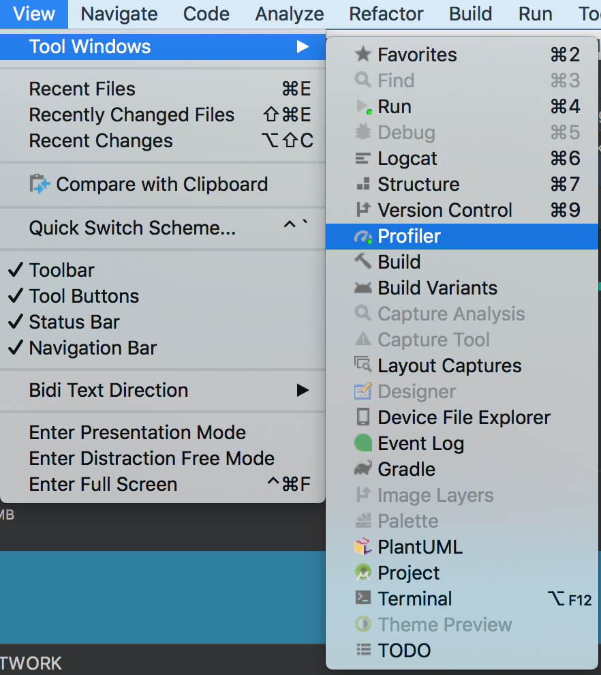
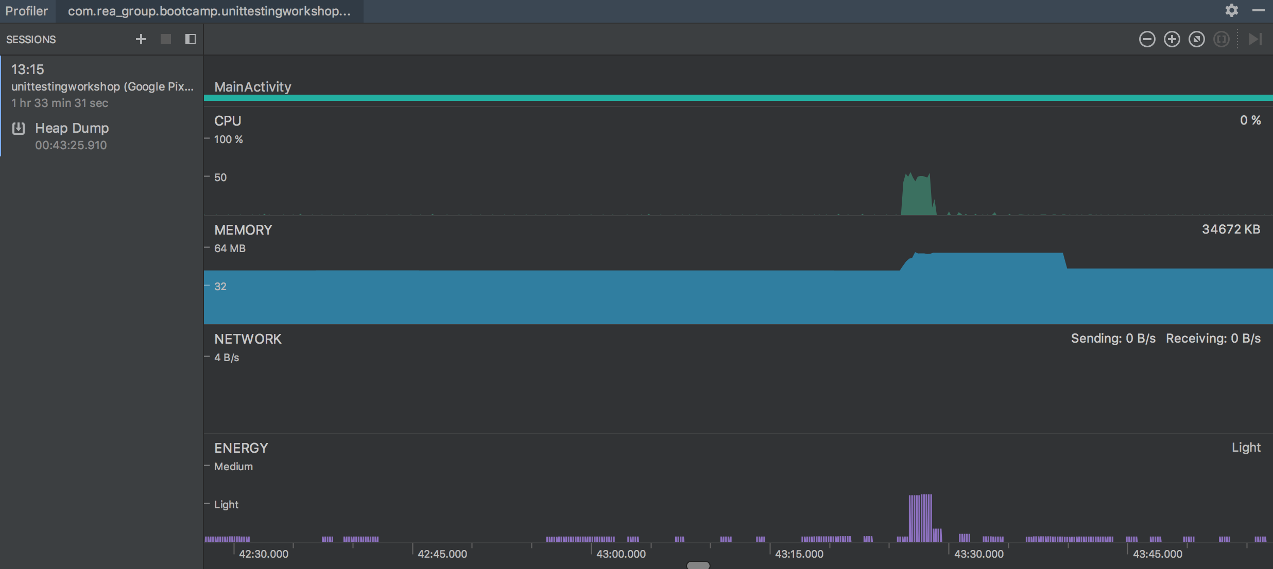
Memory --- Tool Window
Android <= 7.1 (API 25): Have A button to record memory allocations and the allocation count starts only at the time the Memory Profiler connected to your running app. So any objects allocated before you start profiling are not accounted for
Android >= 8.0 (API 26): Automatically record memory allocations and the number of allocation always represents the total number of Java objects outstanding in your app on Android 8.0 and higher.

Slide 5
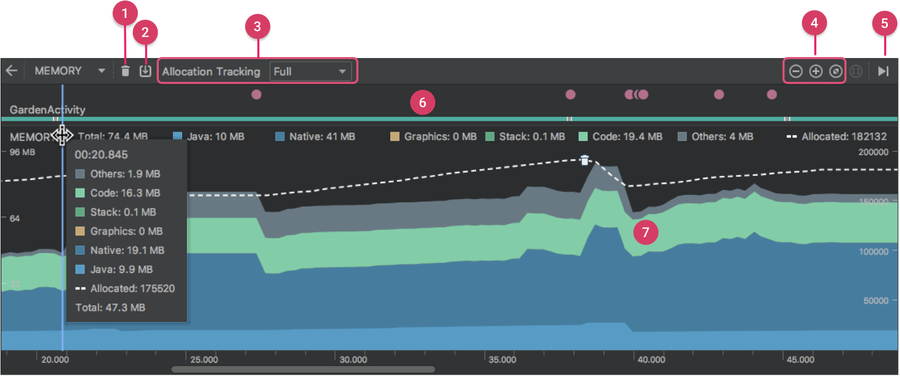
Memory Profiler overview
A button to force a garbage collection event.
A button to capture a heap dump.
A dropdown menu to specify how frequently the profiler captures memory allocations. Selecting the appropriate option may help you improve app performance while profiling.
Buttons to zoom in/out of the timeline.
A button to jump forward to the live memory data.
The event timeline, which shows the activity states, user input events, and screen rotation events.
The memory use timeline, which includes the following:
A stacked graph of how much memory is being used by each memory category, as indicated by the y-axis on the left and the color key at the top.
A dashed line indicates the number of allocated objects, as indicated by the y-axis on the right.
An icon for each garbage collection event.

Slide 6
How memory is counted
The numbers you see at the top of the Memory Profiler are based on all the private memory pages that your app has committed, according to the Android system. This count does not include pages shared with the system or other apps.
Java: Memory from objects allocated from Java or Kotlin code.
Native: Memory from objects allocated from C or C++ code.
Graphics: Memory used for graphics buffer queues to display pixels to the screen, including GL surfaces, GL textures, and so on. (Note that this is memory shared with the CPU, not dedicated GPU memory.)
Stack: Memory used by both native and Java stacks in your app. This usually relates to how many threads your app is running.
Code: Memory that your app uses for code and resources, such as dex bytecode, optimized or compiled dex code, .so libraries, and fonts.
Others: Memory used by your app that the system isn't sure how to categorize.
Allocated: The number of Java/Kotlin objects allocated by your app. This does not count objects allocated in C or C++.

Slide 7
View memory allocations
Memory allocations show you how each Java object and JNI reference in your memory was allocated. Specifically, the Memory Profiler can show you the following about object allocations:
What types of objects were allocated and how much space they use.
The stack trace of each allocation, including in which thread.
When the objects were deallocated (only when using a device with Android 8.0 or higher). Note: The device with system lower than Android 8.0, manually start/stop record is needed.

Slide 8
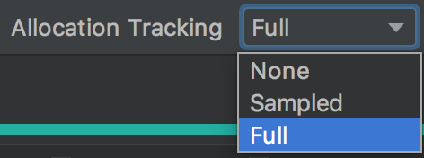
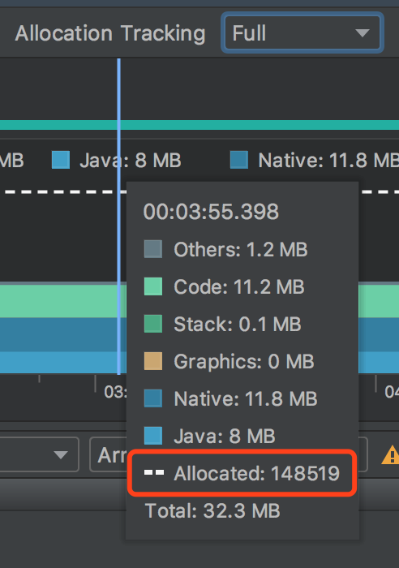
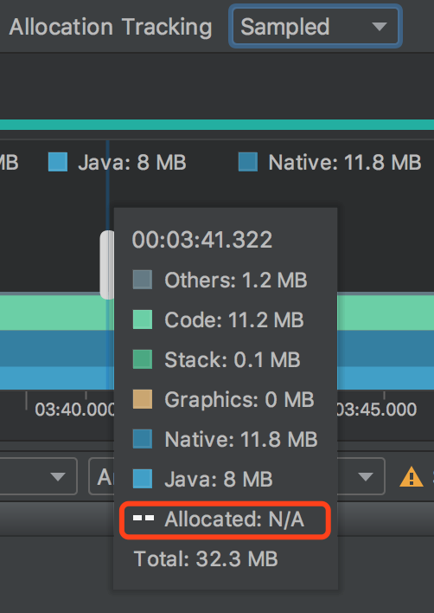
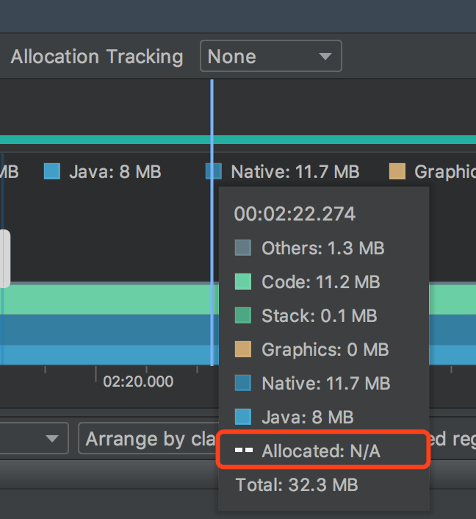
Allocation Tracking options
Full: Captures all object allocations in memory. This is the default behavior in Android Studio 3.2 and earlier. If you have an app that allocates a lot of objects, you might observe visible slowdowns with your app while profiling.
Sampled: Samples object allocations in memory at regular intervals. This is the default option and has less impact on app performance while profiling. Apps that allocate a lot of objects over a short span of time may still exhibit visible slowdowns.
None: Stops tracking your app's memory allocation.

Slide 9
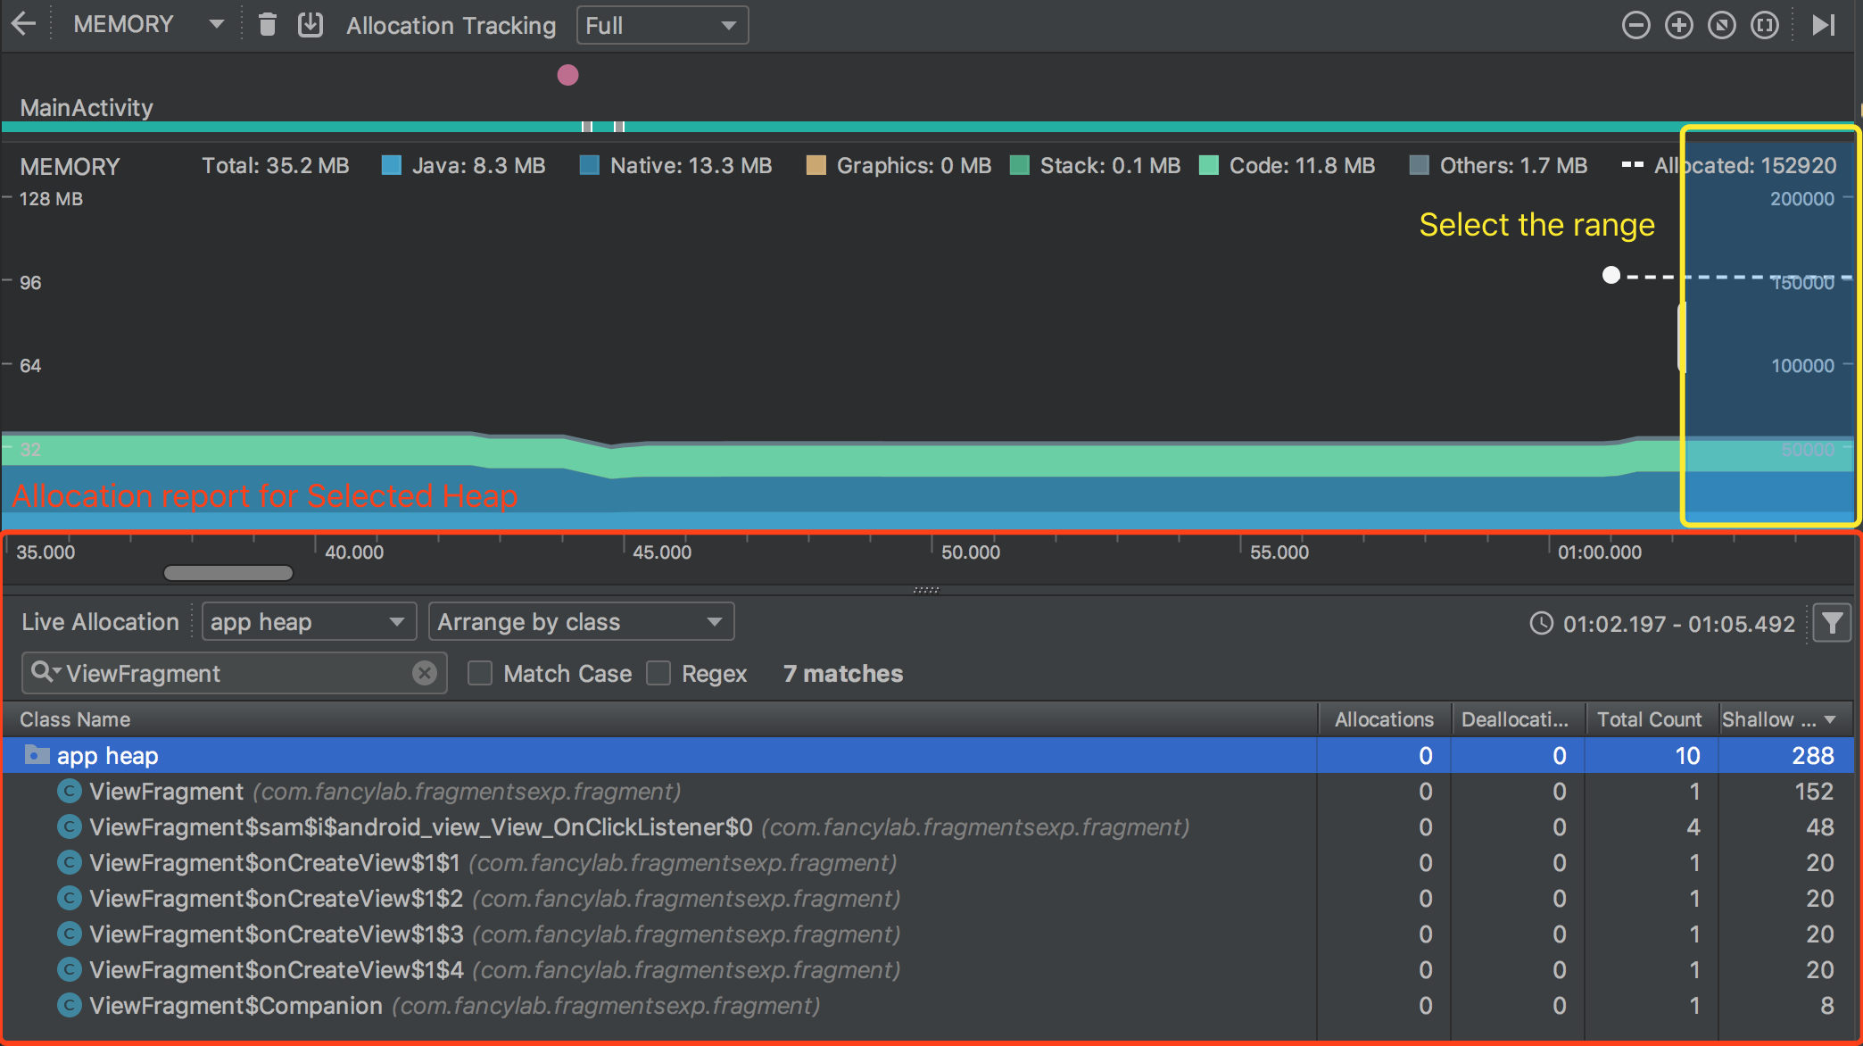

Slide 10
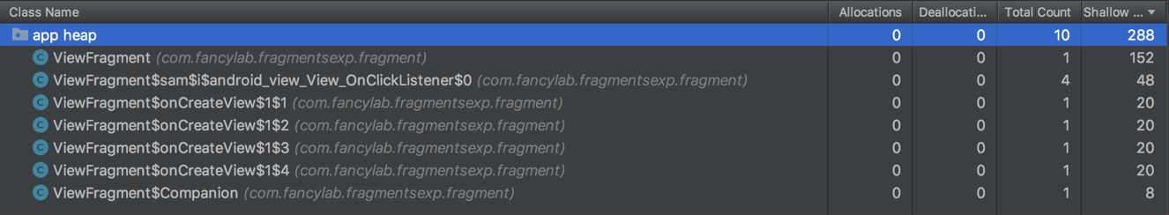
Allocations: Number of allocations in the heap. 0 means that there is no new ViewFragment instance being created in selected time range
Deallocations : Number of deallocations in the heap. 0 means that there is no existing ViewFragment instance(s) being destroyed in selected time range
Total Count: Total amount of instances in the heap at the moment. 1 means that there is only one ViewFragment instance alive at the moment.
Shallow Size: Total amount of Java memory used by this object type (in bytes). 152 means that 152 bytes have been used by ViewFragment instance(s)

Slide 11
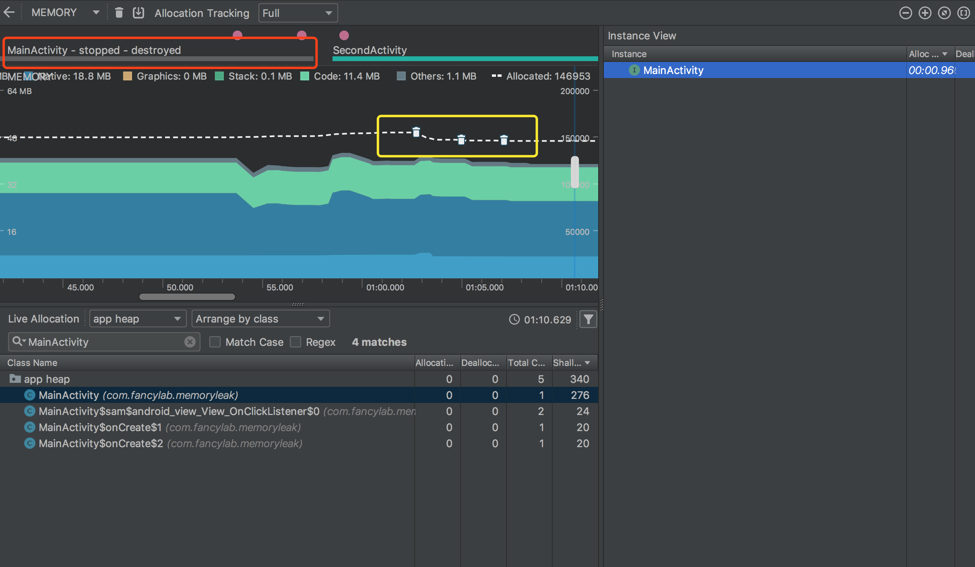
Memory leak detection

Slide 12
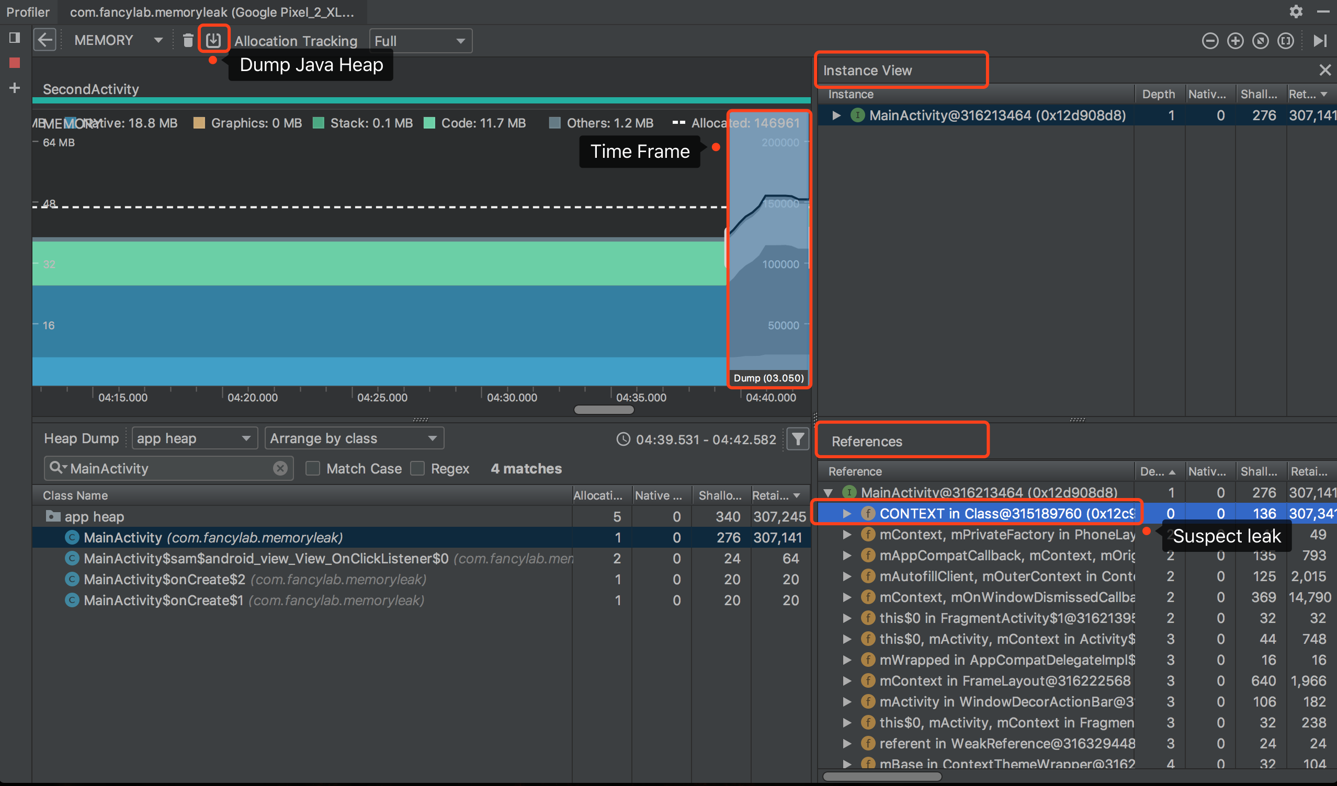

Slide 13

Any quicker way?
LeakCanary

Slide 14
To be continue…
CPU https://developer.android.com/studio/profile/cpu-profiler
Memory
Network https://developer.android.com/studio/profile/network-profiler
Energy https://developer.android.com/studio/profile/energy-profiler

