Slide 1
MicroC/OS Keil 8051 Port
Interface between C/Assembly/Interrupts
- 8051 stack operation (LtH)
- Keil C standard function specification
- Keil C reentrant function specification
- 68hc11/IAR comparison (HtL stack var/par)
- www.ucos-ii.com
port by: John X. Liu

Slide 2
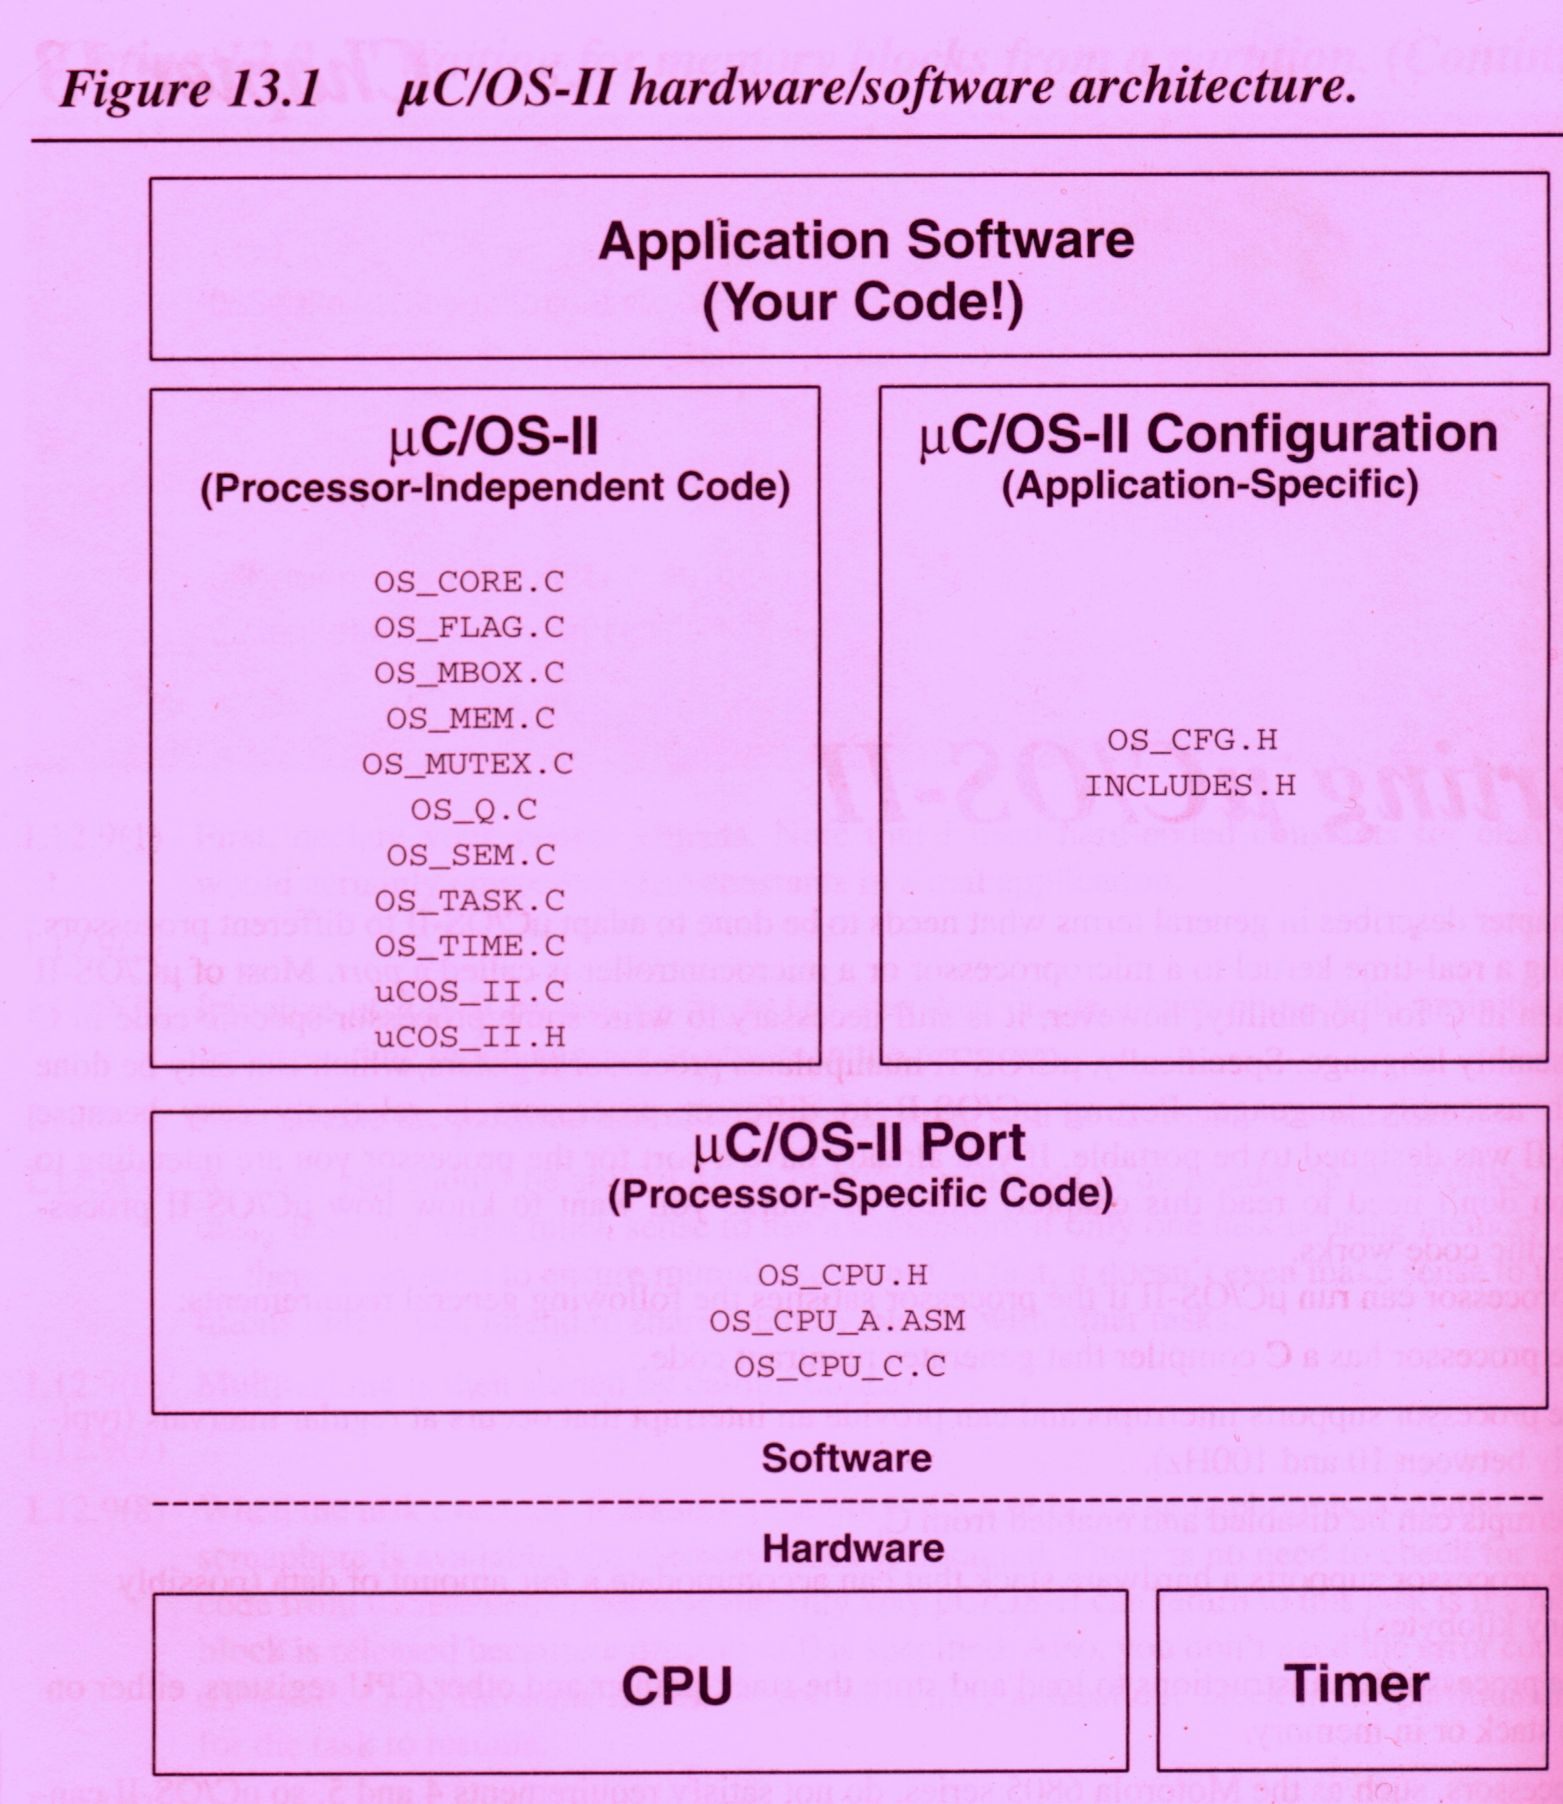

Slide 3
MicroC/OS
OS_CPU_C.C
- OSTaskStartInit
OS_CPU_A.ASM
- OSStartHighRdy
- OSCtxSw
- OSIntCtxSw
- OSTickISR

Slide 4
MicroC/OS Keil 8051 Port
OS_CPU_C.C
- OS_TaskStartInit
- OSstartHighRdy
- OSIntCtxSw
- OSTickISR
- C_OSCtxSw
OS_CPU_A.ASM
- OSCtxSw

Slide 5
8051 C Interrupt Function Entry
PCH and PCL pushed by Interrupt
PUSH ACC PUSH B
PUSH DPH PUSH DPL
PUSH PSW
MOV A,R0 PUSH ACC
MOV A,R1 PUSH ACC
MOV A,R2 PUSH ACC
MOV A,R3 PUSH ACC
MOV A,R4 PUSH ACC
MOV A,R5 PUSH ACC
MOV A,R6 PUSH ACC
MOV A,R7 PUSH ACC

Slide 6
8051 C Interrupt Function Exit
POP ACC MOV R7,A
POP ACC MOV R6,A
POP ACC MOV R5,A
POP ACC MOV R4,A
POP ACC MOV R3,A
POP ACC MOV R2,A
POP ACC MOV R1,A
POP ACC MOV R0,A
POP PSW
POP DPL
POP DPH
POP B
POP ACC
RETI –pops the PCH and PCL

Slide 7
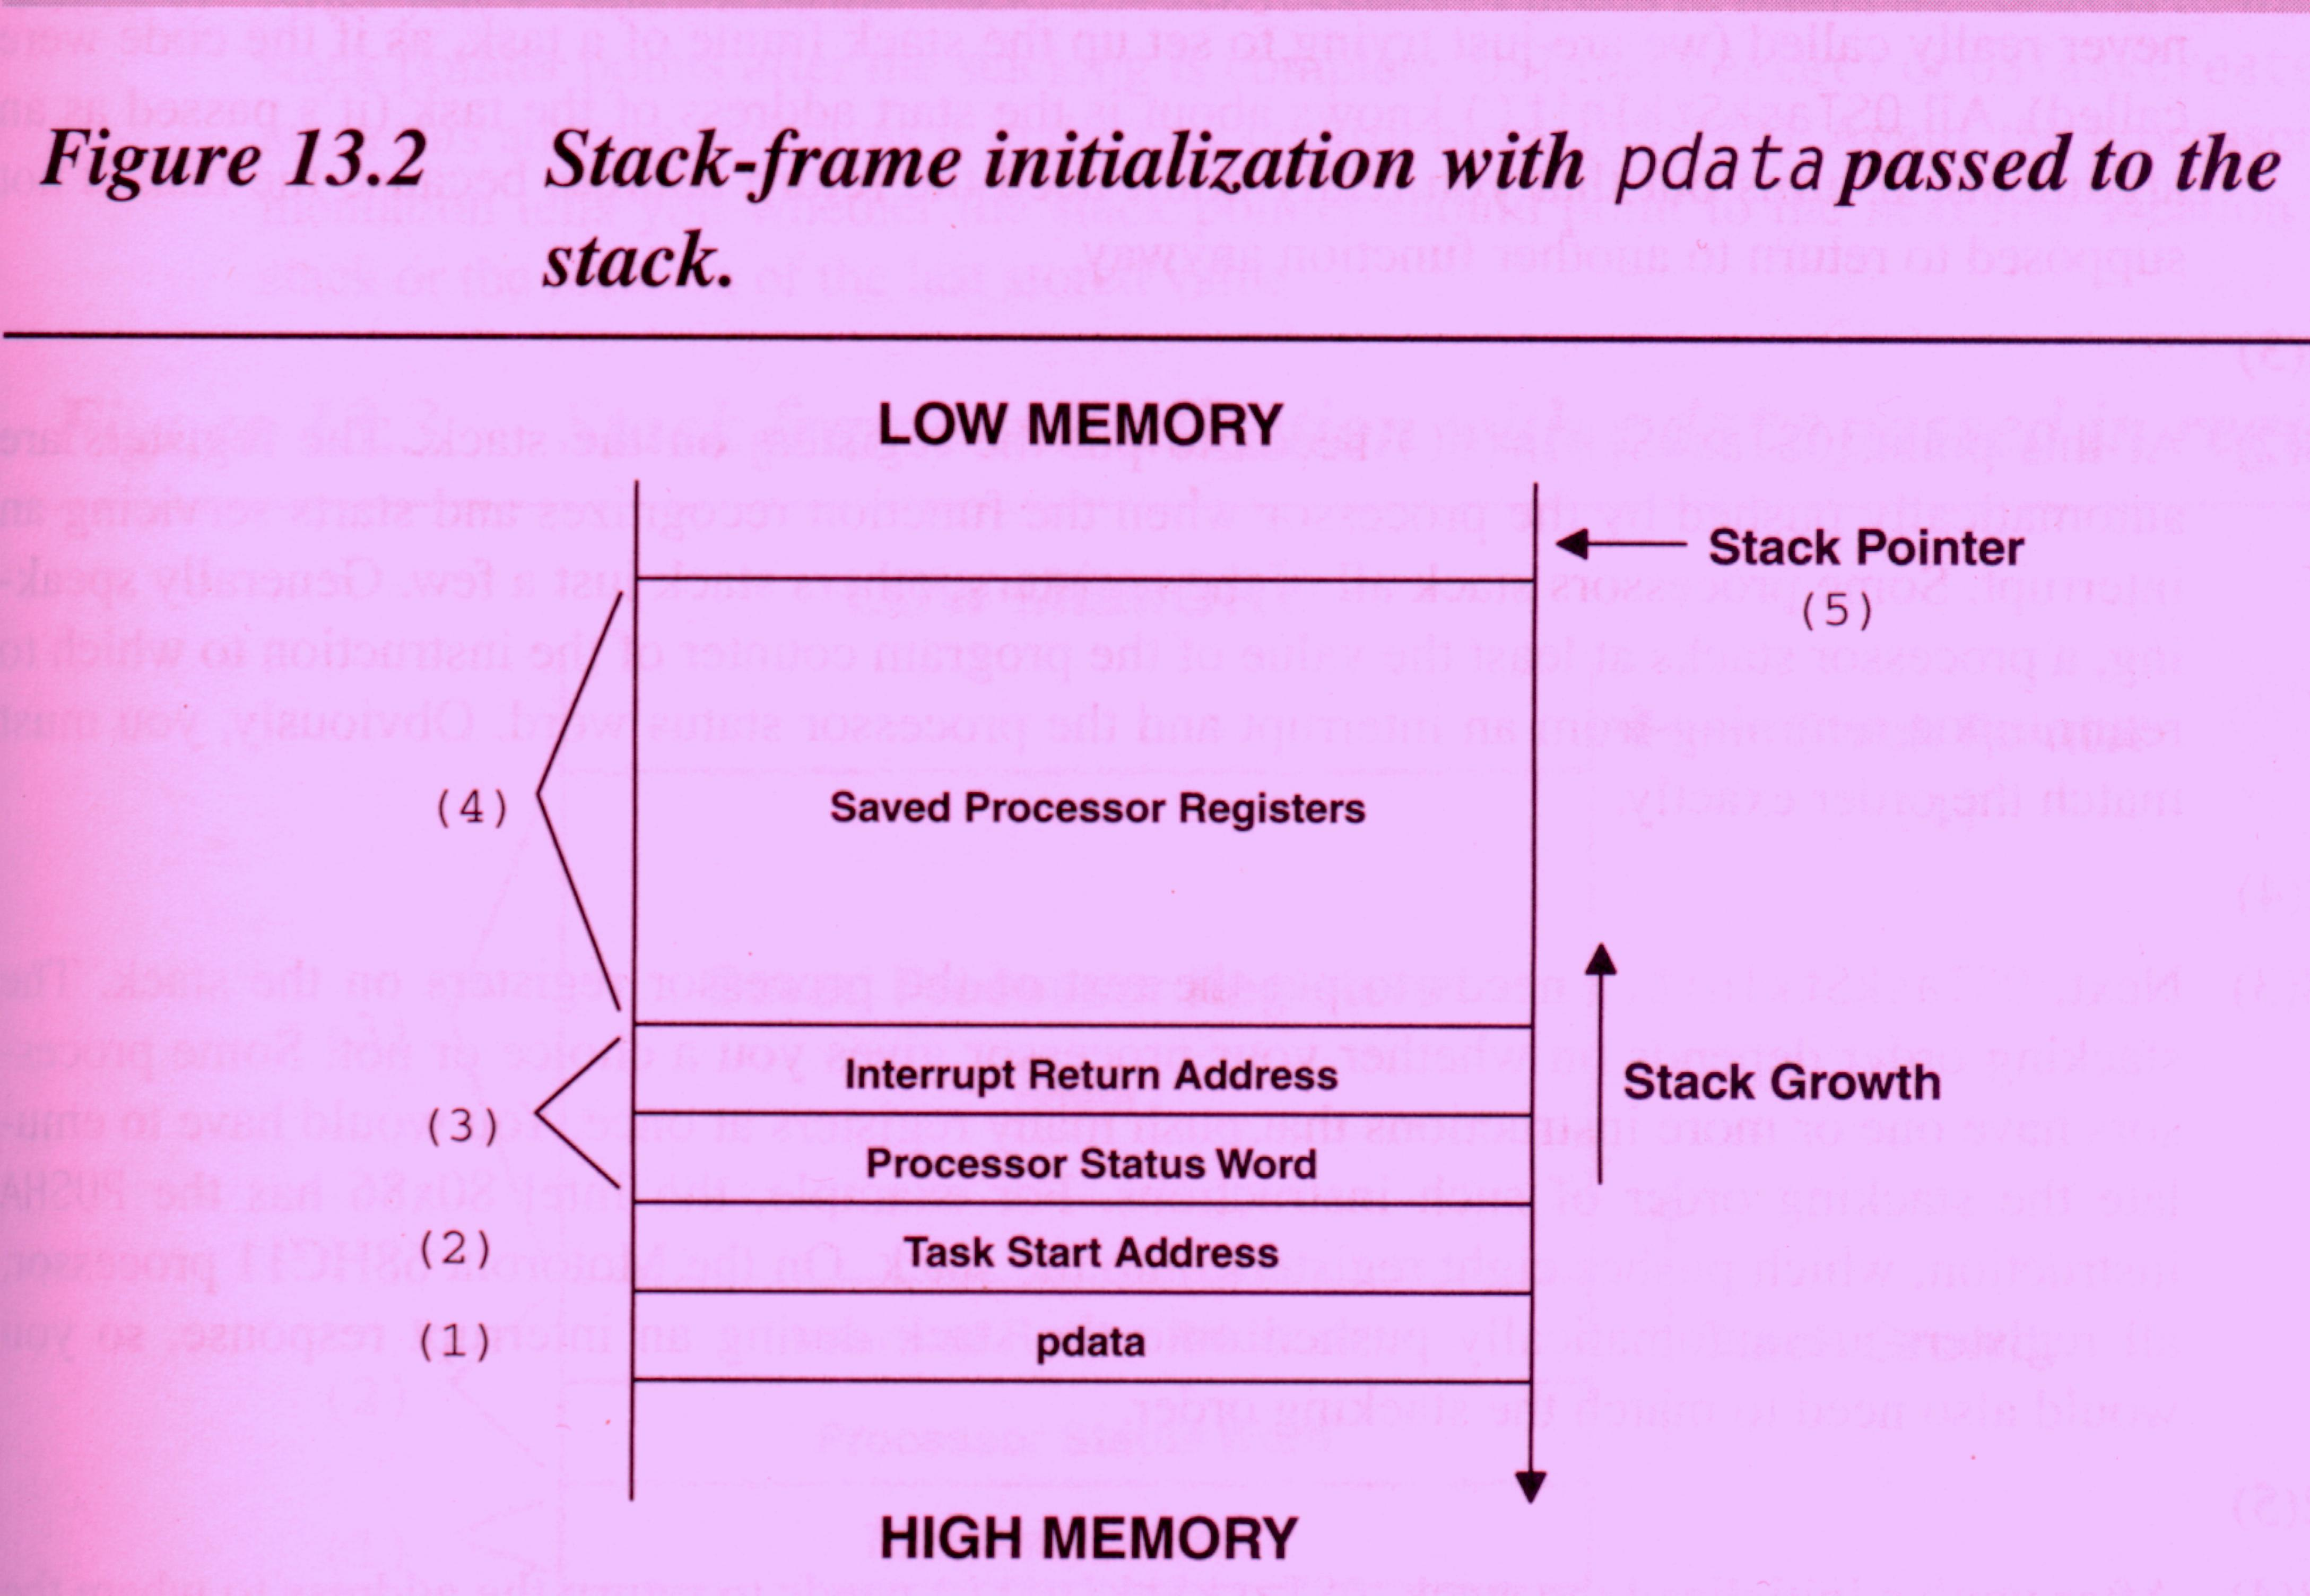

Slide 8
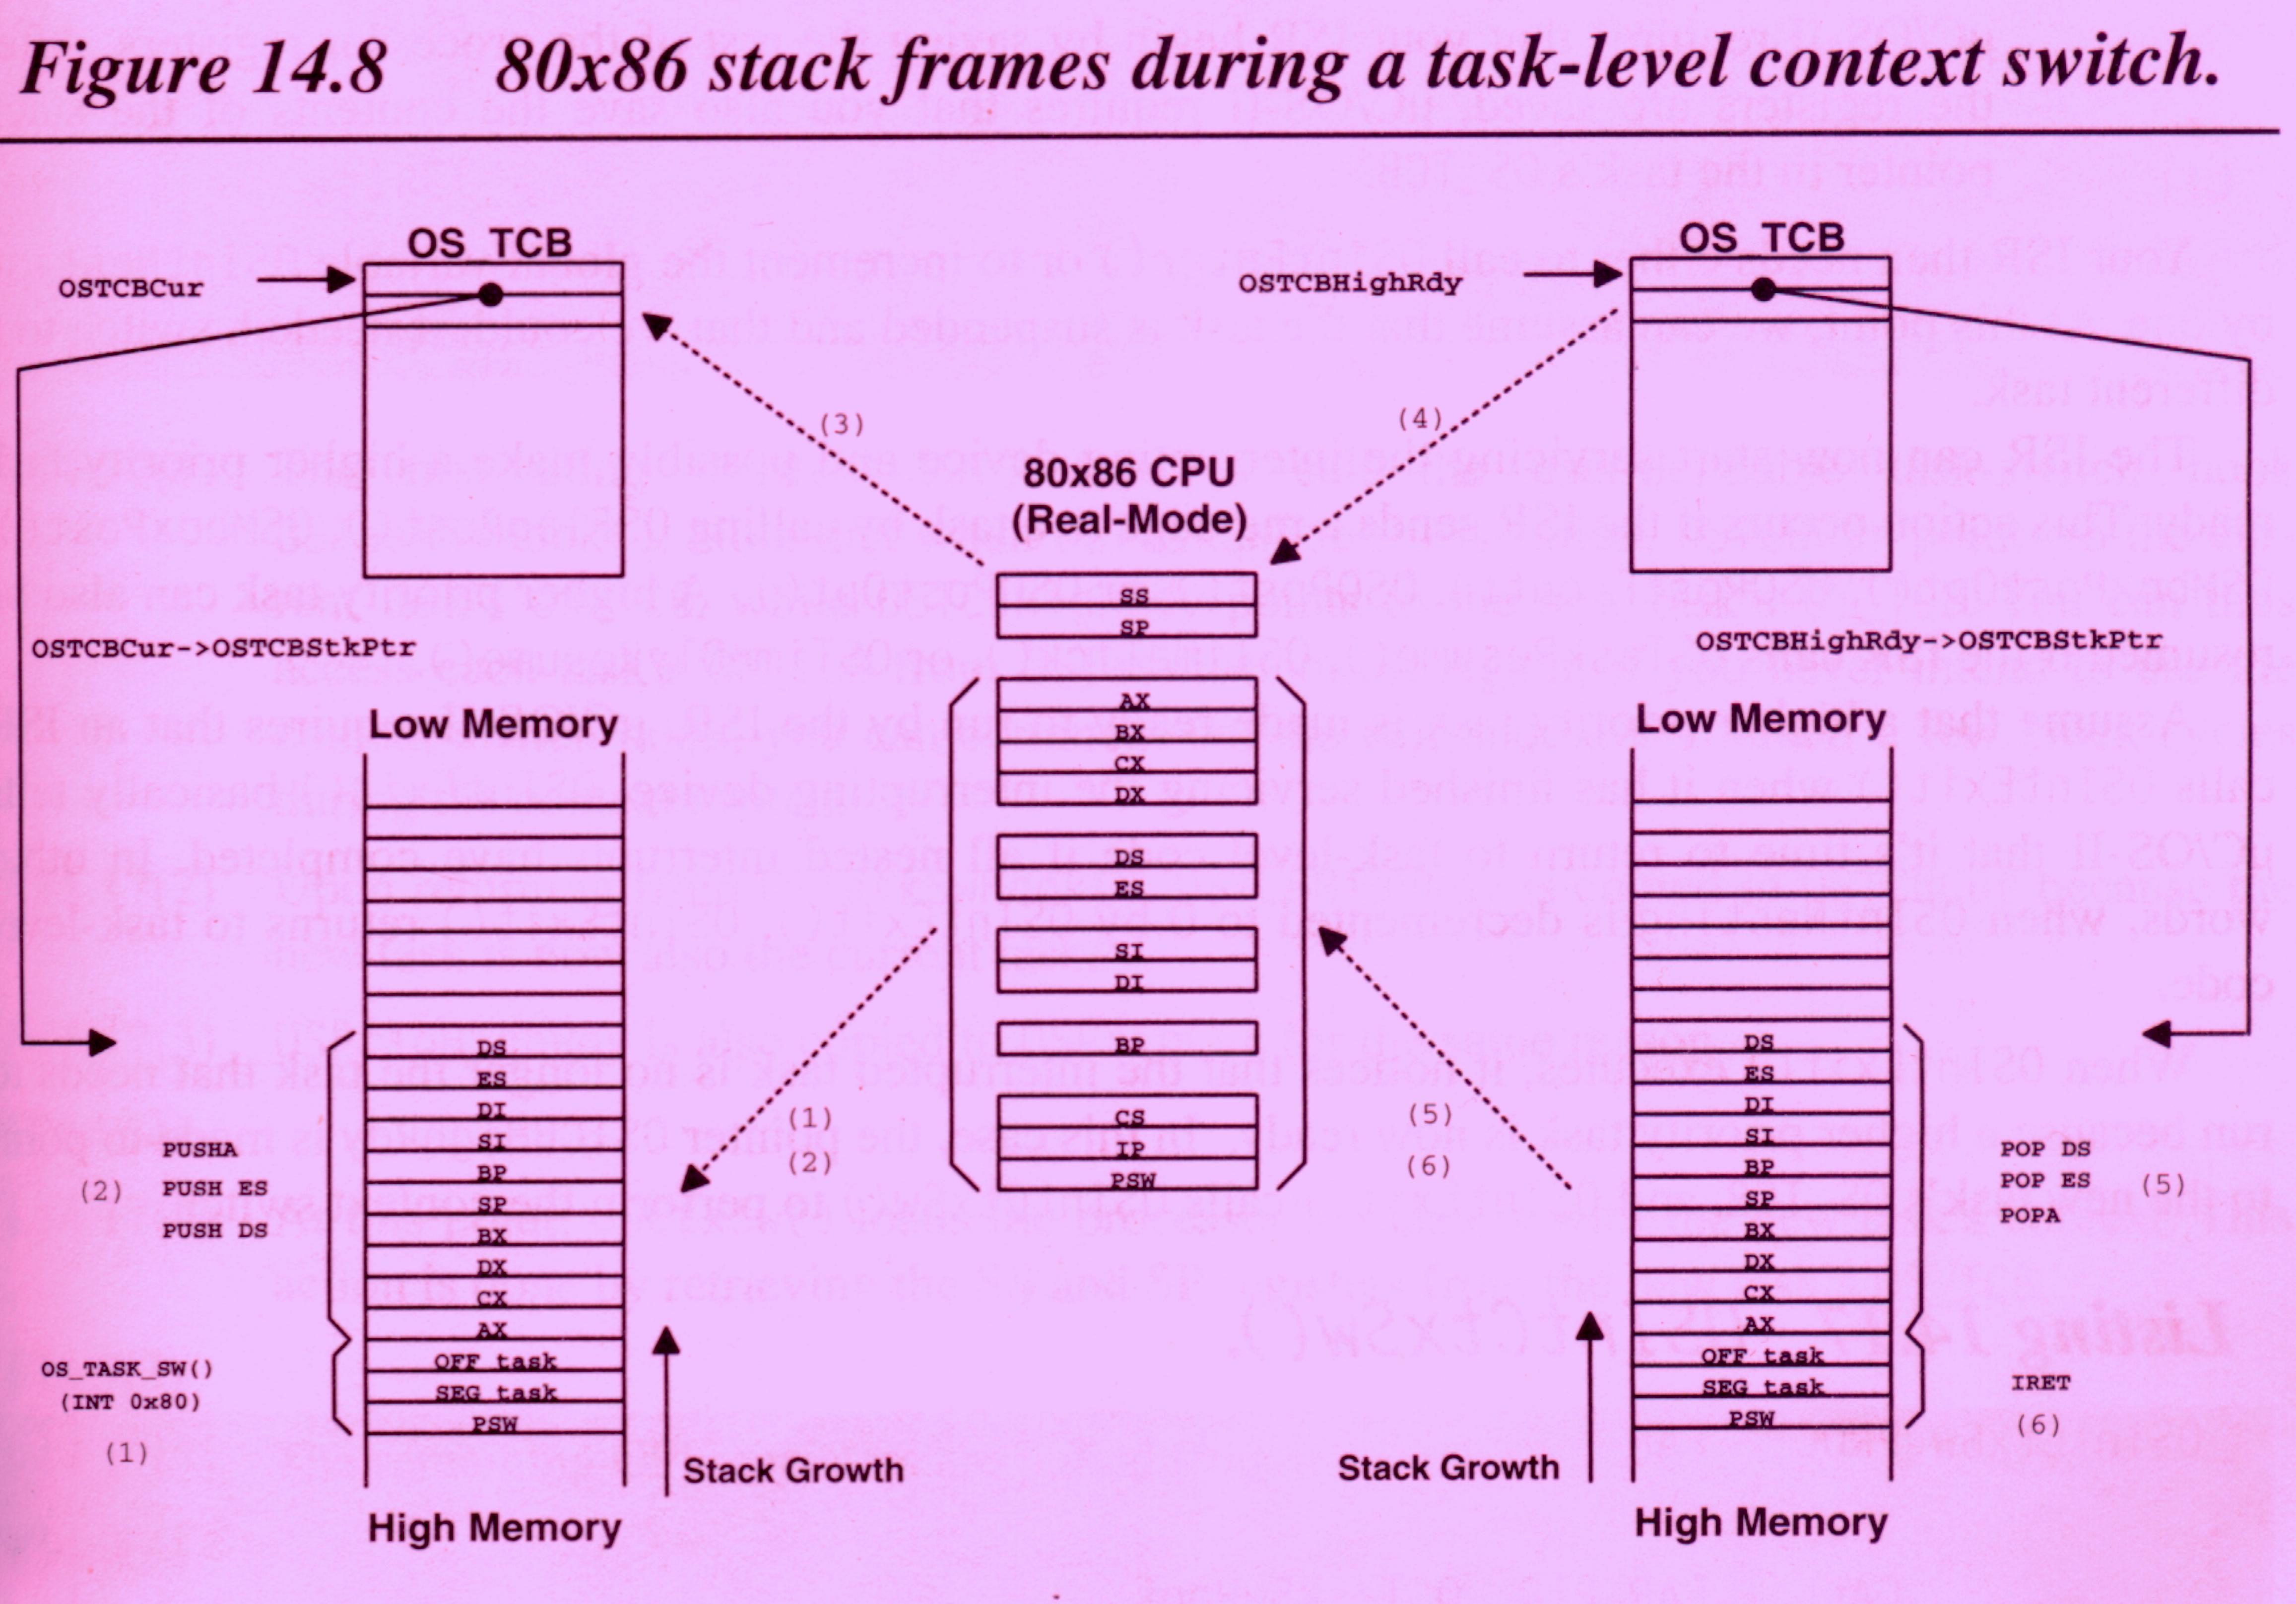

Slide 9
