Slide 1
Eniac’s Discount Strategy

Slide 2



Our recommendation:
Eniac should continue discounting products, with more disciplined strategy than it runs today:
Cap discount at a max discount of 20%.
Rebalance discount toward high-end products,
and away from budget items.
Plan campaigns around the calendar.

Slide 3
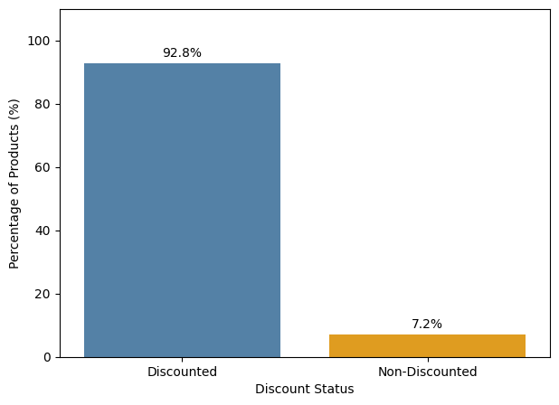
Discounted vs Non-Discounted Products
• 53,231 total sales records
• 49,404 discounted sales records
• 3,827 non-discounted sales records
• 4,906 unique products (SKUs)
• 92.8% of sales records are discounted
• 7.2% are non-discounted

Slide 4
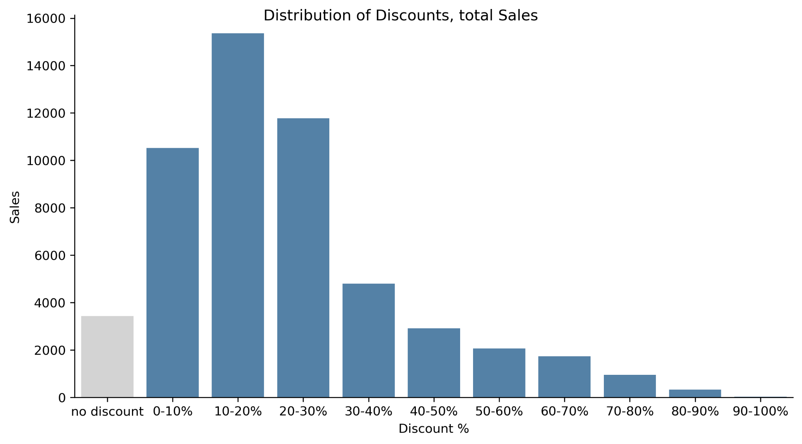
Distribution of Discounts - Sales
Notes:
We splitted the discount into bins of 10% and also considered units sold which are non-discount
Discount from 10%-20% is most successful. As the discount is getting higher the amount of total units sold is decreasing

Slide 5
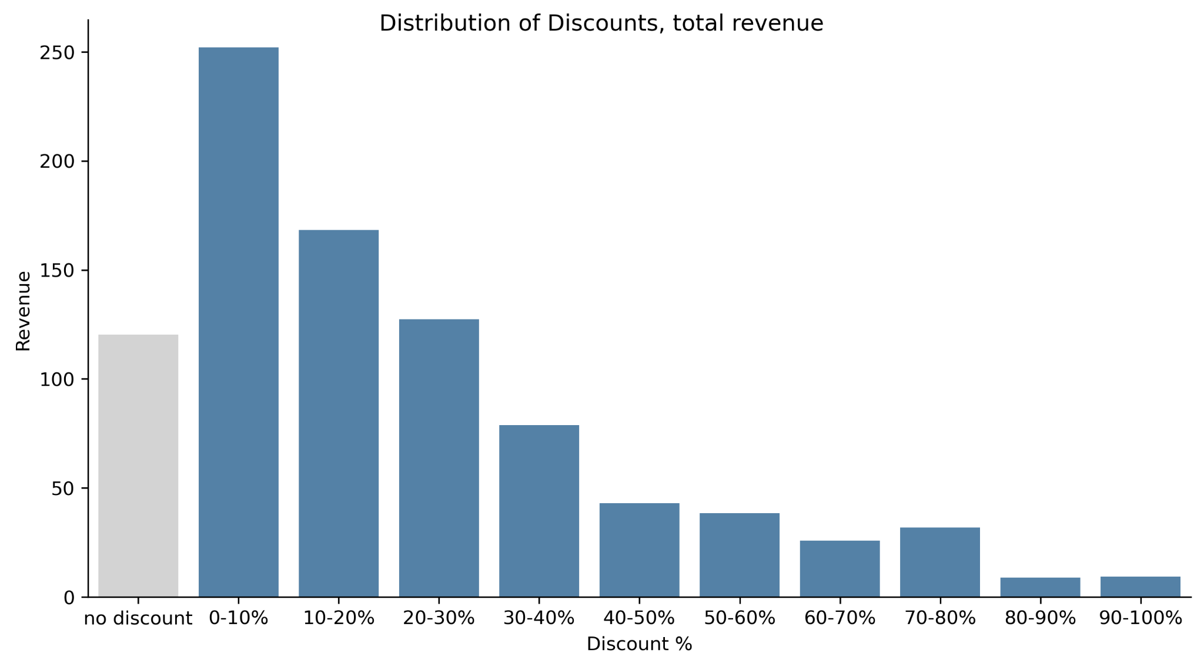
Distribution of Discounts - Revenue
Notes:
same story for revenue. Higher discounts leads to less revenue

Slide 6
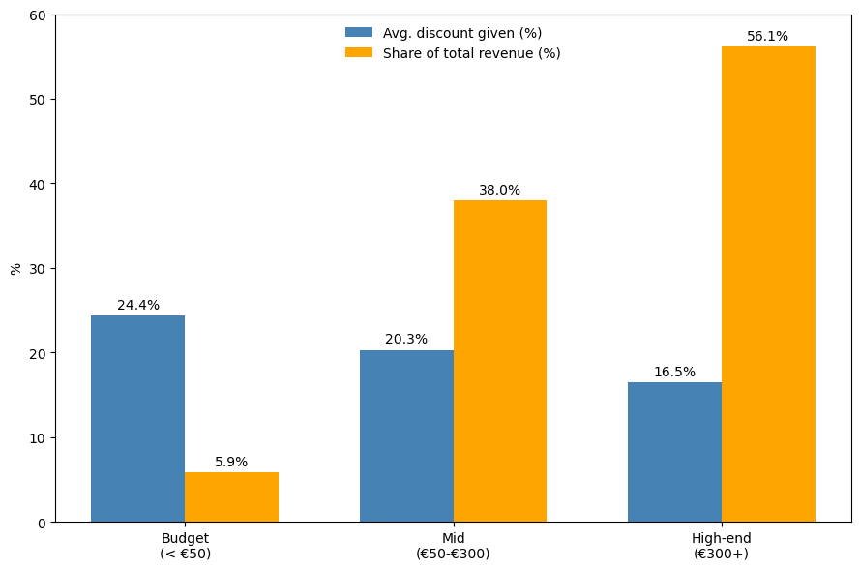
Discount is pointed at the wrong tier
Budget items get highest discount, but bring in the least revenue.
High-end items barely get discounted, yet bring in more than half revenue.

Slide 7
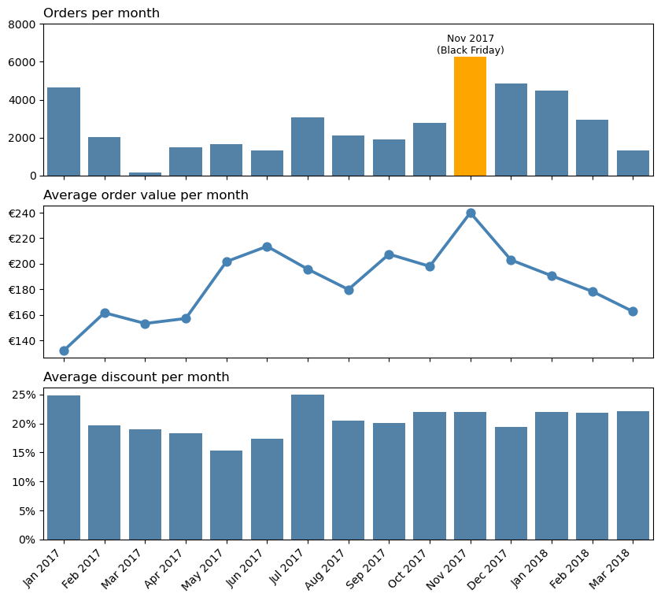
Seasonality & special dates
Nov, 2017
Best month of the year on both counts at once: 6266 orders and €240 average order value
22 % discount
Not the year’s highest - Jan and Jul ran ~25%, yet sold far less.
Takeaway
The calendar drives these swings, not only how high that month’s discount ran.

Slide 8
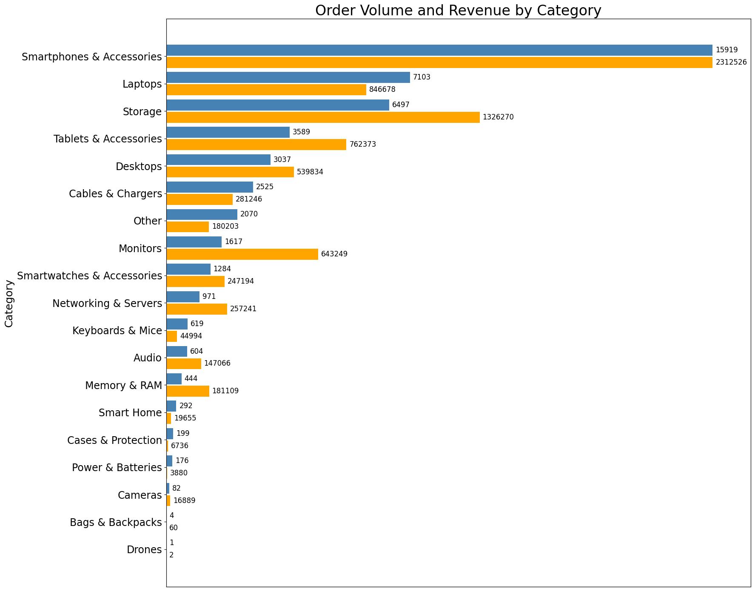
Order Volume and Revenue by Category
Smartphones & Accessories clearly lead in both order volume and revenue
Laptops and Storage are the next largest categories
The remaining categories have considerable lower overall sales volumes.

Slide 9
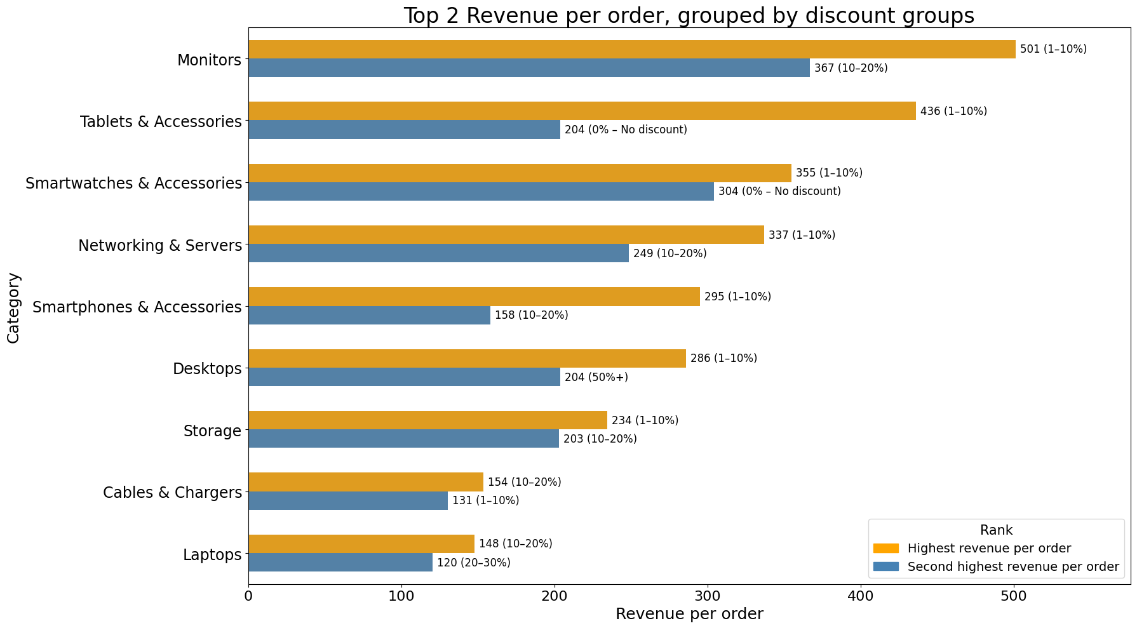
Top 2 Revenue per order, grouped by discount groups

Slide 10
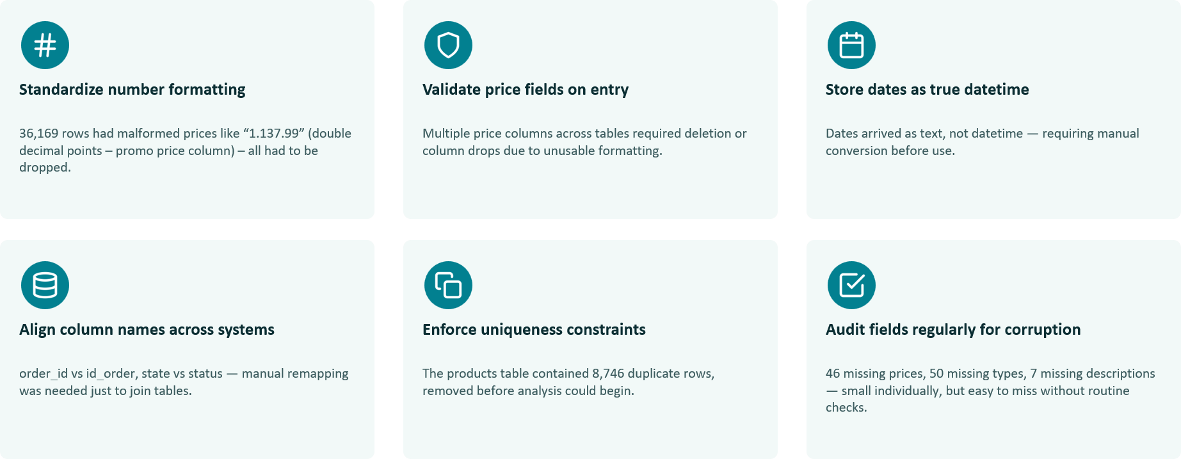
Improving Data Collection

Slide 11
Summary : cap depth, don’t chase it
Based on the overview of discounts and performance of different product categories, a discount cap at 20% is recommendable.
Budget items already receive the highest discount yet generate the least revenue; high-end items are barely discounted despite producing half of the revenue.
Demand varies by calender like Black Friday and holidays so plan campaigns around the calendar.

Slide 12
Backup slides

Slide 13
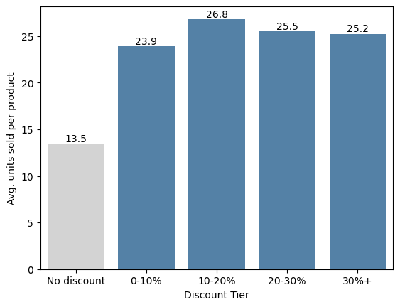
Does a bigger discount sell more ?
Any discount nearly doubles average units sold per product, vs. no discount at all.
Going deeper barely changes anything
No correlation b/w discount depth and units sold
One or two sales could just be luck. So we only trust a product's numbers once it's sold 5 or more times

Slide 14
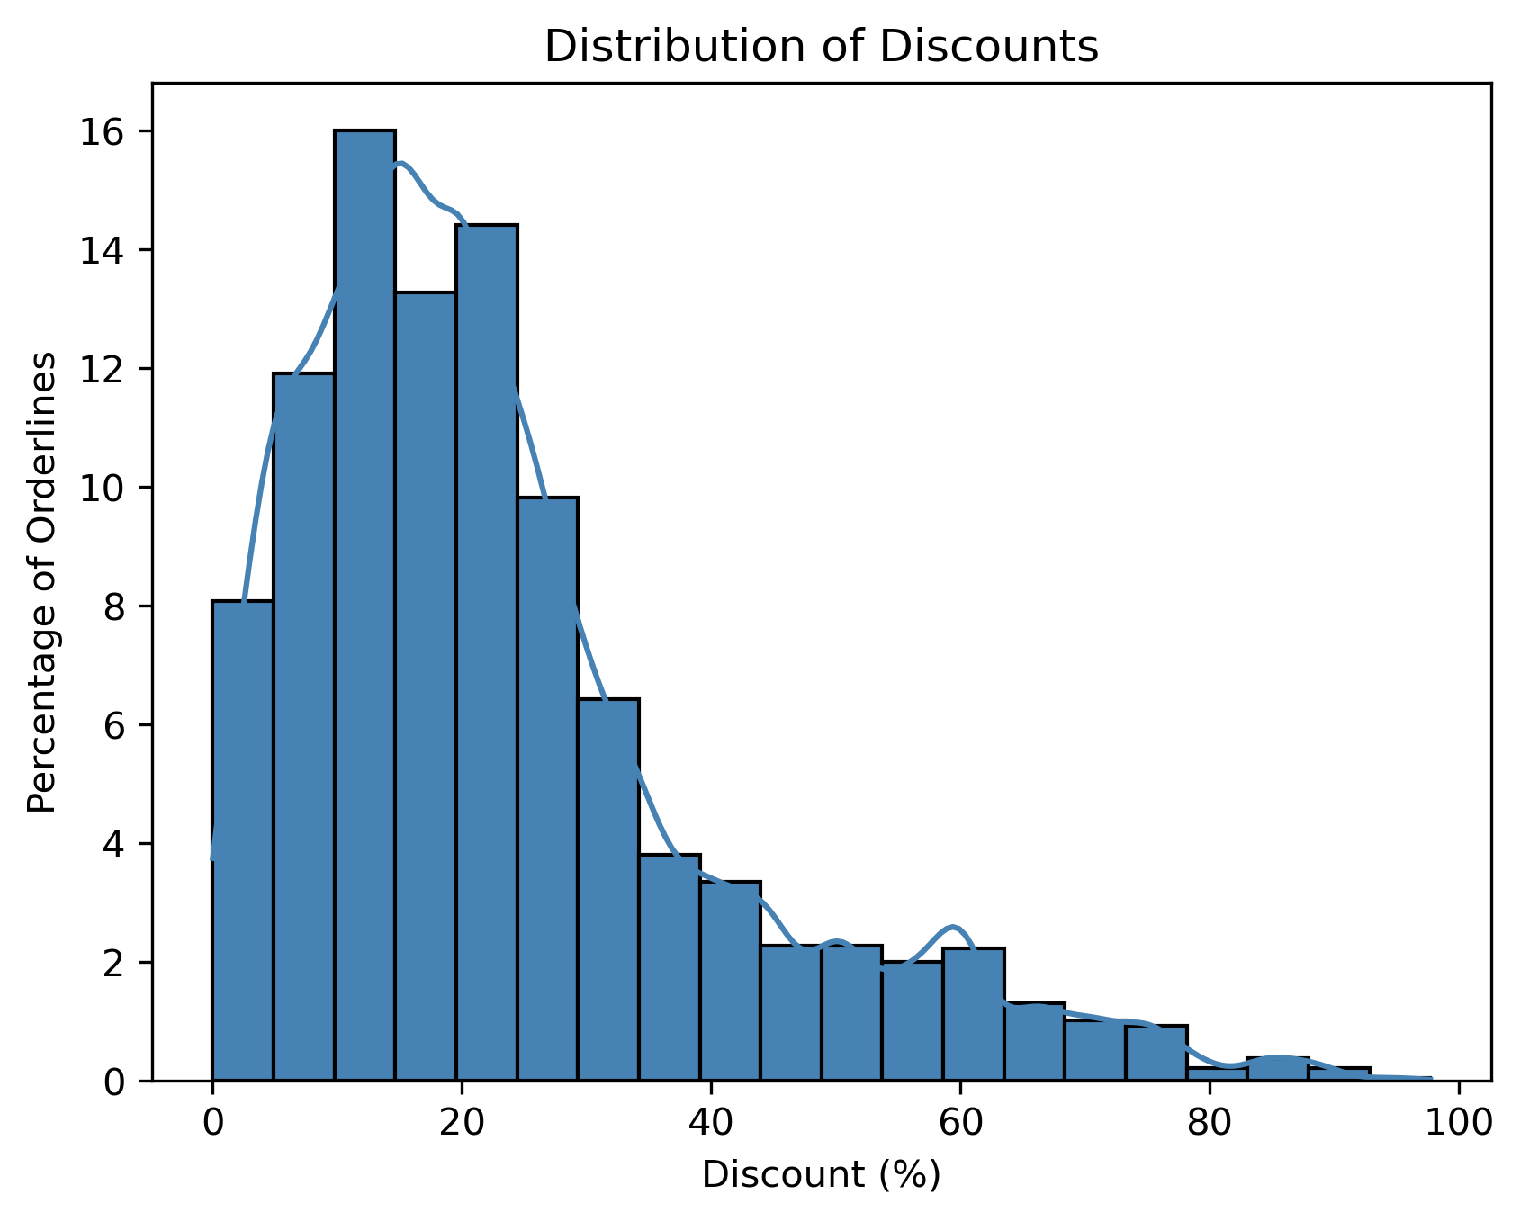
Distribution of Discounts - Sales

