Slide 1
German Manufacturing Industry: Market Trends & Performance

Slide 2
Project objectives
Building an ETL pipeline, extracting Federal Statistical Data regarding the manufacturing industry
Conducting an illustrative analysis to test the datas value: Comparing three industrial sectors performance and market structure
Result: Two fully operational ETL-Functions and Data Studio Dashboard built

Slide 3
GENISIS Database
Database: Two tables:
42111-0026 → monthly data, based on obligatory reports
48121-0003 → annual, based on multiple statistical surveys carried out by the Federal Statistical Office

Slide 4
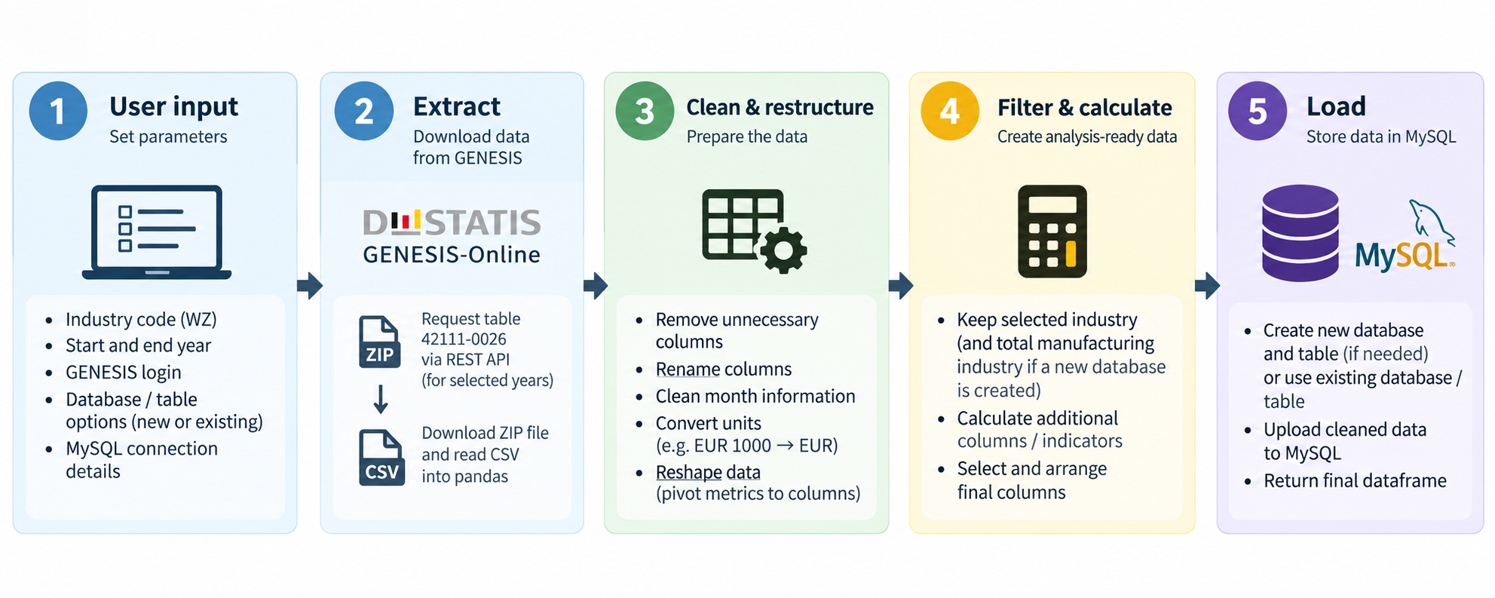
ETL-Functions

Slide 5
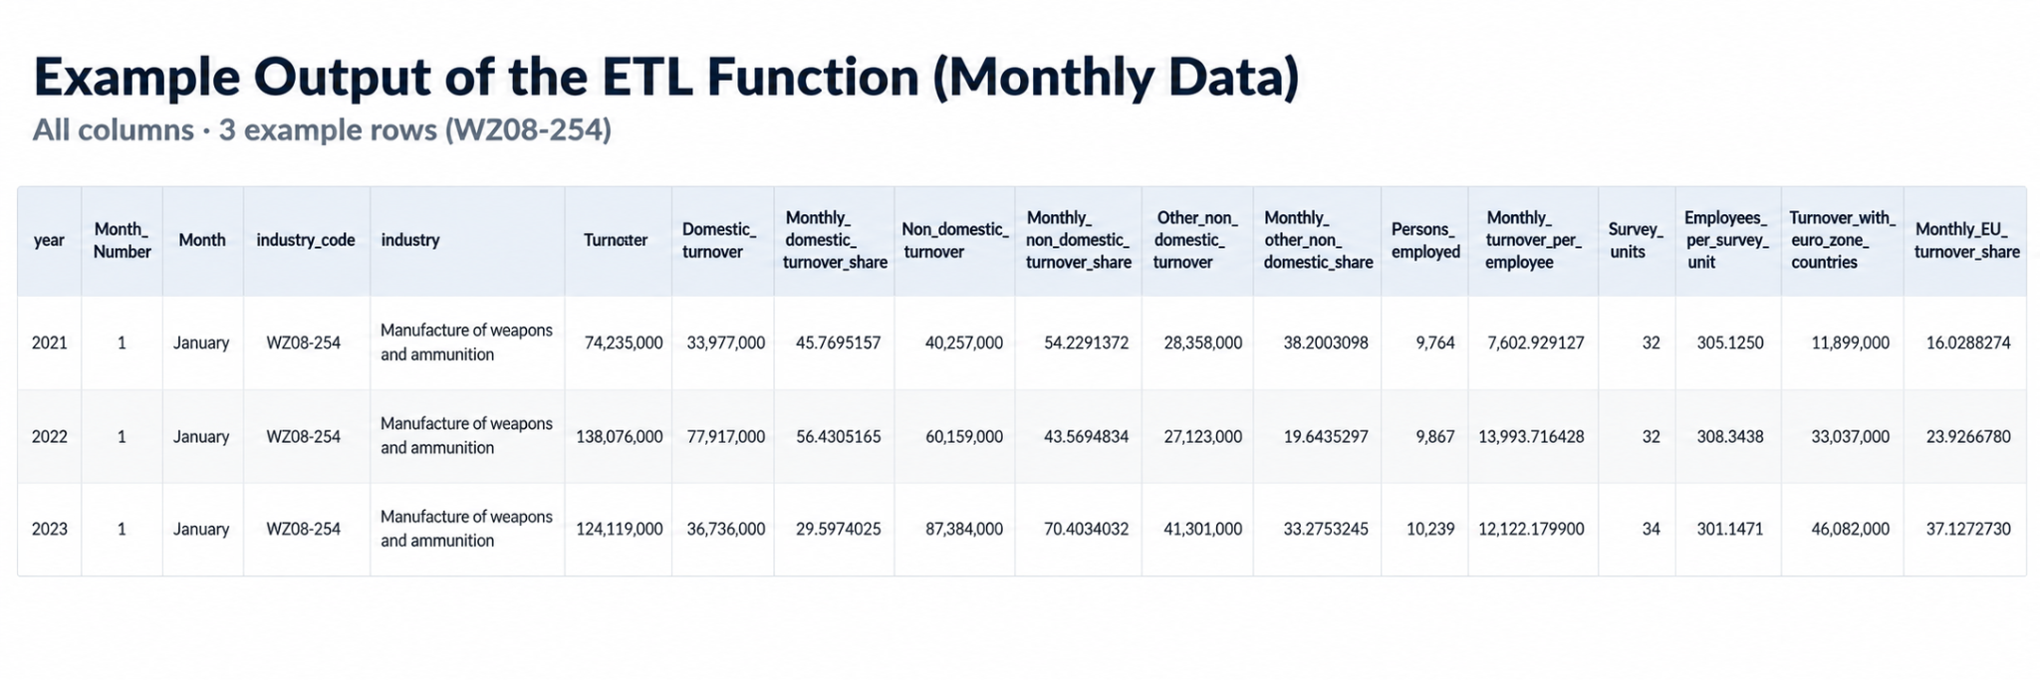

Slide 6
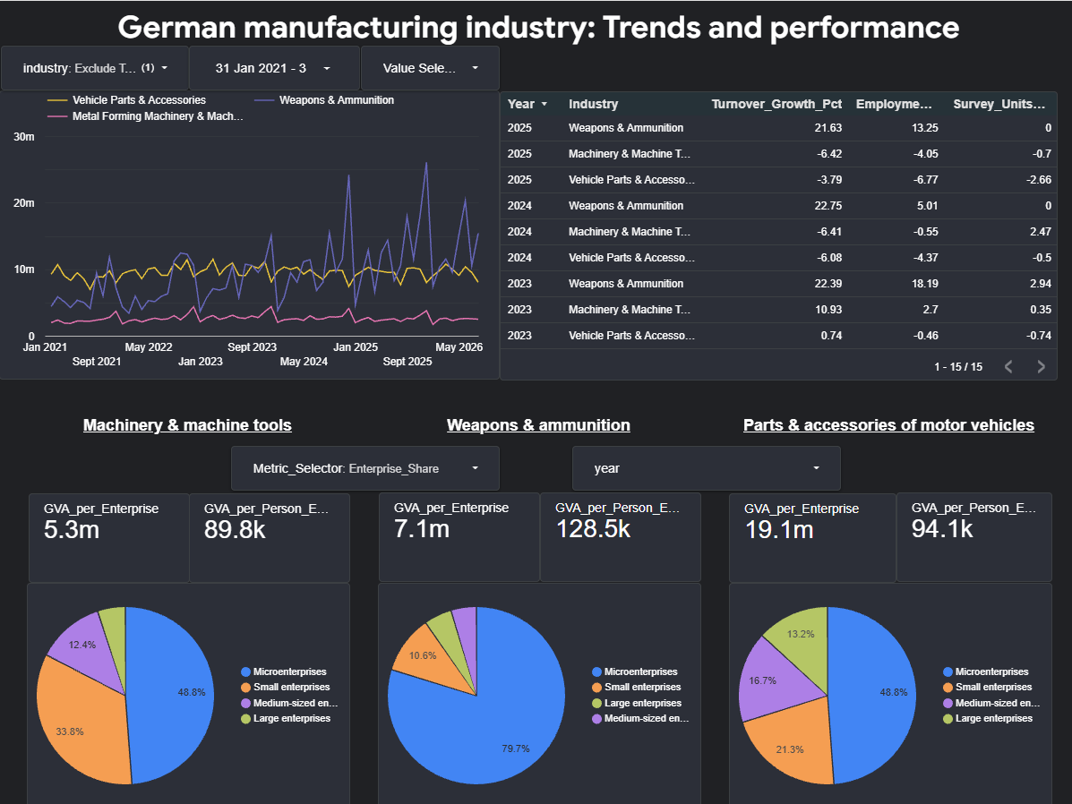

Slide 7
Thank you for your attention!

