Slide 1

Global Superstores: A Timeseries Analysis
Forrest casey
Rachael meinders
David pearcill
Melanie thelen

Slide 2
Melanie’s tableau dashboard – overview of data

Slide 3
All orders vs top countries
Accuracy across regressions

Slide 4
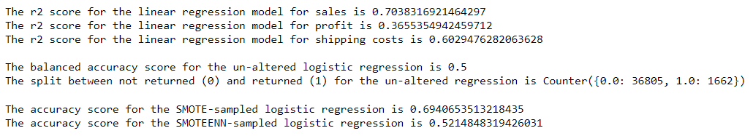
Orders from all countries

Slide 5
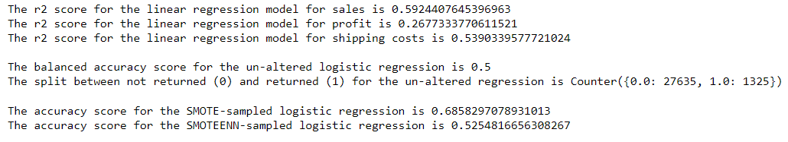
Orders from top countries

Slide 6
Forecasting future sales & profit
Using facebook prophet
Notes:
Open source code for forecast time series data – works best with strong seasonality & several seasons of historical data

Slide 7
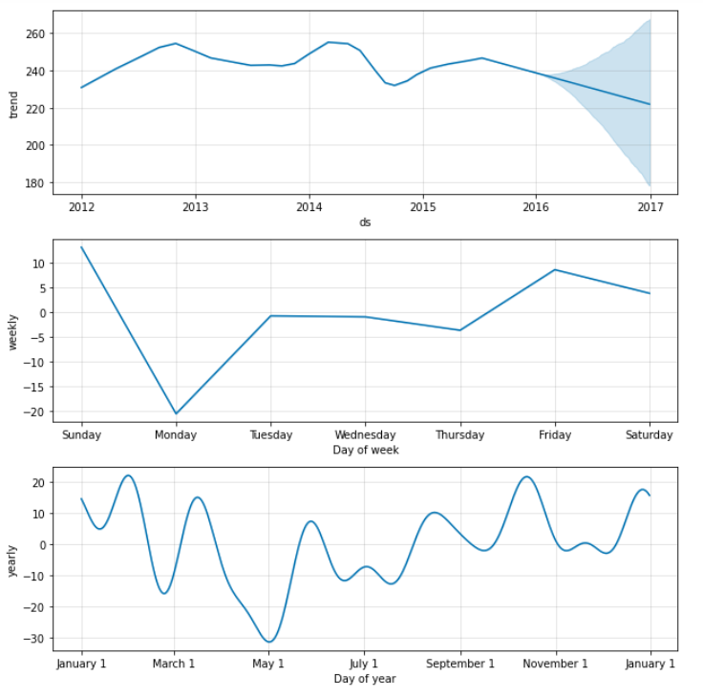
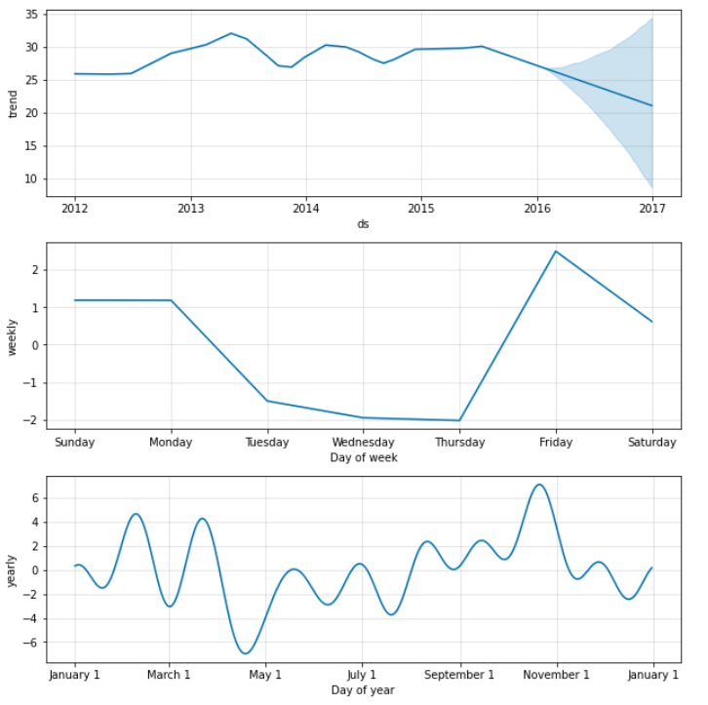
SALES PROFIT

Slide 8
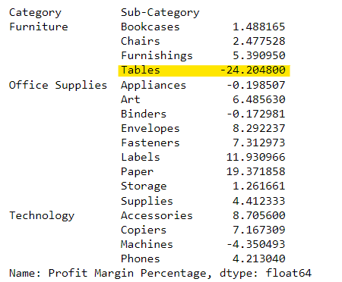
Tables – loss leader

Slide 9
David’s analysis – buying a table makes you 3x more likely to buy chairs

Slide 10
Discounts & profit
Forrest’s analysis – showing discounts past 30% eat profit

Slide 11
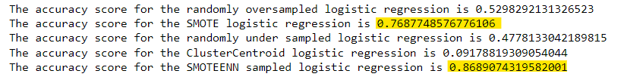
Re-sampling – all orders

Slide 12
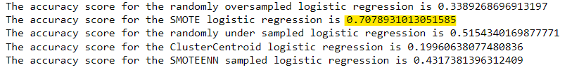
Re-sampling – top countries

