Slide 1
Request for Exception
David Parker
Spencer Shadley
Cheng Ma

Slide 2
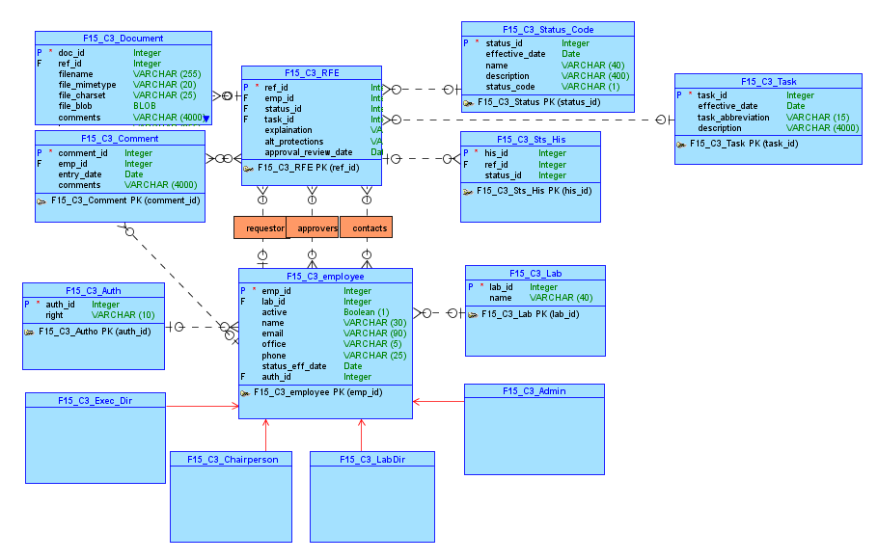
Conceptual Model

Slide 3
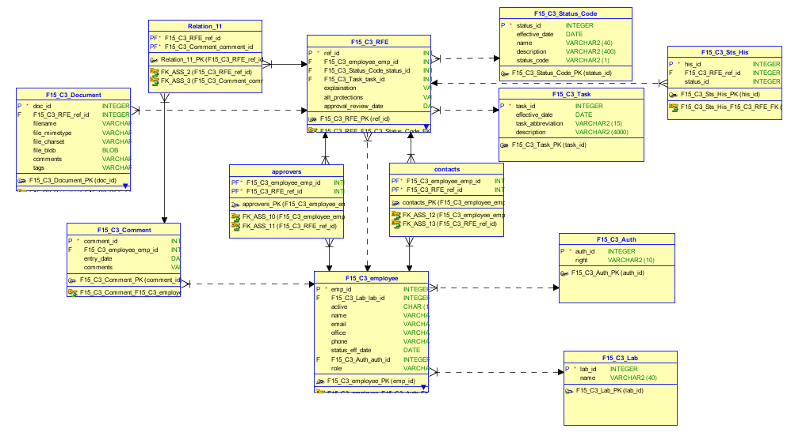
Relational Model

Slide 4
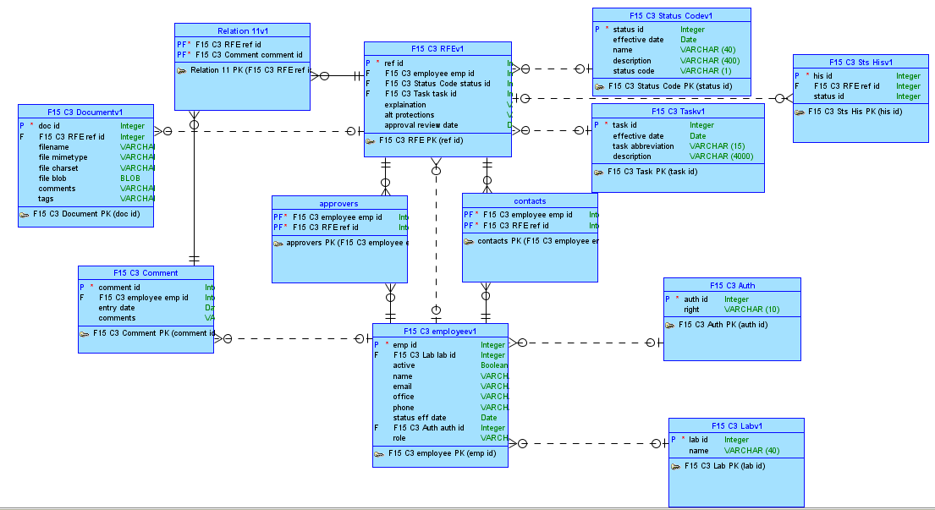
Logical Model

Slide 5
Our Apex Part I Application
Link To APEX

Slide 6
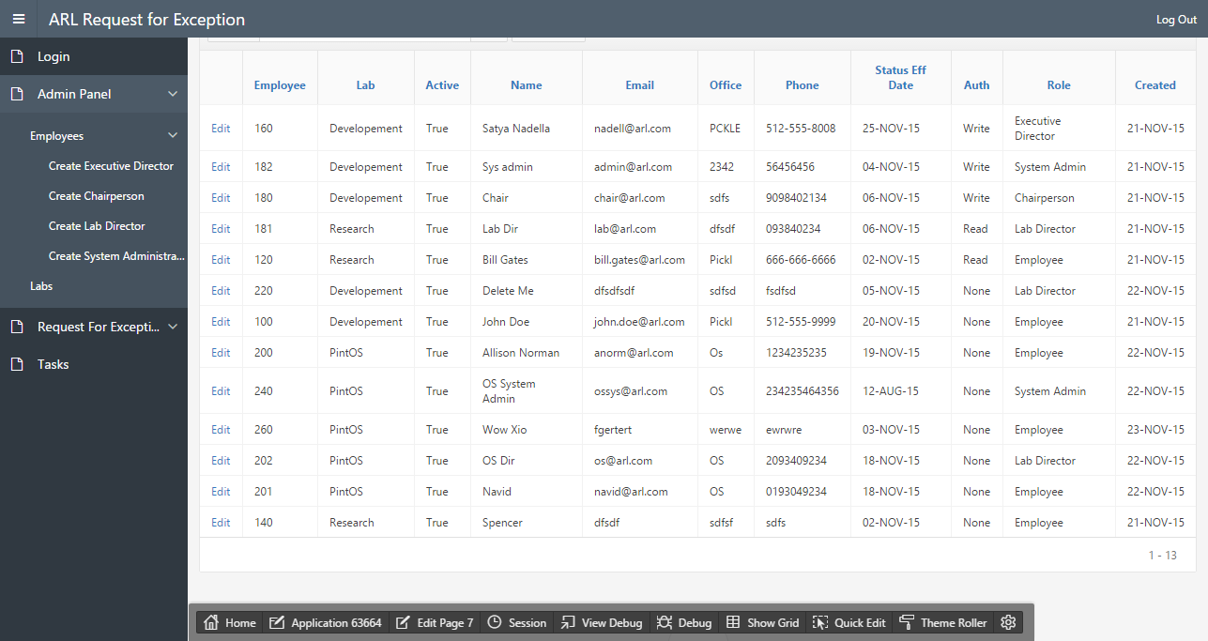

Slide 7
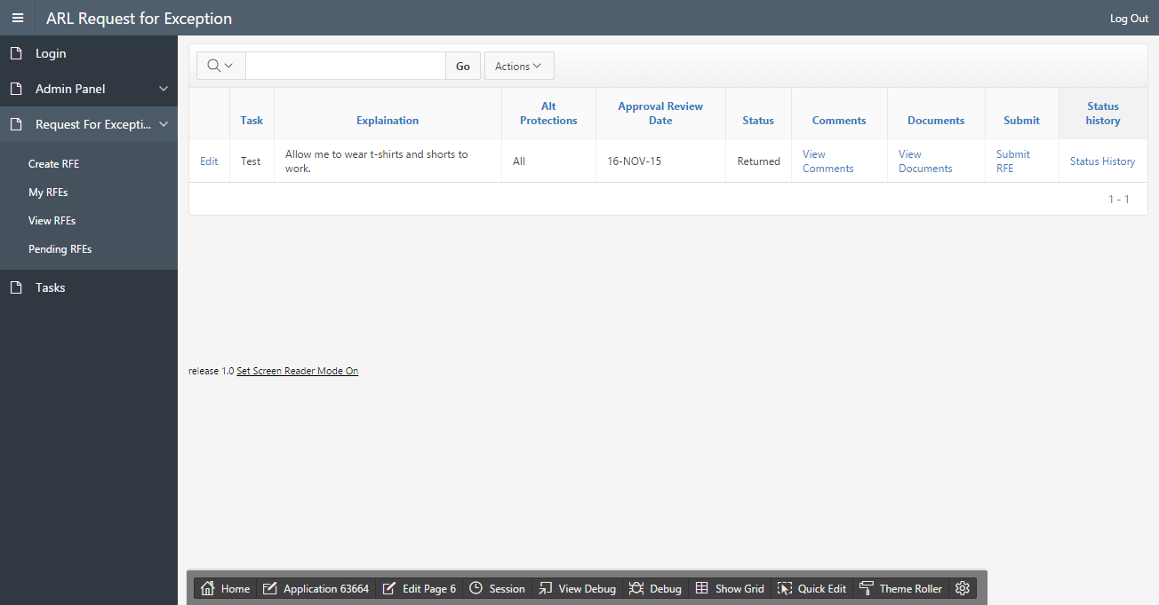

Slide 8
Github Link for Part I
https://github.com/David-Parker/F15_C3_Apex.git

Slide 9
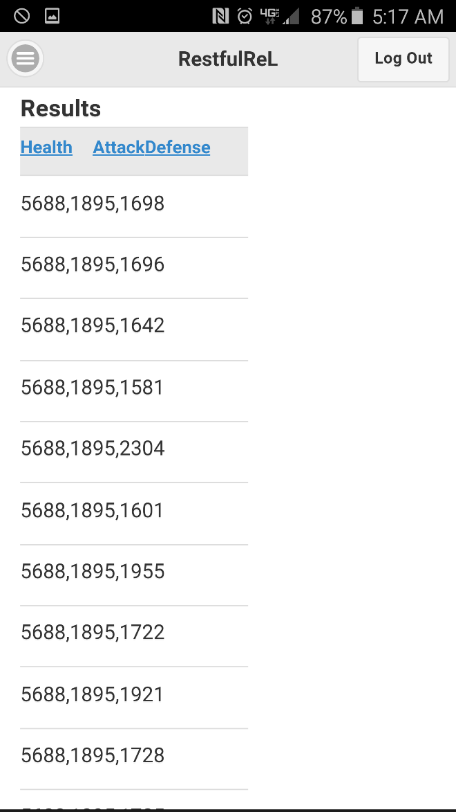
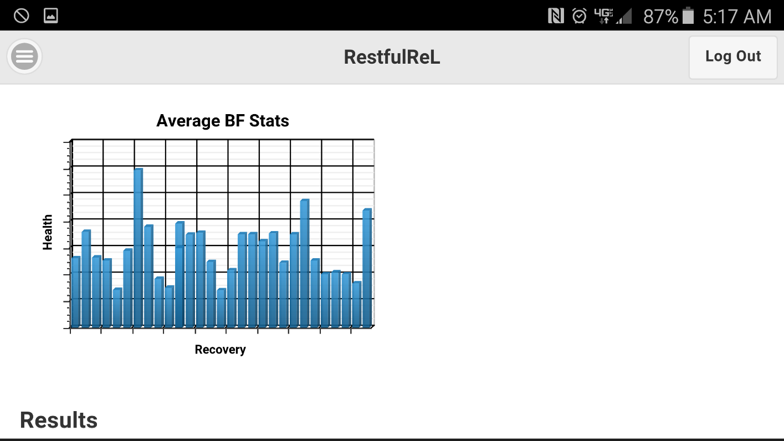
Part II – Brave Frontier
Compare stats of various units within brave frontier with plots to allow easy comparisons. This will mitigate the need to try and compare unit by unit.

Slide 10
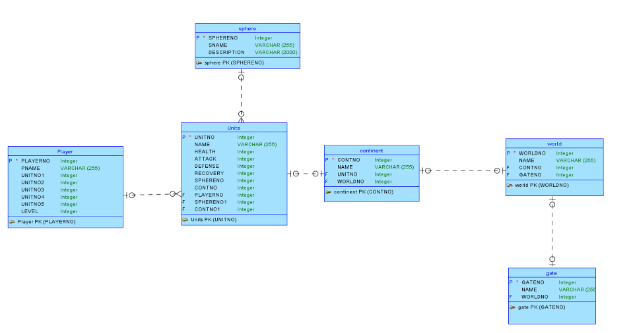

Slide 11
Link to Part II

