Slide 1
Request for Exception
David Parker
Spencer Shadley
Cheng Ma

Slide 2
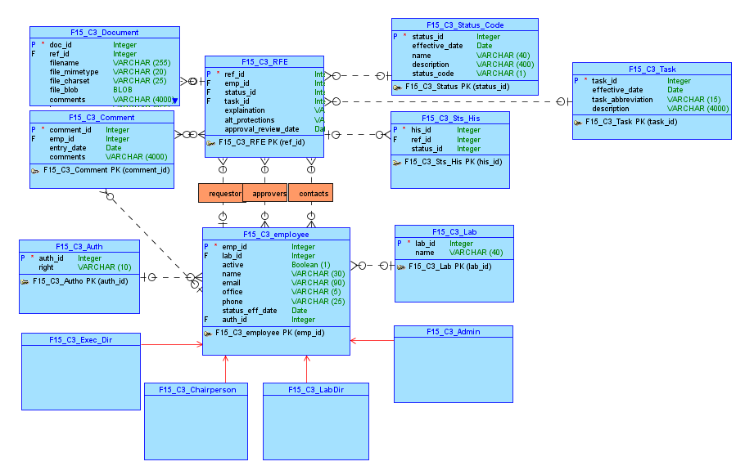
Conceptual Model

Slide 3
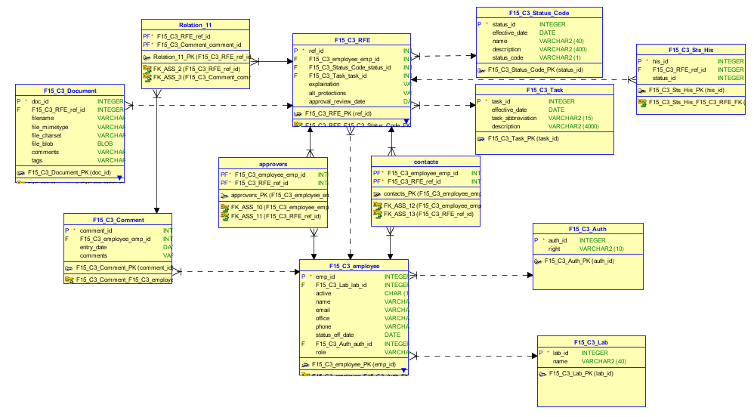
Relational Model

Slide 4
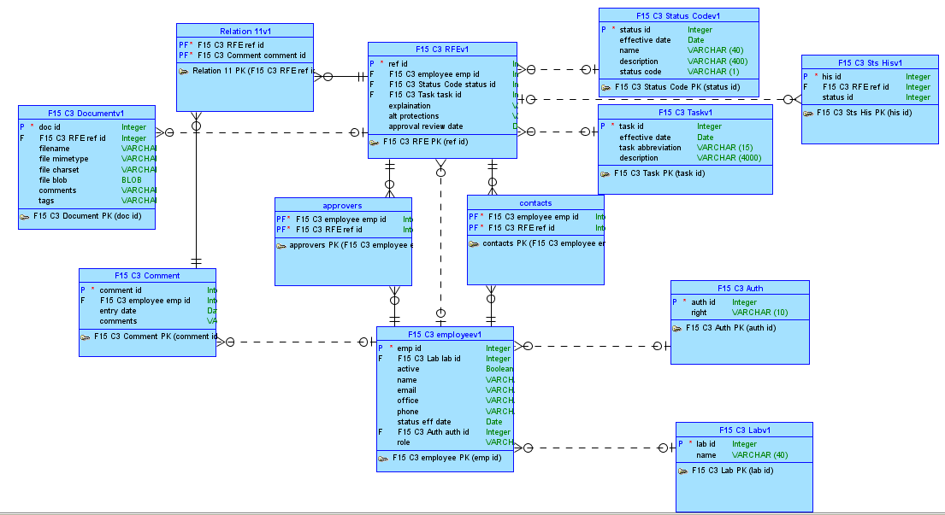
Logical Model

Slide 5
Our Apex Part I Application
Link To APEX

Slide 6
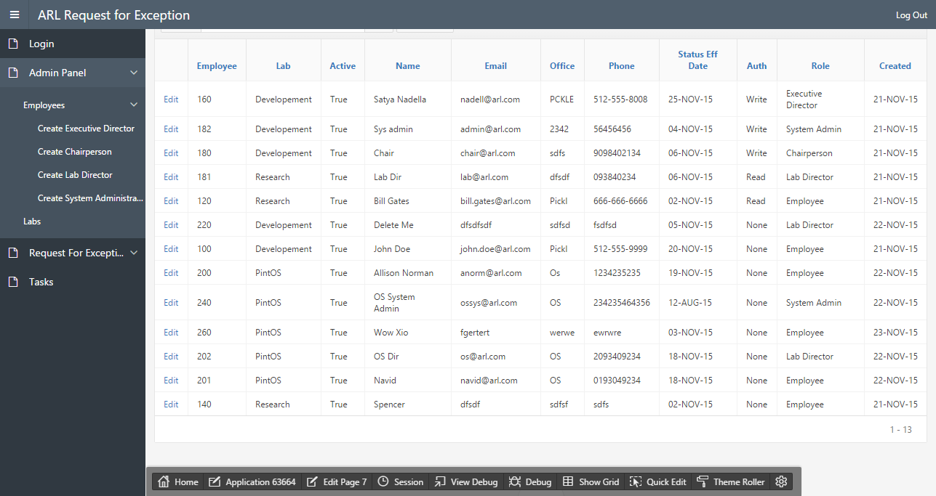

Slide 7
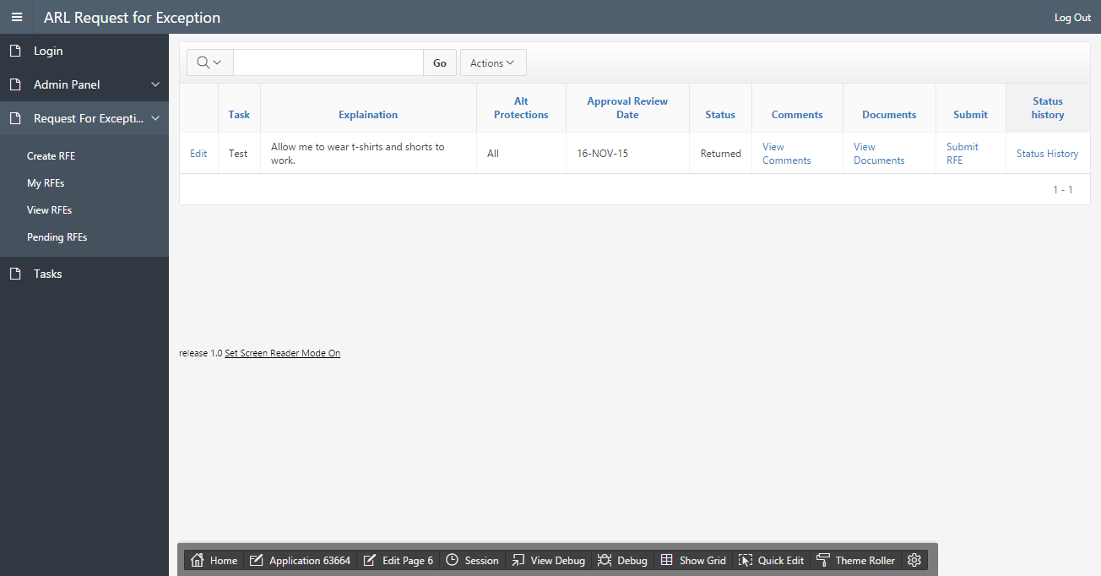

Slide 8
Github Link for Part I
https://github.com/David-Parker/F15_C3_Apex.git

