Slide 1
HyperText
Group 14

Slide 2
HyperText
Group Members:
Andy Sturzu
David Parker
Katherine Bruton

Slide 3
HyperText
Application Description:
HyperText is a spin on traditional eBook reading apps. There exists a lot of literature that states that every person has a different optimal reading rate, and by hiding words other than what is being read, the user suppresses their subvocalization and actually ends up retaining more of what was read.
Our app acts as a virtual library that contains a user’s e-books. The user is allowed to login to the app, access his or her books and then choose a book to “speed read” and set the reading speed. Then the book will be read with the words appearing at that speed. Our app has the ability to pause, play, rewind a sentence or turn off speed reading mode.

Slide 4
HyperText
Target Audience:
Our target audience will be people who struggle with reading literature using the traditional approach or those looking to increases their reading speed.
Students, as it could be helpful when reading academic literature

Slide 5
HyperText
Application Functionality:
Registration screen allows user to create a new account. The account is used to keep track of books in the user’s library.
Library screen shows all of the user’s e-books. From there, the user can tap on a book to start reading it, which will either open in the speed reading view or regular reading view.
The speed reading page lets the user go back to a previous word or forward to the next word. It also gives the user the option to pause or resume speed reading.
The settings screen allows the user to adjust the speed of the text, it also allows user to turn speed reading off.
User can download more books from the book store.

Slide 6
HyperText
Application Challenges Experienced:
Timing asynchronous data download from Firebase with the UI and making sure the data needed for the app exists before calling viewDidLoad()
Search bar and collection view

Slide 7
HyperText
Group Member Contributions:
Katherine Bruton
Account registration and login
Saving/retrieving user settings
Book store
David Parker
Backend database
Library with real books and covers
Data population logic
Andy Sturzu
Speed Reading
UI Polishing
Firebase and Facebook API Setup

Slide 8
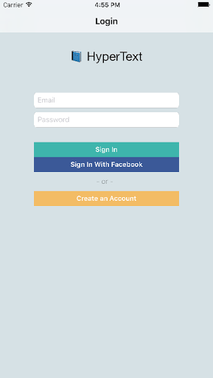
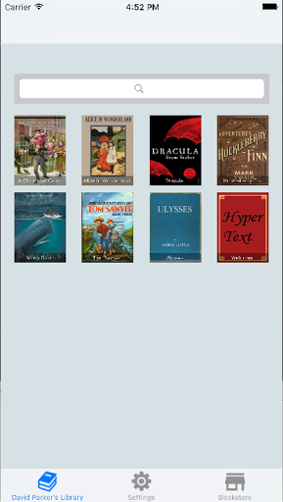

HyperText
Login. Select. Read.

Slide 9
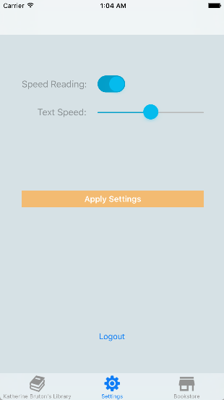
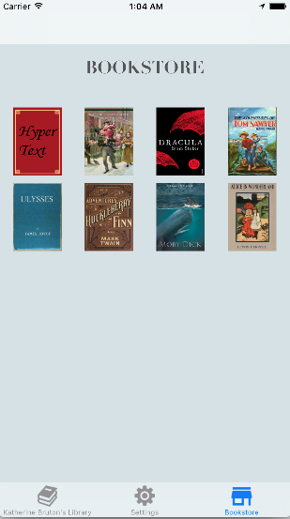
HyperText
Settings. Download.

Slide 10
HyperText
Demo!

Slide 11
HyperText – Future Plans
Bookmarking
More configuration for the default ebook reader
Faster response time – more caching
Support for bookstore uploading by users
Support for different formats

Slide 12
HyperText
Questions & Answers

