Slide 1

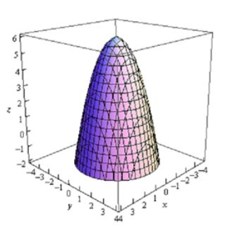
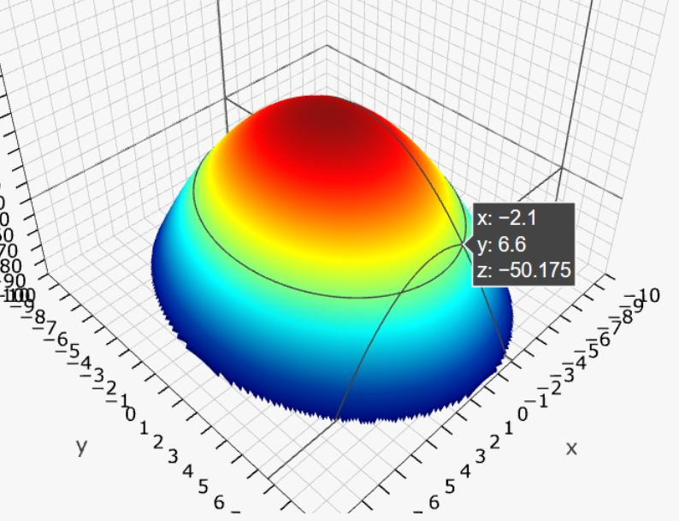

Elliptic Paraboloid as example of “Hill Unit Test”
Can randomize width, depth, height, slope
Notes:
In order to determine if our GAN training was working as expected, we decided to create a Unit Test. [CLICK] The 3D Elliptic Paraboloid geometric shape is similar to a hill and has various adjustable dimensions.

Slide 2
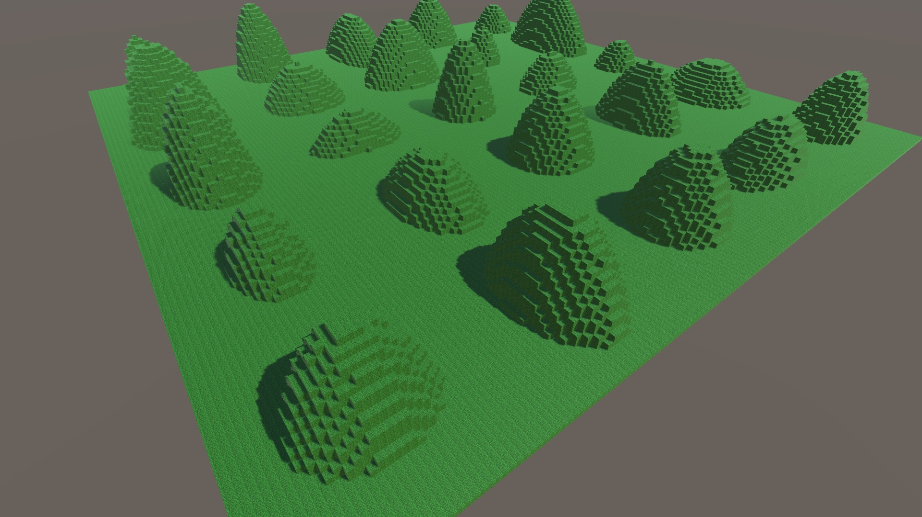
Generated 1,000 variations of a ‘Hill’ as training data for the GAN
Notes:
Training data requires many sample. [CLICK] We created 1,000 variations of the hill shape by randomizing four dimensions.

Slide 3
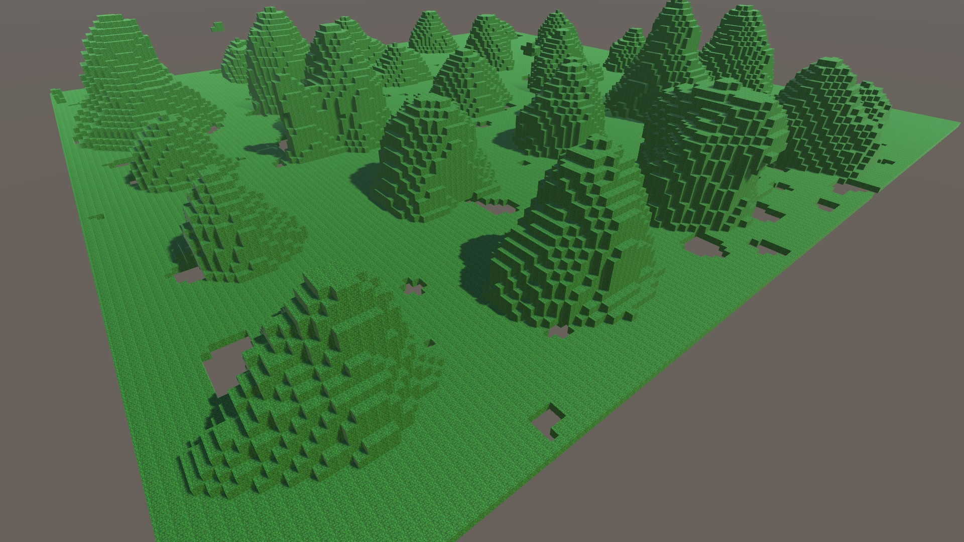
First ‘trained’ output set recognizable with interesting variations.
Notes:
Based on our training parameters, the first output set was ready after 30 minutes [CLICK] This shows the 25 samples produced by the trained model, and they are definitely close to original input shapes.

Slide 4
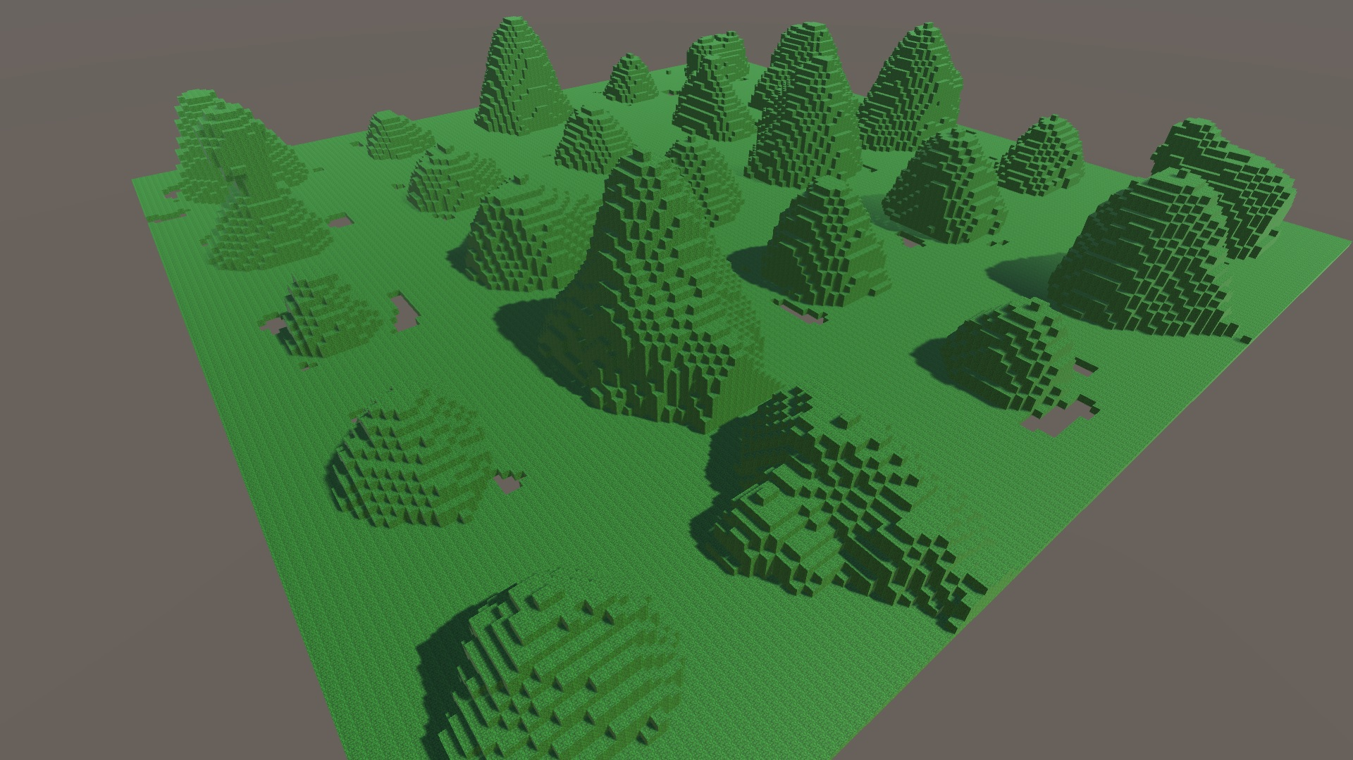
Second output set had a bit more divergence than first.
Notes:
Here is the second output set of 25 shapes [CLICK] There is less noise on the floor and in the sky than the previous set, but more variation on the primary axis.

Slide 5
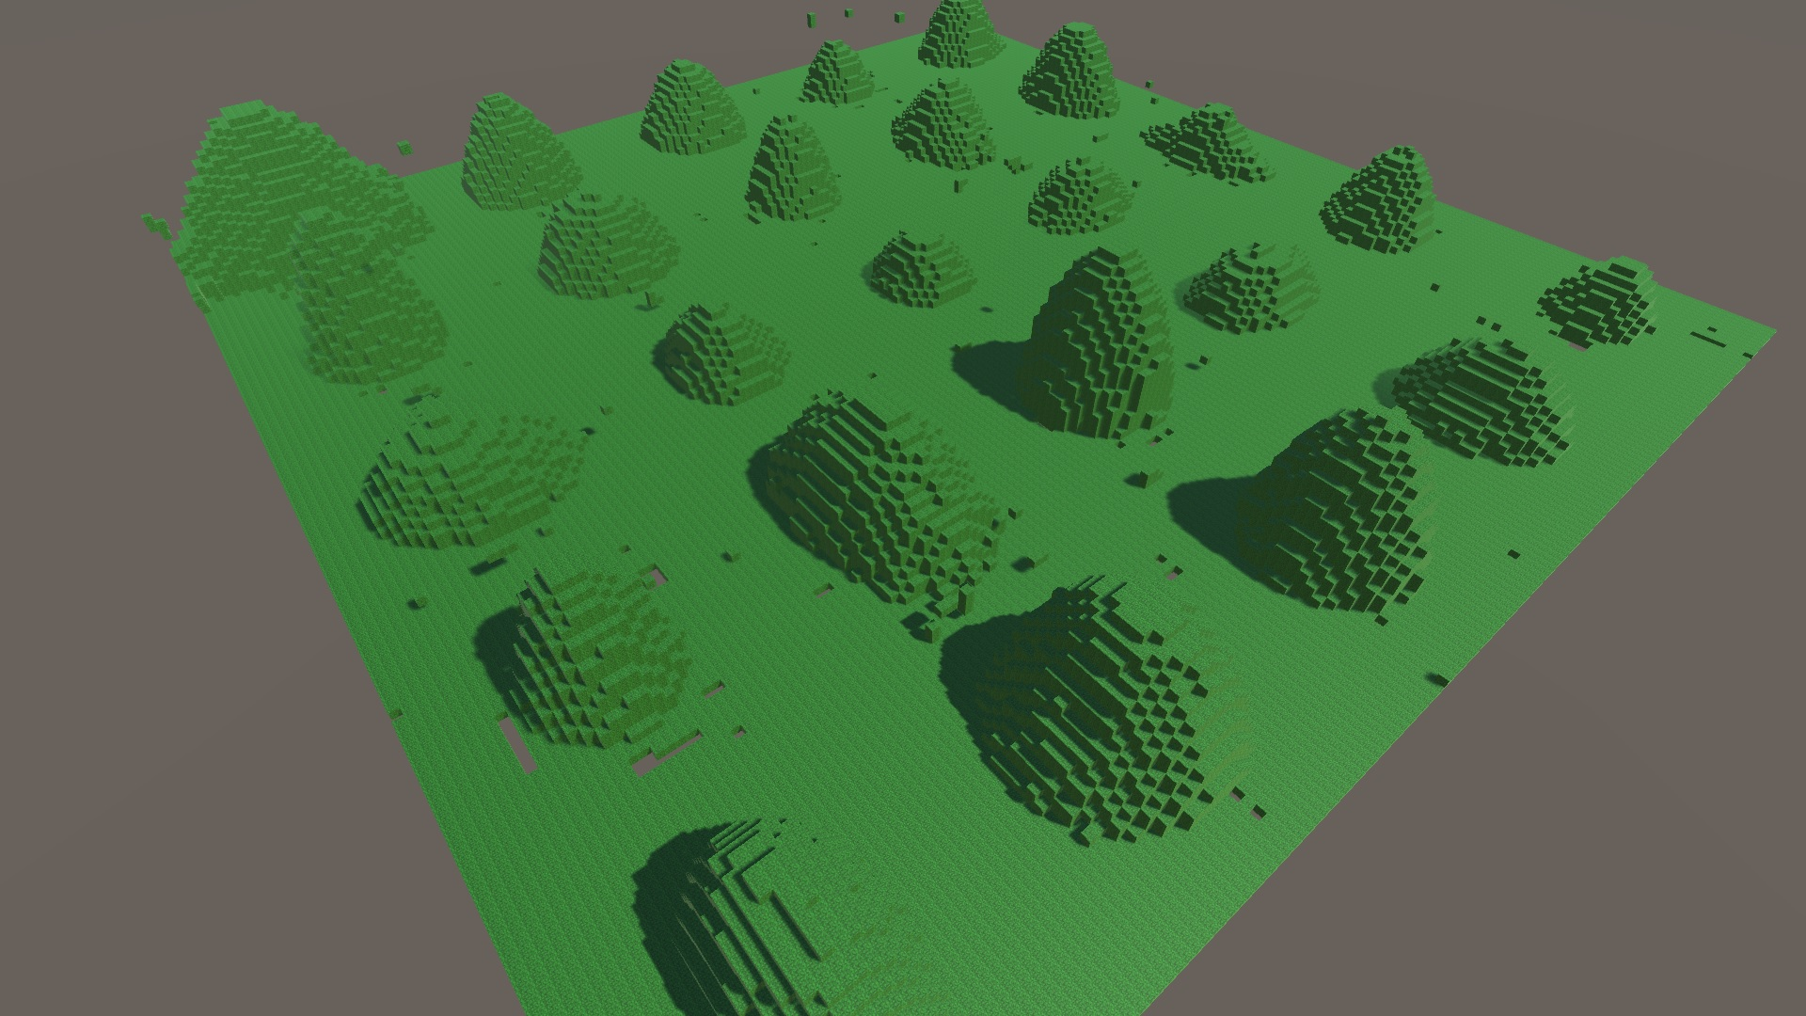
After 15 hours, the 28th output set is fairly close to training.
Notes:
Here are the shapes produced after training overnight [CLICK] They look nearly identical to the training set, but zooming in does expose subtle variations in curvature and indentations on the slopes.

