Slide 1






PSO Model
Every particle has a position, velocity, “best” past position and “best global position”. This information is used to intelligently find the minimum.
$$x_{k+1}^{i}$$
$$p_{k}^{i}$$
$$p_{k}^{g}$$
$$v_{k+1}^{i}$$
Swarm influence
Particle memory influence
Current motion influence
$$v_{k}^{i}$$
$$x_{k}^{i}$$

Slide 2
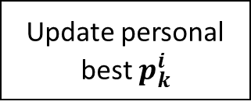


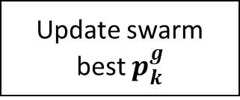
Initialization
Given $φ_{1}$, $φ_{2}$ and $κ,$ Calculate $c_{1}$, $c_{2}$ and $w$
Generate random particles in search volume
Evaluate initialized particles to find swarm best
Loop
For Every Particle
Position and velocity update
Is Current position better then personal best?
Is Current position better then swarm best?
yes
yes
Update personal best $p_{k}^{i}$
Update swarm best $p_{k}^{g}$
Update $w$

Slide 3
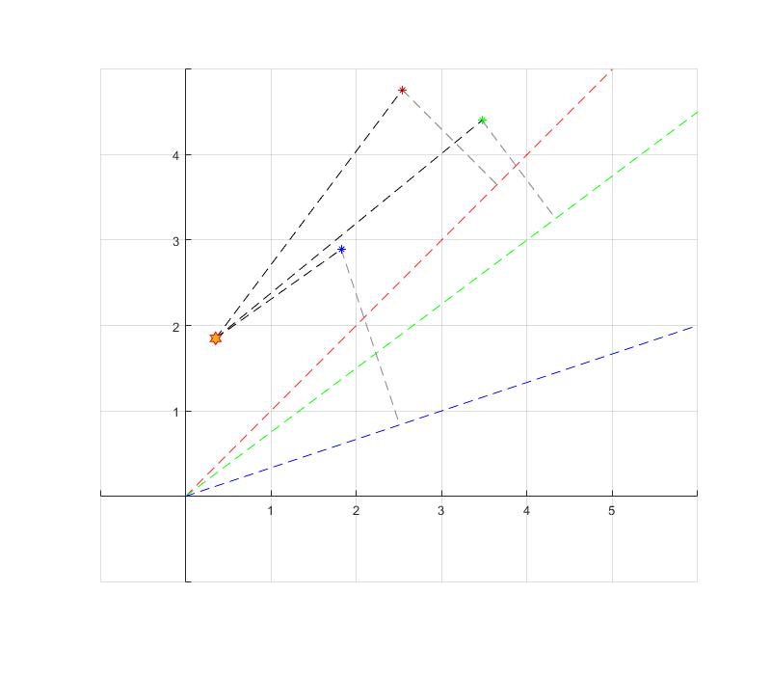




$$ε_{1}$$
$$ε_{3}$$
$$ε_{2}$$
$${ε=ε_{1}+ε}_{2}+ε_{3}≈1.72$$

Slide 4
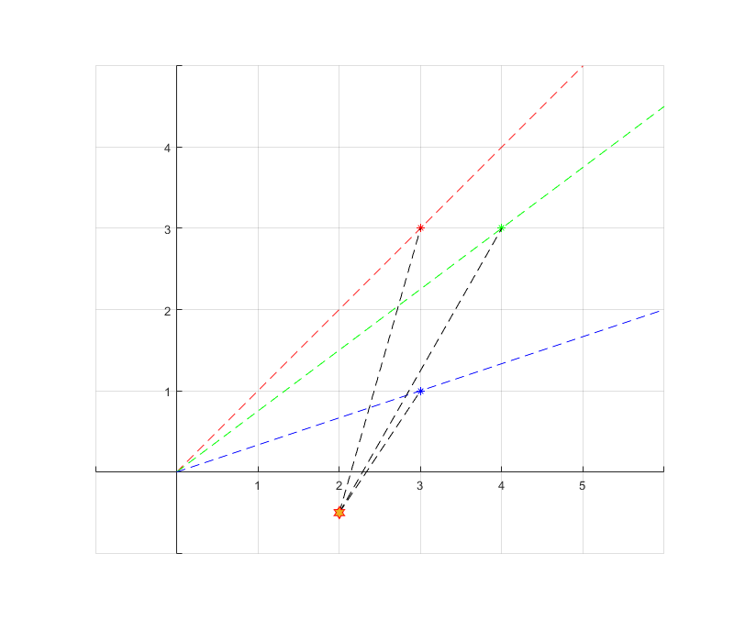


$$ε_{1}$$
$$ε_{3}$$
$$ε_{2}$$

Slide 5









$\left(\begin{matrix}x \\ y\end{matrix}\right)$
Measurements from Sensor (x, y)
Define Error Function, given measurements from pointer and sensor
Use Particle Swarm optimization to get global minimum of the error function
Get Rotation matrix from $θ$
$$f\left(\hat{x}\right)$$
$$θ$$
Measurements from Pointer (elevation)
$θ$
State Vector
$$\left(\begin{matrix}b_{x} \\ b_{y}\end{matrix}\right)$$
$$R$$
Requires a minimum of 3 measurements to get exact solution
$$\hat{x}=\left(\begin{matrix}θ \\ b_{x} \\ b_{y}\end{matrix}\right)$$
Defines rotation matrix
Defines translation vector
$${\overset{⃑}{p}}^{′}=R\overset{⃑}{p}+\overset{⃑}{b}$$

