Slide 2
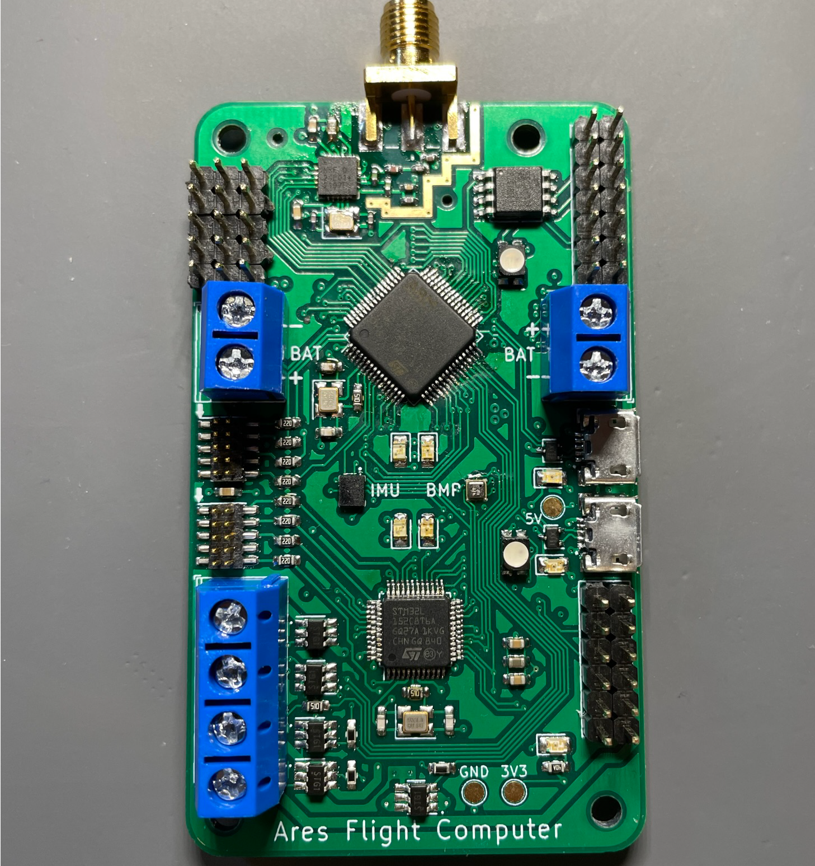
RF Out
Flash Storage
Servo
Out
FCC
GPIO
Servo
Power
FCC
IMU
Barometer
SWD
USB
NAV
NAV
GPIO
Pyro Channels

Slide 3
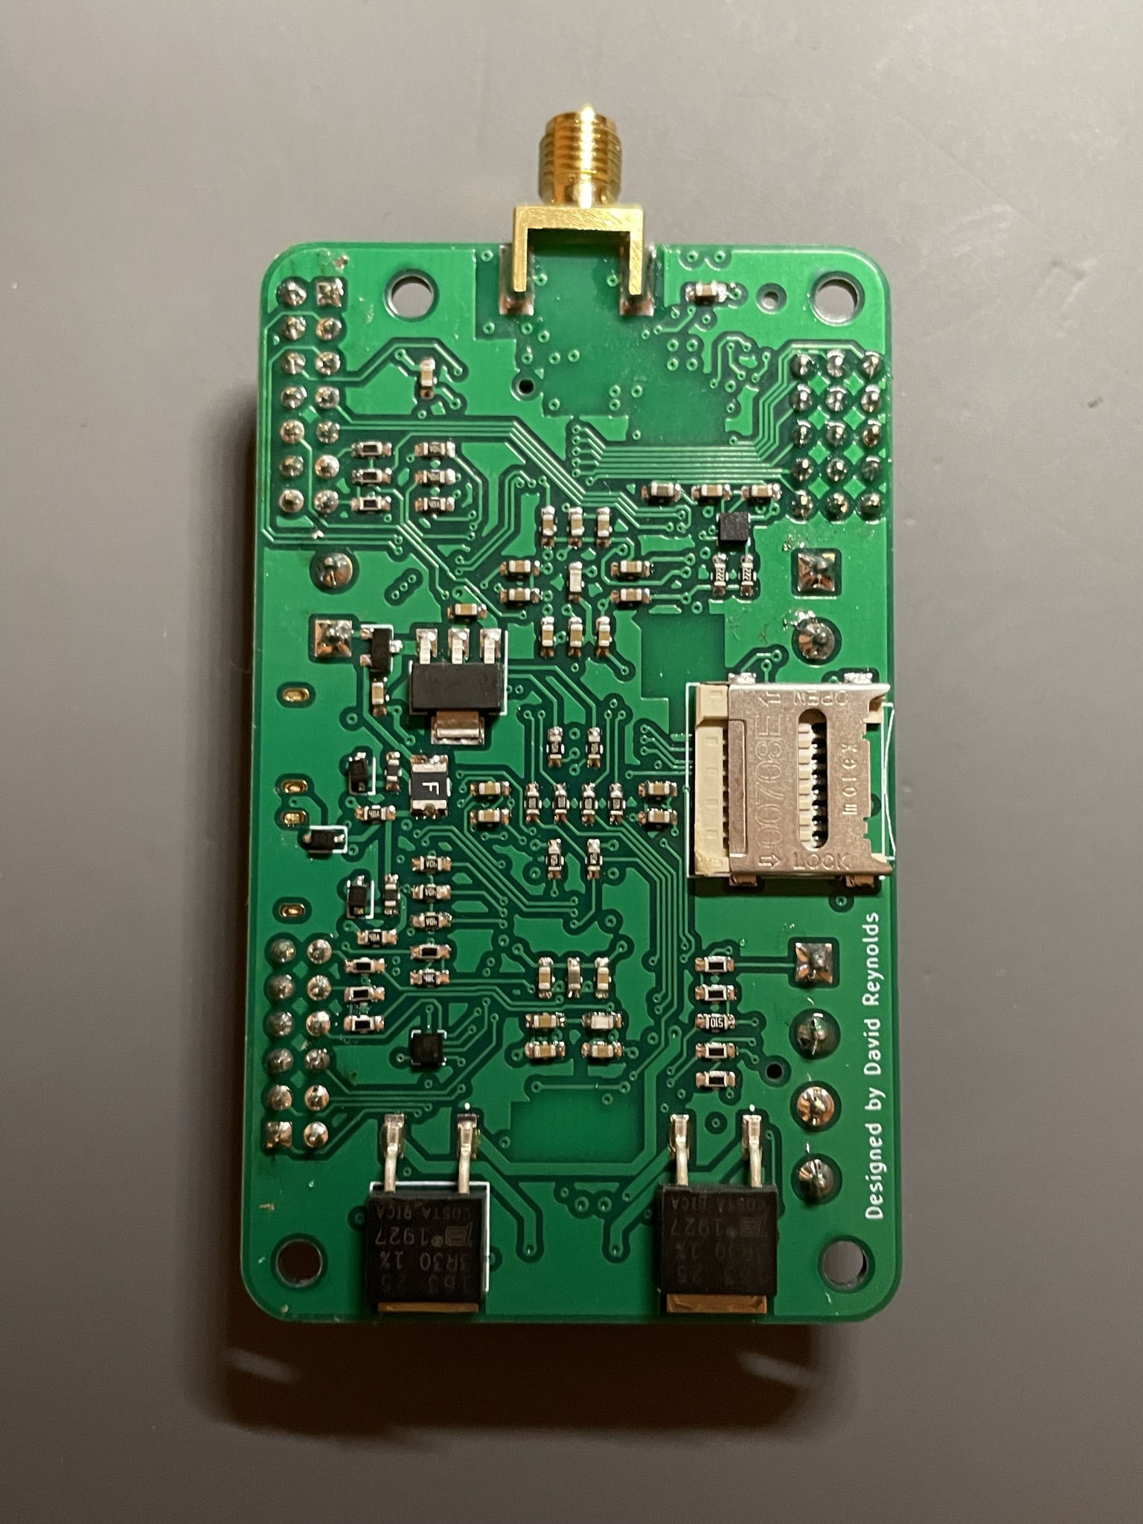
Backup
Acetometer
LDO
MicroSD
Backup
Acetometer

